Slide 1


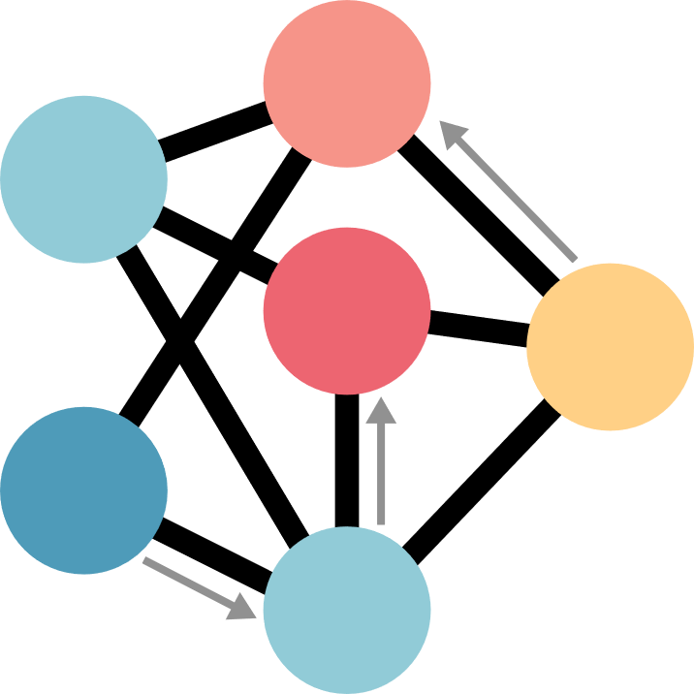

Theoretical
Neuropsychology
Experimental Neuropsychology
Computational
Neuropsychology
Clinical Neuropsychology

