Slide 1
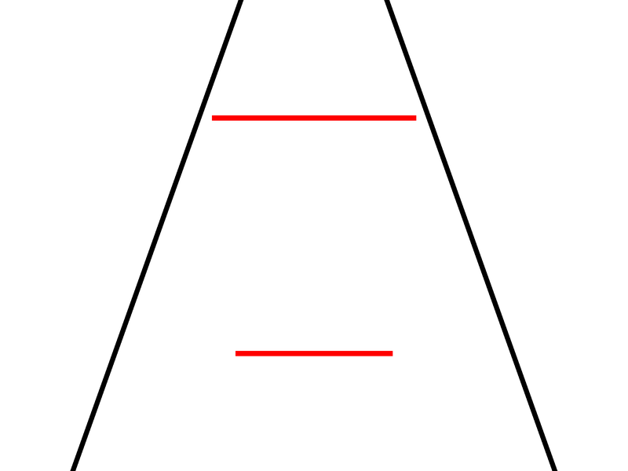
Parameters
Render
1
Illusion strength = -15
Objective difference = 0.3
Size of the smallest rod = 0.5
Color the target = red
Color of the distractor = black
…
0.5
0
-0.5
-1
-1
-0.5
0
0.5
1

