Slide 2
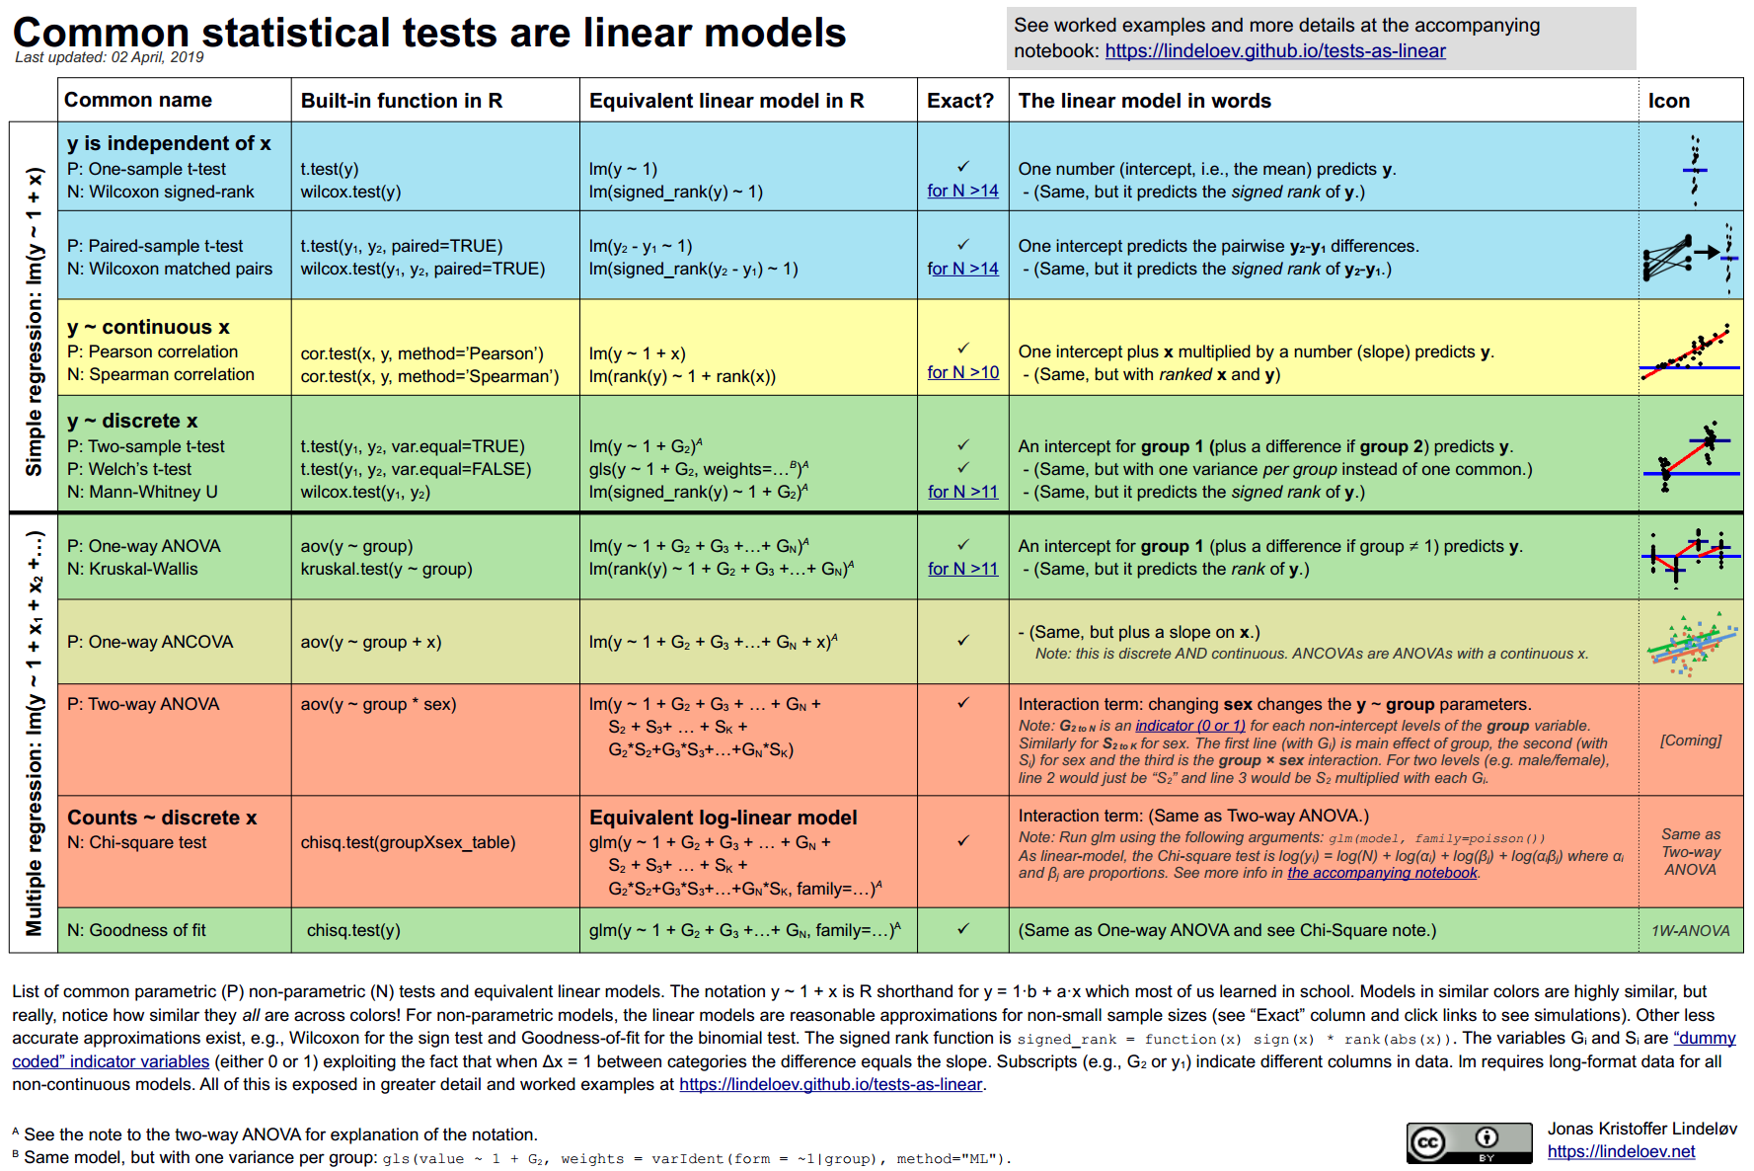
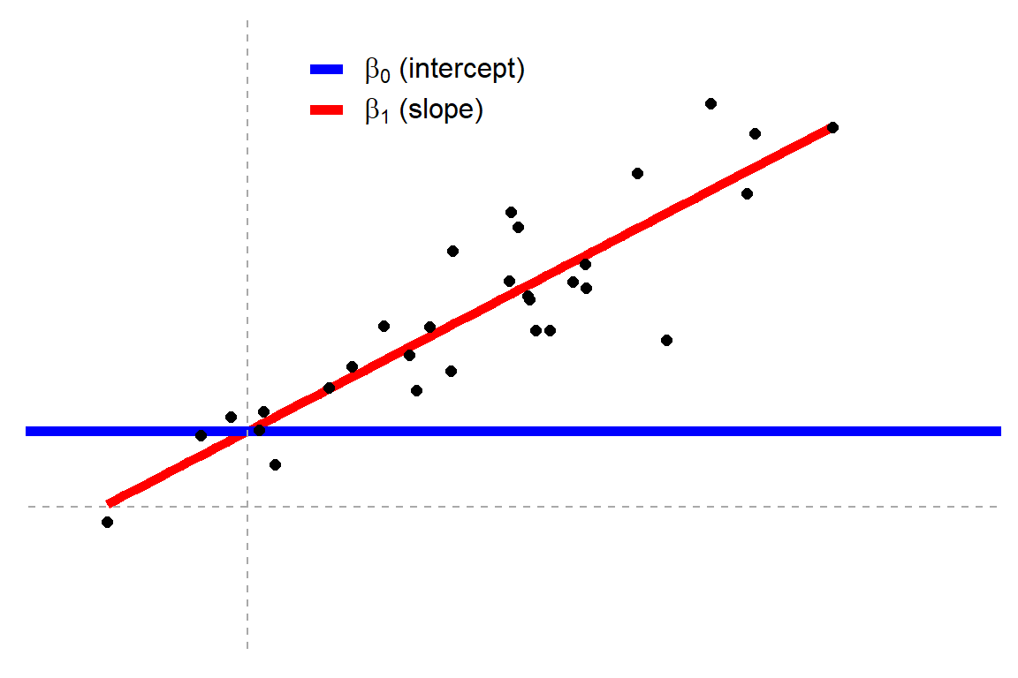
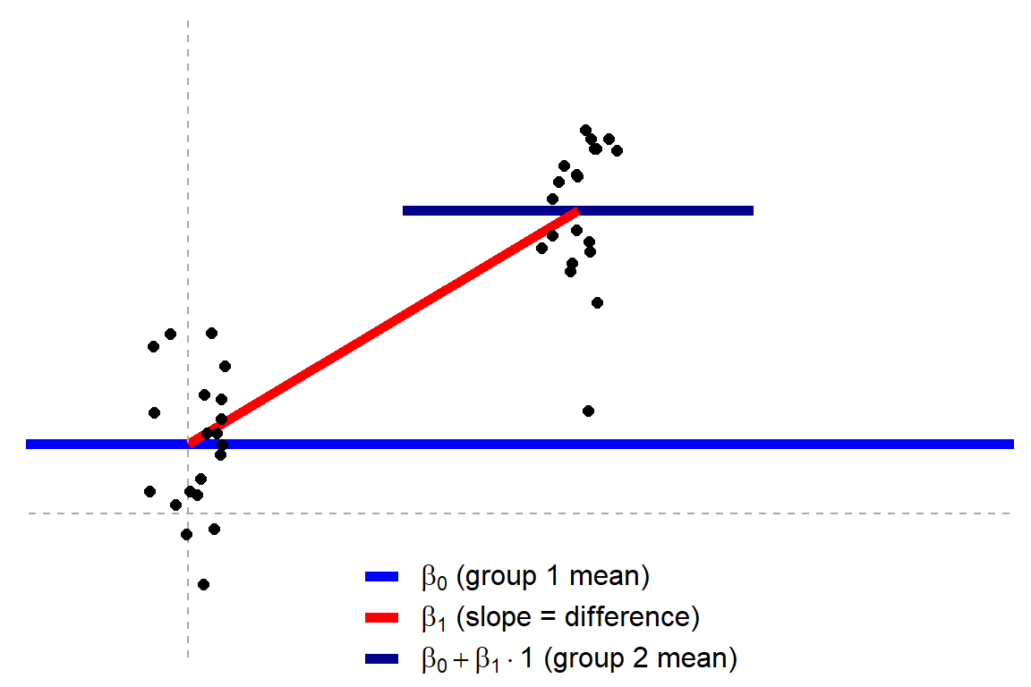
Statistical Tests
Correlation tests, t-tests, tests, anovas, Chi² tests, …
They are (simple) algorithms allowing to compute specific « effects » of interest
e.g., difference, linear relation, …
Statistical Models
Regression models, …
Models a response variable as an equation using a set of predictors
Estimate parameters
Some of these parameters correspond to « effects » of interest
Notes:
Tests are actually « simplified » version of models (cf. « all tests are regressions) »)

Slide 3
OLS and Boostrapping
Models estimate additional parameters (e.g., the spread of errors)
Using them, we can compute the SE using a complicated procedure
The SE is the standard deviation of the « mean » if we repeated the experiment an infinite amount of times
This follows from the Frequentist assumption that « data is a random draw from some true population of interest »
Using the estimate and its SE, one can compute a standardized index of precision (e.g., t-value)
We make the additional assumption about how the parameters would be distributed under the null hypthesis (that they are 0) if we repeated the experiment an infinite amount of times
As a t-distribution with a given amount of degrees of freedom
This t-value is transformed into the probability of observing an effect as large or larger under the null, the p-value
Many problems
Computation of SE
Frequentist philosophy (repeating infinite amount of times)
Data is random
Estimation of properties (degrees of freedom)
Assumption of parameter distribution under the null
Interpretation of p-value and of confidence intervals
Solution? Boostrapping
- Makes use of the assumption that data is at random

