Slide 1
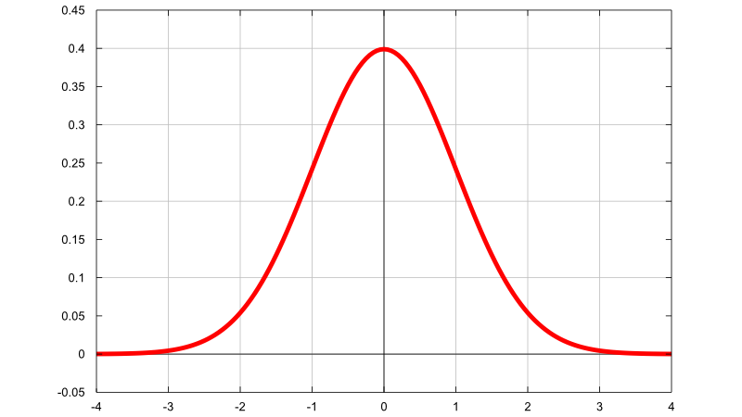
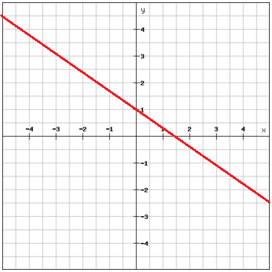
(Hx|data) = P(Hx) P(data|Hx)
Credibility
Data
x
x

Slide 2
(H true|data) = P(H true) P(data|H true)
A model with unknown parameters
P(Hx) P(data|Hx)
Credibility
Data
x
x

