Slide 1
Study 10
FAKE FACE 3
Makowski et al., in preparation

Slide 2
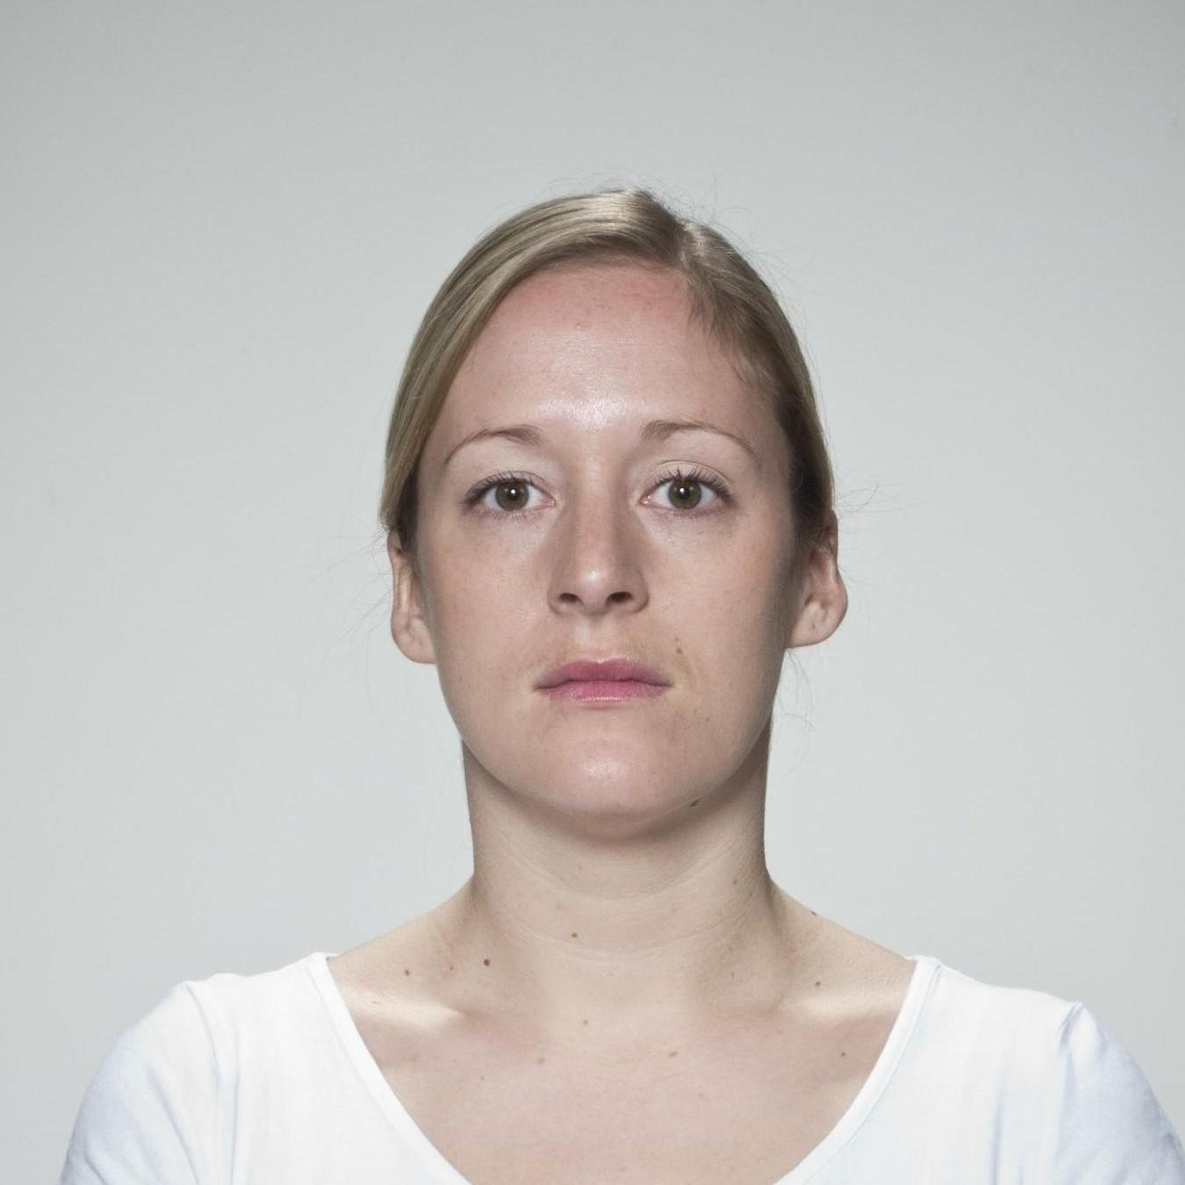
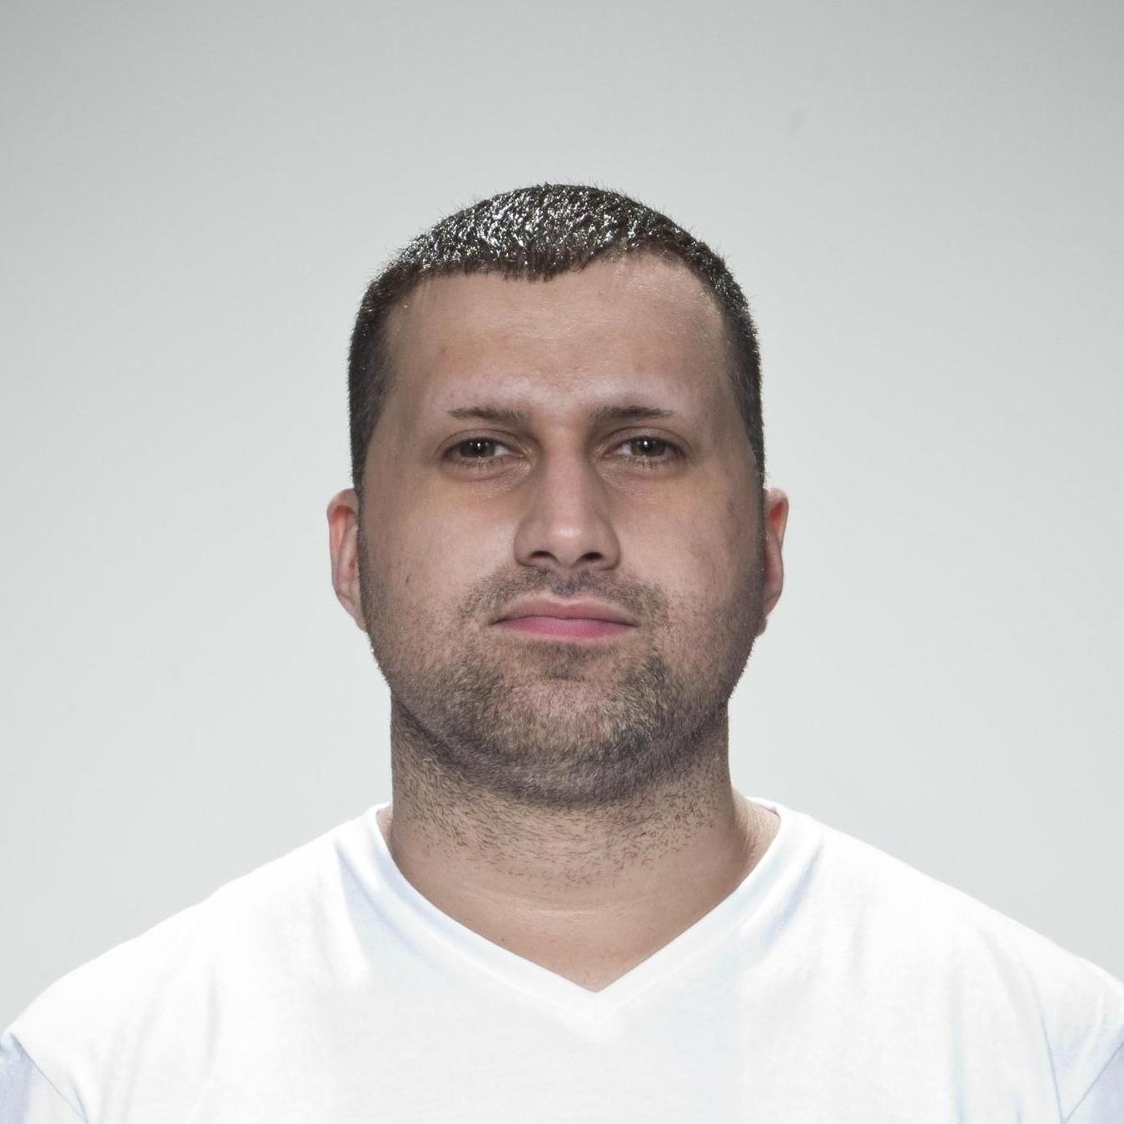
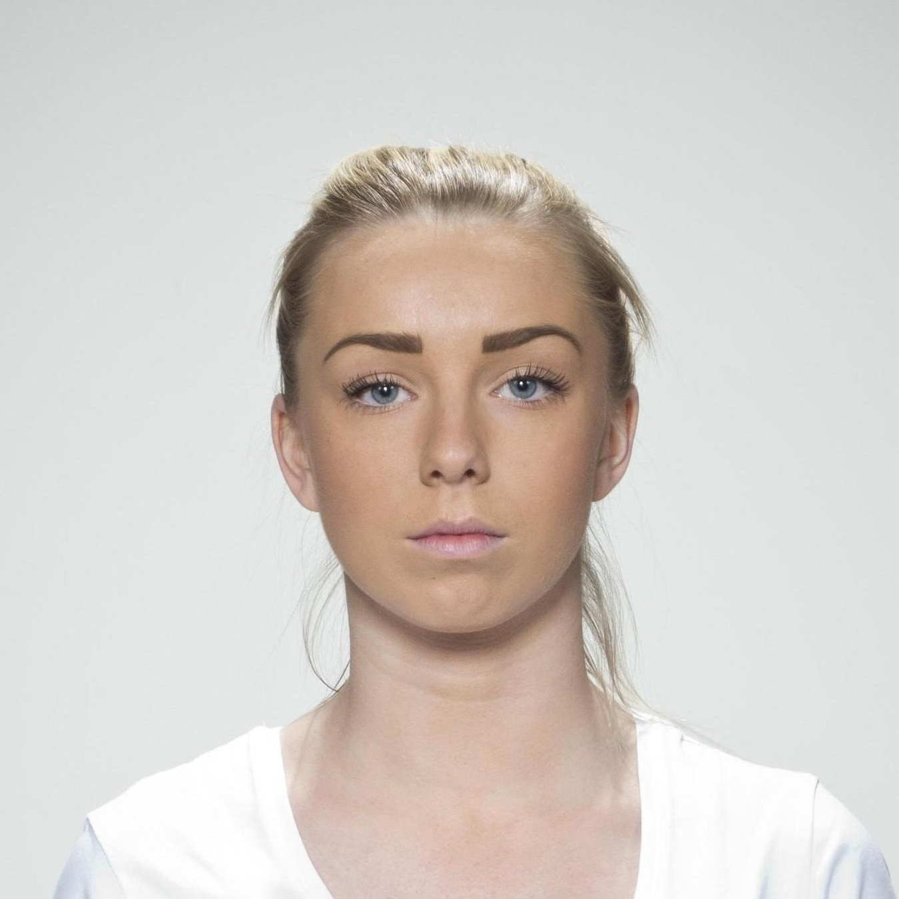
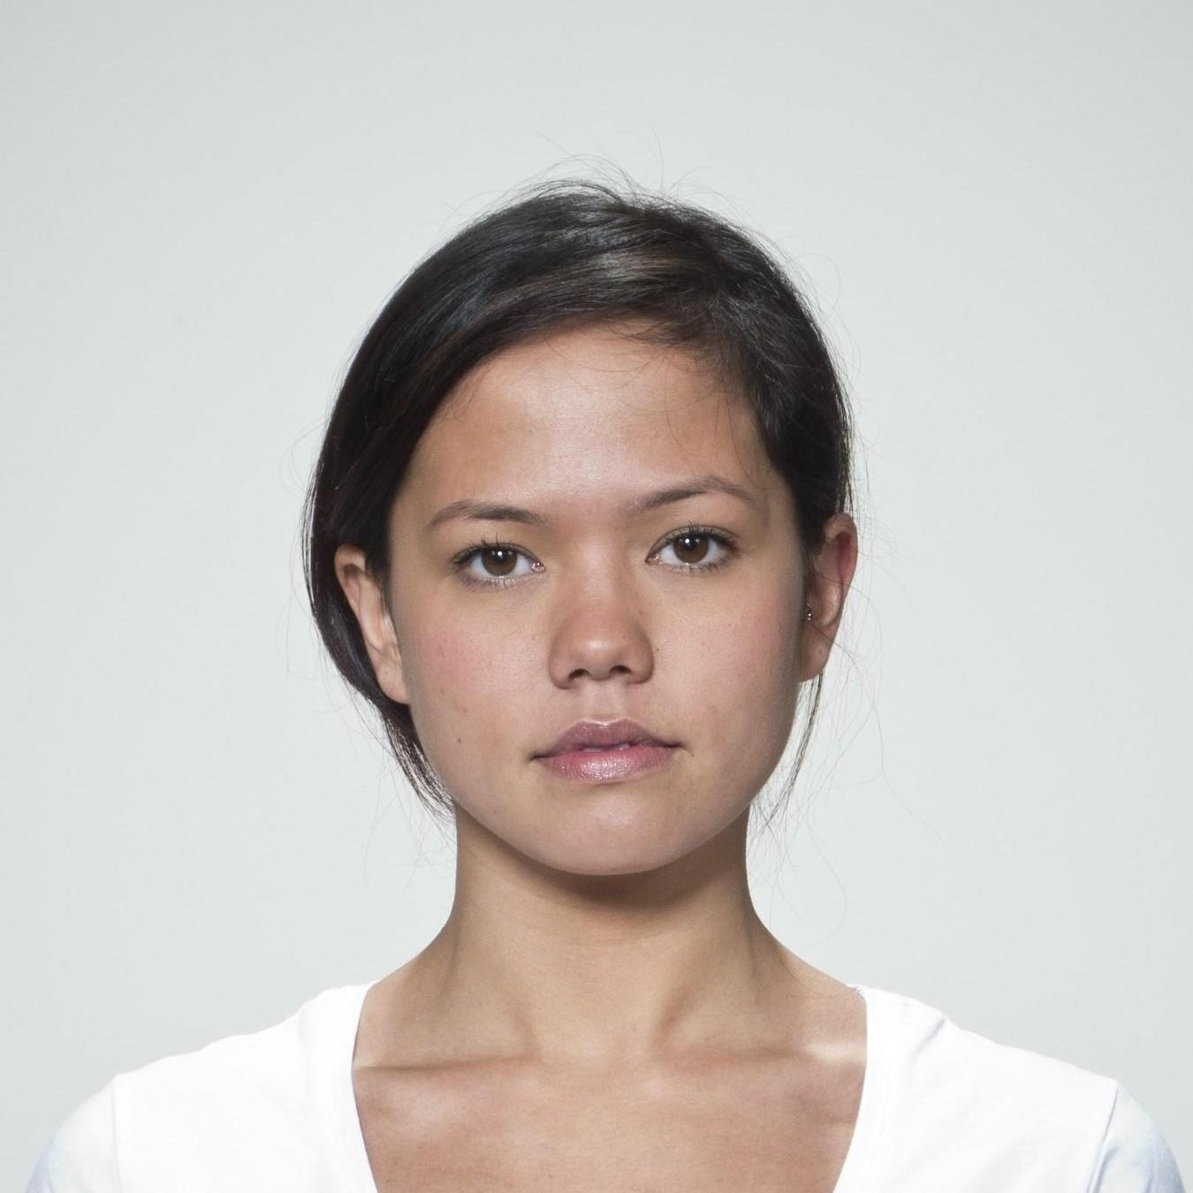
Paradigm –Task FakeFace3
PHASE 1
+
PHOTOGRAPH
+
500ms
+
1s
Attractiveness
Beauty
Symmetry
500ms
+
750ms – 3.75s
PHASE 2
AI-GENERATED
+
500ms
+
1s
1s
500ms
REALITY ASSESSMENT
1.5s
+
500ms
750ms -3.75s
REALITY ASSESSMENT
500ms
1.5s

Slide 3
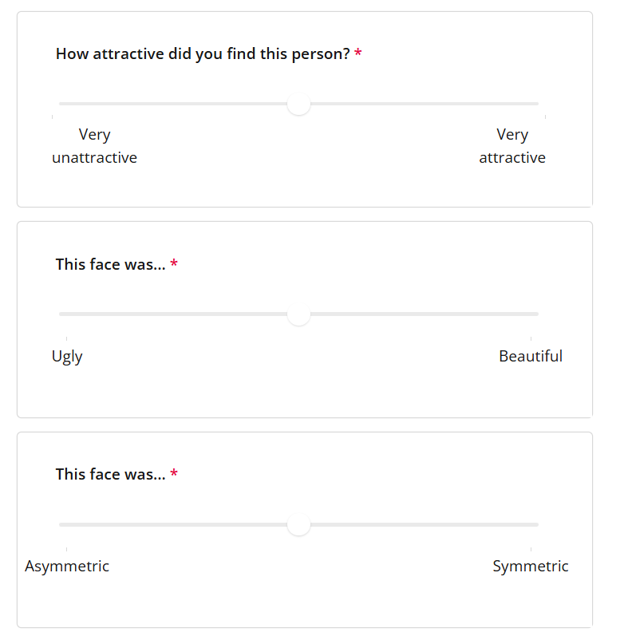
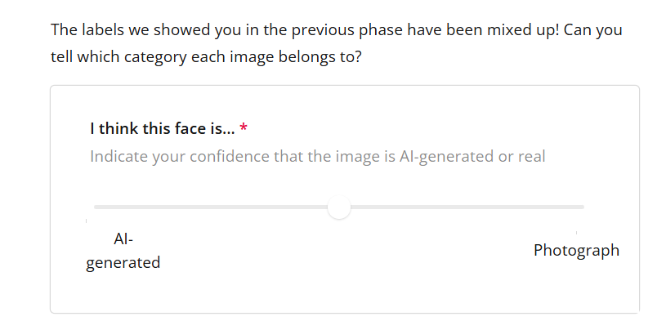
Paradigm – Ratings FakeFace3
PHASE 1
PHASE 2

Slide 4
Paradigm – All FakeFace3
INFORMATION SHEET and CONSENT FORM
DEMOGRAPHICS (age, sexual orientation…)
QUESTIONNAIRE 1
QUESTIONNAIRES:
The Misinformation Susceptibility Test (MIST
Bullshit receptive scale (BRS)
Beliefs about Artificial Images Technology (BAIT)
Questionnaires are randomised
PHASE 1
QUESTIONNAIRE 2
PHASE 2
QUESTIONNAIRE 3
FEEDBACK and DEBRIEF

