Slide 1
NEARESTCART · FEATURE-SPACE KNN
NearestCart: Feature-Space KNN Product Recommendation Engine
Content-Based Recommendations with Reciprocal Distance Weighting and KD-Tree Retrieval
Rahul · Roll No. 2402841540030
Department of AI/ML and Data Science · United Institute of Technology, Prayagraj
Academic Session: 2025–2026
Machine Learning Mini Project

Slide 2

Recommendation breaks when a product has no history
The reality: Shoppers expect relevant alternatives on every product page — and catalogs add thousands of new SKUs every month.
The flaw: Collaborative filtering learns from clicks and purchases. A newly listed SKU has neither, so it is effectively invisible — the cold-start problem.
The opportunity: Price, rating, reviews, weight and volume already describe what a product is. Measure similarity in that space and every SKU is recommendable on day one.
No clicks. No purchase history. No waiting.
02

Slide 3
Four engineering objectives anchor the engine
01
02
03
04
Catalog audit
Leakage-free scaling
Top-N retrieval
Scalability proof
5,000 SKUs, 8 departments, zero missing values and zero duplicate IDs.
z-score moments fitted on the 4,000-row training split only, then frozen.
Euclidean distance mapped to a bounded 0–100% similarity for shoppers.
Brute force vs KD-Tree vs Ball-Tree from 1,000 to 50,000 SKUs.
Success criteria: relevant neighbors in the same department, p95 latency under 1 ms, and a 50× catalog that does not slow queries.
PROJECT SCALE
5,000
5
8
50k
catalog SKUs
continuous features
retail departments
benchmark ceiling
03

Slide 4
Normalize once, then retrieve in real time
01
02
03
04
05
Ingest & audit
Split & fit
Index
Transform
Retrieve & rank
Load 5,000 rows; confirm 0 nulls and 0 duplicate IDs.
Stratified 80/20; fit the scaler on training data only.
Build a KD-Tree over standardized training vectors.
Apply the frozen μ and σ to each incoming query.
Return Top-N, then re-rank by weighted priority.
Leakage guard: μ and σ are learned on 4,000 training rows, frozen, then applied unchanged to the 1,000-row holdout and every live query.
OFFLINE
Catalog CSV
Schema audit
StandardScaler
KD-Tree index
index build
ONLINE
Target SKU
Transform vector
k-neighbors
Similarity + weight
per query
Offline once; the online path runs for every product view.
04

Slide 5
Five continuous signals describe every product
Dataset: 5,000 synthetic retail SKUs modeled on Flipkart distributions — 0 missing values, 0 duplicate IDs.
₹
•••
Unit price
Average rating
Review volume
Rs. 203 – 93,659
1.99 – 4.99
5 – 25,558
Economic position in the catalog
Mean 4.21 on a five-star scale
Verified demand and reputation
Product weight
Package volume
Product category
35 g – 31.8 kg
252 – 189,798 cm³
8 departments
Net physical mass
Shipping footprint L × W × H
Filter and supervised target
Category mix: Electronics 933 · Clothing 895 · Home & Kitchen 724 · Footwear 709 · Sports & Fitness 502 · Beauty 466 · Furniture 417 · Books & Stationery 354.
05

Slide 6
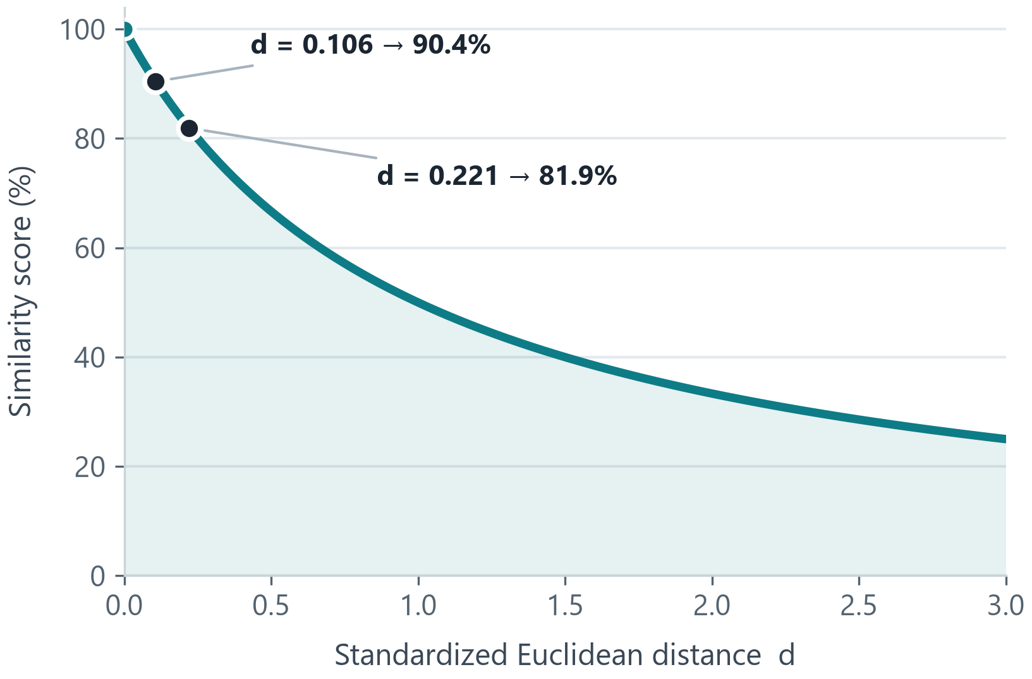
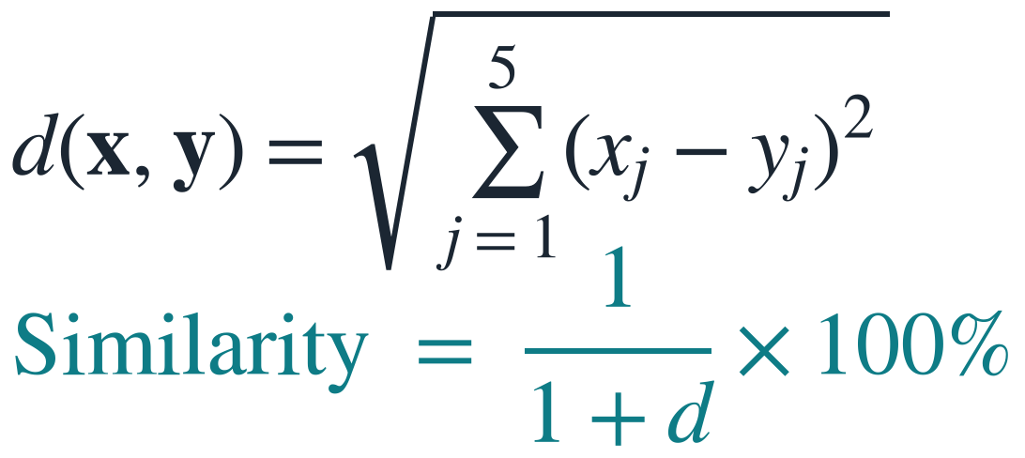
Module 1 maps distance to a similarity score
Each product is a point in standardized five-dimensional space. Euclidean distance measures how far a candidate sits from the query.
WORKED EXAMPLE · SKU_00005 → SKU_03413
d = 0.1062 ⇒ similarity = 90.40%
Distance shrinks as products match; the score rises toward 100%.
Bounded by design: d = 0 gives 100%, d = 1 gives 50%, d = 3 gives 25%. Shoppers see an intuitive score while the engine ranks on raw distance.
06

Slide 7
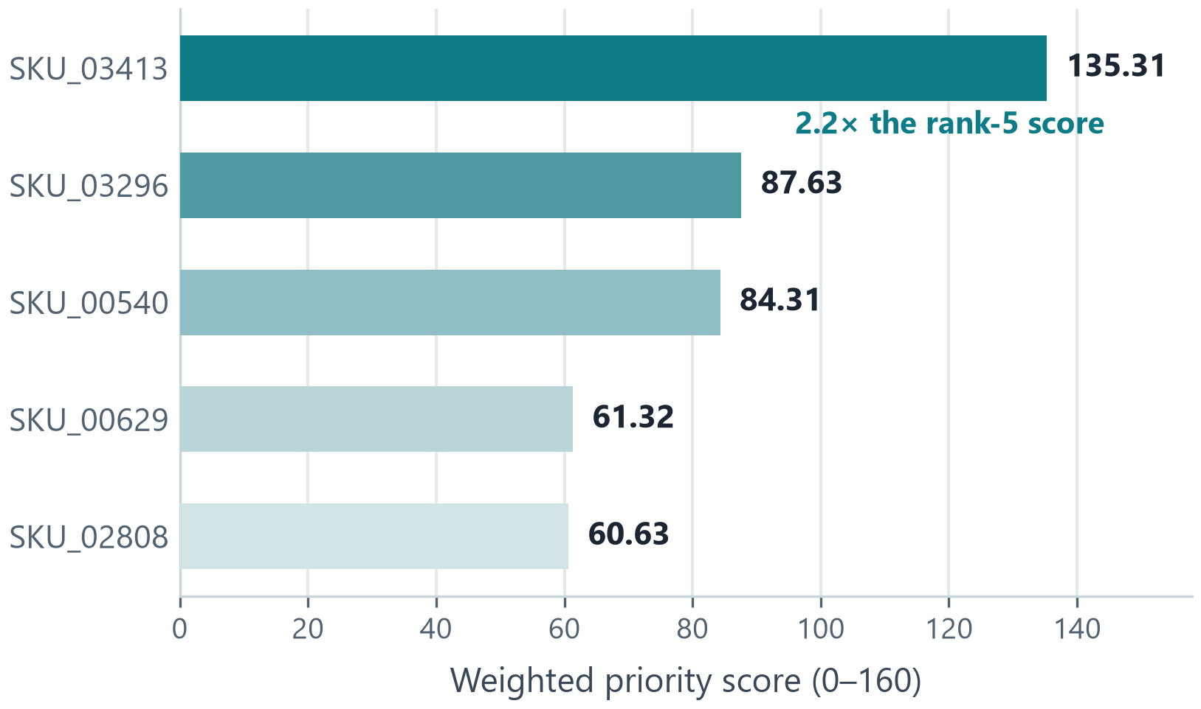
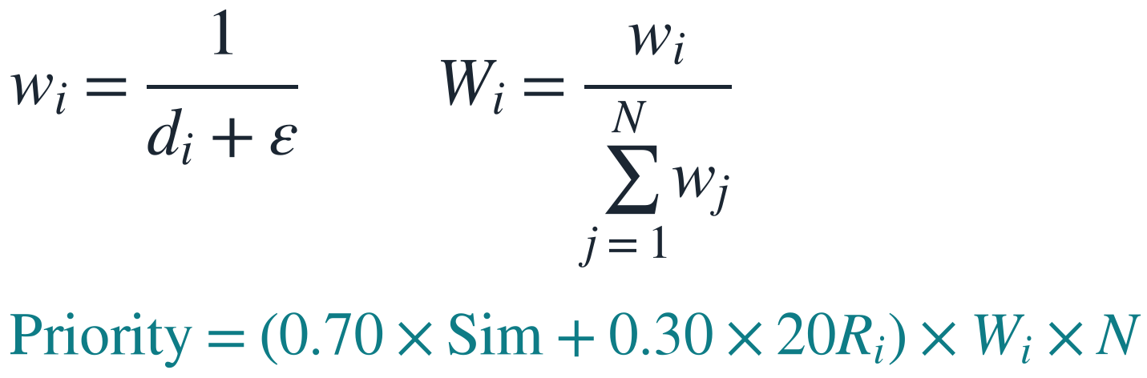
Module 2 lifts the closest product to the top
Unweighted KNN treats rank 1 and rank 5 equally. Reciprocal weighting rewards proximity, then blends in the product rating.
The nearest item earns 2.2× the priority score of rank 5.
RANK
CANDIDATE SKU
UNIT PRICE
DISTANCE
SIMILARITY
PRIORITY
1
SKU_03413
Rs. 13,467.30
0.1062
90.40%
135.31
2
SKU_03296
Rs. 13,539.85
0.1586
86.31%
87.63
3
SKU_00540
Rs. 13,243.14
0.1648
85.85%
84.31
4
SKU_00629
Rs. 14,019.57
0.2182
82.09%
61.32
5
SKU_02808
Rs. 16,323.89
0.2214
81.87%
60.63
07

Slide 8
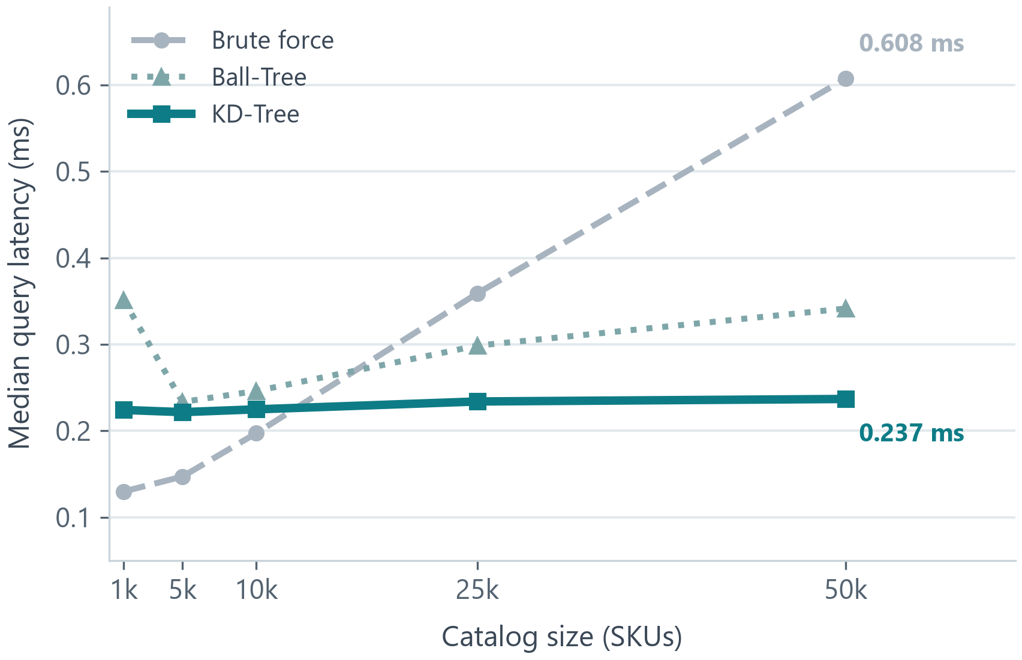
KD-Tree keeps latency flat across a 50× catalog
AT 50,000 SKUs
0.237 ms
KD-Tree median query latency
0.523 ms
95th-percentile latency — inside the 1 ms target
30.9 ms
one-time KD-Tree index build
Brute force: 0.608 ms at 50k — 2.6× slower at the median.
50× more SKUs, effectively the same query time: brute force grows 4.7× (0.130 → 0.608 ms) while KD-Tree moves just 5.7% (0.224 → 0.237 ms).
08

Slide 9
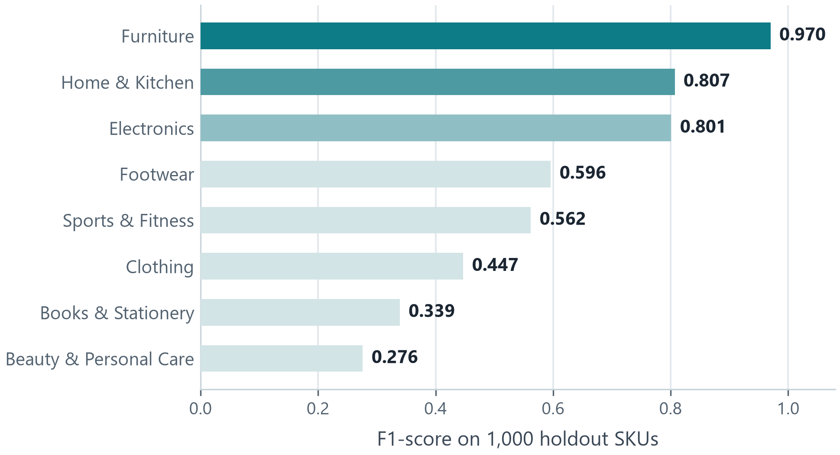
Supervised KNN classifies departments at 61.70%
61.70%
18.66%
+43.0
62.98%
holdout accuracy
majority-class baseline
points of lift
best 5-fold CV score
1,000 unseen SKUs · k = 7, distance-weighted · best grid-search setting: Manhattan, k = 15
STRONG SEPARATION
Furniture 0.970 — 80 of 83 correct; heavy, bulky items isolate cleanly.
Home & Kitchen 0.807 · Electronics 0.801 — clear price and volume profiles.
SOFT BOUNDARIES
Clothing 0.447 · Books 0.339 · Beauty 0.276 — light items share price and weight bands.
Price regression: R² = 0.165 — physical attributes explain 16.5% of price variance.
Takeaway: continuous attributes carry real category signal for bulky goods; light, similarly priced products need text or image features.
09

Slide 10
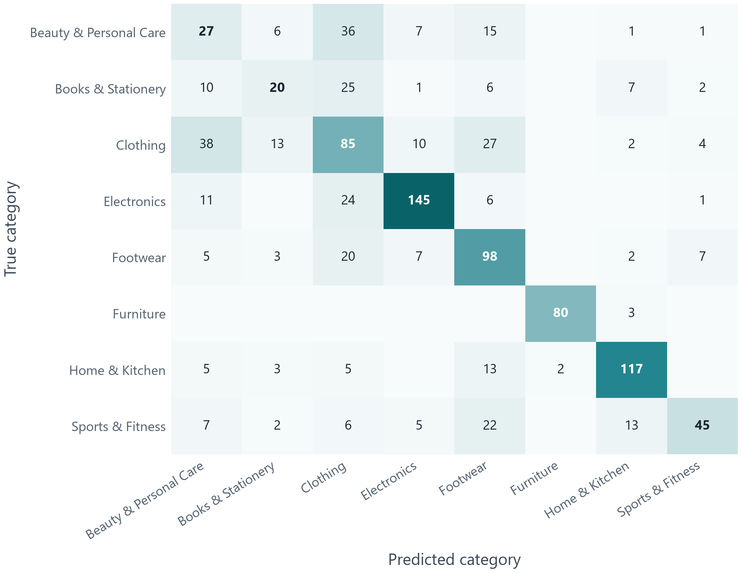
The matrix shows crisp clusters and soft boundaries
STRONG DIAGONAL
Furniture
80 / 83 96.4%
Home & Kitchen
117 / 145 80.7%
Electronics
145 / 187 77.5%
SOFT BOUNDARIES
Clothing
85 / 179 47.5%
Beauty & Personal Care
27 / 93 29.0%
Books & Stationery
20 / 71 28.2%
Off-diagonal mass clusters around Clothing → Footwear and Beauty → Clothing: the same light, mid-price band.
10

Slide 11
NEARESTCART · FROM PROTOTYPE TO PRODUCTION
NearestCart: from cold-start prototype to production retrieval
Add MiniLM text embeddings so titles and descriptions join the distance metric.
Upgrade KD-Tree to HNSW for catalogs with millions of SKUs.
Stream live ratings and reviews instead of batch CSV loads.
Ship a Streamlit SKU explorer for buyer-facing demos and live queries.
Conclusion: content-based KNN makes every new product recommendable from day one — no click history, and retrieval in under a millisecond.
Thank You / Q&A

