Slide 1
Iterative Incremental Development
The fundamental aspect of Agility is incremental and iterative development.
The core idea is to move from all or nothing approach to a world of options.
Break down the Scope into small batches(increments)
and iteratively develop them.
Keep it open to change
So, how does it all work?

Slide 2
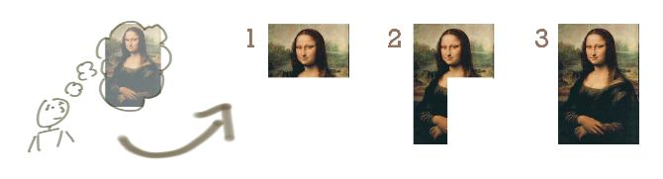
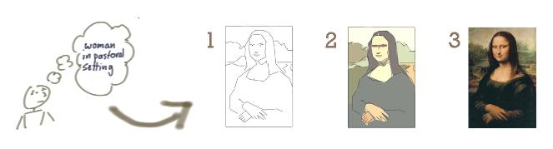
Iterative Incremental Development
“Don’t know what I want, but I know how to get it.” – said Jeff Patton
in his brilliant post where he used a sketch of Mona Lisa
to illustrate the difference between iterative and incremental development .
Incrementing calls for a fully formed idea
“incrementing” builds a bit at a time
Iterating is to move from vague idea to realization
“iterating” builds a rough version,
validates it, then slowly builds up quality

Slide 3
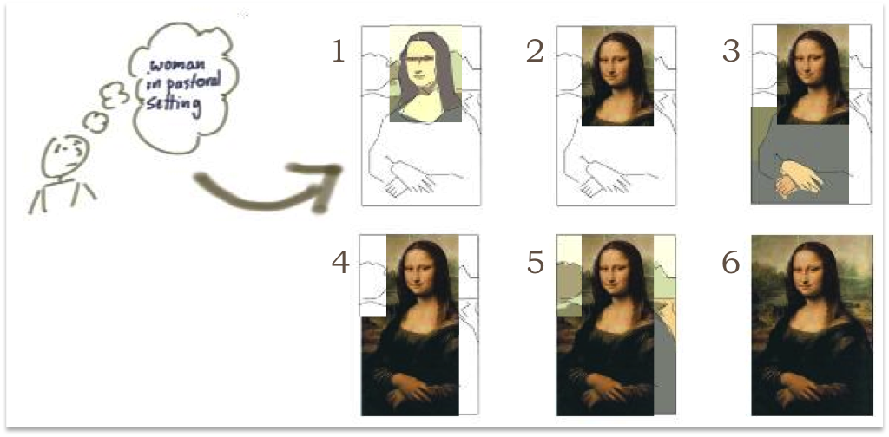
Iterative Incremental Development
The Increment adds completely new features, based on user stories,
hence expanding the scope of the functionality offered
– that makes it Incremental.
Each Increment is also likely to refine existing functionality – that makes it iterative.
This combined Iterative Incremental approach is much more powerful than either in isolation.
This flexibility gives the product owner, team and company more choices.
We can stop at any point and either throw away what we’ve done or launch it.

Slide 4
Iterative Incremental Development
Some examples based on the Iterative Incremental Mona Lisa.
What do we get if we stop at each step … ?
Step 1: We start the project but quickly realise it wasn’t a good idea and abandon it. We’ve lost the money it took to get that far but avoided paying the full cost of the project. Time to stop.
Step 2: We have built the top priority functionality (Mona Lisa’s head) and we’re launching with that. Not sure we need the rest as the return on investment will be too low. Time to stop.
Step 3: We’re now fleshed out the second tier of priorities (Mona Lisa’s hands and body). Not fully featured but filled in a few gaps that significant customers complained about. But we’ve realised the rest of the scope isn’t really needed. Time to stop.
Step 4: We’ve got all the Must Have and Should Have items from the original high level requirements list (Mona Lisa’s head, hands and body). There are other things we could do but the business is starting up a new product line and needs to divert development effort to that. Time to stop.
Step 5: We got all the major features and, in fact, we’ve touched on all the features from the product backlog. There is more we could do but really that would be more like gold plating than delivering essential functionality. Time to stop.
Step 6: Wow. Impossible to improve. Time to stop.

Slide 5
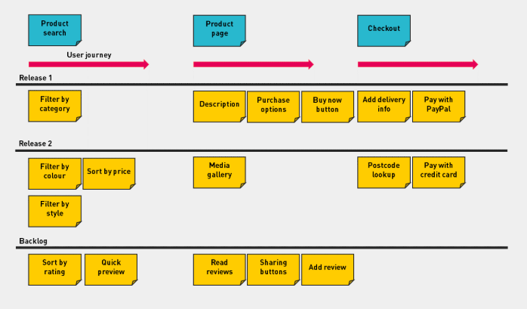
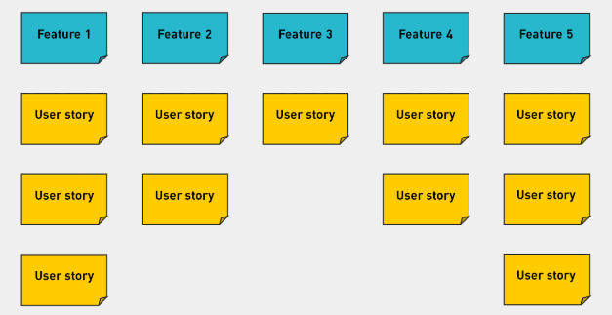
User Story mapping
Story mapping is a technique championed by Jeff Patton. It provides us with a way to envisage the entire product or service as a series of tasks which the user completes.
It involves building a grid of user stories which are laid out under headings that represent the user’s experience moving through your product.
Story mapping as an iterative process

Slide 6

User Story mapping in action
Let’s play “Wake up in the morning” game!
The purpose of this game is to demonstrate
the Agile way to Slice the Product to meaningful increments.
Step1 - Individually list the morning activities:
Please write on sticky notes the activities you do from the moment you wake up until you reach the office/school.

Slide 7
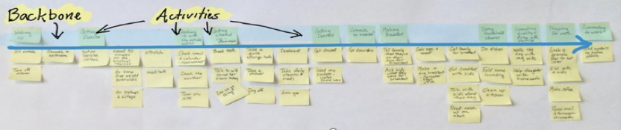
“Wake up in the morning” game
Step2 - Collaboratively grouping the activities:
Please take your notes and group them under common title with a common goal.
The titles are the “backbone” activities.
The tasks beneath are the “Skeleton” (sketches) of product.
Let’s walk the Skeleton and check for missing activities.

Slide 8
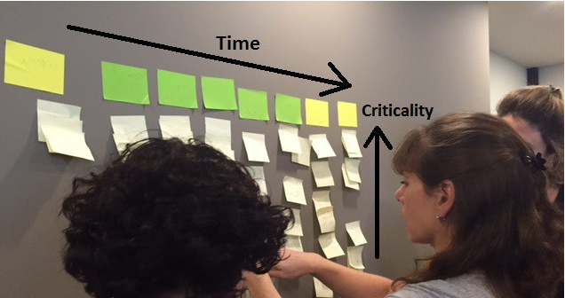
“Wake up in the morning” game
Step3 - Order the group of activities by time :
Please order the activities from left to right sequentially.
Step4 - Order the activities by criticality :
Please prioritize the activities in each group by criticality ordered
from top(most important) to bottom(less important).
certain goal
certain market segment
specific person
Who are our target customers: single men under 25 with no kids, married women with 3 kids over 30?

Slide 9

“Wake up in the morning” game
Step5 – Constraint of time:
Imagine you have missed the alarm
and only have 5 minutes to get ready.
You need to reach the office on-time
with the minimum activities as possible.
Draw the horizontal line through the activities
so the activities you choose to do
are above the line.
Which part will you drop to fit minimal time you have?
Identify the MVP – minimal viable product.
My face when I miss my alarm

Slide 10
“Wake up in the morning” - Summary
With the constraint of time our aim is still to realise the full “value” of getting on time to the office. In the process of minimizing the activities, we removed many of them in each step and left the process very thin and lean but still end-to-end.
Since we have a constraint of time, as we eventually want to be fast which means minimize the time to reach value. In many cases we will go too deep in a single step and not realise the full end-to-end value. in this exercise we demonstrate how it should be done across the map and how in every increment we build we have the full end-to-end.
We don’t invest equally in each step – in some steps we left only one activity and in some we left more, depending on the step. Some steps where even entirely removed.
Choosing the depth of each step is easier when the full picture is available since the alternatives are visible.
Focusing on a single activity but in the context of end-to-end value helps development teams better understand the scope of the requirement. For example, preparing breakfast in the context of getting out of the house in 15 minutes is totally different from preparing breakfast for the family on a vacation morning. Communicating effectively the context helps to make the scope more precise and to trim the less important parts of the scope.

Slide 11
Retro
We have a Product story map
We identified the MVP
We can see Vertical activities (features)
We can see Horizontal lanes (potential releases)
Next steps/actions?
Identify what are Epics/Features/Tasks
Add Features/Epics for orphaned tasks
Regroup to discuss, try to spot missing features, identify dependencies and get the features ready for the Release Kanban board.

Slide 12
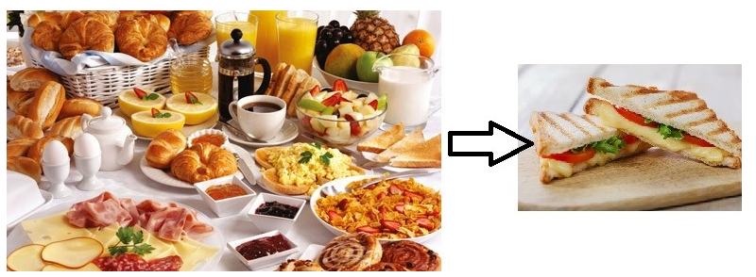
“Wake up in the morning” game
Enjoy and good luck.

Slide 13
“Wake up in the morning” game
Step1 - Individually list the morning activities
Step2 - Collaboratively grouping the activities
Step3 - Order the group of activities by time
Step4 - Order the activities by criticality
Step5 - Add constraint of time
Target customers: married woman over 30 with 3 kids,
married man with 1 kid and a dog

Slide 14
“Wake up in the morning” game
Step1 - Individually list the morning activities
Step2 - Collaboratively grouping the activities
Step3 - Order the group of activities by time
Step4 - Order the activities by criticality
Step5 - Add constraint of time
Target customers:
single man under 25 with no kids/pets addicted to sport
single woman under 25 with no kids/pets

Slide 15
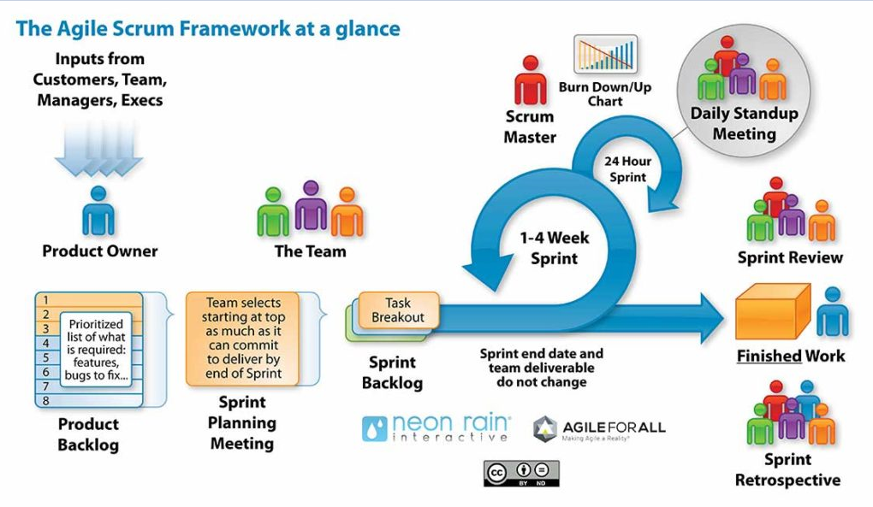

Slide 16
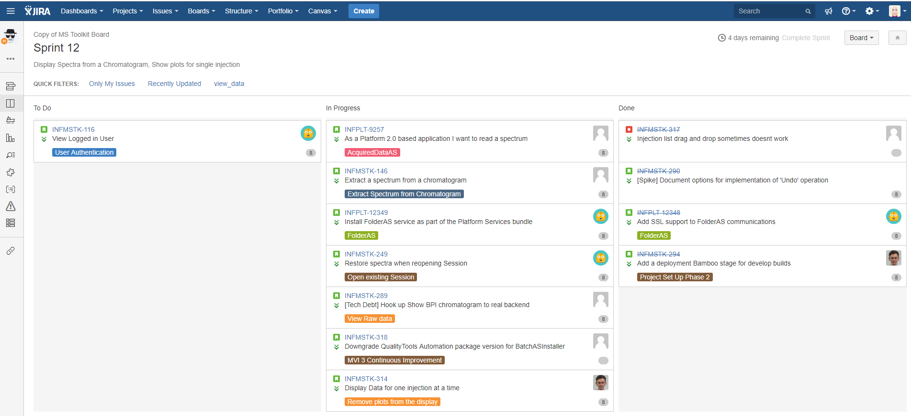
Jira – Sprint board

