Slide 1
Effective Teams

Slide 2
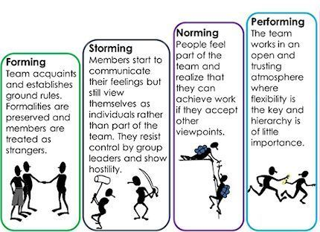
Notes:
The forming–storming–norming–performing model of group development was first proposed by Bruce Tuckman in 1965, who said that these phases are all necessary and inevitable in order for the team to grow, face up to challenges, tackle problems, find solutions, plan work, and deliver results.
Forming
Little agreement
Unclear pupose
Guildance and Direction
Storming
Conflict Increased clarity if purpose
Power struggles
Coaching
Norming
Agreement and Concensus
Clear roles and Resonsibility
Facilitaion
Performing
Clear vision and pupose
Focus on goal achievement
Delegation
Adjourning
Task completion
Good feeling about achievements
Recognition

Slide 3
Team Manifesto - Optional Exercise
Forming
Create a set of ground rules for a newly formed team
Dealing with other teams
Dealing with other team members

Slide 4
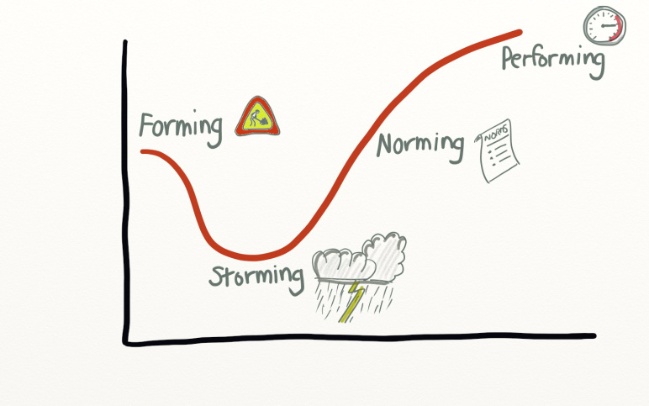

Slide 5
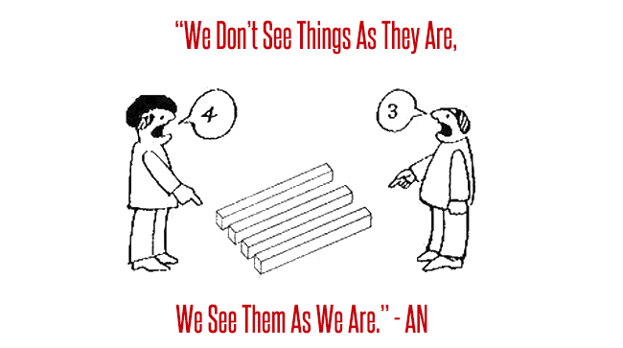
Perception
Notes:
Two people can look at the same thing and yet both see something different.
Your unique view is formed by your own individual perceptions and beliefs. If you can understand where these perceptions and beliefs come from, you can then begin to understand why other people see things differently. By understanding people, you can begin to appreciate who they are and improve your relationships with them.

Slide 6
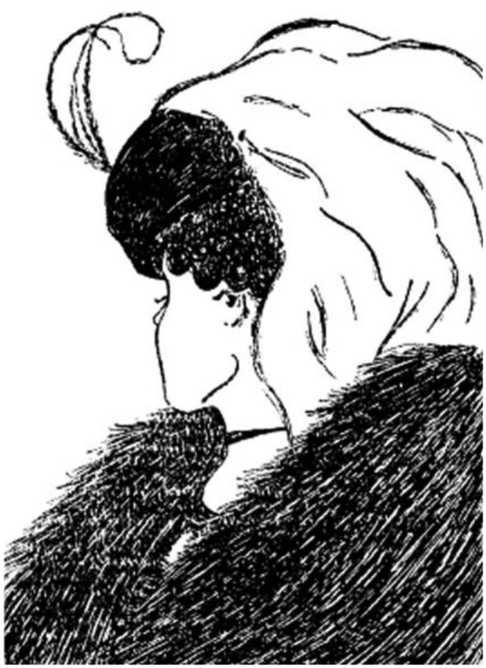
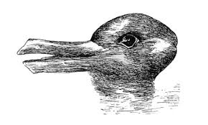
Perception
Notes:
Two people can look at the same thing and yet both see something different.
Your unique view is formed by your own individual perceptions and beliefs. If you can understand where these perceptions and beliefs come from, you can then begin to understand why other people see things differently. By understanding people, you can begin to appreciate who they are and improve your relationships with them.

Slide 7
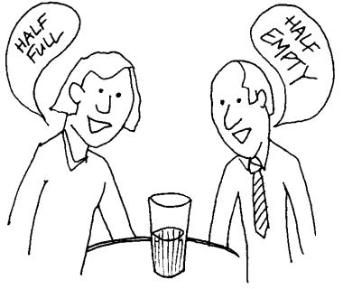
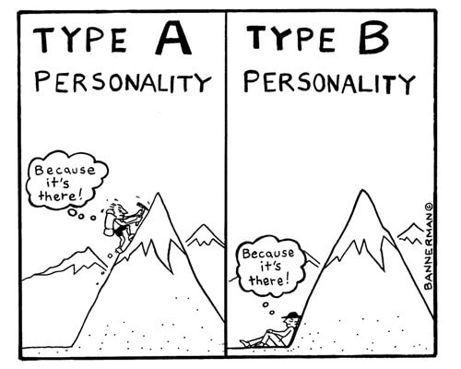
Personalities
Notes:
Two people can look at the same thing and yet both see something different.
Your unique view is formed by your own individual perceptions and beliefs. If you can understand where these perceptions and beliefs come from, you can then begin to understand why other people see things differently. By understanding people, you can begin to appreciate who they are and improve your relationships with them.

Slide 8
Group excercise
Each apprentice starts with randomly selected cards
Look at each card
If it applies to you, keep it
If not give it, to someone it does apply to
Notes:
At end apprentices read one of cards they think applies to them

Slide 9
Colour Energies on a good day
Cautious, precise, deliberate, questioning, formal
Competitive, demanding, determined, string-willed, purposeful
Persuasive, demonstrative, sociable, enthusiastic, dynamic
Caring, encouraging, sharing, patient, relaxed
Cool Blue
Firey Red
Sunshine Yellow
Earth Green

Slide 10
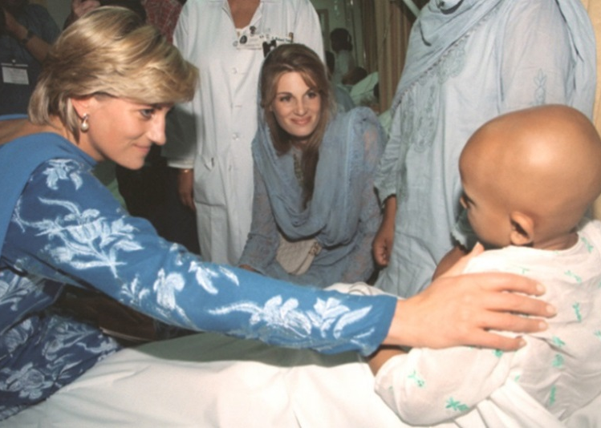
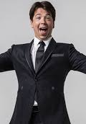

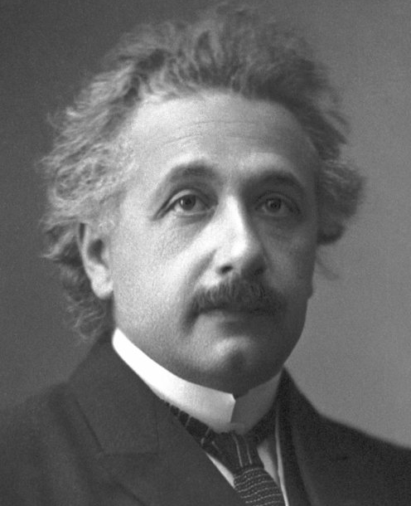
Colour Examples

Slide 11
Colour Energies on a bad day
Stuffy, indecisive, cold, reserved
Aggressive, controlling, driving, overbearing, intolerant
Excitable, frantic, indiscreet, flamboyant, hasty
Docile, bland, plodding, reliant, stubborn
Cool Blue
Firey Red
Sunshine Yellow
Earth Green
Notes:
Relate this back to forming, norming storming
Everyone is a mix
Apprentices relate back their top two colours (mostly red and green)
Hands up on accuracy

Slide 12
What Are We Like?
https://www.16personalities.com/

Slide 13
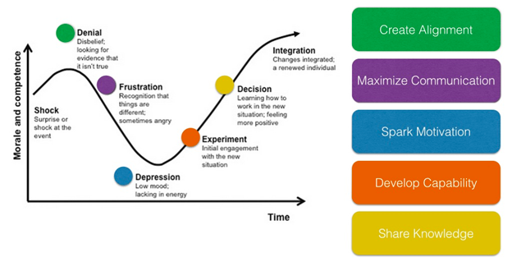
Dealing with Change
Notes:
Create Alignment: Write down in non-buzzwordy language why this change happening, who is affected, the benefits. Put up a “feedback” area next to these 3 statements, let people poke holes in them.
Maximize Communication: Informal communication - open and honest dialogue. Sometimes when people feel frustrated they need to be listened to. Don’t worry about having a solid plan and outcomes from those sessions.
Spark Motivation: Understand what is holding people back from trying new practices. Motivation isn’t everything, sometimes people need to develop capability first, but look for what motivates different people. Do something to help people break out of the funk.
Develop Capability: This stage is perfect for the “safe to fail” phrase. Build time to let people practice new skills. Innovation and collaboration doesn’t happen by chance; you as a change agent need to enable it.
Share Knowledge: Get teams together to share stories. Encourage teams to learn from each other. Let teams showcase what they’ve done.

