Slide 1

Paperlandia needs you
(Or at least it needs some paper airplanes making really soon)

Slide 2
Scenario – Paperlandia needs to defend itself
The president of Paperlandia us been told his country will be attached by Cardboardonia in less than 15 mins
He needs some paper planes to help defend his country
Two teams will try to help: one using Waterfall and one using Scrum. They each have 12 mins to deliver!

Slide 3
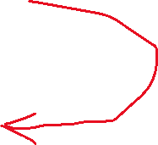
Instructions
Waterfall
Read requirements spec
Write functional spec
Write design doc and/or prototype
Start development
Write test spec
Start testing (FAT)
Scrum
3 min “sprint zero”. (Create/refine backlog)
4 min sprint1 (30s refinement, 2 mins dev, 30s retro)
4 min sprint2 (30s refinement, 2 mins dev, 30s retro)
FS must be signed off before dev starts

