Slide 1
Level Design

Slide 2
Što je level design i tko su level designeri?

Slide 3
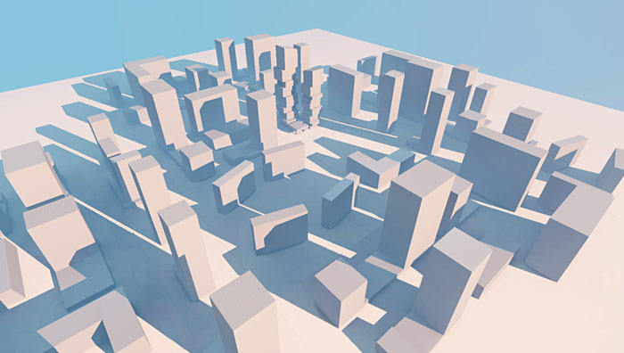
Level design blockout

Slide 4
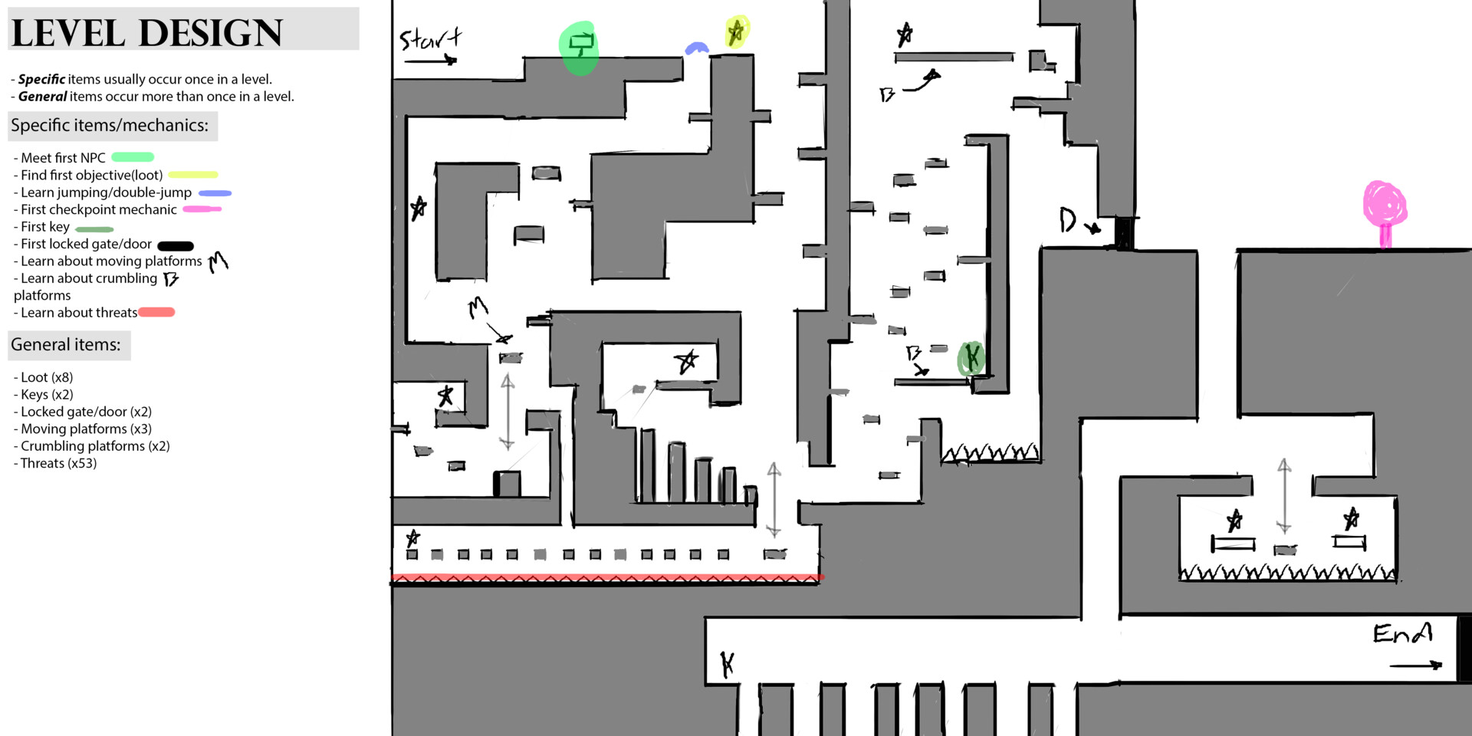

Slide 5
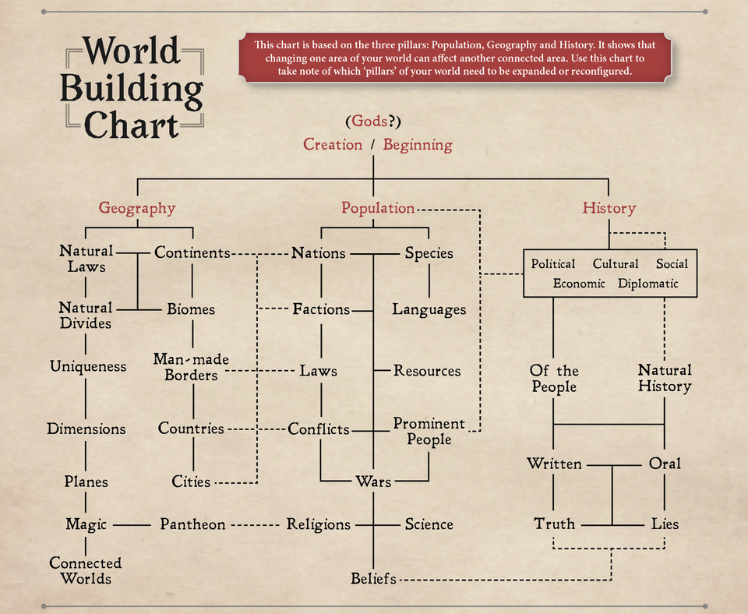
World building

Slide 6

Primjeri lošeg level designa

Slide 7

Nekoliko primjera dobrog level designa

Slide 8


Slide 9
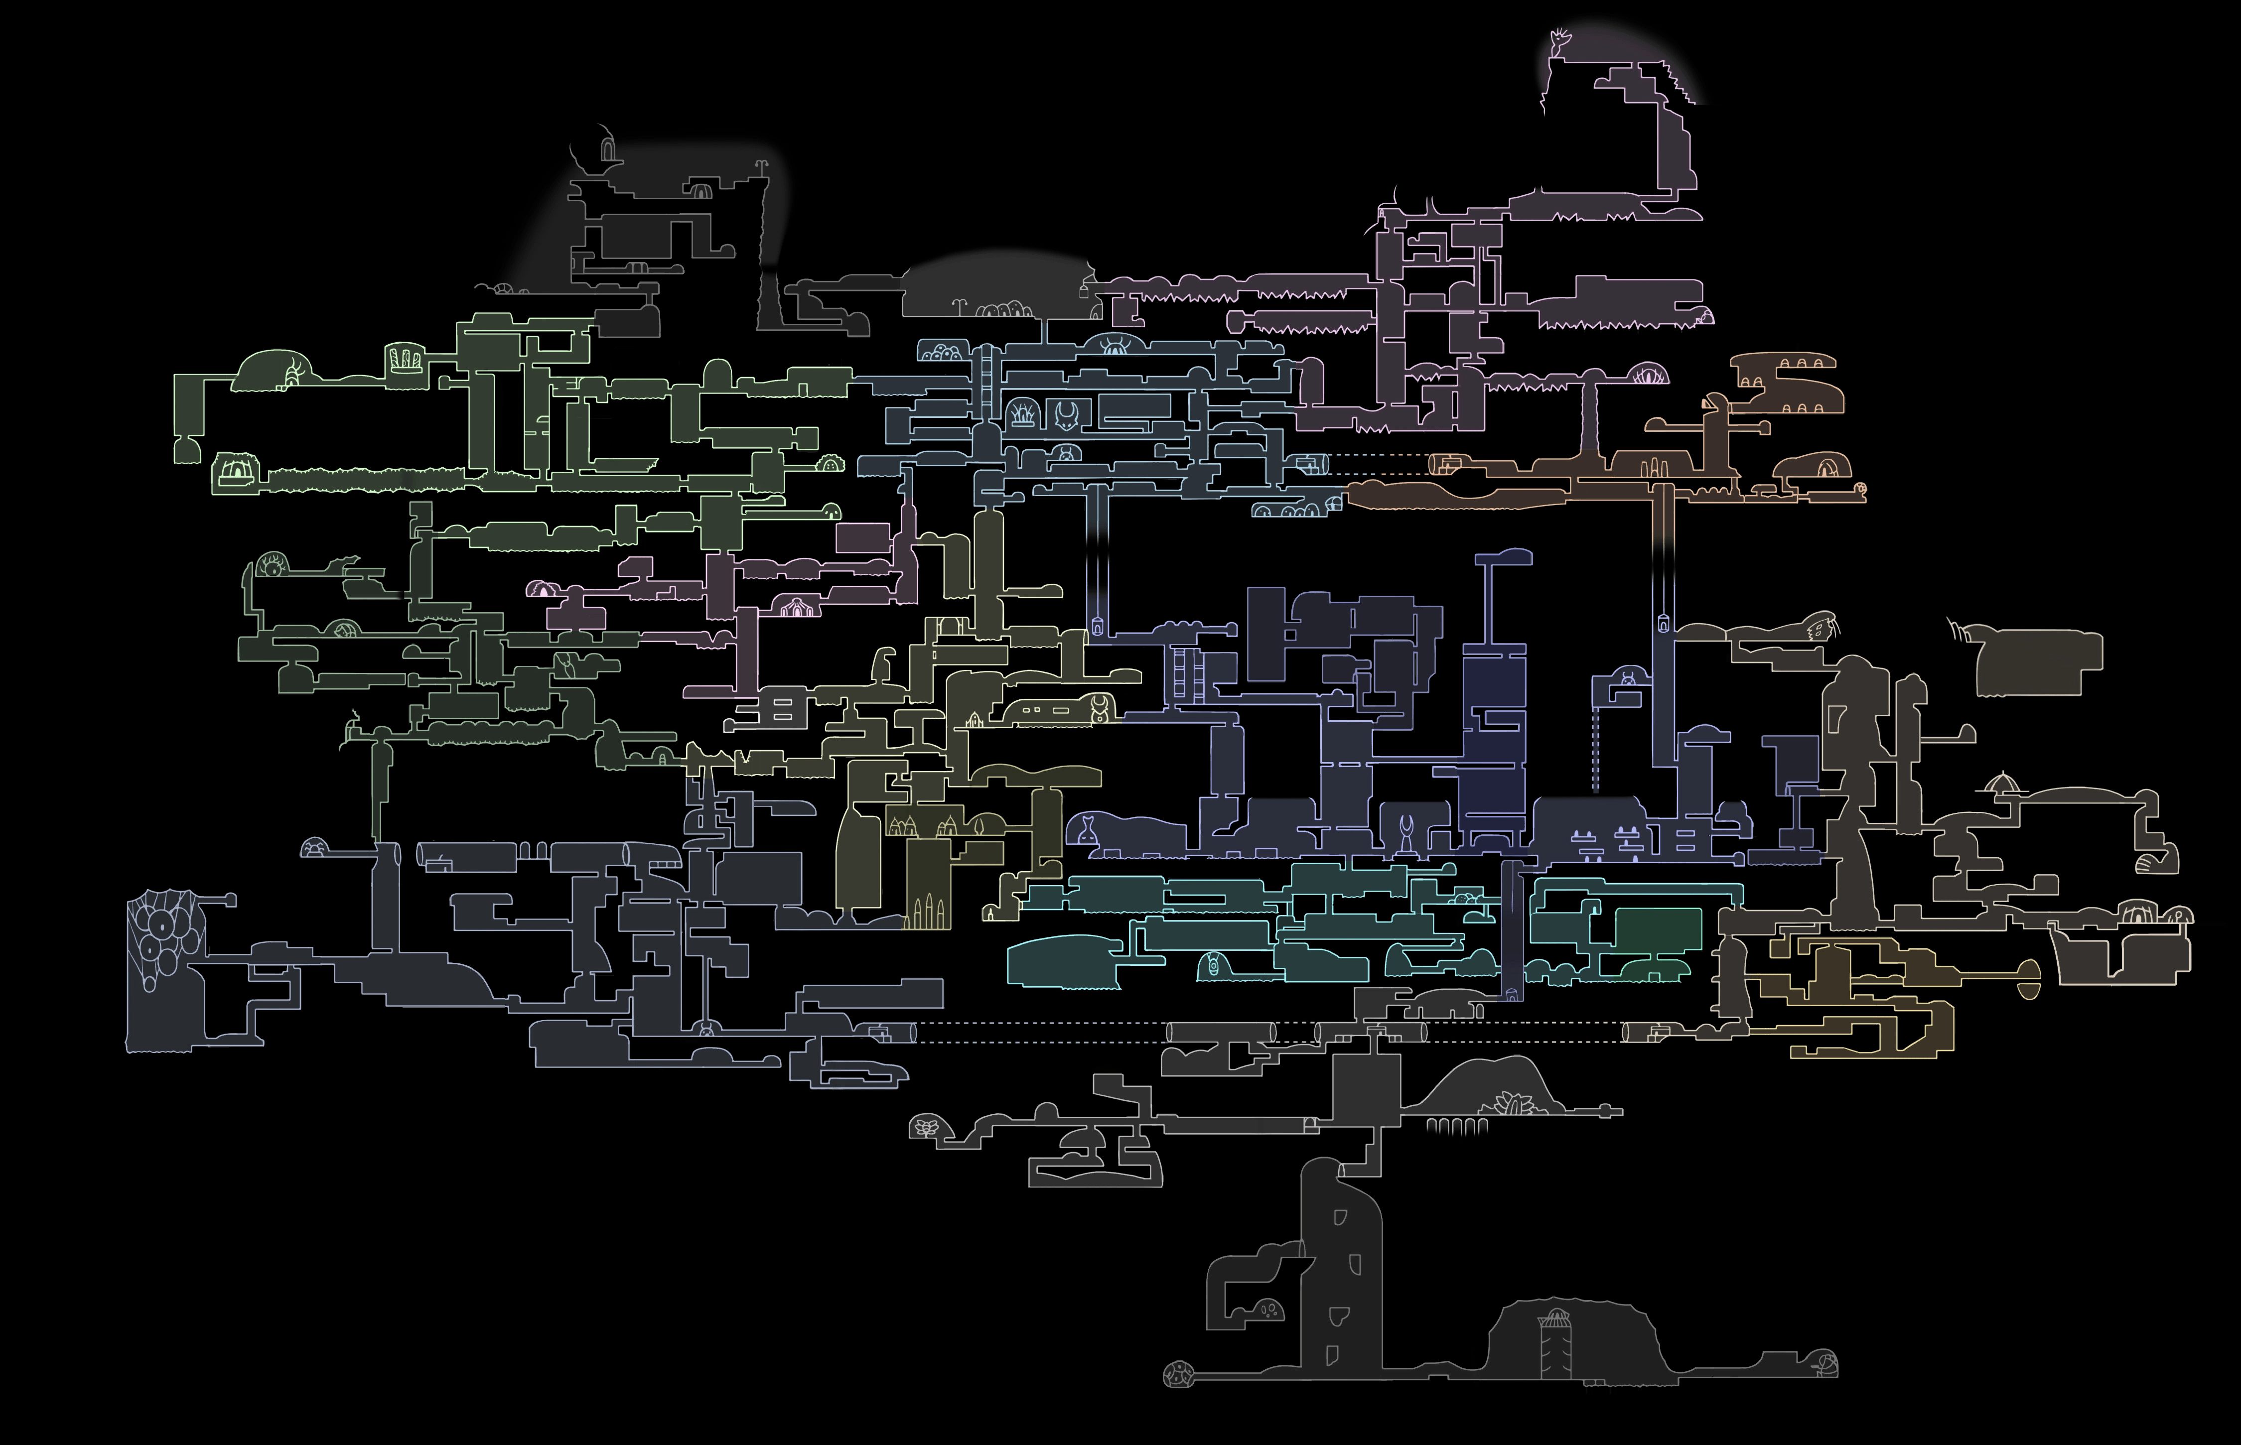

Slide 10
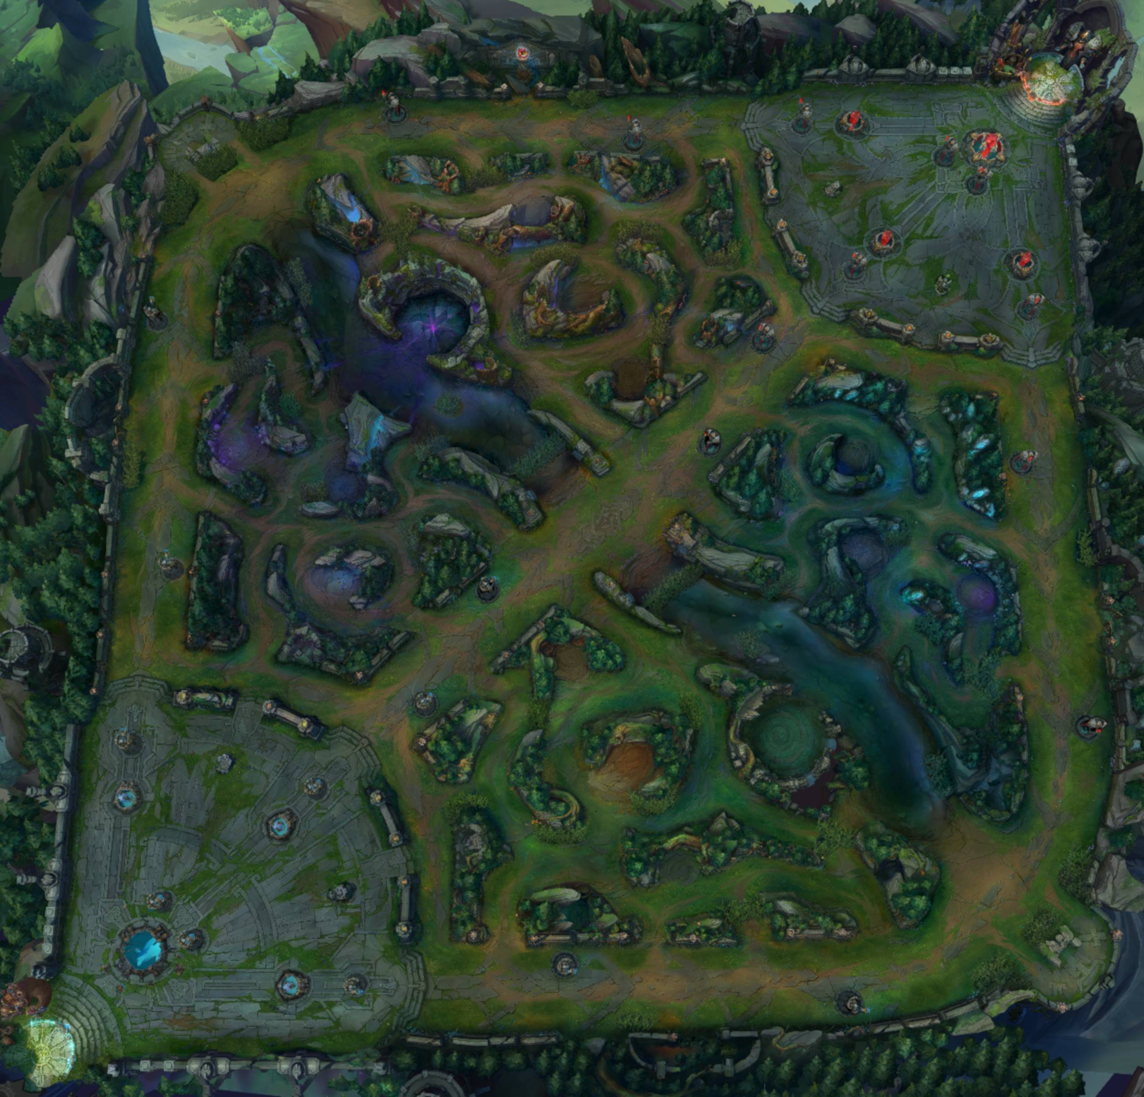

Slide 11

Good
Bad

Slide 12
https://www.youtube.com/watch?v=pwHqY_4nsJ4&list=PLc38fcMFcV_t6cVUpPXYnooVe1r_C0_4f

