Slide 2
GameObject

Slide 3
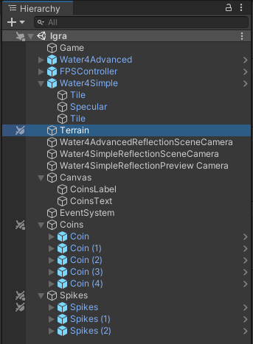
Object >
GameObject

Slide 4
Creation

Slide 5
new GameObject()
new GameObject("Bullet")
new GameObject("Bullet",
typeof(RigidBody),
typeof(SphereCollider),
typeof(MeshRenderer),
typeof(MeshFilter),
typeof(Bullet)
)

Slide 6
GameObject.CreatePrimitive(PrimitiveType.Plane);
PrimitiveType.Sphere
.Capsule
.Cylinder
.Cube
.Plane
.Quad

Slide 7
Active

Slide 8

gameObject.activeSelf
READ-ONLY
gameObject.SetActive(bool value)

Slide 9
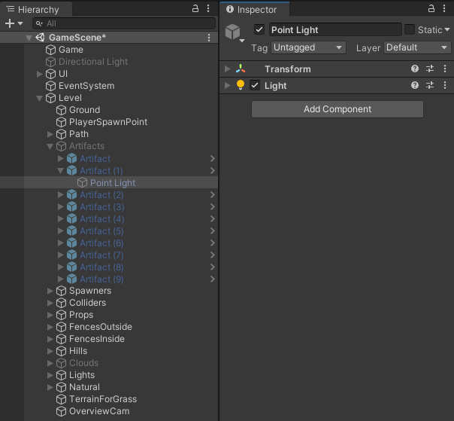
gameObject.activeSelf
gameObject.activeInHierarchy

Slide 10
Tags

Slide 11
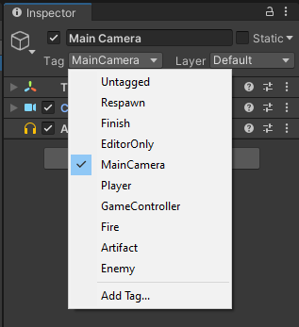
gameObject.tag

Slide 12
gameObject.tag = "Tag, you're it!"
MUST BE DEFINED

Slide 13
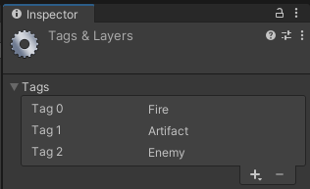

Slide 14
?

Slide 15
10001
IT'S OVER 9000!

Slide 16
gameObject.tag == "Player"
gameObject.CompareTag("Player")

Slide 17
Finding stuff

Slide 18
GameObject.FindWithTag("GameManager")
GameObject.FindGameObjectsWithTag("Artifact")

Slide 19
GameObject.Find("GameManager")
GameObject.Find("Characters/Player")
GameObject.Find("/Characters/Player")

Slide 20
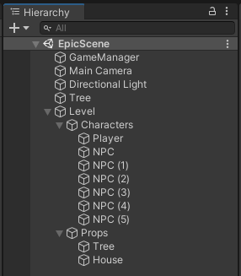

Slide 21
Components

Slide 22
gameObject.AddComponent<AudioSource>()
gameObject.AddComponent(typeof(AudioSource))

Slide 23
gameObject.GetComponent<AudioSource>()
gameObject.GetComponents<AudioSource>()
AudioSource as; gameObject.TryGetComponent<AudioSource>(out as)

Slide 24
gameObject.GetComponentInChildren<Light>();
gameObject.GetComponentsInChildren<Light>();
gameObject.GetComponentInParent<Light>();
gameObject.GetComponentsInParent<Light>();

Slide 25
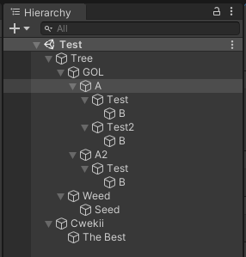

Slide 26
GetComponents

Slide 27
GetComponents
GetComponentsInChildren

Slide 28
GetComponents
GetComponentsInChildren
GetComponentsInParent

Slide 29
Messages

Slide 30
gameObject.SendMessage("EndGame");
gameObject.SendMessage("TakeDamage", 5);
gameObject.SendMessage("PlayMusic",
0.8,
SendMessageOptions.RequireReceiver
);

Slide 31
gameObject.SendMessage("FlyUp");
gameObject.BroadcastMessage("ArtifactDestroy");
gameObject.SendMessageUpwards("OnArtifactCollected");

Slide 32
SendMessage
BroadcastMessage
SendMessageUpwards

Slide 33
Misc

Slide 34
gameObject.transform
transform
AKA

Slide 35
gameObject.scene

Slide 36
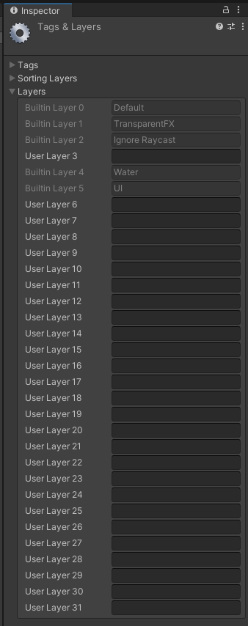
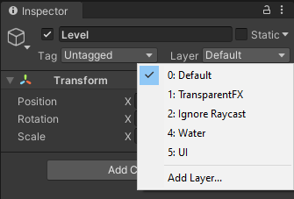
gameObject.layer

Slide 37
gameObject.isStatic

Slide 38
KRAJ

