Slide 1
Scene Management

Slide 2
Što je Scene Management?
Što je scena?
Scene Management (library):
- CreateSceneParameters
- LoadSceneParemeters
- Scene
- SceneManager
- SceneManagerAPI
- SceneUtility

Slide 3
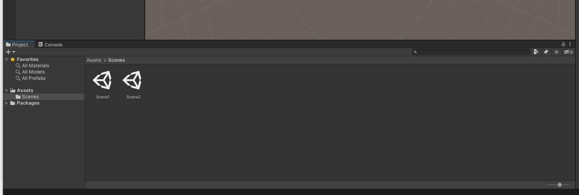
Stvaranje scene…

Slide 4
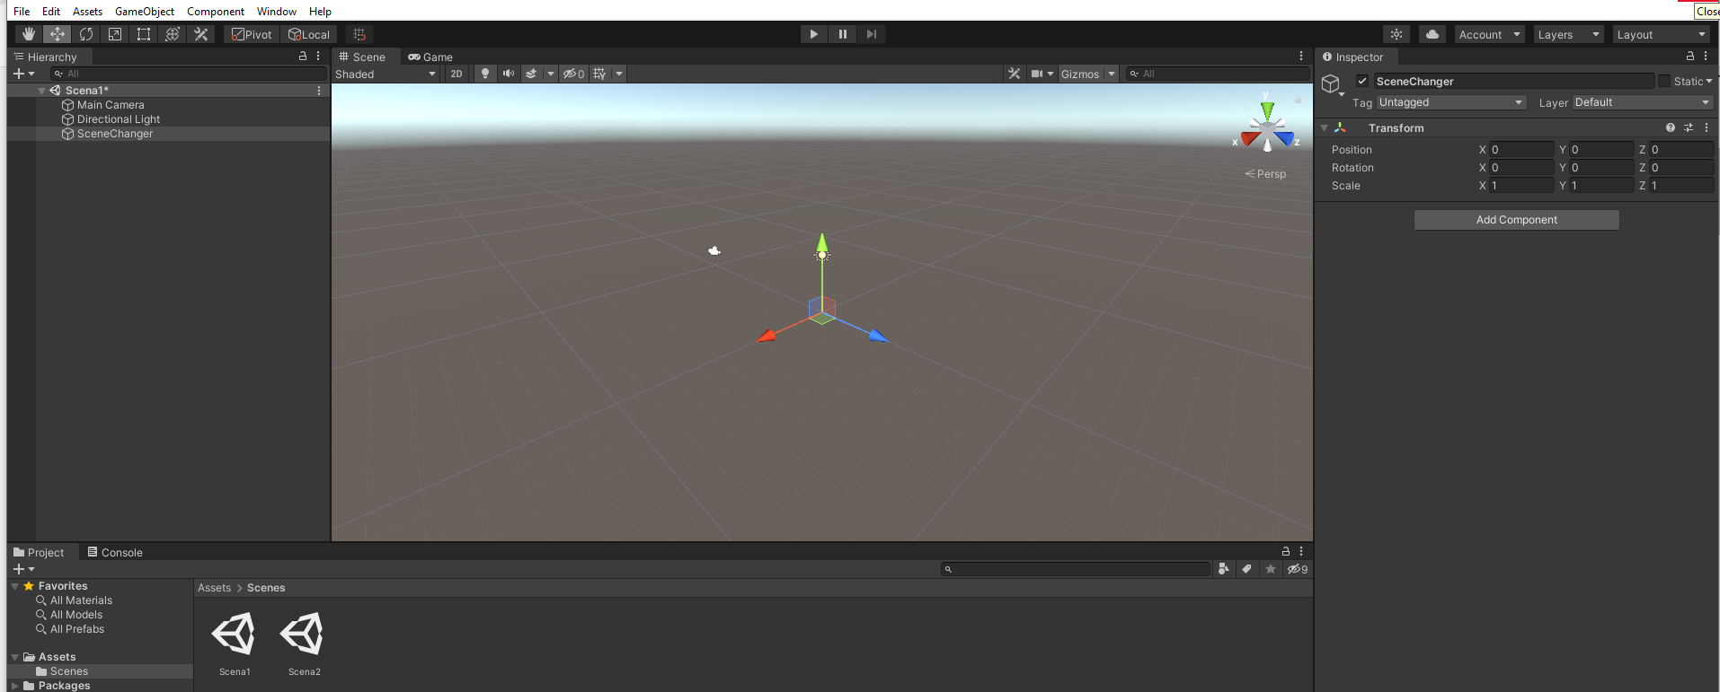
Stvaranje SceneChanger objekta i Prefab

Slide 5
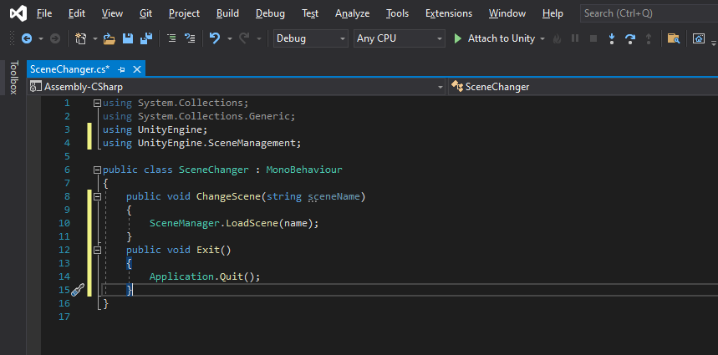

Slide 6
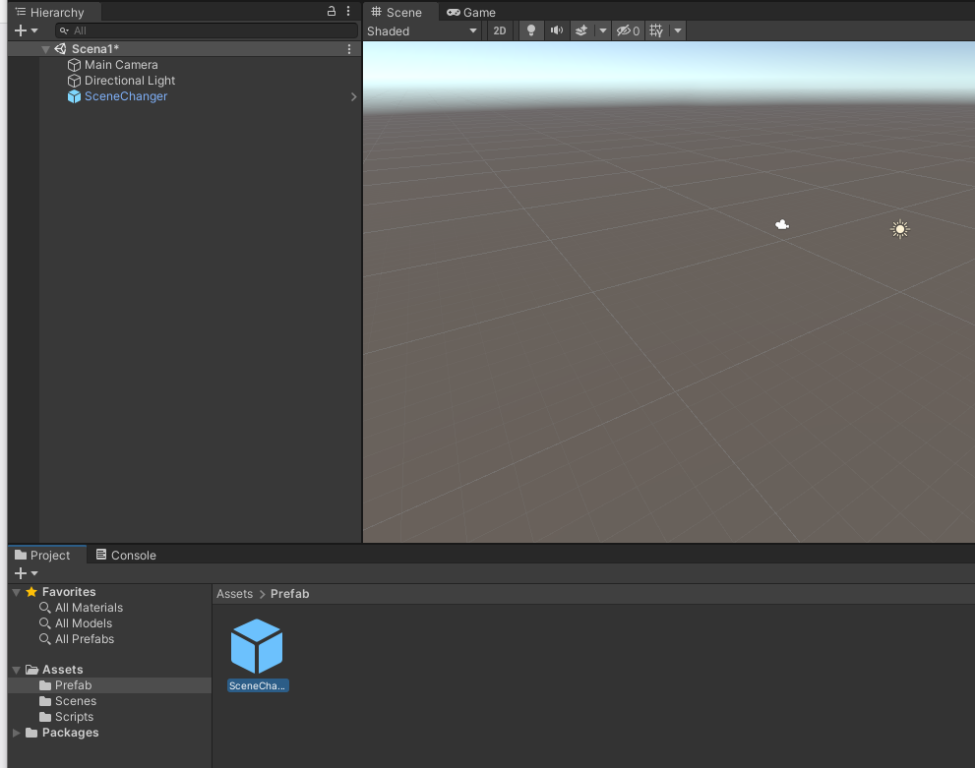

Slide 7
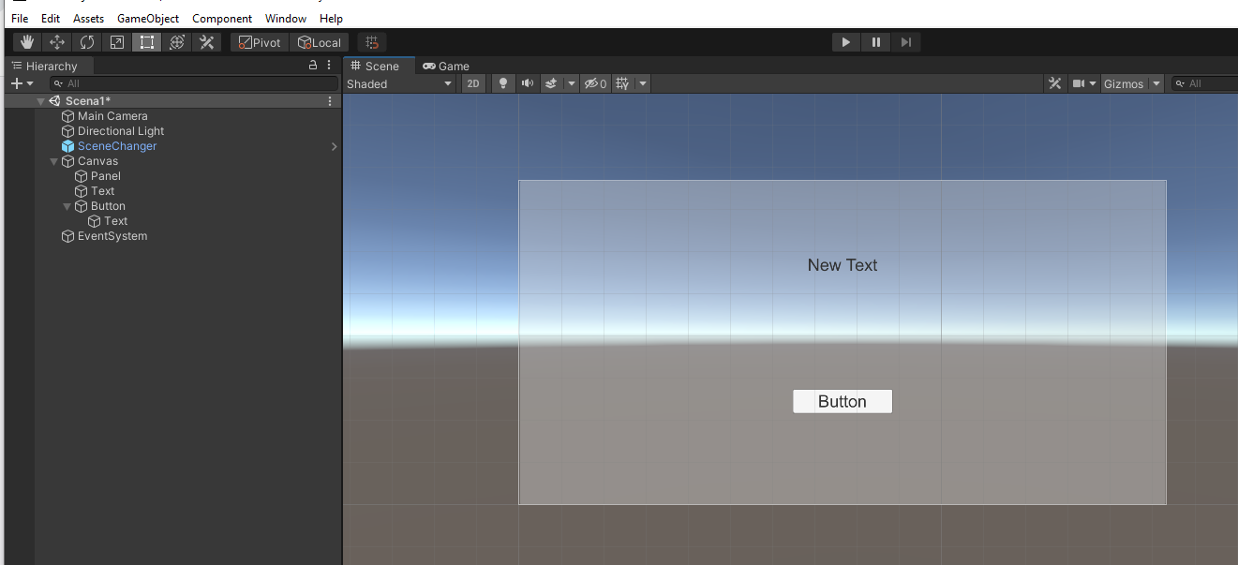
Stvaranje UI

Slide 8
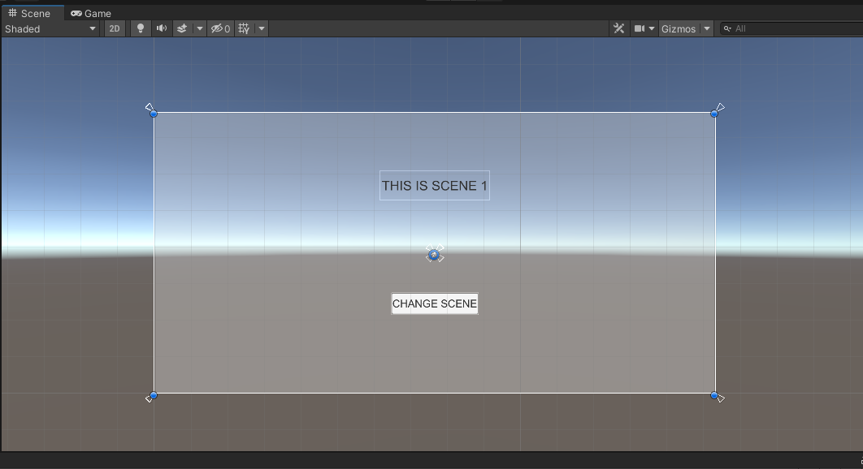

Slide 9


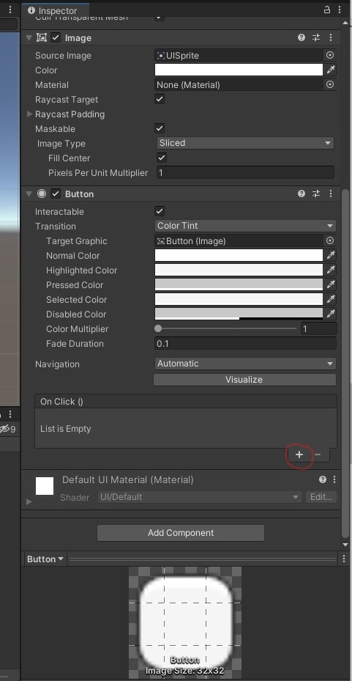

Slide 10
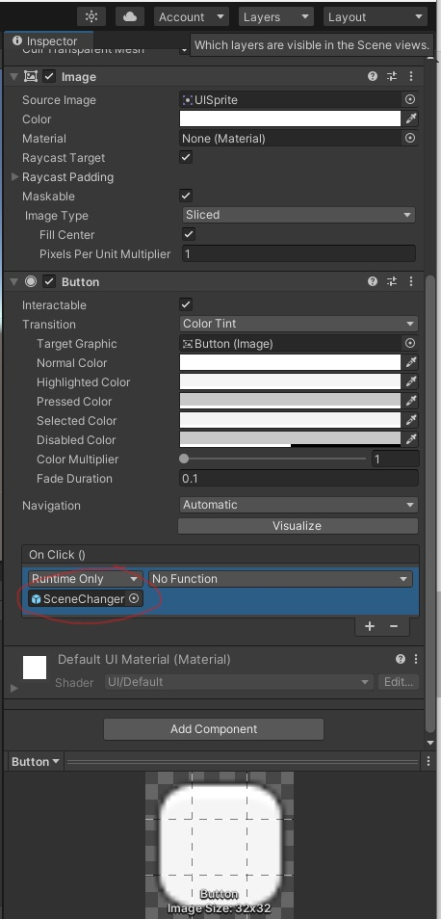

Slide 11
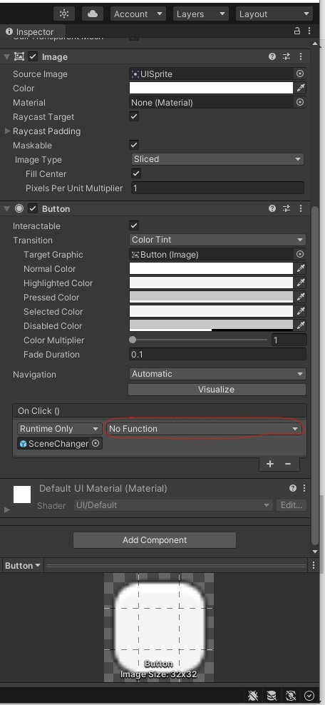

Slide 12
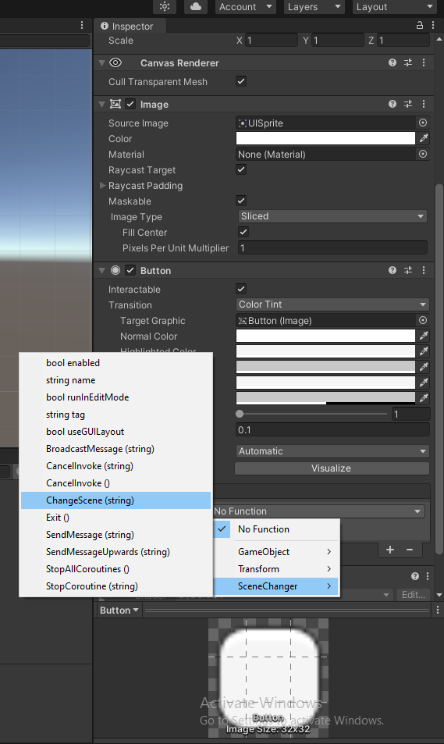

Slide 13
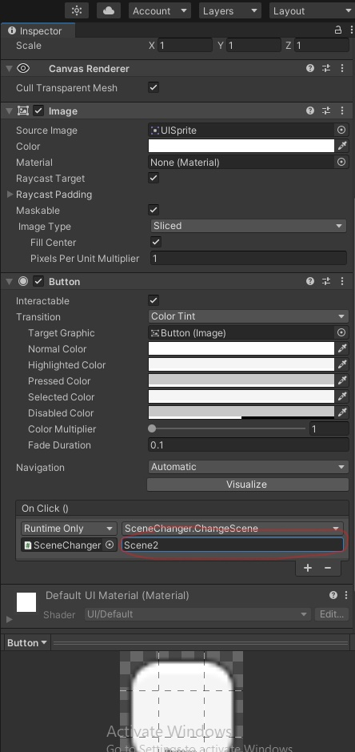

Slide 14
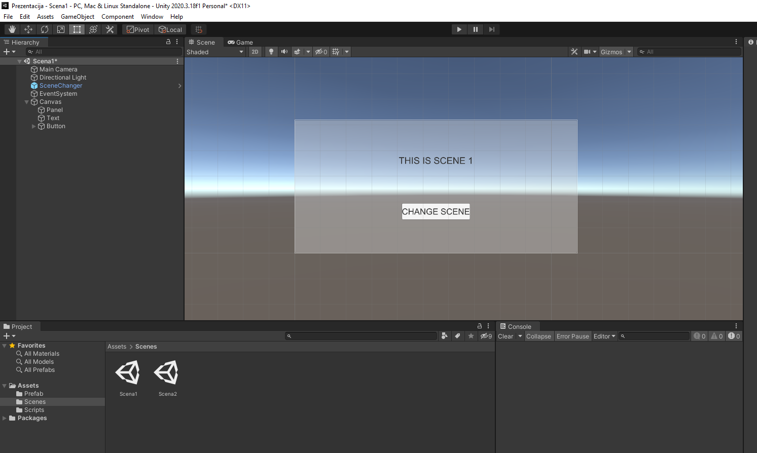

Slide 15


Slide 16


Slide 18


Slide 19


Slide 20


Slide 21


Slide 22


Slide 24
Scene manager
Static Properties:
sceneCount
sceneCountInBUild

Slide 25
Static Methods:
CreateScene
GetActiveScene
GetSceneAt
GetSceneByBuildIndex
GetSceneByName
GetSceneByPath
LoadScene
LoadSceneAsync
MergeScenes
MoveGameObjectToScene
SetActiveScene
UnloadSceneAsync

Slide 26
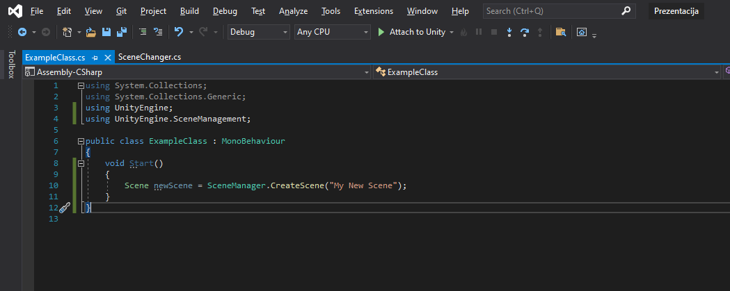
CreateScene(string sceneName);

Slide 27
Static Methods:
CreateScene
GetActiveScene
GetSceneAt
GetSceneByBuildIndex
GetSceneByName
GetSceneByPath
LoadScene
LoadSceneAsync
MergeScenes
MoveGameObjectToScene
SetActiveScene
UnloadSceneAsync

Slide 28
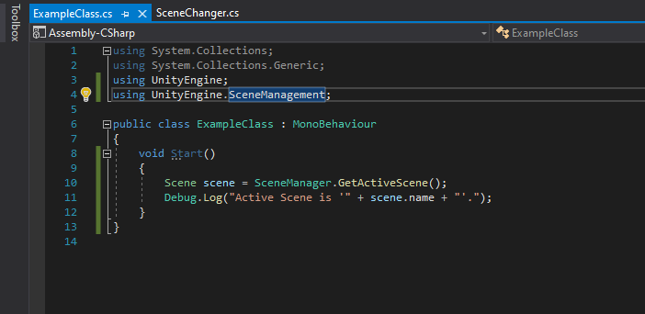
GetActiveScene();

Slide 29
Static Methods:
CreateScene
GetActiveScene
GetSceneAt
GetSceneByBuildIndex
GetSceneByName
GetSceneByPath
LoadScene
LoadSceneAsync
MergeScenes
MoveGameObjectToScene
SetActiveScene
UnloadSceneAsync

Slide 30
GetSceneAt(int index);

Slide 31
Static Methods:
CreateScene
GetActiveScene
GetSceneAt
GetSceneByBuildIndex
GetSceneByName
GetSceneByPath
LoadScene
LoadSceneAsync
MergeScenes
MoveGameObjectToScene
SetActiveScene
UnloadSceneAsync

Slide 32
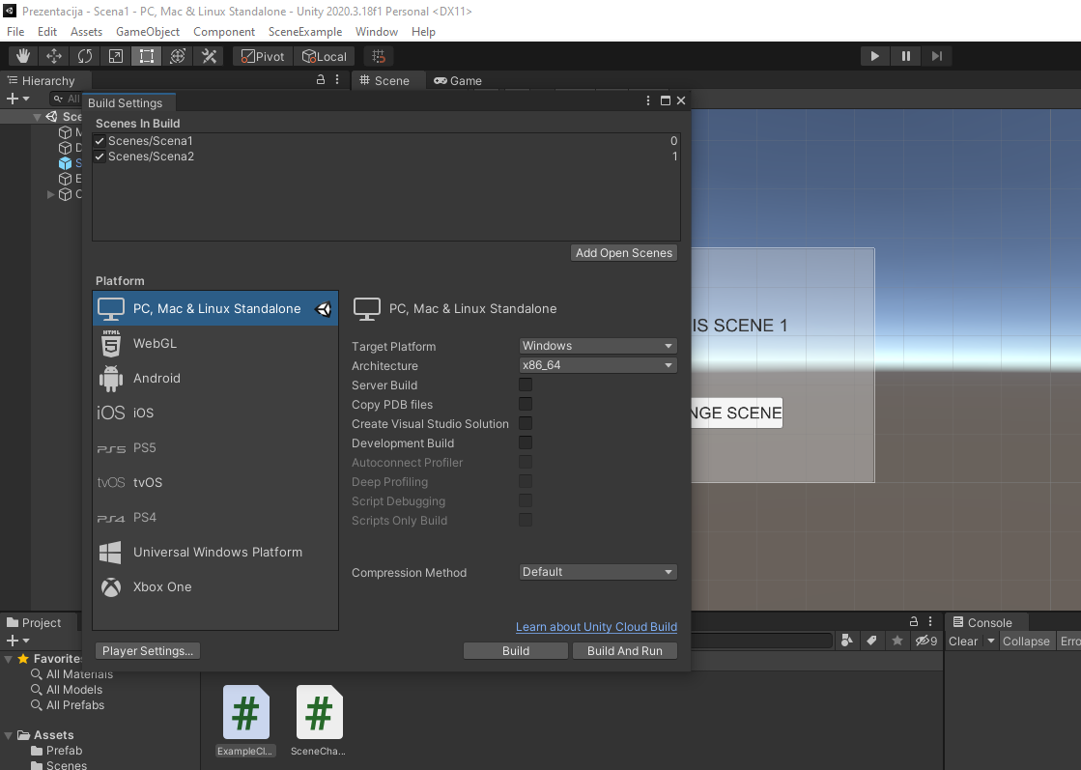
GetSceneByBuildIndex(int buildIndex);

Slide 33
Static Methods:
CreateScene
GetActiveScene
GetSceneAt
GetSceneByBuildIndex
GetSceneByName
GetSceneByPath
LoadScene
LoadSceneAsync
MergeScenes
MoveGameObjectToScene
SetActiveScene
UnloadSceneAsync

Slide 34
GetSceneByName(string name);

Slide 35
Static Methods:
CreateScene
GetActiveScene
GetSceneAt
GetSceneByBuildIndex
GetSceneByName
GetSceneByPath
LoadScene
LoadSceneAsync
MergeScenes
MoveGameObjectToScene
SetActiveScene
UnloadSceneAsync

Slide 36
GetSceneByPath(string scenePath);
npr. „Assets/MyScenes/MyScene.unity”.

Slide 37
Static Methods:
CreateScene
GetActiveScene
GetSceneAt
GetSceneByBuildIndex
GetSceneByName
GetSceneByPath
LoadScene
LoadSceneAsync
MergeScenes
MoveGameObjectToScene
SetActiveScene
UnloadSceneAsync

Slide 38
LoadScene(int sceneBuildIndex);
LoadScene(string sceneName);
- next frame

Slide 39
Static Methods:
CreateScene
GetActiveScene
GetSceneAt
GetSceneByBuildIndex
GetSceneByName
GetSceneByPath
LoadScene
LoadSceneAsync
MergeScenes
MoveGameObjectToScene
SetActiveScene
UnloadSceneAsync

Slide 40
LoadSceneAsync(string sceneName);
LoadSceneAsync(int sceneBuildIndex);

Slide 41
Static Methods:
CreateScene
GetActiveScene
GetSceneAt
GetSceneByBuildIndex
GetSceneByName
GetSceneByPath
LoadScene
LoadSceneAsync
MergeScenes
MoveGameObjectToScene
SetActiveScene
UnloadSceneAsync

Slide 42
MergeScenes(sourceScene, destinationScene);

Slide 43
Static Methods:
CreateScene
GetActiveScene
GetSceneAt
GetSceneByBuildIndex
GetSceneByName
GetSceneByPath
LoadScene
LoadSceneAsync
MergeScenes
MoveGameObjectToScene
SetActiveScene
UnloadSceneAsync

Slide 44
MoveGameObjectToScene(GameObject go, SceneManagement.Scene scene);

Slide 45
Static Methods:
CreateScene
GetActiveScene
GetSceneAt
GetSceneByBuildIndex
GetSceneByName
GetSceneByPath
LoadScene
LoadSceneAsync
MergeScenes
MoveGameObjectToScene
SetActiveScene
UnloadSceneAsync

Slide 46
SetActiveScene(SceneManagement.Scene scene);

Slide 47
Static Methods:
CreateScene
GetActiveScene
GetSceneAt
GetSceneByBuildIndex
GetSceneByName
GetSceneByPath
LoadScene
LoadSceneAsync
MergeScenes
MoveGameObjectToScene
SetActiveScene
UnloadSceneAsync

Slide 48
UnloadSceneAsync(int sceneBuildIndex);
UnloadSceneAsync(string sceneName);

Slide 49
Events:
activeSceneChanged
sceneLoaded
sceneUnloaded

Slide 50
The end

