Slide 1


Emotional Support Platform
https://github.com/Domy-MANS/Us
Emotional Support Platform - Us

Slide 2
Emotional Support Platform
https://github.com/Domy-MANS/Us
Idea
Action
AI
Research
Conclusion

Slide 3
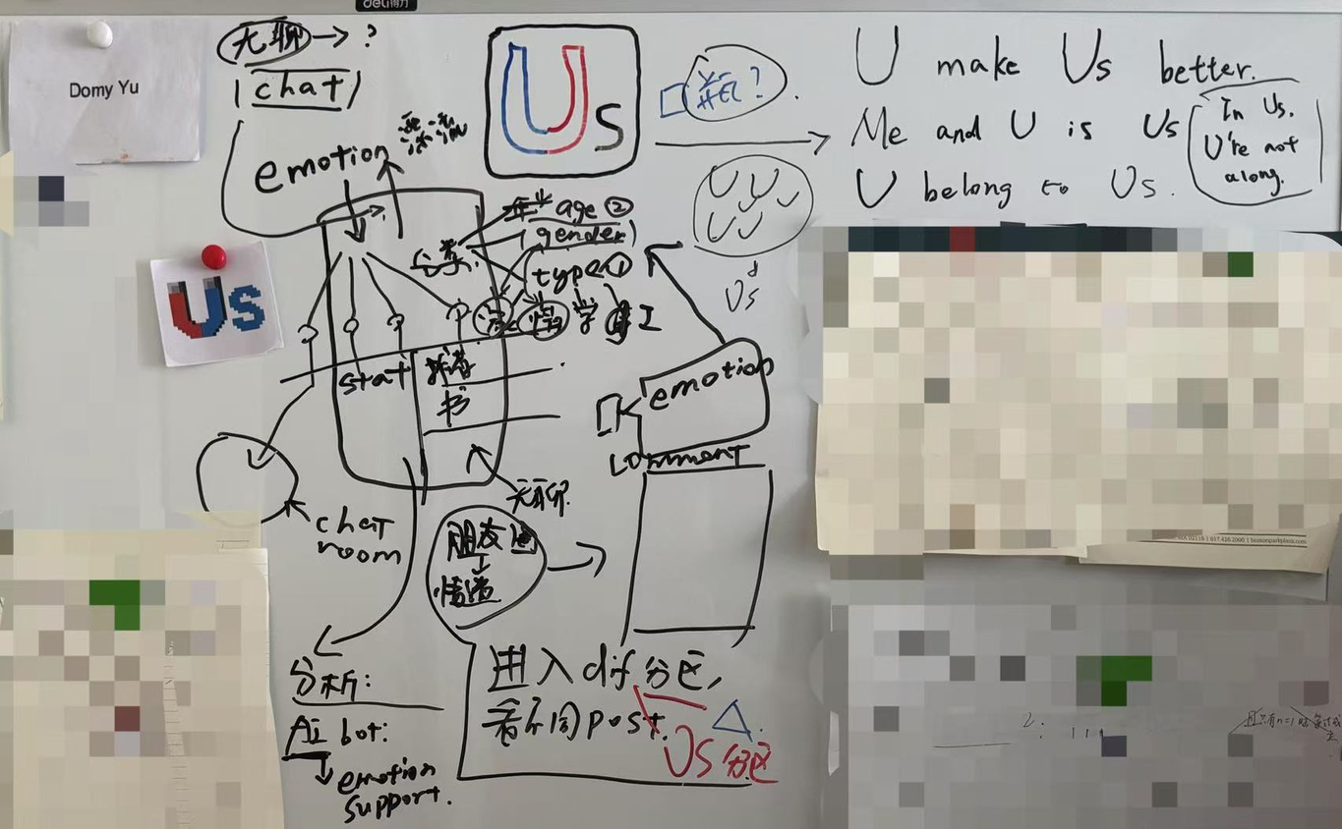
Emotional Support Platform
https://github.com/Domy-MANS/Us

Slide 4
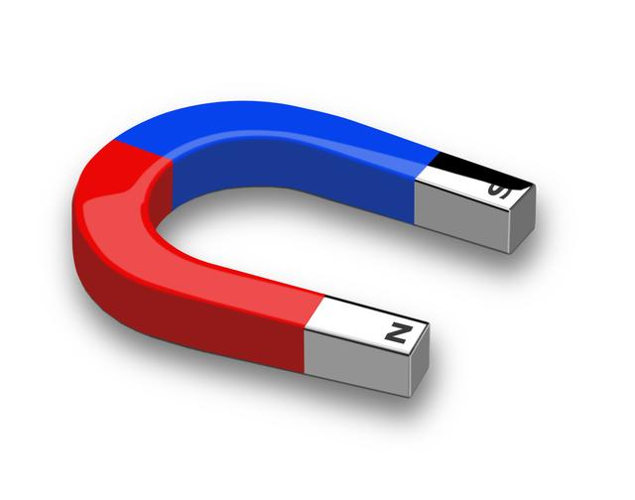
Emotional Support Platform
https://github.com/Domy-MANS/Us
Us is many U.
Us focus on U.
Us can help U.
U can help Us.
U belong to Us.

Slide 5
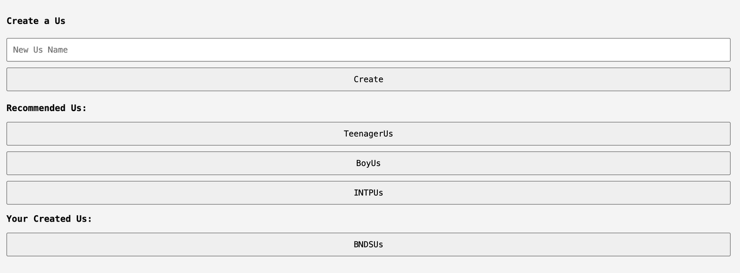
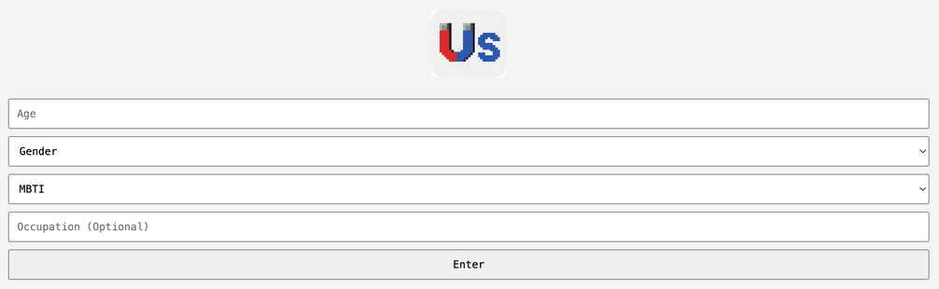
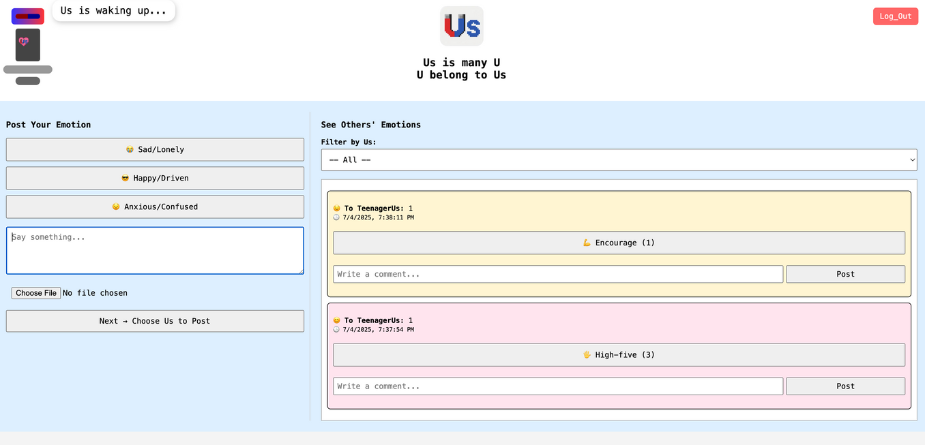
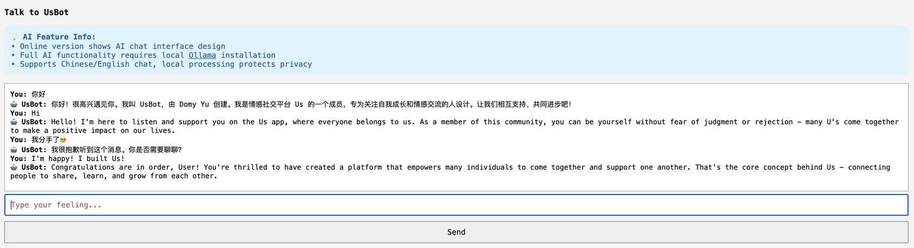
FindUs
Emotional Support Platform
https://github.com/Domy-MANS/Us
Login
SeeU
HelpU

Slide 6
Emotional Support Platform
https://github.com/Domy-MANS/Us
Try Us on Github:
https://github.com/Domy-MANS/Us

Slide 7
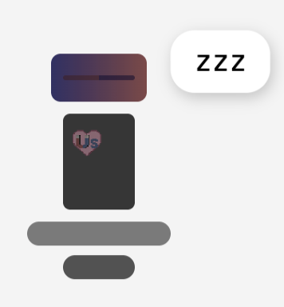

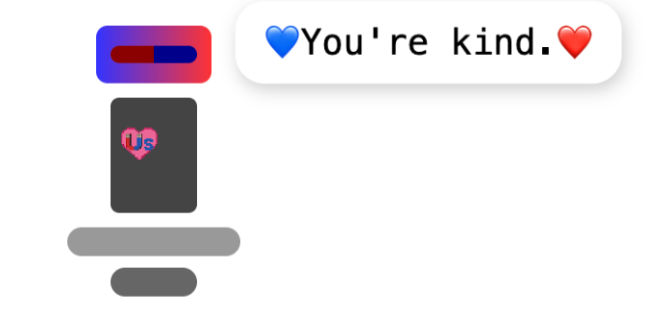
Emotional Support Platform
https://github.com/Domy-MANS/Us
Embodied AI Agent - UsBot
CSS
JS
Ollama
Huggingface
OpenAI

Slide 8
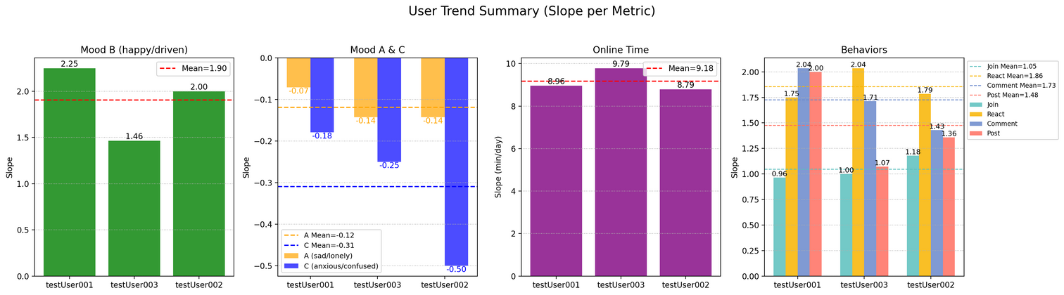
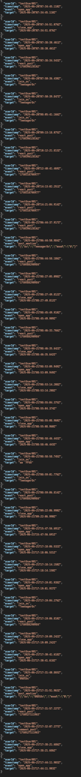

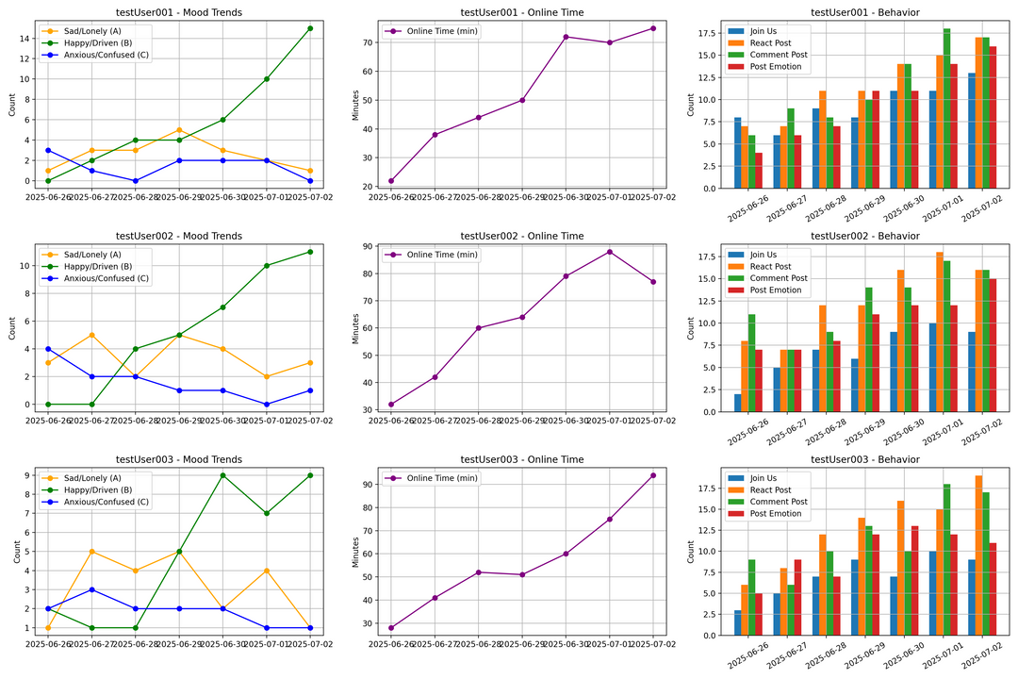
Emotional Support Platform
https://github.com/Domy-MANS/Us
Simulated
Real

Slide 9
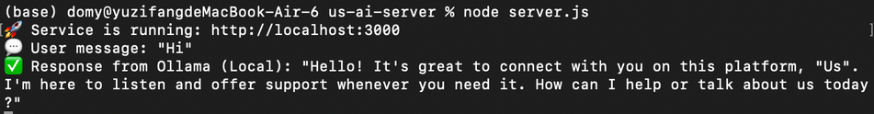
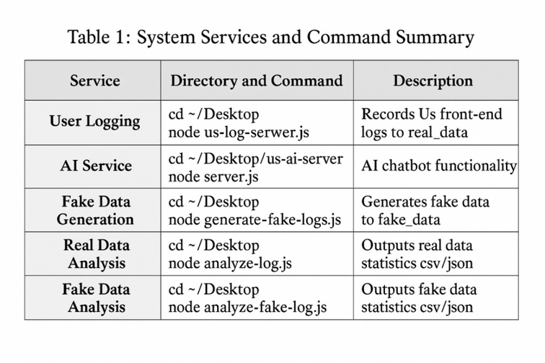
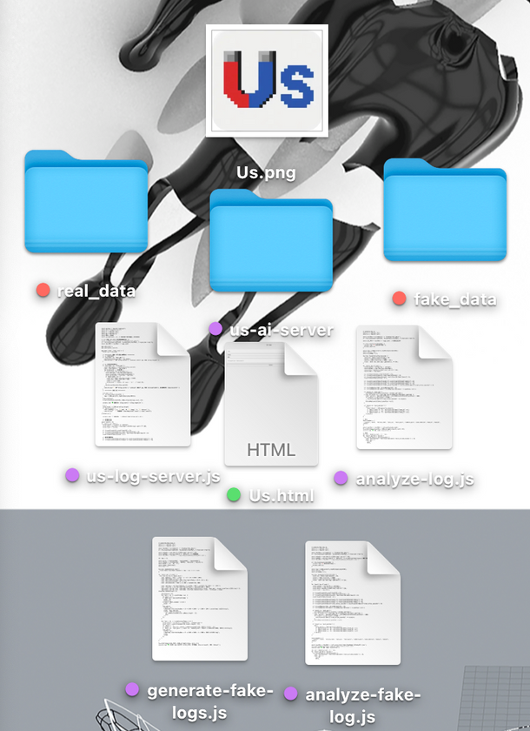
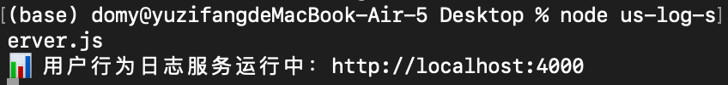
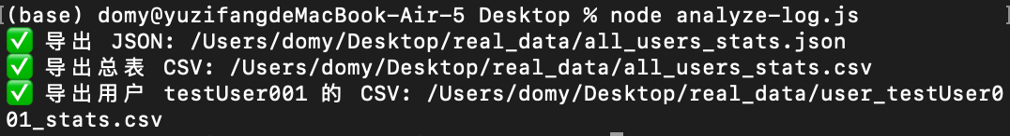
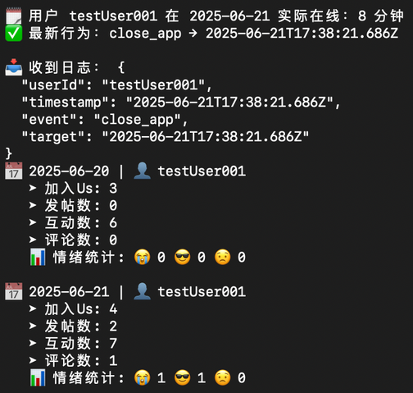
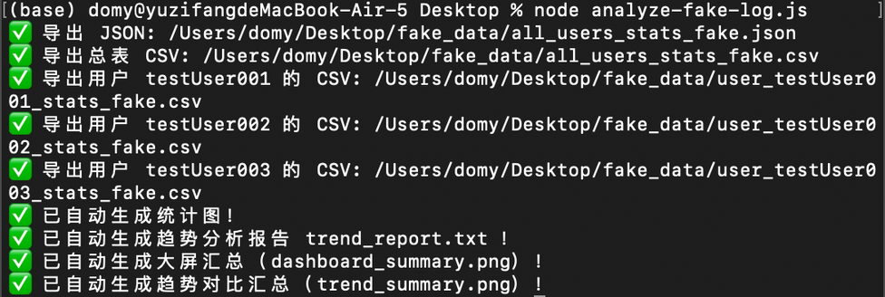
Emotional Support Platform
https://github.com/Domy-MANS/Us

Slide 10

Emotional Support Platform
https://github.com/Domy-MANS/Us
:Thank U.

