Slide 1

COMP 4900 - PROJECTS PRACTICUM
TEAM 04 - PROJECT 052 Alex Bai
Harold (Hu Hyung) Lee
Tommy Tran
Stanley Chu
Notes:
Alex

Slide 2
INTRODUCTION
We aim to deliver a web application solution for researchers specializing in plant/crop data to easily manage and observe their own information.
A challenge with the creation of this tool is the complexity behind integrating open source softwares (GMOD components) with a multitude of varying requirements for configuration.
No knowledge of plant genomics and how to parse and interpret large data files.
Notes:
Alex

Slide 3
CLIENT
Who is our client?
Richard Bruskiewich (CEO of Delphinai Corp/STAR Informatics) partnered with Dr. Loren Rieseberg (UBC Professor).
Government of Canada (Pending funding for continuance of project)
Notes:
Alex

Slide 4
SOLUTION
Project started from scratch, no previous documentation, information, or similar industry prototypes
Application’s individual software components stored in Docker containers sitting within a Vagrant environment
Utilized Vagrant, Docker, Tripal, JBrowse, PHP, Javascript
Notes:
Alex

Slide 5
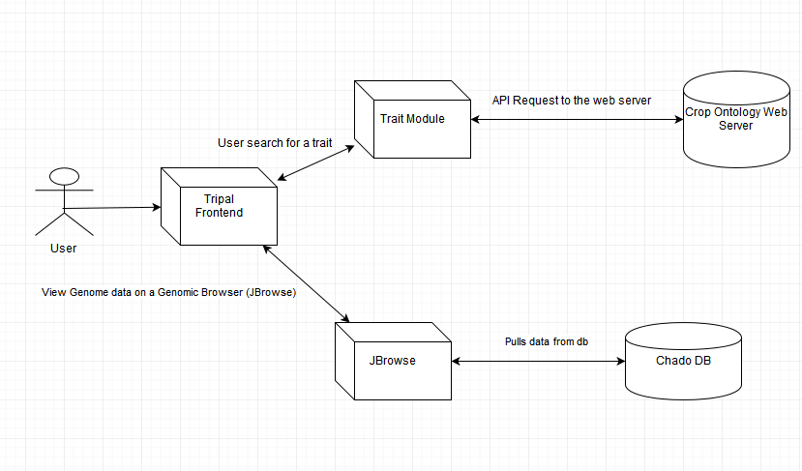
System Architecture
Notes:
Stanley

Slide 6
LIVE DEMONSTRATION
Notes:
Stanley

Slide 7
Auto-installation Script
Reasons why we created a script:
No knowledge of Linux commands needed for the end users.
Zero complications
Easy to run.
Easy to update and configure.
Notes:
Tommy

Slide 8
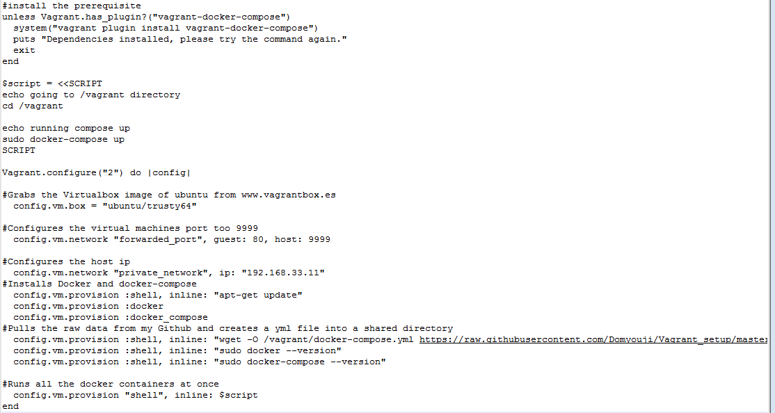
Auto-installation Script
Notes:
Tommy

Slide 9
TECHNOLOGIES USED
Components:
Vagrant environment, Docker
Tripal front end, Chado Database, Jbrowse and PHP Trait Query Search module
Value of Project:
Portable and interchangeable deployment of specific softwares
Does not require a running server
Makes crop information much more accessible and convenient to manage
Notes:
Tommy

Slide 10
TECHNICAL ISSUES/CHALLENGES
Developing the automation script
Configuring vagrant and docker along with it’s many back end pre-requisites.
Difficult to interpret and categorize complex plant/crop data with no prior knowledge of subject
Notes:
Stanley

Slide 11
PROJECT MANAGEMENT ISSUES/CHALLENGES
Little guidance on project, therefore delegation of tasks were not as efficient and productive as it could have been
Big component of project time was dedicated to research over development
Ambiguous on project deliverable for first few weeks due to switching of end product requirements from client
Notes:
Stanley

Slide 12
TEAM/CLIENT ISSUES/CHALLENGES
Poor communication and inability to arrange face to face meetings became a big challenge when trying to get feedback on desired end product
Development on a linux environment provided unique challenges when troubleshooting
Notes:
Stanley

Slide 13
Roles
Accomplished
Improvement required
Not accomplished
Name | Role
All | Vagrant environment & Docker installation
Alex | Working instance of Chado Relational Database schema JBrowse
Harold | Trait module
Stanley | Tripal implementation
Tommy | Automation script Passing data over docker containers
Notes:
Stanley

Slide 14
What did we take away from this project for the next one?
Technical skills
Learning new tools (e.g. Vagrant, Docker etc.)
Development experience on linux environment
Linux commands, script writing, automation, researching technologies
Lessons
Time management
Communication with client
Notes:
Harold

Slide 15
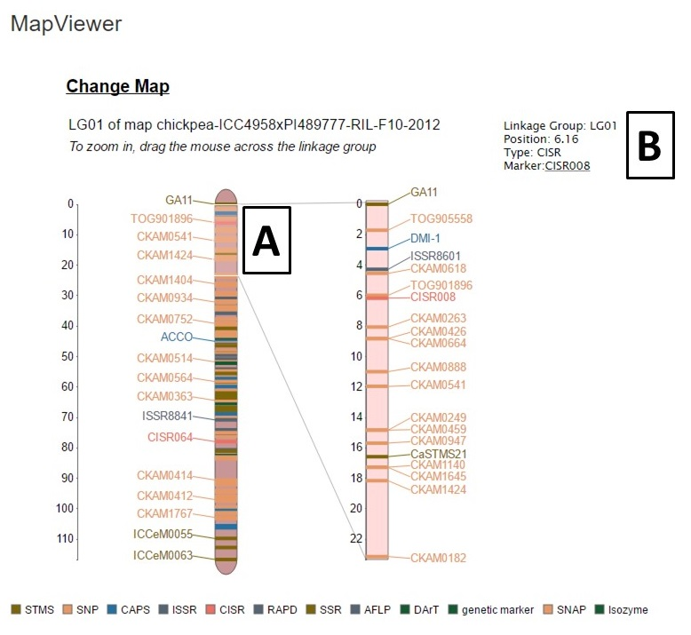
Future work
Connect docker containers with PostgreSQL and import Chado DB schema
Installing QTL(Quantitative Trait Loci) tool or implement QTL.
Notes:
Harold

Slide 16
QUESTIONS/ANSWERS
Notes:
Everyone

