Slide 1

AI Chatbot &
RAG Document Assistant
AI-Powered Conversational and Document Retrieval System
BY
PROJECT
Vaishnav R
Internship Project
TECHNOLOGIES
Groq
LangChain
ChromaDB
Streamlit
HuggingFace

Slide 2
Project Overview
Conversational AI
PDF Document Retrieval
Answer questions naturally through multi-turn conversations
Upload PDFs and extract precise, contextual answers
RAG Architecture
Context-Aware Responses
Retrieval-Augmented Generation for accurate responses
Understands document context and conversation history

Slide 3
Business Problem
Unmanageable Documents
Time-Consuming Search
Large documents are impossible to search manually at scale
Finding relevant info wastes valuable working hours
Repetitive Queries
Lack of Context
Same questions answered repeatedly, reducing productivity
Traditional search misses semantic meaning and relationships

Slide 4
Proposed Solution
User
PDF Upload
Embeddings
ChromaDB
AI Response
Query / Upload
Document Input
HuggingFace
Vector Store
Groq LLM
Key Benefits
Conversational AI assistant
Multi-document support
Semantic document retrieval
Faster information access
Context-aware responses

Slide 5
Task 1 — Basic AI Chatbot
Multi-Turn Conversations
Maintains full conversation context across messages
$ python chatbot.py
AI Chatbot Ready! Type 'exit' to quit.
Conversation Memory
Remembers prior context for coherent dialogue
You: What is RAG?
Groq LLM Integration
AI: RAG stands for Retrieval-
Blazing-fast inference with Groq API
Augmented Generation. It combines
Real-Time Responses
retrieval with generation to
Instant streaming answers to user queries
Adjustable AI Behavior
You: _
Customizable system prompts and temperature

Slide 6
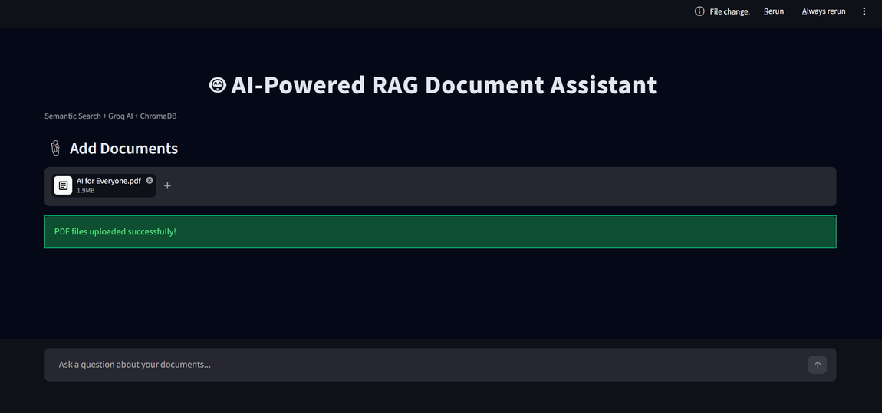
Task 2 — RAG AI Document Assistant
PDF Upload Interface
Semantic Search
ChromaDB Vector DB
Source Chunk Tracking
Multi-Document Retrieval
Streamlit Web Interface
Conversational Memory

Slide 7
Technologies Used
G
Groq
L
LangChain
C
ChromaDB
AI RESPONSE GENERATION
RAG WORKFLOW
VECTOR DATABASE
Ultra-fast LLM inference API for real-time answers
Orchestrates retrieval chains and LLM pipelines
Stores and queries document embeddings efficiently
H
HuggingFace
S
Streamlit
P
Python
EMBEDDING GENERATION
WEB INTERFACE
BACKEND DEVELOPMENT
Semantic text embeddings for document indexing
Rapid web app framework for the AI frontend
Core language powering all system components

Slide 8
Challenges & Solutions
⚠ CHALLENGE
✓ SOLUTION
Slow document retrieval
→
Optimized chunking strategy
Context handling across turns
→
Conversational memory buffer
Dynamic PDF uploads
→
Real-time indexing pipeline
Accurate semantic retrieval
→
Embedding-based semantic search

Slide 9
My Contribution
01
Chatbot Backend
05
PDF Upload System
Developed core chatbot backend logic and conversation handling
Added real-time PDF upload and indexing capability
02
Groq API Integration
06
Source Tracking & Memory
Integrated Groq LLM API for high-speed inference
Enabled chunk-level source tracking and memory
03
RAG Pipeline
07
Futuristic UI Design
Implemented full Retrieval-Augmented Generation pipeline
Designed the dark AI-themed user interface
04
Streamlit Frontend
Built responsive and interactive web UI with Streamlit

Slide 10
Future Improvements
1
Hybrid Retrieval
2
Better Caching
3
Streaming Responses
Combine semantic + lexical search for better accuracy
Smarter caching layer to reduce response latency
Token-level streaming for real-time AI output
4
Voice Input Support
5
Cloud Deployment
6
Advanced Reranking
Speech-to-text interface for voice queries
Deploy on AWS / GCP with auto-scaling support
Cross-encoder reranking for more precise results

Slide 11
Thank You

