Slide 1
School Performance Indicators
Group 3:
How to optimize school performance?
Anabela Silva Berenice Avrard Dominic Crippa João Bernardo Sousa
Notes:
https://colab.research.google.com/drive/11lJCCEH8xC51mR-bJAWPDQt52bcflxIA#scrollTo=QAwBzOChVRu2
15 minutes (strict) + 5 minutes for questions

Slide 2
Table of content
The project
Our idea
Similar research
Data
Knowledge
Visualization
Problem encountered
What we tried and Future ideas
Notes:
Do you see a problem or goal that can be solved or
improved with the data?
– Is it novel?
– Would the solution lead to added value?
– Would it possibly lead to a product?
– Would it lead to economic return?

Slide 3
The project
Answer a problem that could improve something with knowledge acquired from data.
Lectures
Practicals
Application
Notes:
https://www.kaggle.com/aljarah/xAPI-Edu-Data
https://www.kaggle.com/marlonferrari/elearning-student-reactions

Slide 4
Our idea
What we were looking for?
Our motivation
Our target (OUT -> OUT)
Notes:
The nature if

Slide 5
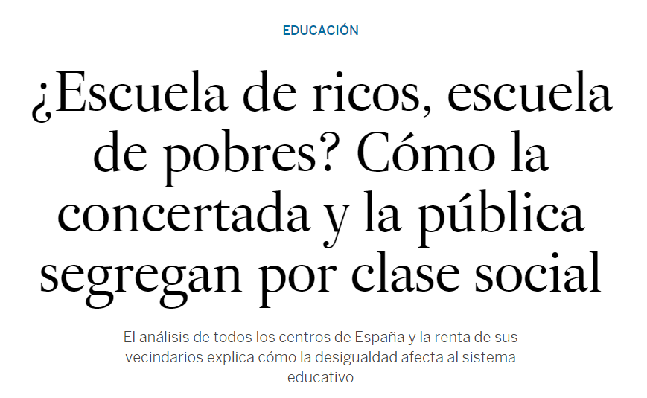


Similar Research
Program for international student assessment
Measure the performance of the education system
High school level lower than ever
The Valencian results are lower than the Spanish average result.
Differences between Public and Private schools
Socioeconomic differences are a serious problem
Notes:
https://www.elmundo.es/opinion/2019/12/04/5de6b2ca21efa0ce7f8b456f.html
https://www.lasprovincias.es/comunitat/informe-pisa-comunitat-valenciana-ocde-20191202213401-nt.html

Slide 6



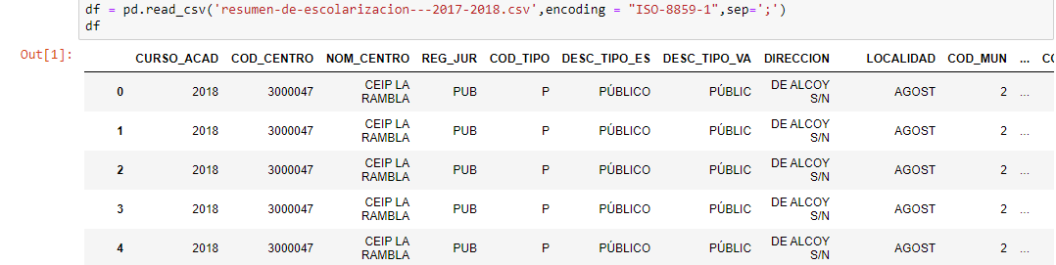
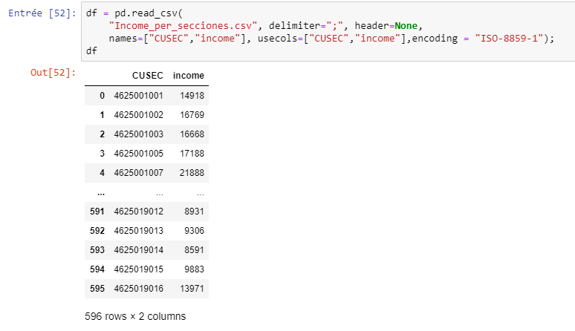
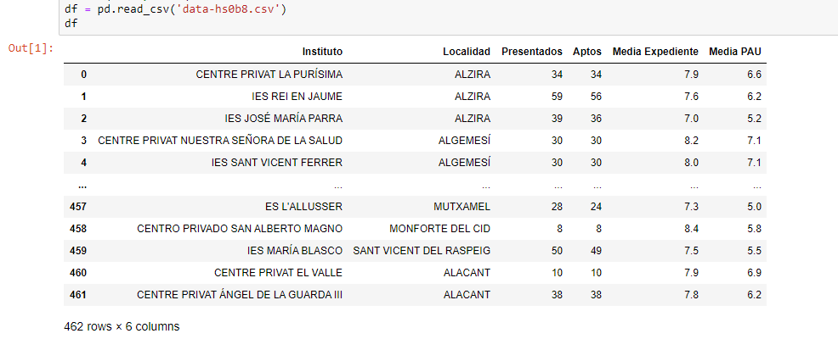
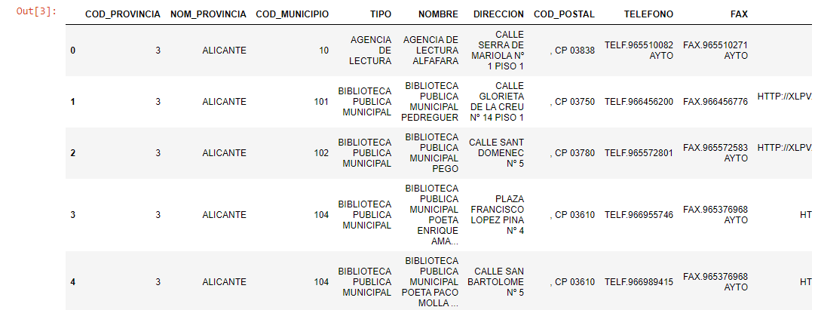
Data
Download external Datas from different websites
Average grade of High schools (Bachillerato)
Type of the school
Libraries in Valencia
Average income per section
Notes:
INE → income, and census sectiones
→ Area of school districts
→ Grades
→ libraries

Slide 7

What Knowledge?
What kind of knowledge we want to extract from these datas:
The type of school influence the grades?
Having libraries close to the school influence the grades?
The income influence the grades?

Slide 8


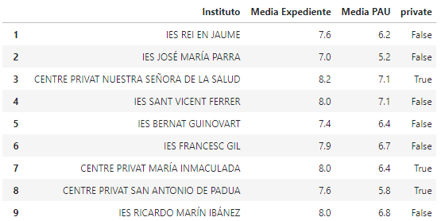
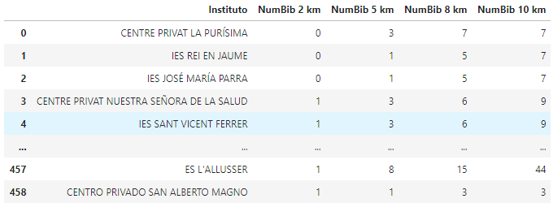
Data
Data
preparation
1. School grades related to its type (Public or Private)
2. Add geographical coordinates (google map)
-Libraries
-Schools
Using a distance function to get the number of libraries radius of the school
Notes:
Anabela
From the data we collect about the school we runned a script that tells us if it is public or private.
From the address of the libraries using google maps we found the coordinates of the schools and of the liraries

Slide 9
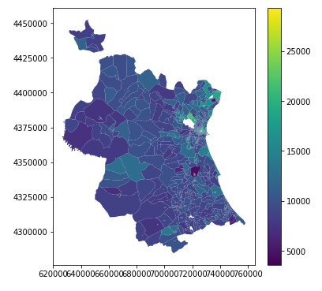
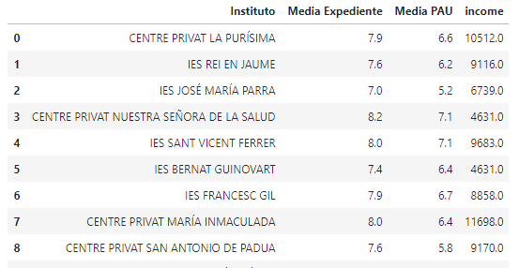
Data
Data
preparation
Mapping and visualizing the income
3. School grades related to the average income of its section
Notes:
Anabela
With the data collect from the INE we cloud construct a map of the income per census section.
using the location of the schools we know in wich section they are located an can as sush see the income.

Slide 10
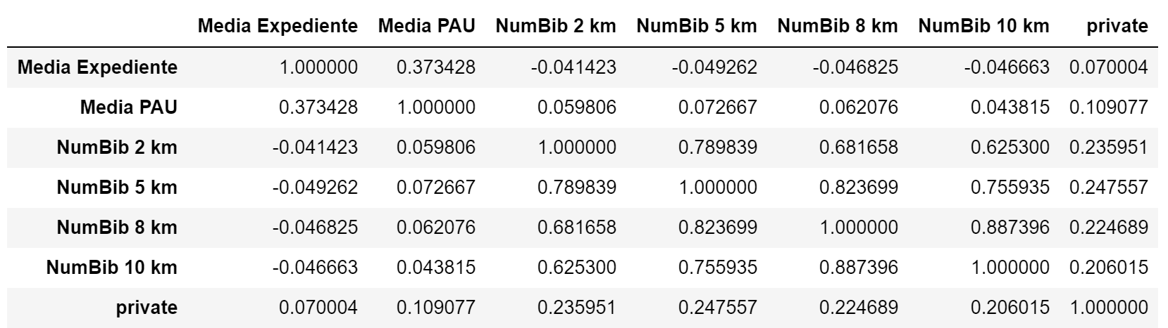
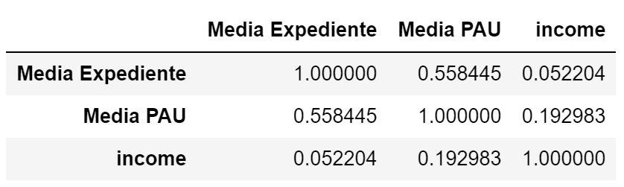
Knowledge
With less data -->
Notes:
close to che school

Slide 11
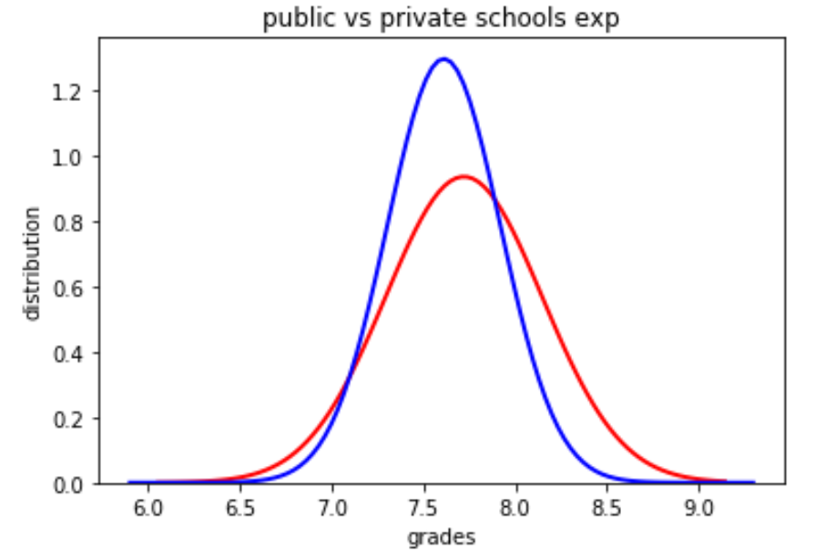
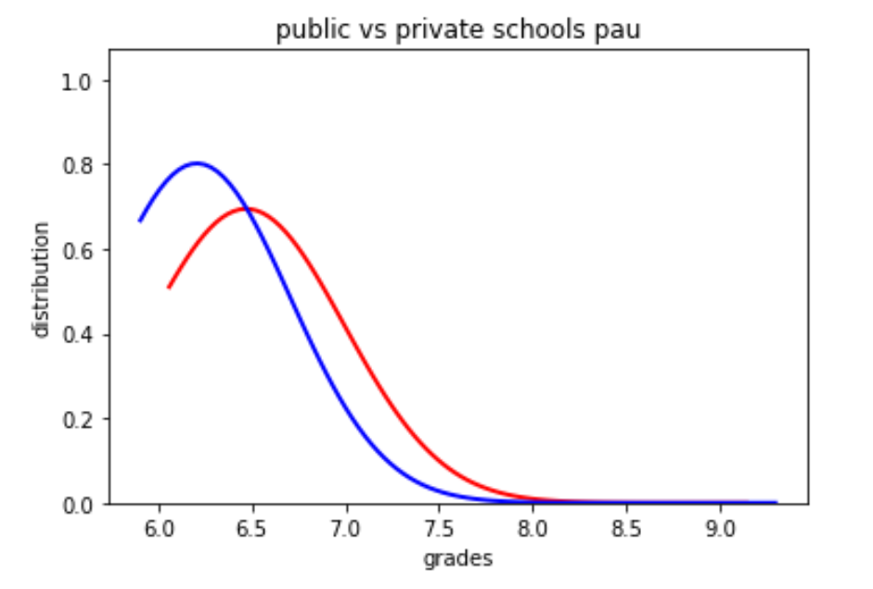
Knowledge
Avg public = 7.6
Avg private = 7.7
Avg public = 6.2
Avg private = 6.5

Slide 12
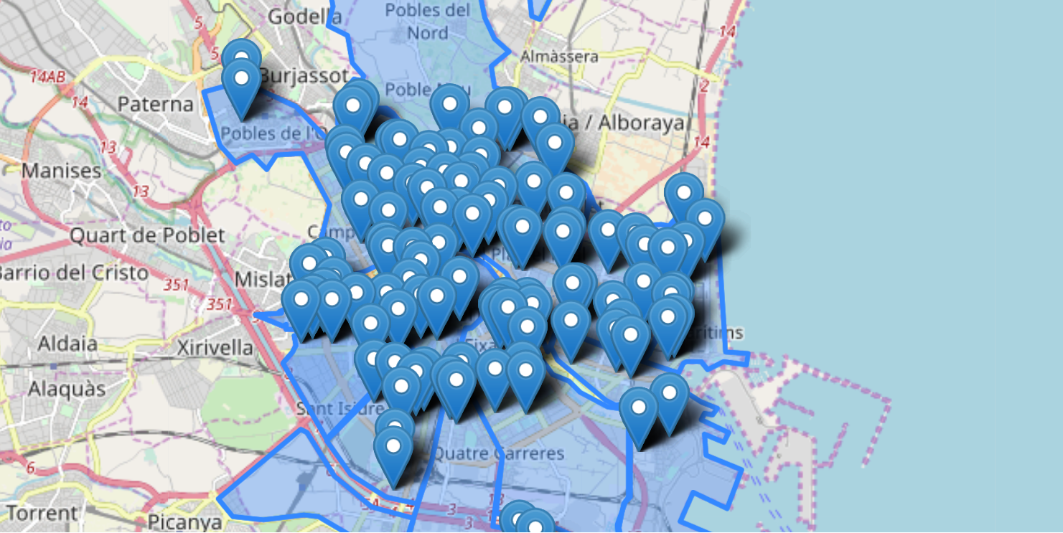
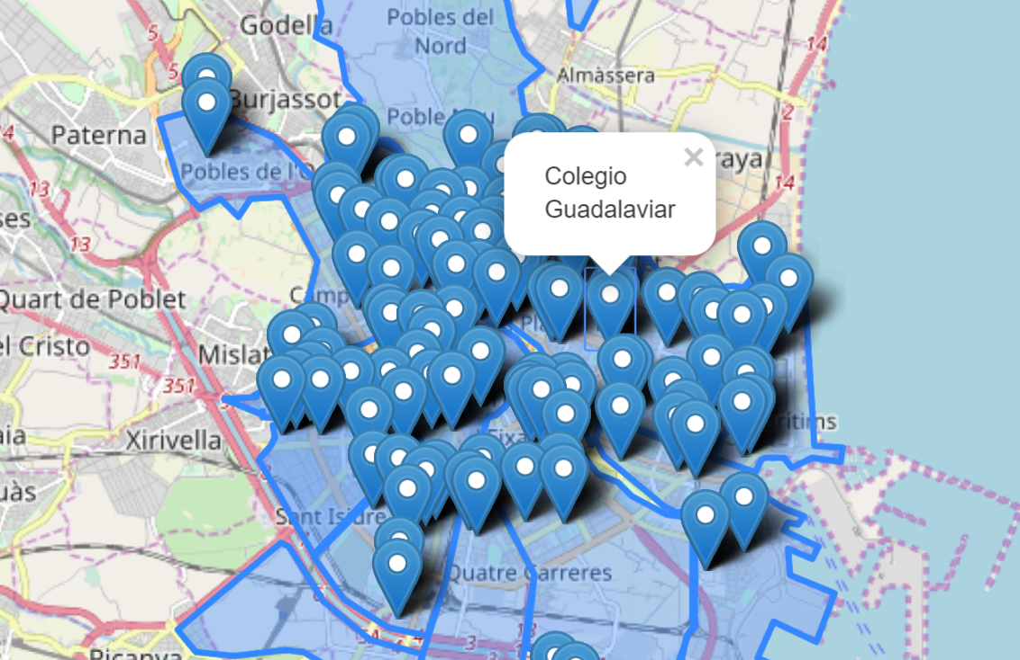
Visualization

Slide 13
Problems encountered
The school system is different compared to our countries.
It was difficult to find data related to education.
The information was stored in different formats
We were not used to working with GeoData.
But we overcome them!

Slide 14
What we tried and Future Ideas
What we tried
We tried to built some predictive models, but without great results
We tried to see the grades differences between the different locations
Ideas
The map with all the schools could be a good tool for parents
A more in-depth analysis can be made among all the schools in Spain
A comparison can be made between the results of several years

Slide 15

Thank you for your attention!
Notes:
https://www.ine.es/jaxiT3/Tabla.htm?t=31250
https://www.lasprovincias.es/sociedad/educacion/ranking-notas-selectividad-20190709230400-nt.html
http://www.ceice.gva.es/documents/161863209/168438192/Estadísticas+Junio+2019/29726ace-20a9-4ccf-910e-1cfc1ae20708

