Slide 1


🎯 Sales Performance Dashboard (Excel Project)
I developed a dynamic and interactive Excel dashboard designed to analyze business performance by tracking total sales, regional and product performance, and sales representative productivity. The dashboard empowers business users to make informed, data-driven decisions through the use of slicers and visual KPIs. This project delivered a powerful, user-friendly tool featuring automated updates and actionable insights to support strategic decision-making.

Slide 2


🛠️ Dashboard Features & Tools Used
The dashboard includes key features such as interactive slicers for filtering by region, product, sales representative, and date; real-time data aggregation through pivot tables and charts; conditional formatting and trendlines for visual emphasis; and dynamic KPI tiles displaying revenue, growth percentage, average order value, and top-performing products. It was built using Microsoft Excel, leveraging tools like PivotTables, Slicers, and Charts, and formulas such as VLOOKUP, IF, SUMIFS, INDEX MATCH, and COUNTIF. The data was sourced from both simulated and real transactional sales records.

Slide 3

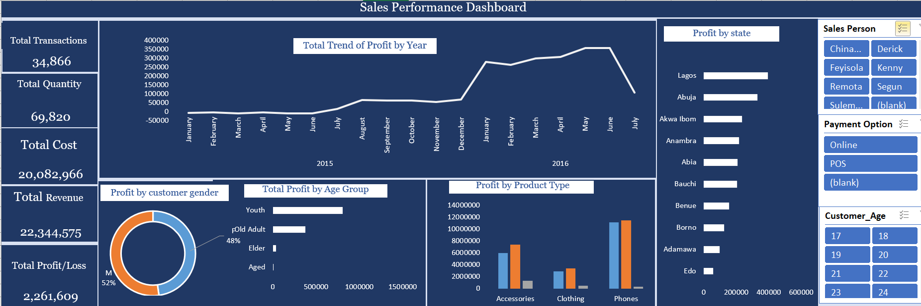
Dashboard

Slide 4

📊 Dashboard Visual Overview
💡 Actionable Insights Gained
📸 Insert Screenshot of Excel Dashboard Here Recommendations: - Highlight key KPI tiles, slicers, and charts - Use a high-resolution image that shows the full layout - Annotate slicers, charts, and values if needed for clarity
Q2 recorded the highest growth (22%) over Q1 Western region underperformed by 18% — recommended targeted marketing Product Line B generated 35% of revenue Top 3 sales reps contributed 60% of overall sales Weekend sales dipped significantly — revised sales team schedules
These insights guided strategy shifts and optimized marketing campaigns.

