Slide 1
IMS Project
By Don Uherka

Slide 2
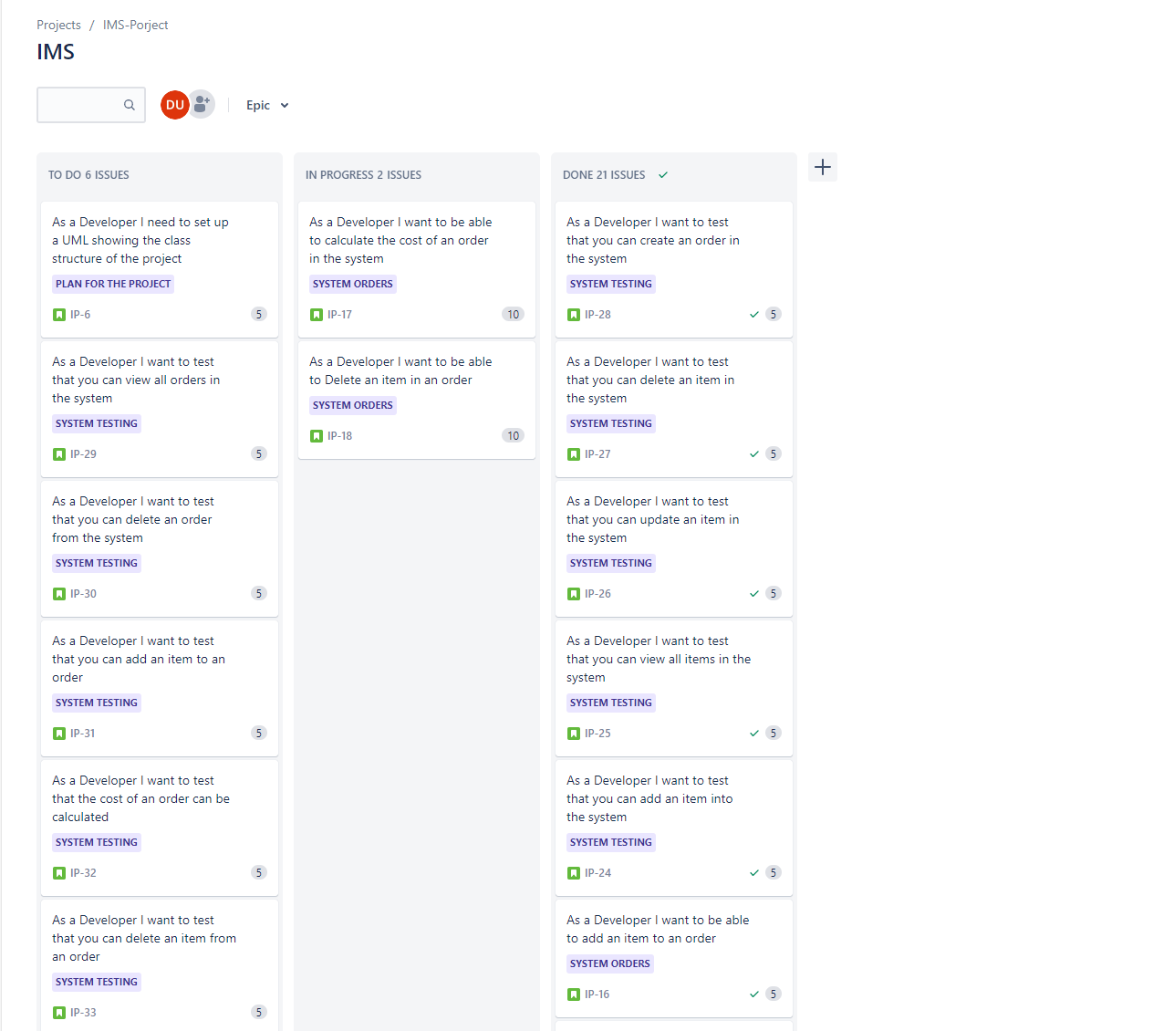
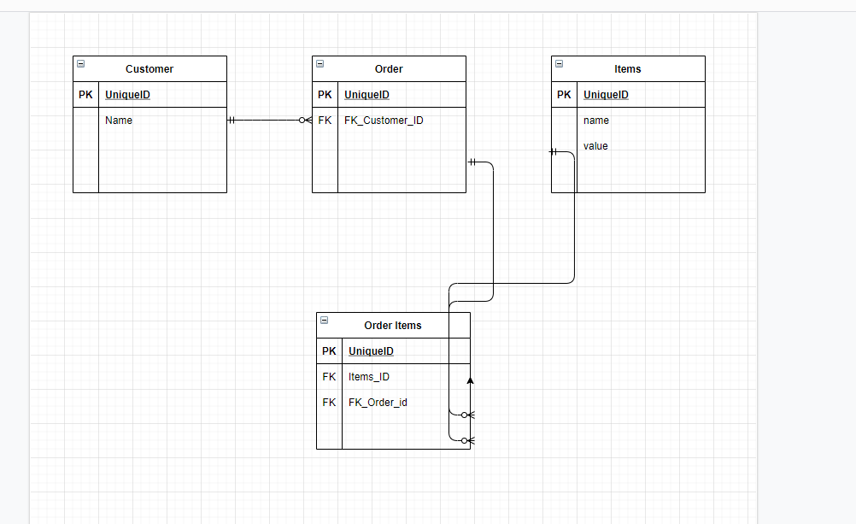
Introduction/Approach
Jira Board
ERD
Starter Project overview

Slide 3
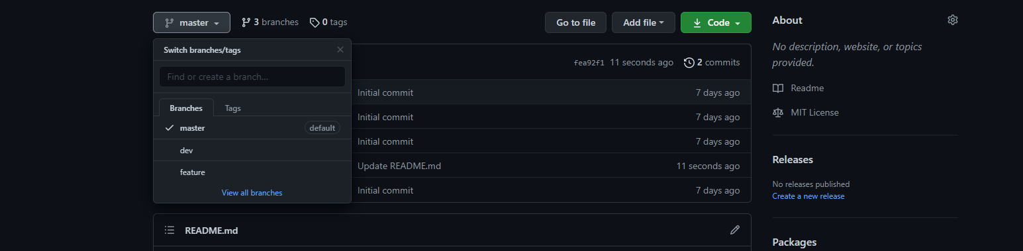
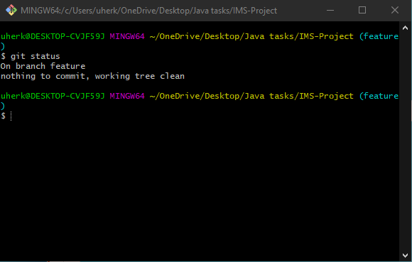
Technologies
Version Control – Git
Code Management – GitHub
Kanban Board – Jira
Database Management system = MySQL Server 5.7 local
Programming Language – Java
Build Tool – Maven
Testing - JUnit

Slide 4
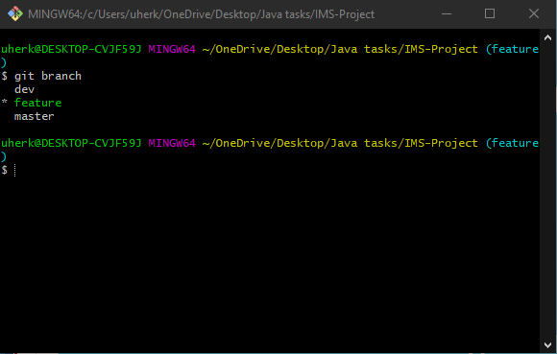
Version Control approach
Cloned the repo.
3 Branches
Worked in feature branch
Merged into Dev

Slide 5
What was tested
Customer
Item
Order
Order/Items

Slide 6
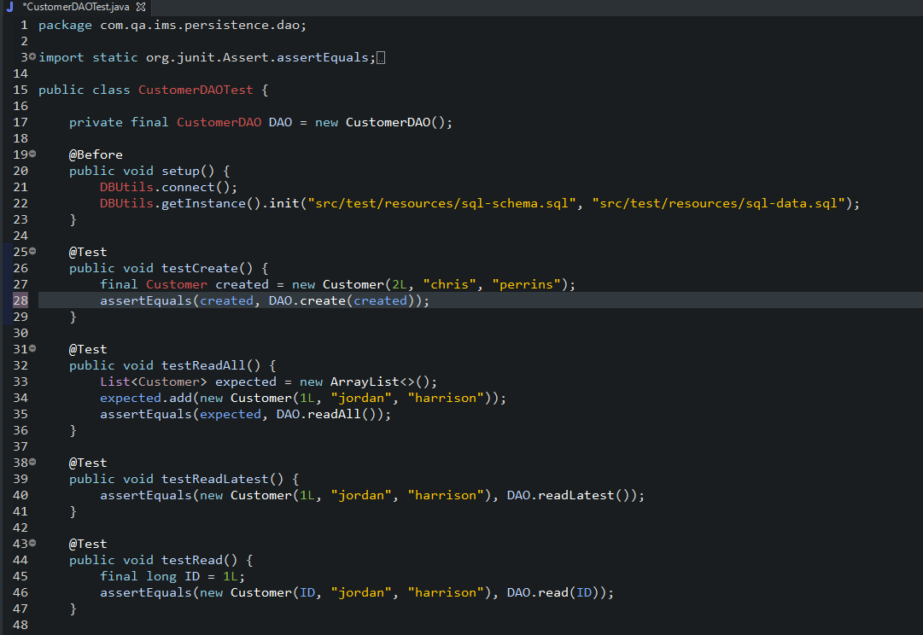
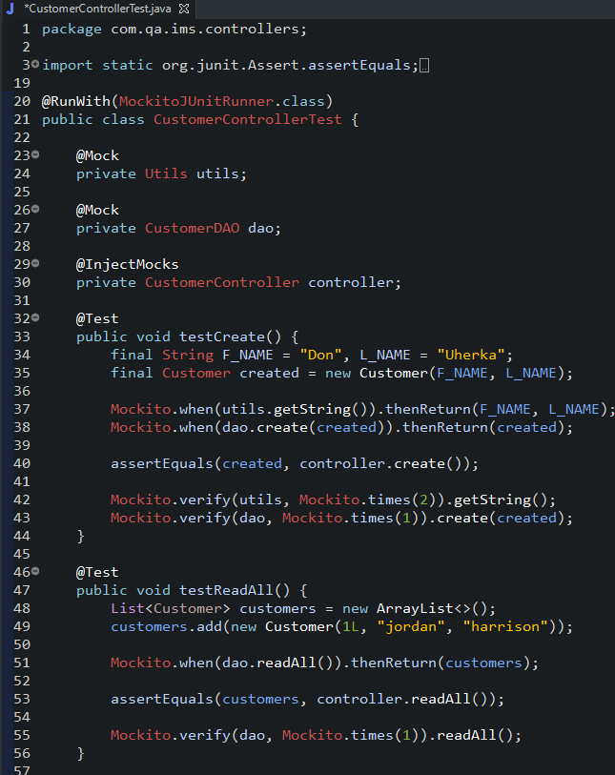
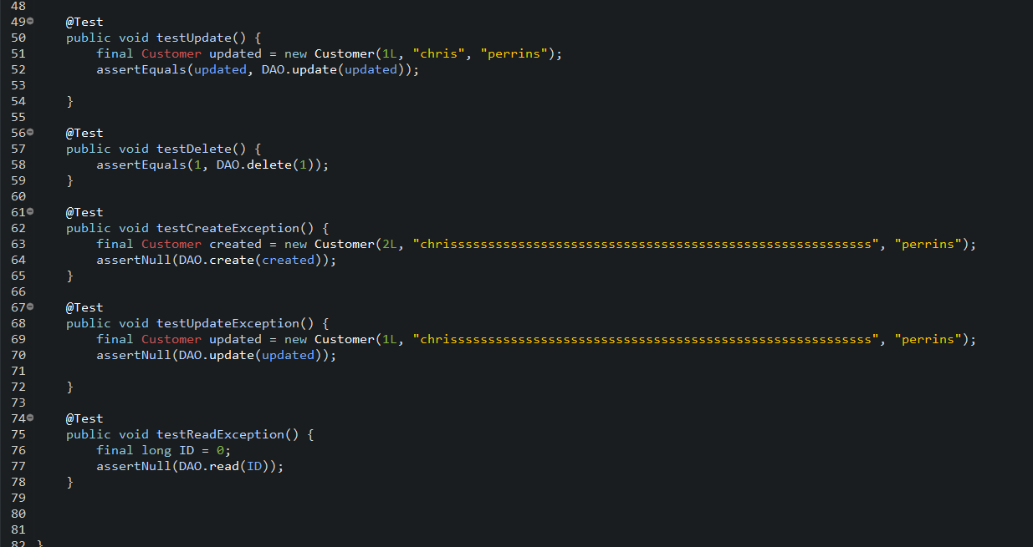
Customer testing
Customer class – holds values for the object
Customer Controller – handles the user side
Customer DAO – handles the database

Slide 7
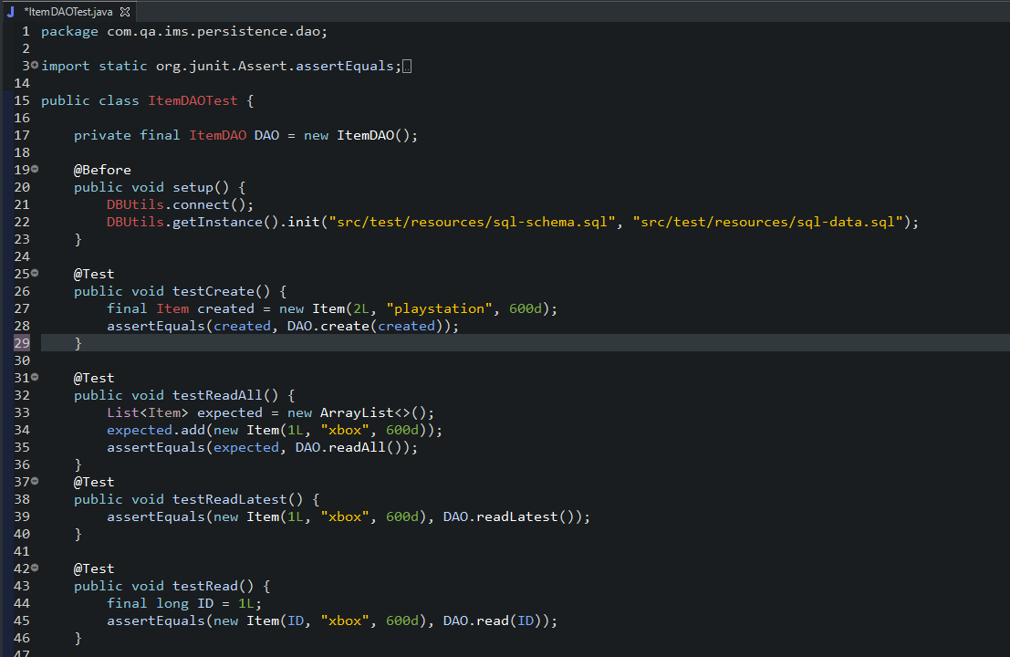
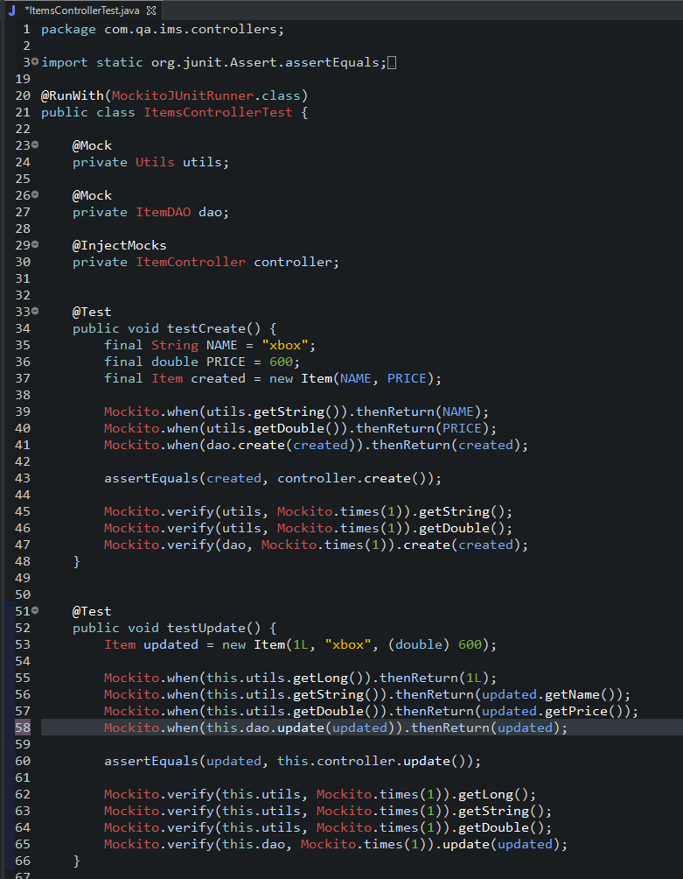
Item testing
Item class – holds values to create a Item object
Item Controller – handles the user side
Item DAO – handles the database

Slide 8
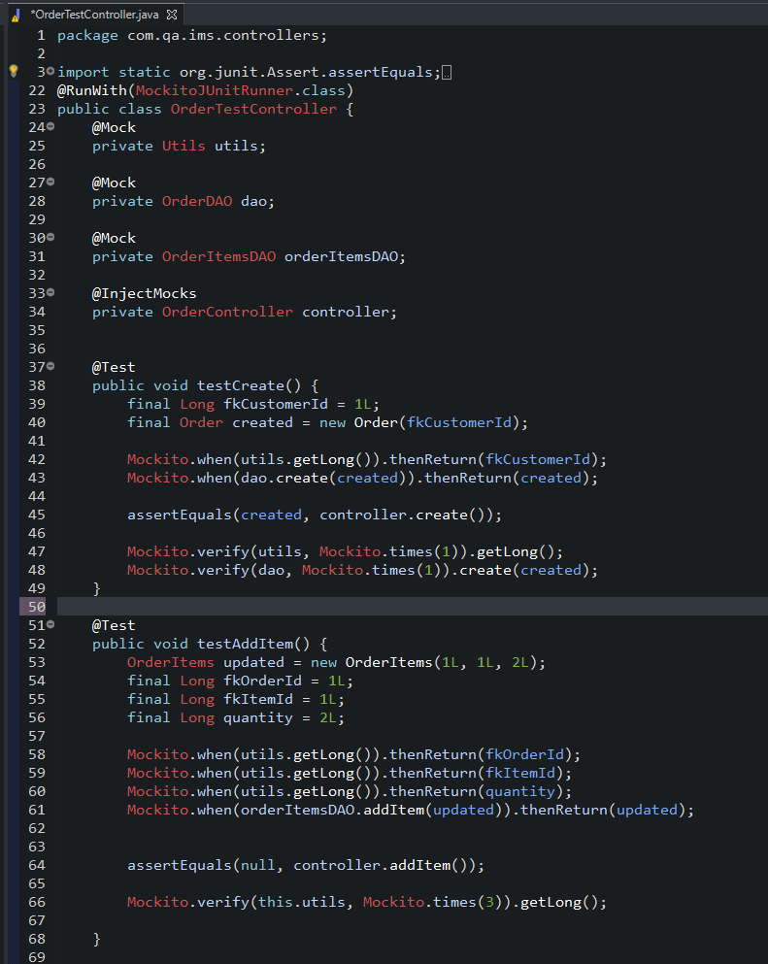
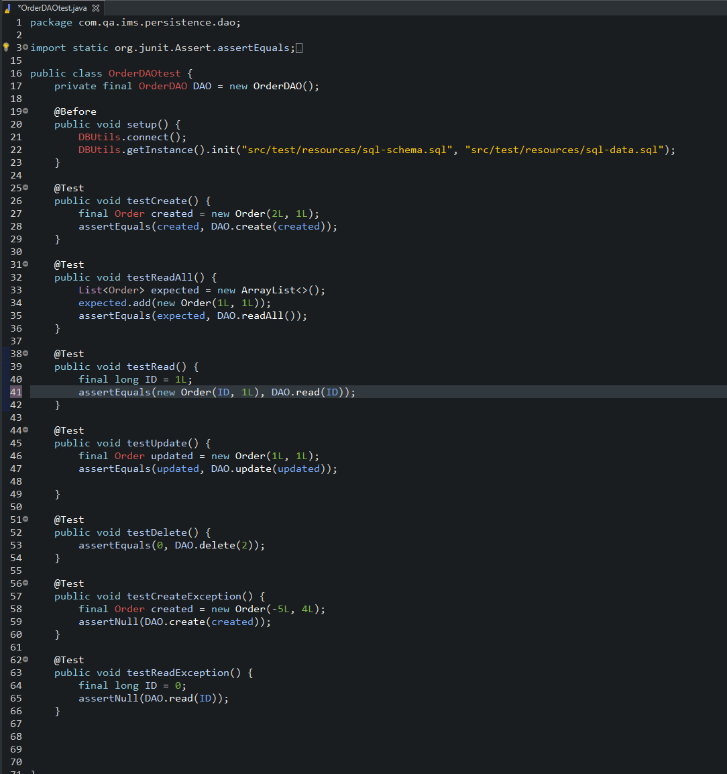
Order testing
Order class – holds values for order
Order Controller – handles the user side
Order DAO – handles the database

Slide 9
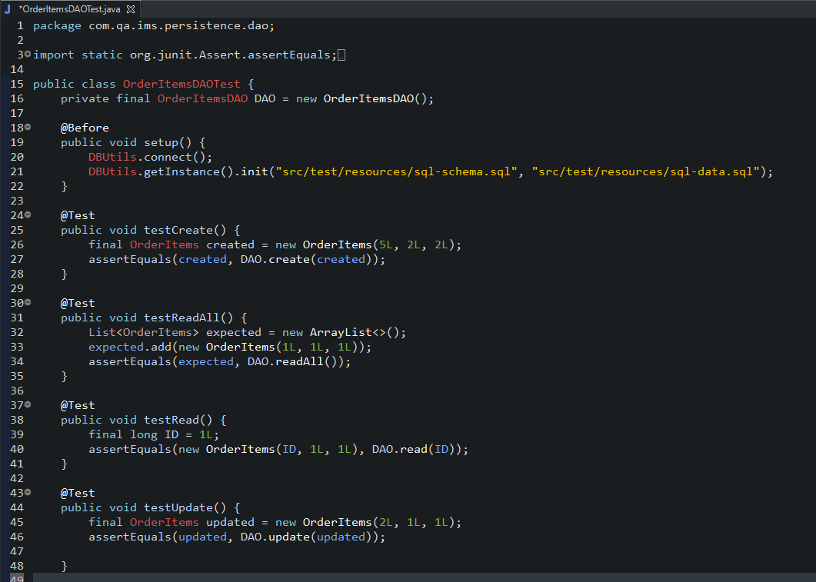
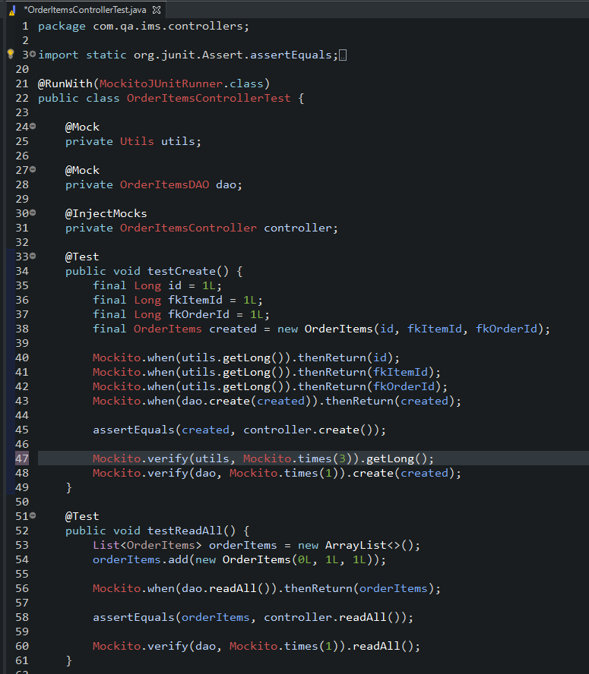
Order/Items Testing
Order/Items Class – holds values for objects
Order/Items Controller – handles the user side
Order/Items DAO – handles the database

Slide 10


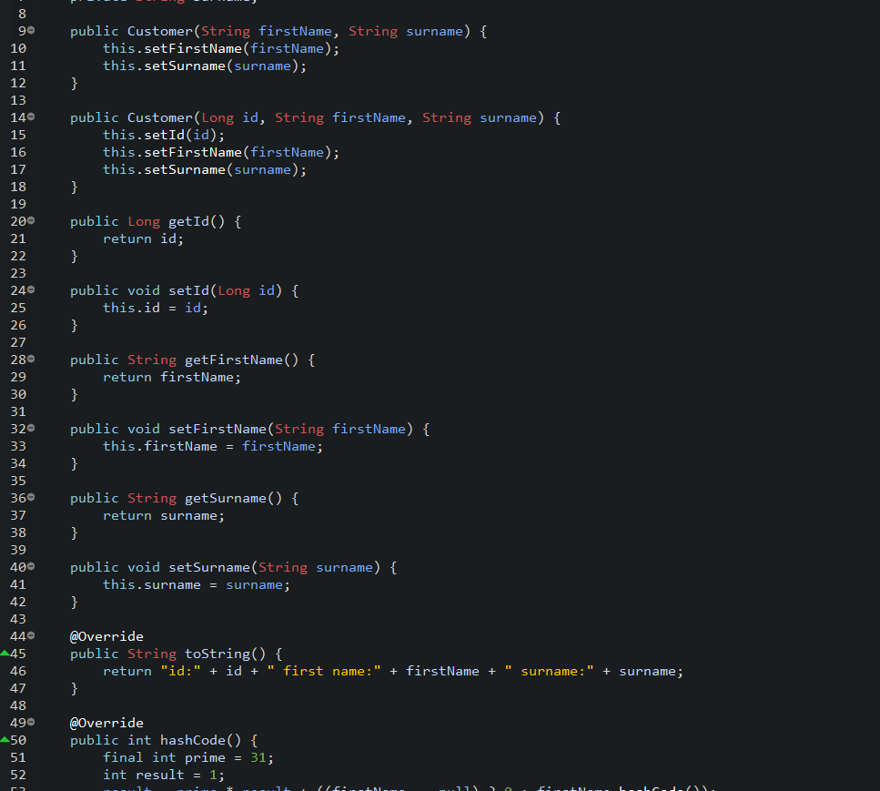
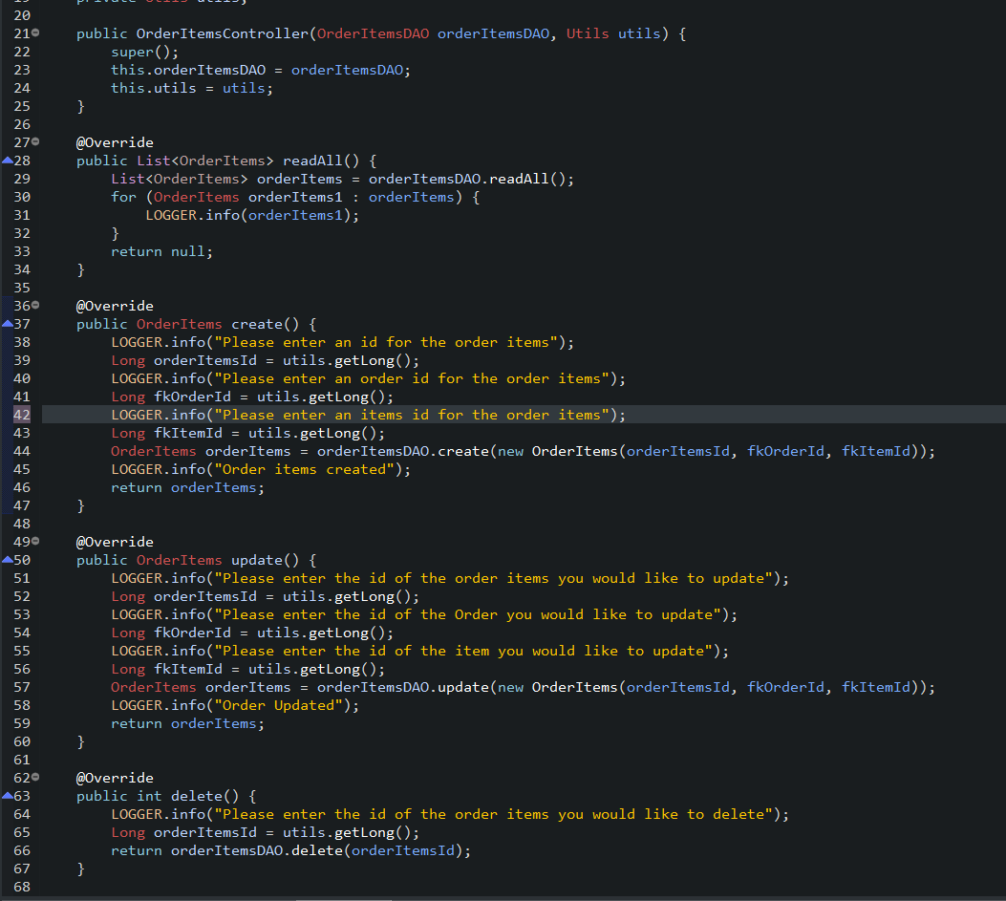
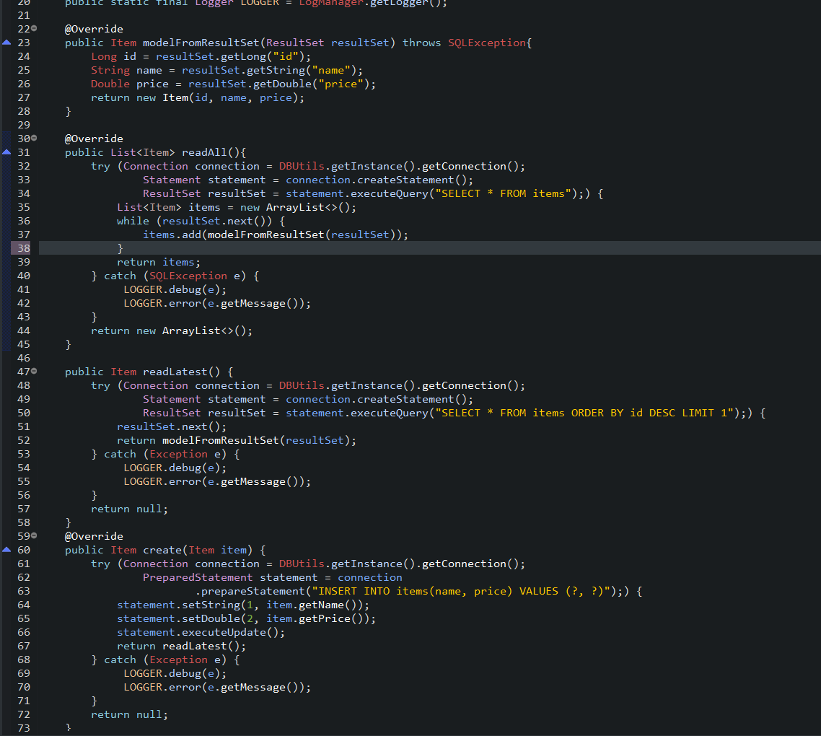
Demo
Run through some user stories

Slide 11
Review
What was completed
What was left behind

Slide 12
retrospective
What went well?
What could be improved?

Slide 13

Conclusion
Reflection on the project
Future steps

