Slide 1
ROS Path Planning for Robotic Surgery
28th March 2023
Don Yin
Notes:
Project Goals

Slide 2
Implement a path planning algorithm for robotic surgery
Integrate the algorithm with a ROS-based robot model
Validate the selected trajectory and robot end effector position
Notes:
Project Goals
In this project,
our main goals are to implement a path planning algorithm for robotic surgery,
integrate the algorithm with a ROS-based robot model,
and validate the selected trajectory and robot end effector position.

Slide 3
Trajectory selection
Constraints:
Critical structure avoidance
Target structure placement
Trajectory length
Maximizing distance from critical structures
Testing on the BrainPlanning dataset
Notes:
Path Planning Algorithm
The path planning algorithm will select a straight trajectory from a set of inputs,
considering constraints such as critical structure avoidance, target structure placement, trajectory length, and maximizing distance from critical structures. We will test the algorithm on the BrainPlanning dataset.

Slide 4
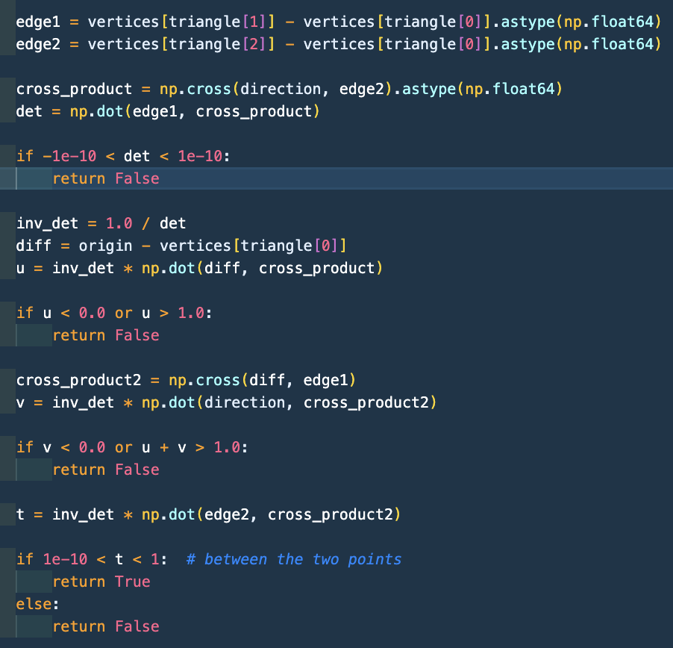
Critical Structure Avoidance & Target Structure Placement
Möller–Trumbore Intersection Algorithm
Notes:
Path Planning Algorithm

Slide 5

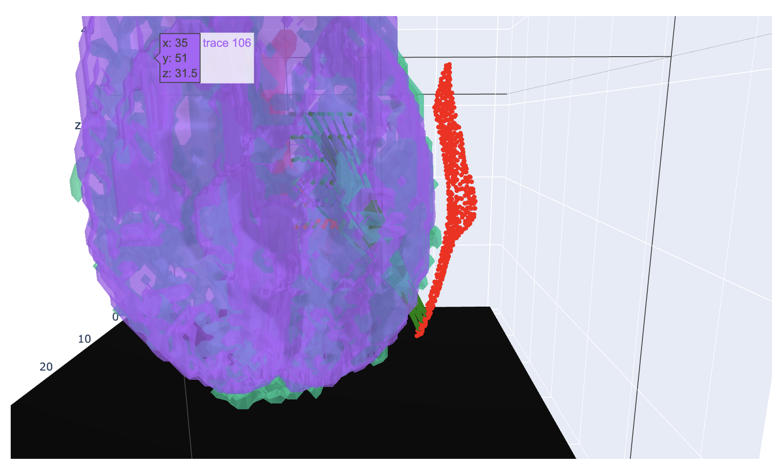
Trajectory length & Maximizing Distance From Critical Structures
Already in the Möller–Trumbore Algorithm
Consider the angle of the insertion?
Distance to the nearest vertex
Next:
Tensor / Array Operation for speed
Notes:
Path Planning Algorithm

Slide 6
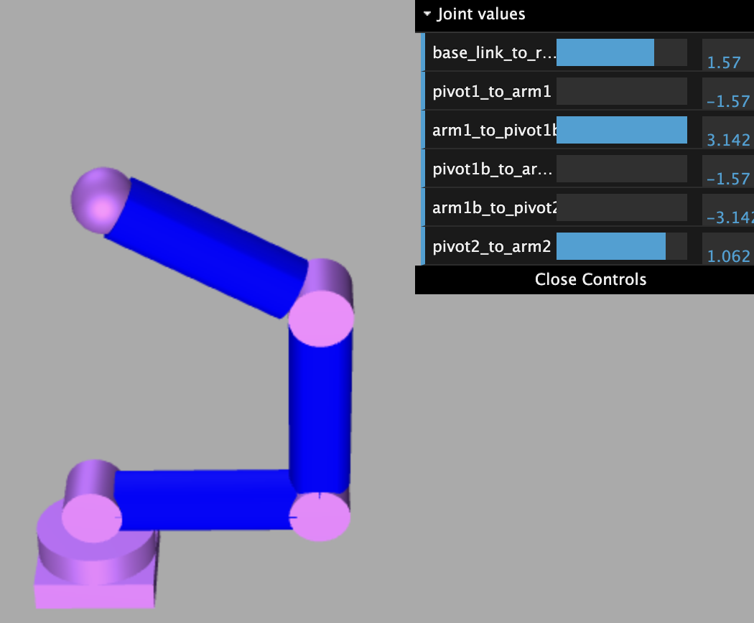
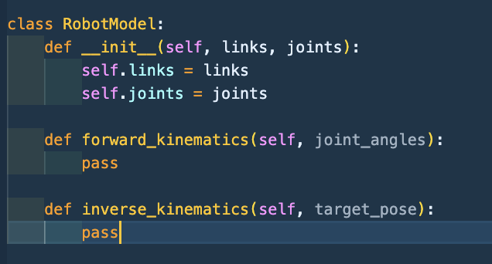
URDF 6DOF Robot Model
But spheric end effector?
Inverse Kinematics
(maybe Reinforcement Learning)?
Notes:
ROS Robot Model
We will define a URDF-based RobotModel with at least 6 degrees of freedom and create helper classes for controlling the end effector.
A class will listen to data transmitted using PyRos and identify the requested point/pose, attempting to move the end effector accordingly.
In my head the helper will look like this …

Slide 7
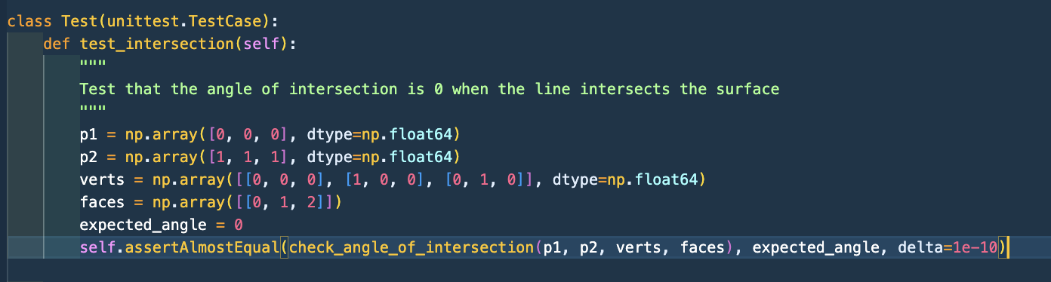
Validation Strategy
Unit tests for algorithm performance
Visualization for trajectory and end effector position
Notes:
Validation Strategy
We will validate the system by demonstrating point co-location in python and ROS.
Unit tests will be used to assess algorithm performance, and visualization will help verify trajectory selection and end effector position using RviZ

Slide 8
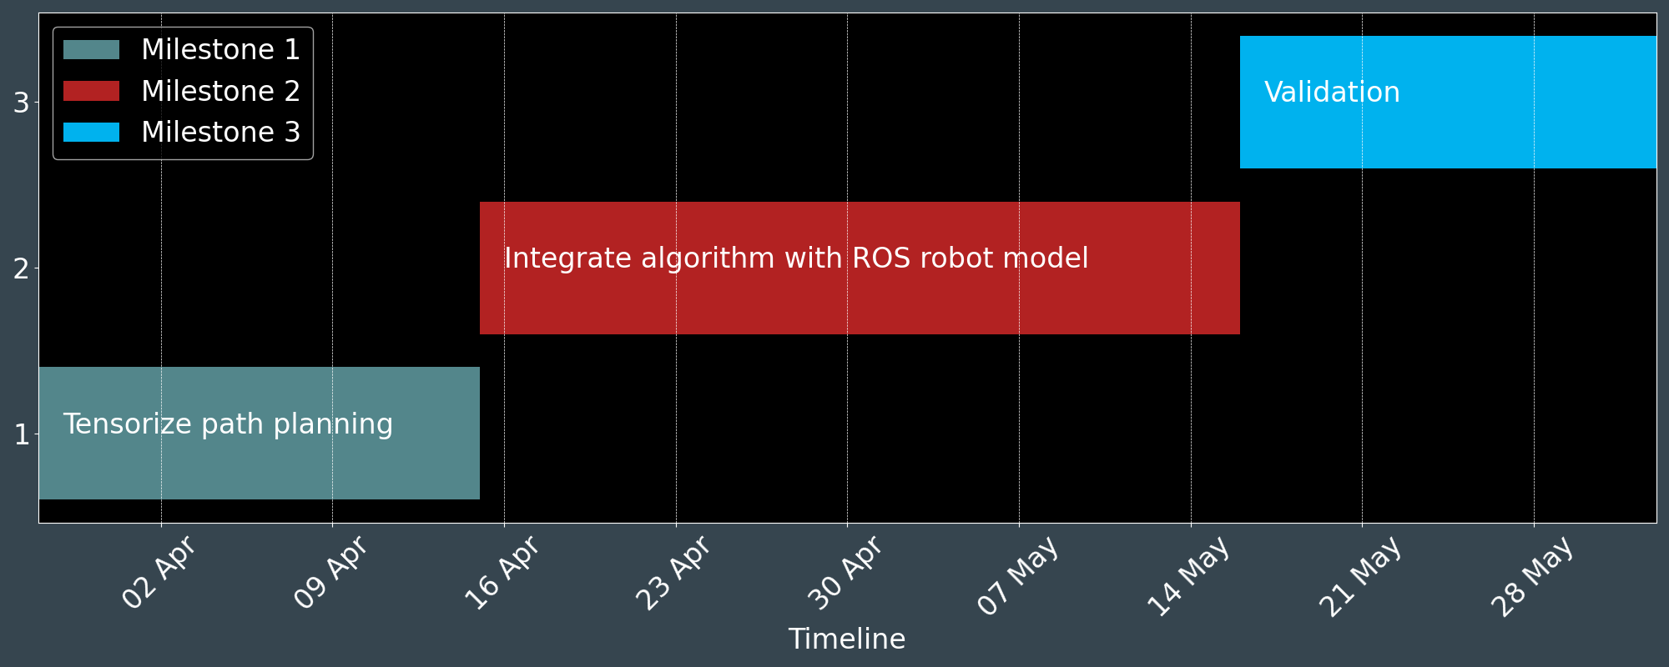
Next Steps
Milestone 1: Rewrite path planning implementation using array or tensor operation
Milestone 2: Integrate algorithm with ROS robot model
Milestone 3: Perform validation and testing
Notes:
Next Steps
The next steps include completing the path planning algorithm implementation, integrating the algorithm with the ROS robot model, and performing validation and testing to ensure the system works as expected.

