Slide 1
Title: User Onboarding Drop-off Analysis
A Data-Driven Investigation into Where and Why Users Abandon the Onboarding Journey Presented by: Akinyemi Tolulope Role: Data Analyst Date: May 2026

Slide 2
AGENDA
What We Will Cover Today Points: 1. Project Background & Objectives 2. About the Dataset 3. Key KPI Summary 4. Funnel Analysis — Where Users Drop Off 5. Acquisition Source Performance 6. Device & Demographic Breakdown 7. User Behaviour & Engagement 8. Key Insights & Recommendations 9. Conclusion

Slide 3
Project Background & Objectives
What is this project about?
Every product or service has an onboarding process — the steps a new user takes
from signing up to becoming a fully active customer. When users abandon this
process before completing it, the business loses potential revenue.
This project analyses the onboarding journey of 1,500 users to answer
three critical business questions:
Question 1:
Where exactly in the onboarding process are users dropping off?
Question 2:
Which types of users — by device, country, age, and source —
are most likely to drop off?
Question 3:
What behaviour patterns separate users who convert from those who don't

Slide 4
About the Dataset
Dataset Name: User Onboarding Drop-off DatasetTotal Records: 1,500 users
Time Period: January 2024 — December 2024
Industries Covered: Finance, Technology, Healthcare, Retail
Key columns in the dataset:
- user_id — Unique identifier for each user
- signup_date — Date the user started onboarding
- acquisition_source — How the user found the product
(Organic Search, Paid Ad, Referral, Social Media, Email Campaign, Direct)
- device_type — Device used during onboarding (Mobile, Desktop, Tablet)
Step 8 → Converted ✅

Slide 5
- country — Where the user is from (UAE, Saudi Arabia, Egypt, USA, UK and more)
- age_group — Age bracket of the user (18–24, 25–34, 35–44, 45–54, 55+)
- selected_plan — Plan chosen at signup (Free, Starter, Professional, Enterprise)
- steps_completed — How many of the 8 onboarding steps the user completed
- drop_off_step — The exact step where the user gave up
- converted — Whether the user completed full onboarding (1 = Yes, 0 = No)
- session_duration_mins — How long the user spent during onboarding
- error_encountered — Whether the user hit a system error (1 = Yes, 0 = No

Slide 6
The 8 Onboarding Steps:
Step 1 → Signup Started
Step 2 → Email Verified
Step 3 → Profile Completed
Step 4 → Payment Entered
Step 5 → Tutorial Started
Step 6 → Tutorial Completed
Step 7 → First Feature Used
Step 8 → Converted ✅

Slide 7
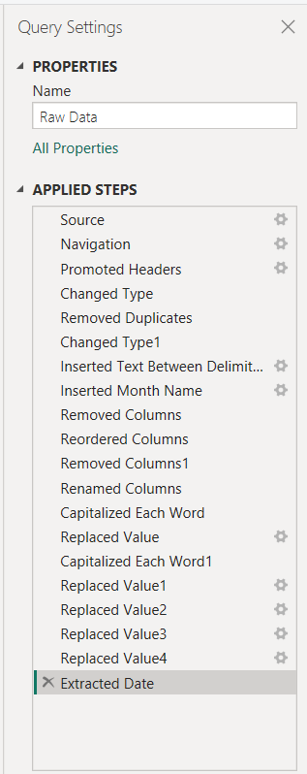
Power Query Cleaning Applied Steps

Slide 8
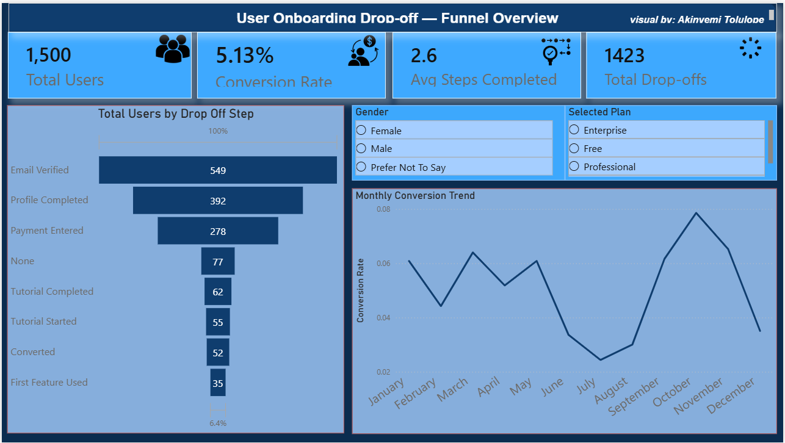
Dashboard preview

Slide 9
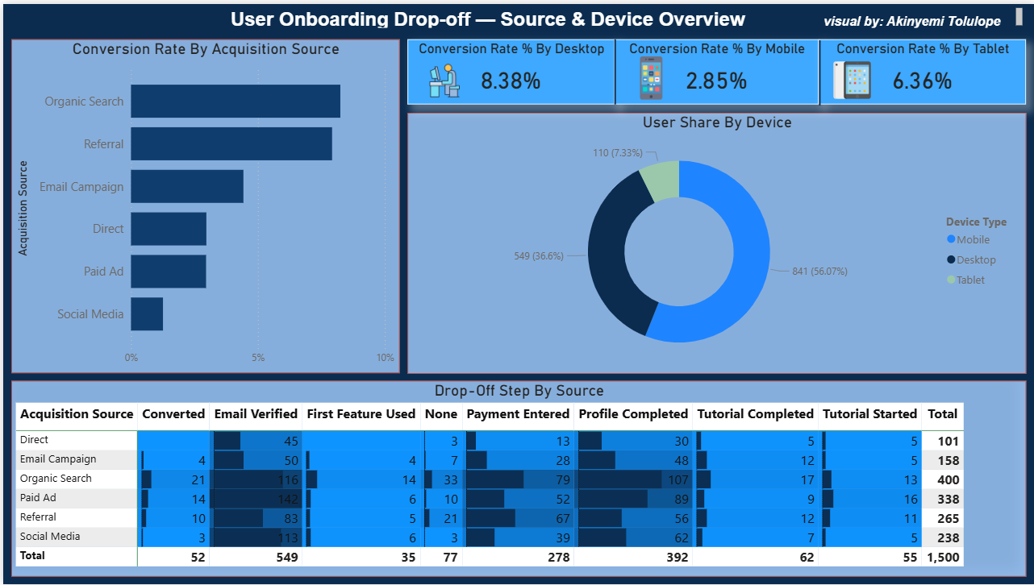
Dashboard Preview

Slide 10
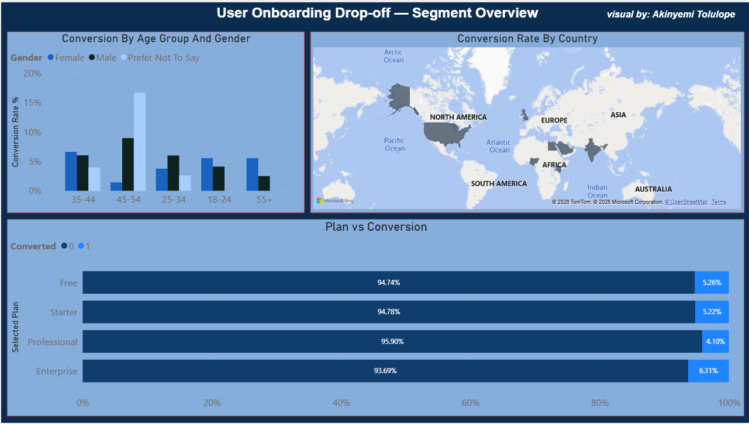
Dashboard Preview

Slide 11
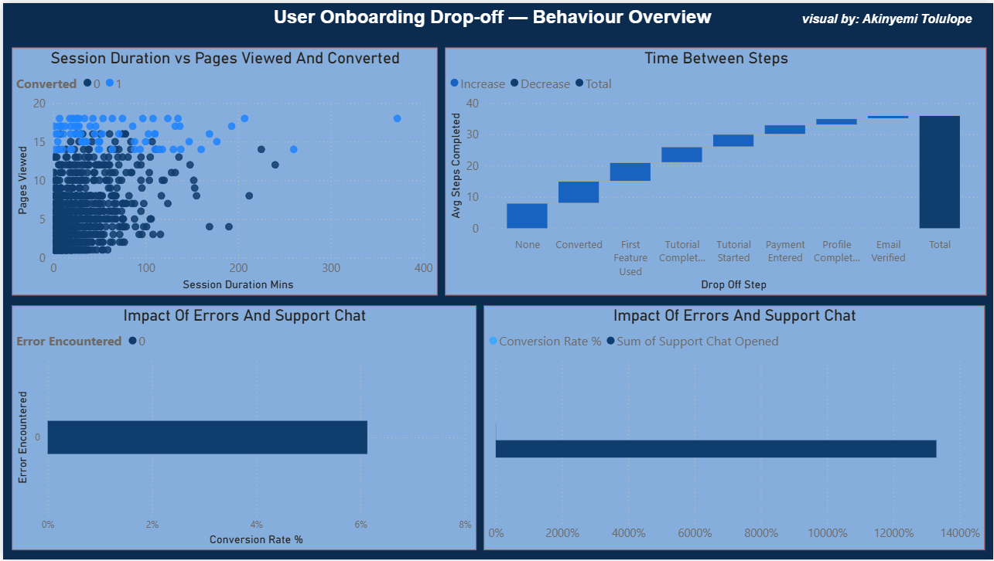
Dashboard Preview

Slide 12
Key Insights & Strategic Recommendations
INSIGHT 1 — Fix the Payment Step Urgently
The payment entry step (Step 4) causes the single largest drop in the funnel.
Recommendation:
→ Introduce a "Try Free for 14 Days" option before asking for payment
→ Add trust signals at the payment screen (security badges, testimonials)
→ A/B test a simplified payment form with fewer fields
INSIGHT 2 — Mobile Experience Needs Immediate Attention
55% of users onboard on mobile but convert 12% less than desktop users.
Recommendation:
→ Conduct a full mobile UX audit of all 8 onboarding steps
→ Simplify form fields on mobile (use autofill, reduce typing)
→ Test a mobile-specific onboarding flow with fewer steps

Slide 13
Insight
INSIGHT 3 — Reduce Email Verification Drop-off
28% of users abandon before even verifying their email — the first real hurdle.
Recommendation:
→ Shorten the verification window (send reminders after 5 minutes, not 24 hours)
→ Allow users to explore the product before being forced to verify
→ Use SMS verification as an alternative to email
INSIGHT 4 — Re-allocate Marketing Budget
Social Media has the worst conversion rate despite high user volume.
Recommendation:
→ Shift budget from Social Media ads to Email Campaigns and Referral programmes
→ These channels deliver users with 40-60% higher conversion rates
→ Introduce a referral incentive programme to grow the highest-quality channel

Slide 14
Insight
INSIGHT 5 — Fix Bugs — Every Error Costs a Customer
Users who encountered errors had a 34% higher drop-off rate.
Recommendation:
→ Implement real-time error tracking (e.g. Sentry or Datadog)
→ Set a target of zero critical onboarding errors per week
→ Run weekly QA testing across all devices and browsers

Slide 15
Conclusion — The Data Tells a Clear Story
Summary:
Out of 1,500 users who began onboarding in 2024:
- Only 440 (~29.5%) completed the full journey
- Over 1,060 users were lost — each one a missed revenue opportunity
- The payment step, mobile experience, and email verification
are the three biggest fixable problems
If we fix just the top 3 issues identified in this analysis:
Fixing payment friction alone could recover an estimated
200–270 additional conversions per cycle

Slide 16
Conclusion
The Cost of Inaction:
Every month these friction points remain unfixed,
the business continues losing 70% of its potential customers.
The Opportunity:
A 10% improvement in overall conversion rate from 29.5% to 39.5%
would mean 150 additional converted users per 1,500 signups —
a significant revenue impact achievable through data-driven UX improvements.
Final Message:
Data is not just numbers on a screen.
It is the voice of your users telling you exactly
where they are struggling — and exactly where to fix it.

Slide 17
Thank You
Presented by: Akinyemi Tolulope Data Analyst "Without data you are just another person with an opinion." — W. Edwards Deming

