Slide 1
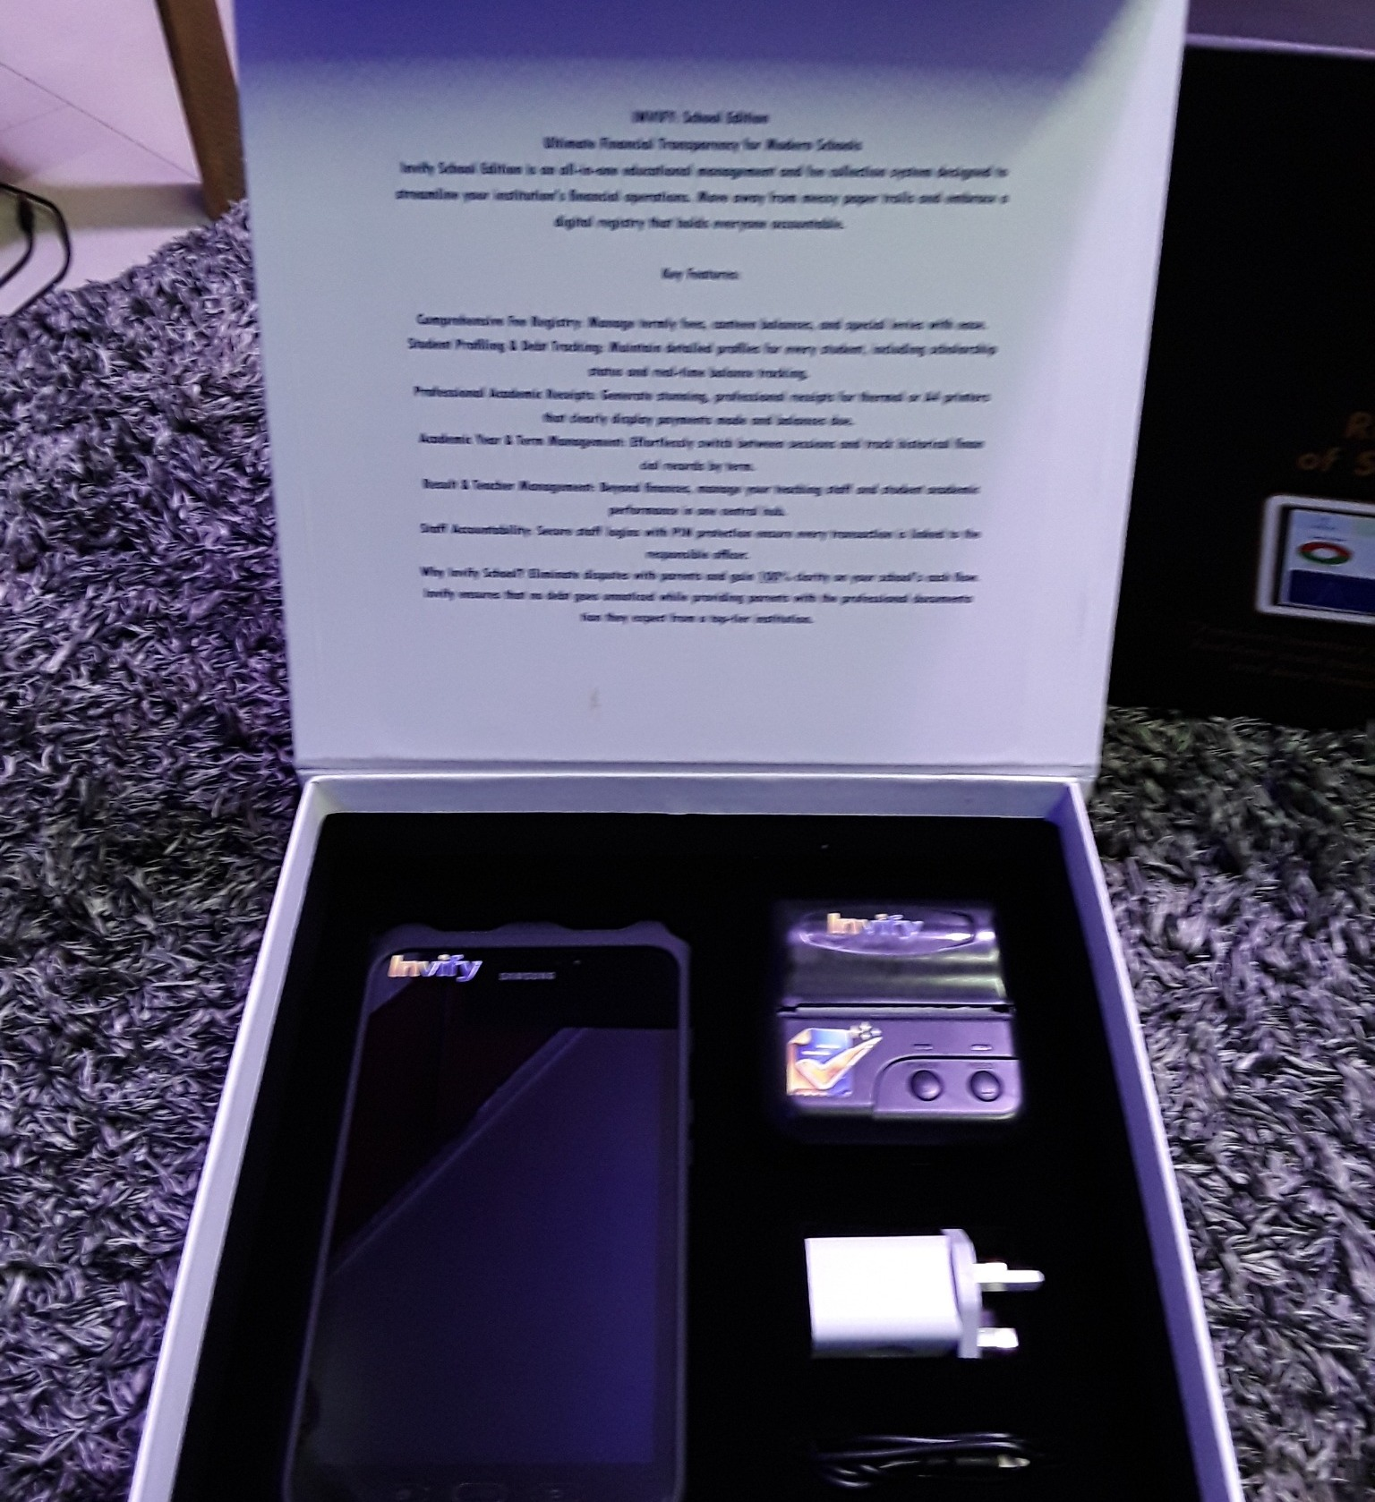
Invify × FCMB
Smart mPOS & Digital Collections
Product Demonstration • Partnership Discussion • Pilot Proposal
Presented by Aramide Adebayo
CEO • Integrated Independent Product and Services (IIPS)
Invify Technologies
Notes:
Opening (Aramide, ~2 min): Thank FCMB for the opportunity. Frame this as a working session: what Invify has built, the merchant problem, the Smart mPOS proposition, the payment architecture, Dotroid device layer, and the specific role FCMB could play. Do not position Invify as replacing FCMB's existing POS estate; position it as a complementary mPOS ecosystem.

Slide 2
Today's Discussion
AGENDA
• 1. Invify and the merchant problem
• 2. Product and customer journey
• 3. Smart mPOS device proposition
• 4. Payments, collections and reconciliation
• 5. Dotroid managed-device layer
• 6. Target market and business model
• 7. FCMB partnership model and pilot
• 8. Discussion, requirements and next steps
What FCMB asked to understand
Product, key value proposition, target market, use cases, business model and partnership approach.
Today's objective
Agree the commercial and technical questions required to move toward a controlled pilot.
Format
Presentation → live product walk-through → device demo → partnership discussion.
Invify × FCMB | Strategic Smart mPOS & Digital Collections Discussion 2
Notes:
Presenter: Aramide. Keep this short. Tell FCMB that the deck is not intended to answer every certification detail today; it is designed to get the right business, acquiring, technology, risk and operations stakeholders aligned.

Slide 3
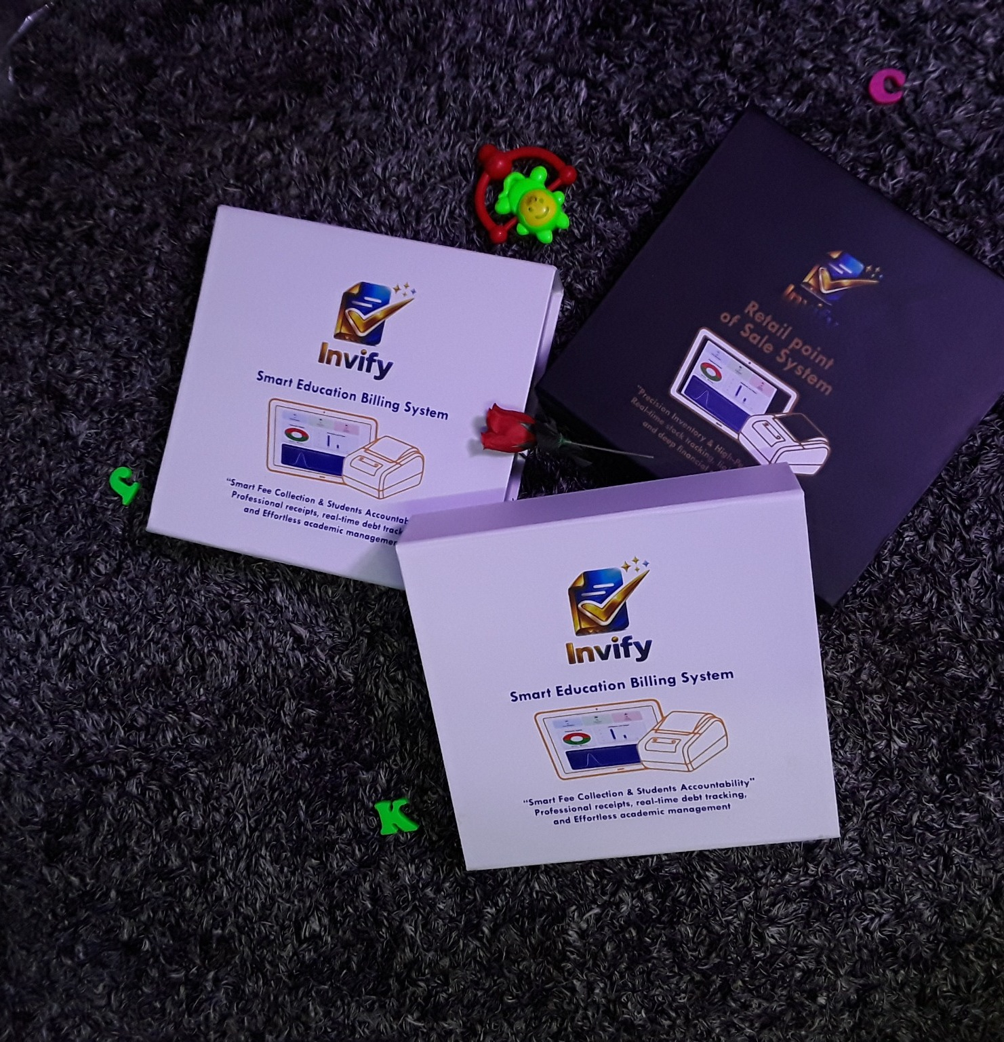
Who We Are
COMPANY
IIPS
Integrated Independent Product and Services — technology and product development organization behind the Invify proposition.
Invify
Merchant, invoicing, collections and business-management platform with Smart mPOS payment acceptance.
Current product stage
Invify v1.0. Product demonstrations and payment workflow tests completed; commercial scale-up is the next phase.
Invify × FCMB | Strategic Smart mPOS & Digital Collections Discussion 3
Notes:
Presenter: Aramide. Keep claims factual. Explain that Invify is currently at v1.0 and the FCMB engagement is about moving from product capability into bank-led acquiring and controlled commercial deployment.

Slide 4
The Merchant Problem
OPPORTUNITY
• Payment acceptance is often separated from invoicing, billing, customer records and reconciliation.
• Conventional POS workflows can be optimized for the transaction itself, while merchants still manage the wider business process elsewhere.
• Schools need fee collection, student accountability and reconciliation—not only a payment terminal.
• Service businesses need job records, materials/labour billing, payment status and receipts in one workflow.
• Retail merchants need a simple sales, inventory and payment experience with clear transaction records.
The gap
Payment device ≠ complete merchant operating workflow.
Invify response
Bring business workflow and payment acceptance closer together.
Bank opportunity
Extend acquiring into richer merchant use cases without displacing the bank's payment infrastructure.
Invify × FCMB | Strategic Smart mPOS & Digital Collections Discussion 4
Notes:
Presenter: Product lead. Describe the problem from the merchant's perspective. Avoid criticizing existing POS providers. The message is that a richer application layer can create more merchant value around the bank's existing acquiring capability.

Slide 5
Invify at a Glance
PLATFORM
Merchant onboarding
Billing & invoicing
Collections
Business profile, contact, CAC/TIN and operational setup.
Create bills, jobs, items, fees and customer-linked records.
Cash, transfer, wallet/virtual account and POS/card workflows.
Receipts
Reconciliation
Analytics
Digital/PDF receipt and print-ready workflows.
Payment history, statuses, pending/failed/unsettled views and reconciliation.
Revenue, student/payment analytics and executive/finance dashboards.
School workflow
Multi-sector foundation
Students, guardians, terms, fees, results, billing records and fee collection.
Retail and service/handworker workflows can use the same merchant and payment foundation.
Invify × FCMB | Strategic Smart mPOS & Digital Collections Discussion 5
Notes:
Presenter: Product lead. Use the screenshots later for the live demonstration. Emphasize that the platform is not only a POS app; it is a merchant operating layer.

Slide 6
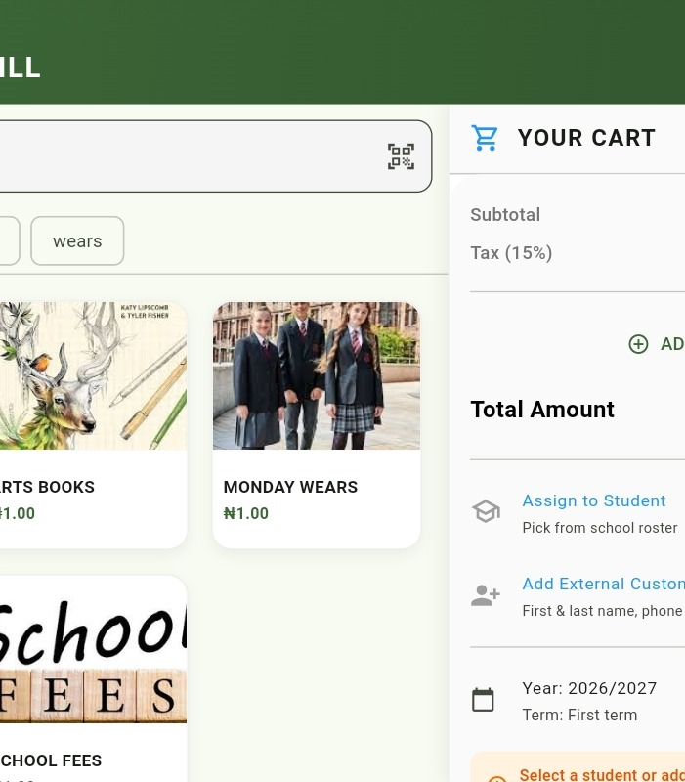
Primary Use Case: Schools
CUSTOMER JOURNEY
• Set up academic year and term
• Configure fees/items and assign to students
• Track expected vs recovered revenue
• Collect through supported payment channels
• Generate receipts and maintain payment history
• Monitor paid/owing students and revenue analytics
• Reconcile collections against expected fees
Invify × FCMB | Strategic Smart mPOS & Digital Collections Discussion 6
Notes:
Presenter: Product lead. Walk the bank through one simple school story: school creates a term bill → parent/student is identified → payment is collected → receipt is generated → school sees the transaction → finance team reconciles. This is a strong use case because it demonstrates recurring collections and structured reconciliation.

Slide 7
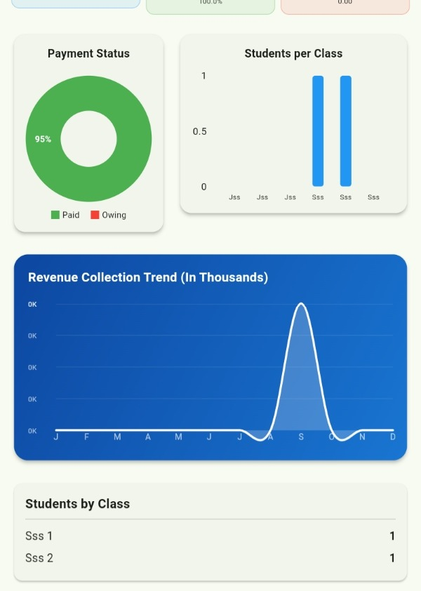
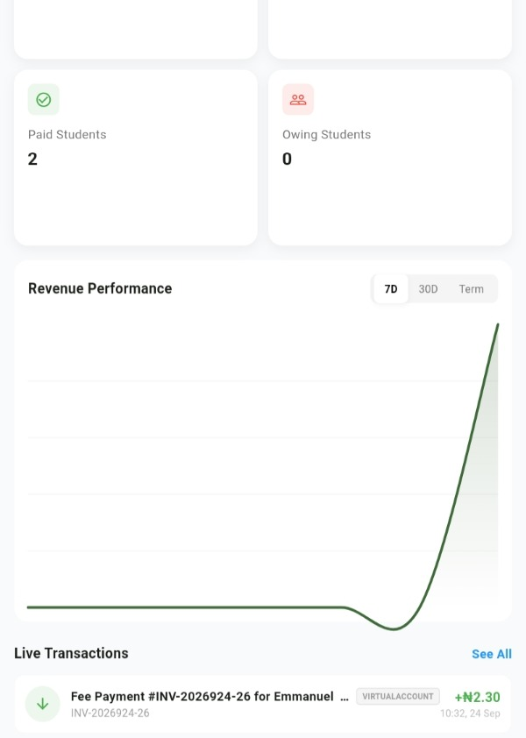
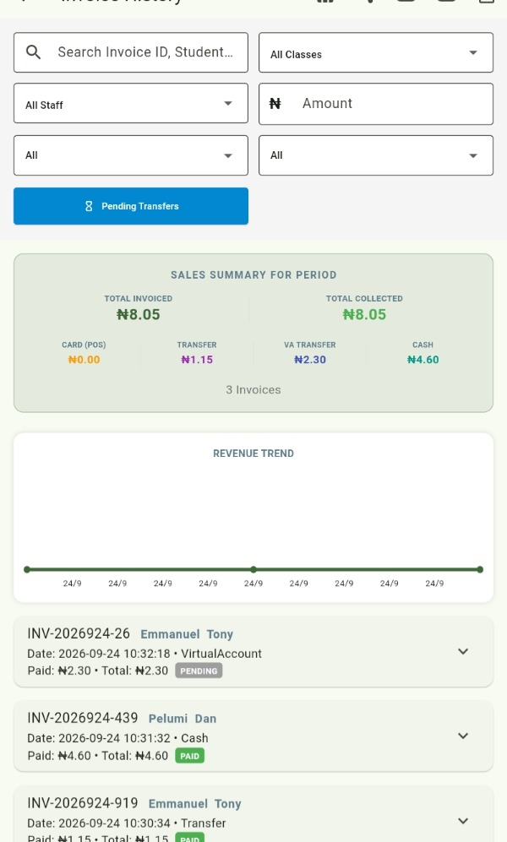
From Collection to Accountability
SCHOOL ANALYTICS
Invify × FCMB | Strategic Smart mPOS & Digital Collections Discussion 7
Notes:
Presenter: Product/finance lead. Point out that the merchant can move from a single payment event to management information: student status, revenue trend, expected vs recovered amounts and invoice/payment history.

Slide 8
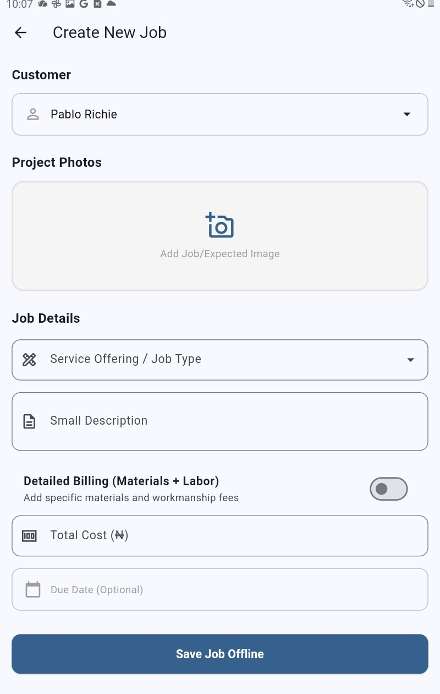
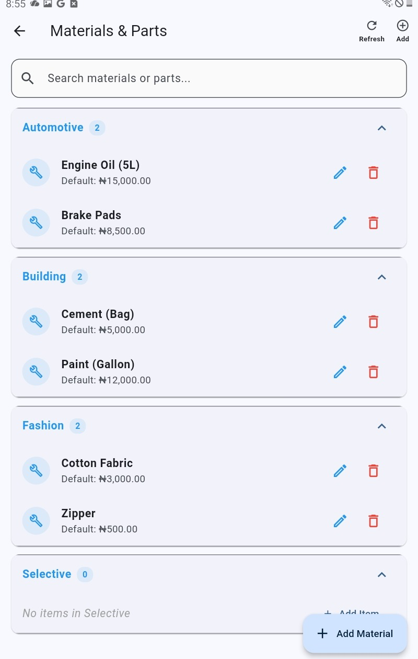
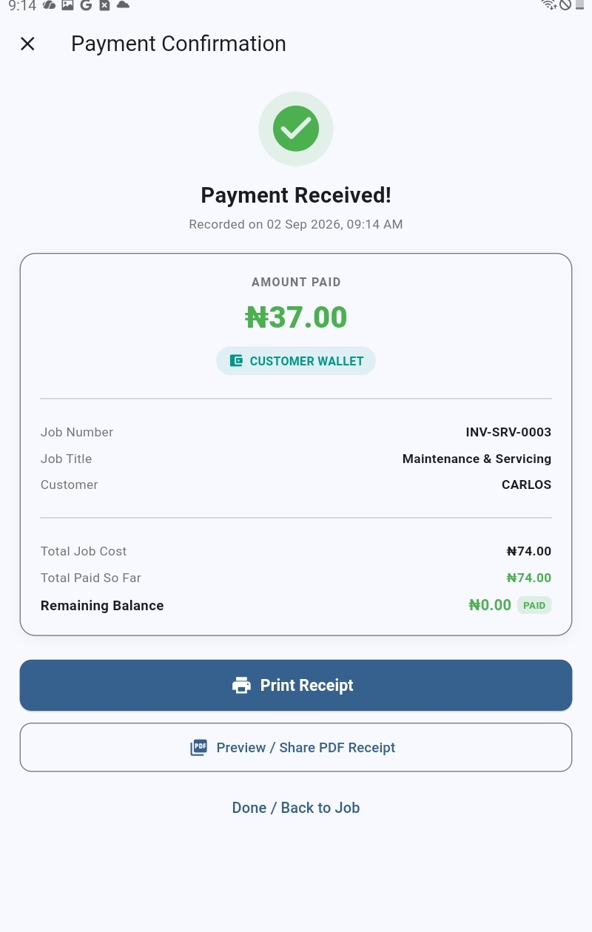
Beyond Schools: Retail & Services
USE CASES
Invify × FCMB | Strategic Smart mPOS & Digital Collections Discussion 8
Notes:
Presenter: Product lead. Show that the same foundation can support service businesses: customer → job → materials/labour → bill → payment → receipt. Mention the current retail version 1.0 use case at Odies Bar in Ikorodu as an example of the broader platform direction, without presenting it as a scaled deployment.

Slide 9

The Smart mPOS Proposition
DEVICE
• Large-format Android tablet experience paired with a dedicated card-payment device
• Designed for a richer merchant interface than a conventional small-screen POS
• High-resolution screen supports dashboards, invoices, customer records and guided payment workflows
• More local storage/memory supports richer applications and offline-oriented workflows
• Portable, presentable and suitable for merchant-facing operations
• Dedicated payment device handles chip + PIN card acceptance
• Printer option supports immediate physical receipts
Invify × FCMB | Strategic Smart mPOS & Digital Collections Discussion 9
Notes:
Presenter: Device lead. Explain the core distinction carefully: Invify is not asking FCMB to replace its existing POS estate. The proposition is a complementary Smart mPOS form factor: a capable Android tablet running the merchant workflow, paired with a dedicated payment device. State that final hardware/acquiring certification and approved models are subject to FCMB/acquirer requirements.

Slide 10
Hardware & Integration Experience
ENGINEERING EVIDENCE
15 devices tested
9+ POS families worked on
Android 9+ foundation
Invify application and device workflows have been exercised across multiple Android/payment-device environments.
K11, NEXGO, TOPWISE, TELPO, AISINO, D60, NEWPOS and others.
Application experience designed for supported Android versions 9 and above.
• Engineering experience includes payment-device SDK integration, POS application workflows and transaction handling.
• Current Smart mPOS hardware partner/manufacturer identified: AISINO / Vanstone Electronic (Beijing) Co., Ltd.
• Working demonstration transaction is available.
• Card capability demonstrated with chip + PIN; NFC is not currently part of this proposition.
• FCMB certification would be the formal path for production acquiring, TID/MID, keys, device approval and operational controls.
Invify × FCMB | Strategic Smart mPOS & Digital Collections Discussion 10
Notes:
Presenter: Engineering lead. This is where the team demonstrates technical credibility. Do not claim formal production certification unless FCMB has granted it. Say that Invify has experience across multiple device families and is ready to work through the bank's certification process.

Slide 11
Payments & Collections
PAYMENTS
Merchant
Invify
FCMB / Acquirer
Merchant Account
Invoice / bill / customer / payment request
Transaction orchestration, records, receipt and reconciliation
MID / TID, card processing, acquiring controls and settlement
Settlement destination and banking relationship
• Current capabilities / integrations: payment collection, settlement workflows, virtual accounts, reconciliation, refunds/reversals and transaction status/requery.
• Current external payment integration: Paystack; NIBSS/ISO implementation experience.
• Proposed FCMB integration: acquiring → MID/TID → card processing → settlement → APIs → merchant account → certification → device acquiring.
• Additional digital channels such as QR or payment links can be considered as part of the agreed roadmap.
Invify × FCMB | Strategic Smart mPOS & Digital Collections Discussion 11
Notes:
Presenter: Payments lead. This slide is critical for FCMB. Explain exactly what you want from the bank. Make clear which capabilities exist today versus which require FCMB integration. Ask FCMB to confirm their preferred acquiring architecture, APIs/SDKs, TID/MID lifecycle, settlement model, certification process and device-acquiring requirements.

Slide 12
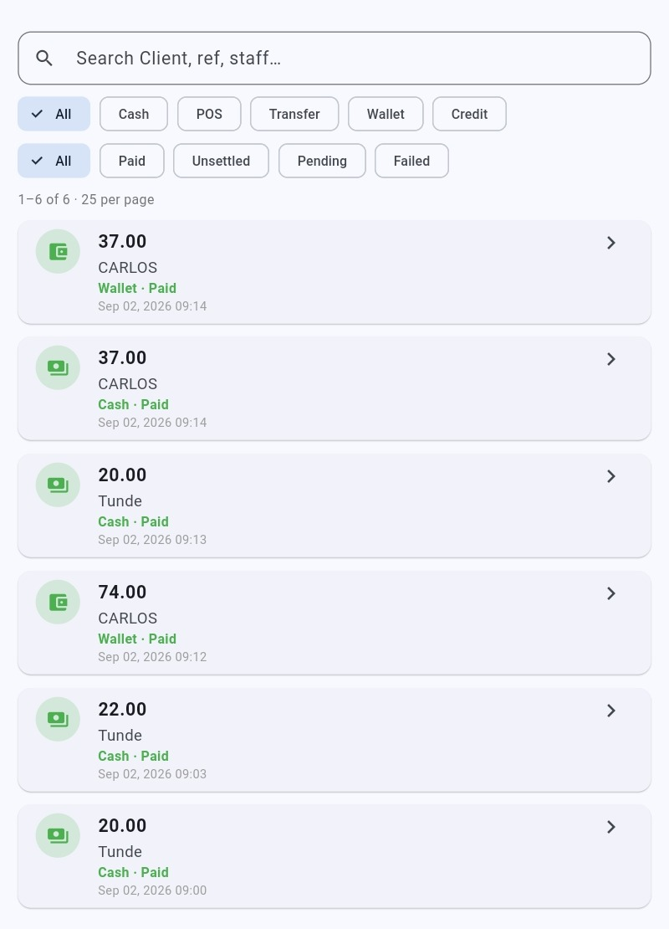
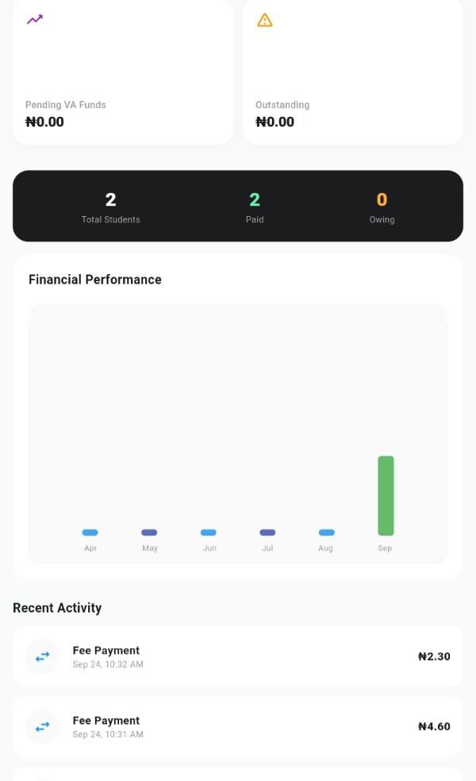
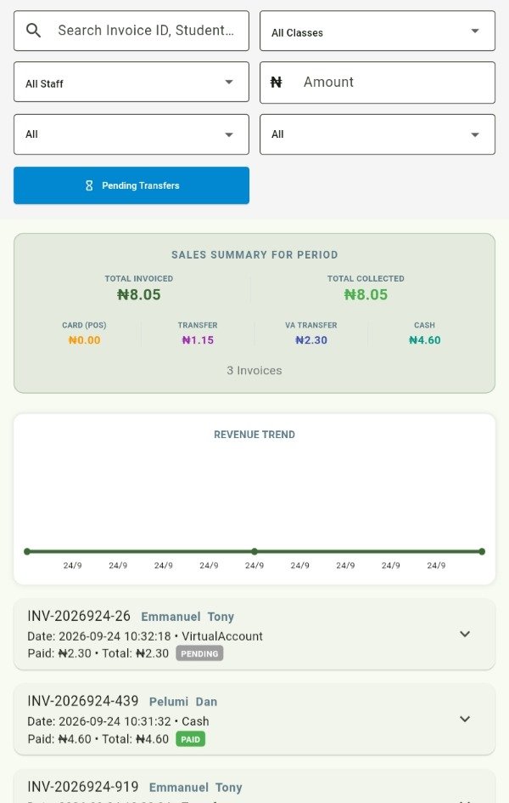
The Control Loop: Collection → Settlement → Reconciliation
PAYMENTS
Invify × FCMB | Strategic Smart mPOS & Digital Collections Discussion 12
Notes:
Presenter: Finance/payments lead. Demonstrate that a payment is not the end of the workflow. Invify maintains transaction history and management views so the merchant can understand what was expected, what was collected and what remains pending/failed/unsettled. Discuss how FCMB settlement files/APIs could feed a bank-grade reconciliation process.

Slide 13
Customer Journey: From Bill to Settlement
JOURNEY
1
2
3
4
5
6
Create
Identify
Collect
Confirm
Settle
Reconcile
Merchant creates bill, invoice or sale
Customer/student/job is linked
Cash, transfer, wallet/VA or card
Transaction status and receipt
Acquirer settles to merchant account
Invify matches collection to business record
Key value
Invify connects the business event to the payment event and gives the merchant a single operational record.
Invify × FCMB | Strategic Smart mPOS & Digital Collections Discussion 13
Notes:
Presenter: Aramide or product lead. This is the simple story to repeat throughout the meeting. FCMB provides the regulated/acquiring payment rail; Invify provides the merchant workflow and operational context.

Slide 14
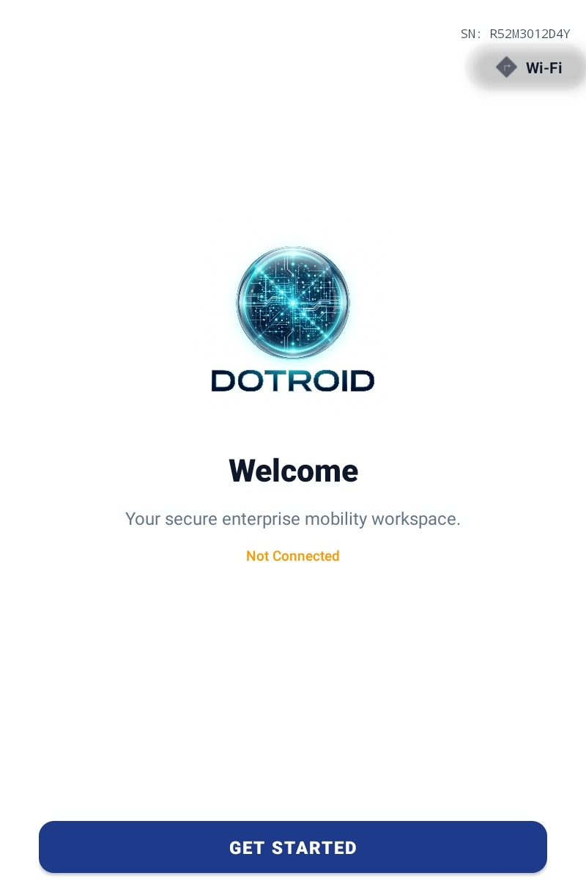
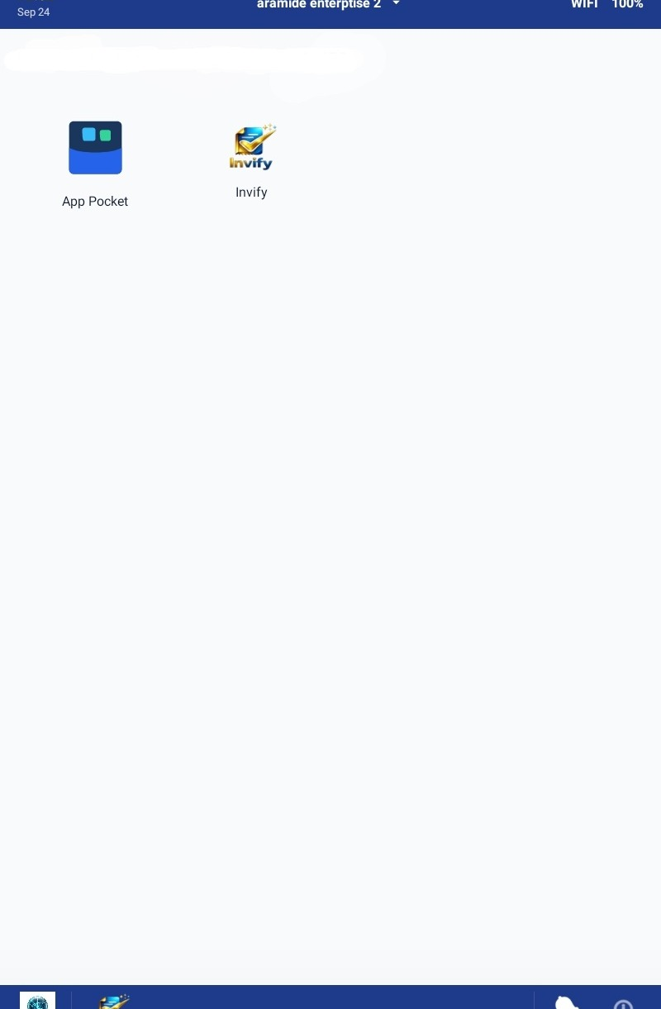
Dotroid: The Managed Device Layer
DEVICE MANAGEMENT
• Launcher / controlled home experience
• Kiosk and device-owner capabilities
• Application control and managed device lifecycle
• Device heartbeat / telemetry and remote management
• Location and recovery capabilities
• Designed as an additional control layer around the Smart mPOS device
Positioning
Dotroid is complementary: device control + security + lifecycle management.
Invify × FCMB | Strategic Smart mPOS & Digital Collections Discussion 14
Notes:
Presenter: Device/security lead. Introduce Dotroid as the additional layer that makes the hardware deployable as a managed fleet. Do not imply that Dotroid itself is a banking security certification. Explain that final security controls would be agreed with FCMB and relevant payment/acquiring requirements.

Slide 15
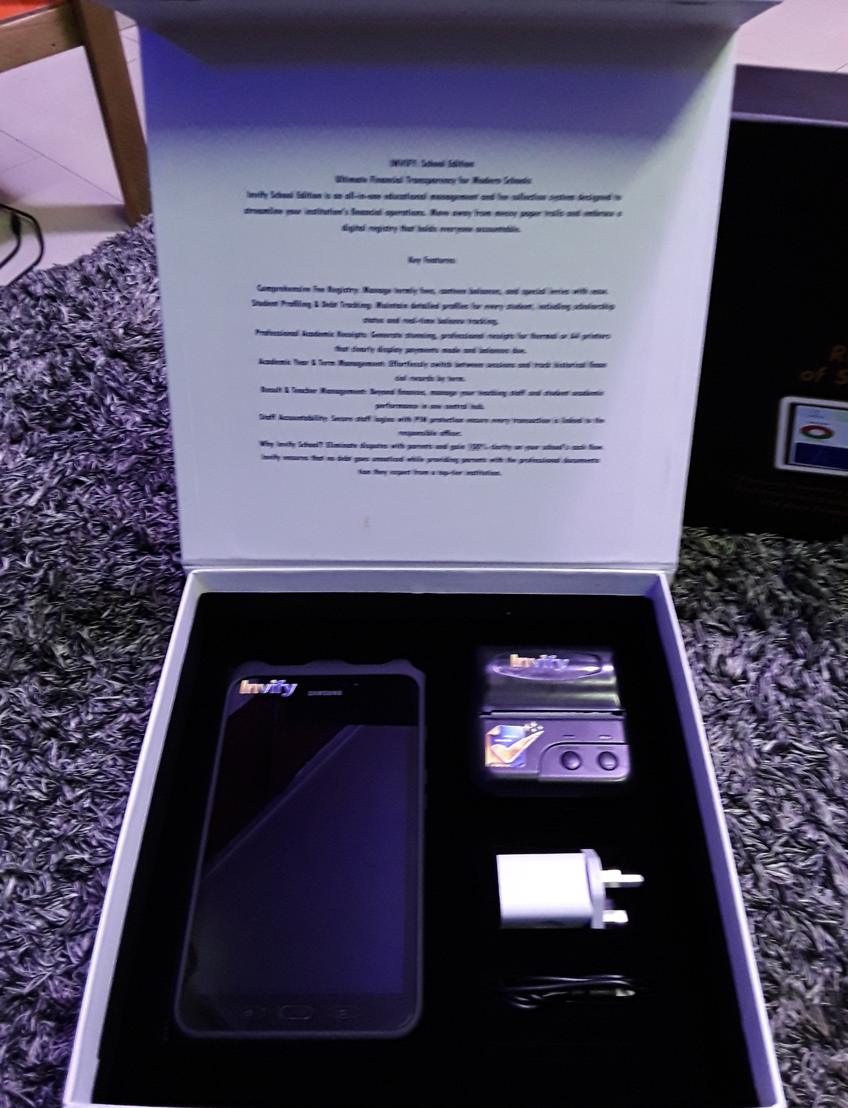
Why the Tablet + Payment Device Model?
DIFFERENTIATION
Richer interface
Merchant-ready
Large screen for guided payment, invoicing, records and analytics.
Portable, presentable and designed for customer-facing operations.
Operational depth
Dedicated payment
More memory/storage for richer applications and offline-oriented workflows.
Separate card device provides chip + PIN payment acceptance.
Important distinction
Invify is not replacing FCMB's existing POS estate. The Smart mPOS is a complementary form factor and merchant experience.
Invify × FCMB | Strategic Smart mPOS & Digital Collections Discussion 15
Notes:
Presenter: Aramide/device lead. This is the core differentiator. Keep the tone collaborative: 'We are not asking the bank to abandon what already works. We are proposing another device category for merchants who need a richer operating experience.'

Slide 16
Target Market & Use Cases
GO-TO-MARKET
01 Schools
02 Retail
03 Service / Artisans
Fee billing
Student/guardian records
Collections
Receipts
Expected vs recovered
Reconciliation
Analytics
Sales workflows
Inventory/materials
Customer records
Payment acceptance
Receipts
Transaction history
Job creation
Materials + labour
Customer records
Billing
Payment collection
Receipts
Payment history
Invify × FCMB | Strategic Smart mPOS & Digital Collections Discussion 16
Notes:
Presenter: Commercial lead. State that schools are the primary focus for this FCMB discussion, with retail and service businesses as adjacent markets. Mention Odies Bar in Ikorodu only as an example of the retail version 1.0 direction.

Slide 17
Business Model
COMMERCIAL
• Monthly SaaS subscription
• Device sale
• Transaction fee
• Payment revenue share
• Enterprise licensing
• Support / service fee
Commercial principle
The model can combine recurring software revenue with device economics and payment-related revenue, subject to FCMB's acquiring and commercial framework.
Bank opportunity
Acquire/retain merchants while extending the bank's payment relationship into business workflows and collections.
Pilot approach
Agree pricing, revenue share, device economics and merchant onboarding rules after technical/acquiring feasibility is confirmed.
Invify × FCMB | Strategic Smart mPOS & Digital Collections Discussion 17
Notes:
Presenter: Commercial lead. These are proposed revenue streams, not final agreed pricing. Invite FCMB to discuss its preferred commercial and acquiring model.

Slide 18
FCMB × Invify: Proposed Partnership Model
PARTNERSHIP
FCMB / Bank & Acquiring
Invify / Technology & Merchant Layer
• Merchant account / banking relationship
• Acquiring and card-processing infrastructure
• MID / TID provisioning and lifecycle
• Settlement
• APIs / SDKs / integration specifications
• Certification & security requirements
• Device acquiring / approved hardware process
• Pilot and operational support
• Merchant platform and application
• Billing / invoicing / collections
• Smart mPOS experience
• Reconciliation and reporting
• Merchant onboarding workflow
• Device/application integration
• Dotroid device management layer
• Merchant support / product operations
Joint outcome
A controlled, bank-powered Smart mPOS and digital collections proposition for Nigerian merchants.
Invify × FCMB | Strategic Smart mPOS & Digital Collections Discussion 18
Notes:
Presenter: Aramide. This is the key partnership slide. Ask FCMB to validate the division of responsibilities and identify the internal teams required: Business, Acquiring/Payments, Technology, Risk, Operations, Information Security and possibly Legal/Compliance.

Slide 19
Proposed Pilot Framework
NEXT STEP
• Phase 1 — Technical alignment: confirm acquiring architecture, APIs/SDKs, device model, MID/TID process, certification and security requirements.
• Phase 2 — Controlled integration: connect Invify to FCMB-approved payment services and settlement/reconciliation flows.
• Phase 3 — Device certification: validate tablet + dedicated payment device combination under FCMB/acquirer requirements.
• Phase 4 — Merchant pilot: deploy a controlled number of devices to selected merchants, with defined support and monitoring.
• Phase 5 — Review: assess transaction performance, merchant adoption, settlement/reconciliation, operational issues and commercial viability.
Pilot size & duration
To be agreed jointly after FCMB confirms certification and operational requirements.
Invify × FCMB | Strategic Smart mPOS & Digital Collections Discussion 19
Notes:
Presenter: Aramide. Do not commit to a device count or duration yet. The team can say the pilot size and duration will be proposed after FCMB confirms technical and operational prerequisites.

Slide 20
Questions for FCMB
DISCUSSION
• Which FCMB acquiring architecture should Invify integrate with for Smart mPOS?
• What card-processing APIs/SDKs and certification artefacts are required?
• What is the process for MID/TID provisioning, key injection, device onboarding and lifecycle management?
• What approved Smart mPOS/card-device models can FCMB support or certify?
• How should settlement, refunds/reversals, requery and reconciliation be integrated?
• What merchant KYC, risk, monitoring and operational requirements apply?
• Which FCMB teams should own the business, technical and pilot workstreams?
• What commercial structure would FCMB consider for the partnership?
Invify × FCMB | Strategic Smart mPOS & Digital Collections Discussion 20
Notes:
Presenter: Aramide. Turn the meeting into a working session. The strongest outcome is not simply 'they liked the demo'; it is that FCMB identifies owners and requirements for the next stage.

Slide 21
Invify Team
PEOPLE
Aramide Adebayo
CEO
Saliu Sherifdeen
Team Member
Oluwele Temitope
Team Member
Adekunle Matthew
Team Member
Aramide Adebayo
CEO
Saliu Sherifdeen
Team Member
Oluwele Temitope
Team Member
Okafor Helen
Team Member
Adewunmi Daniel
Team Member
Akwaja Chukwuma Daniel
Team Member
Nwosu Kelvin
Team Member
Adekunle Matthew
Team Member
Okafor Helen
Team Member
Presentation allocation
Aramide — opening/partnership • Product lead — workflow • Payments lead — acquiring/reconciliation • Device lead — Smart mPOS/Dotroid • Team members — demo support & Q&A.
Aramide — opening/partnership • Product lead — workflow • Payments lead — acquiring/reconciliation • Device lead — Smart mPOS/Dotroid • Team support — Q&A/demo.
Invify × FCMB | Strategic Smart mPOS & Digital Collections Discussion 21
Notes:
Suggested allocation: Aramide opens and closes. One team member owns the product walk-through. One owns payments/acquiring and reconciliation. One owns hardware/Dotroid. The remaining team members support live demo, evidence and Q&A. Confirm actual roles internally before the meeting.

Slide 22
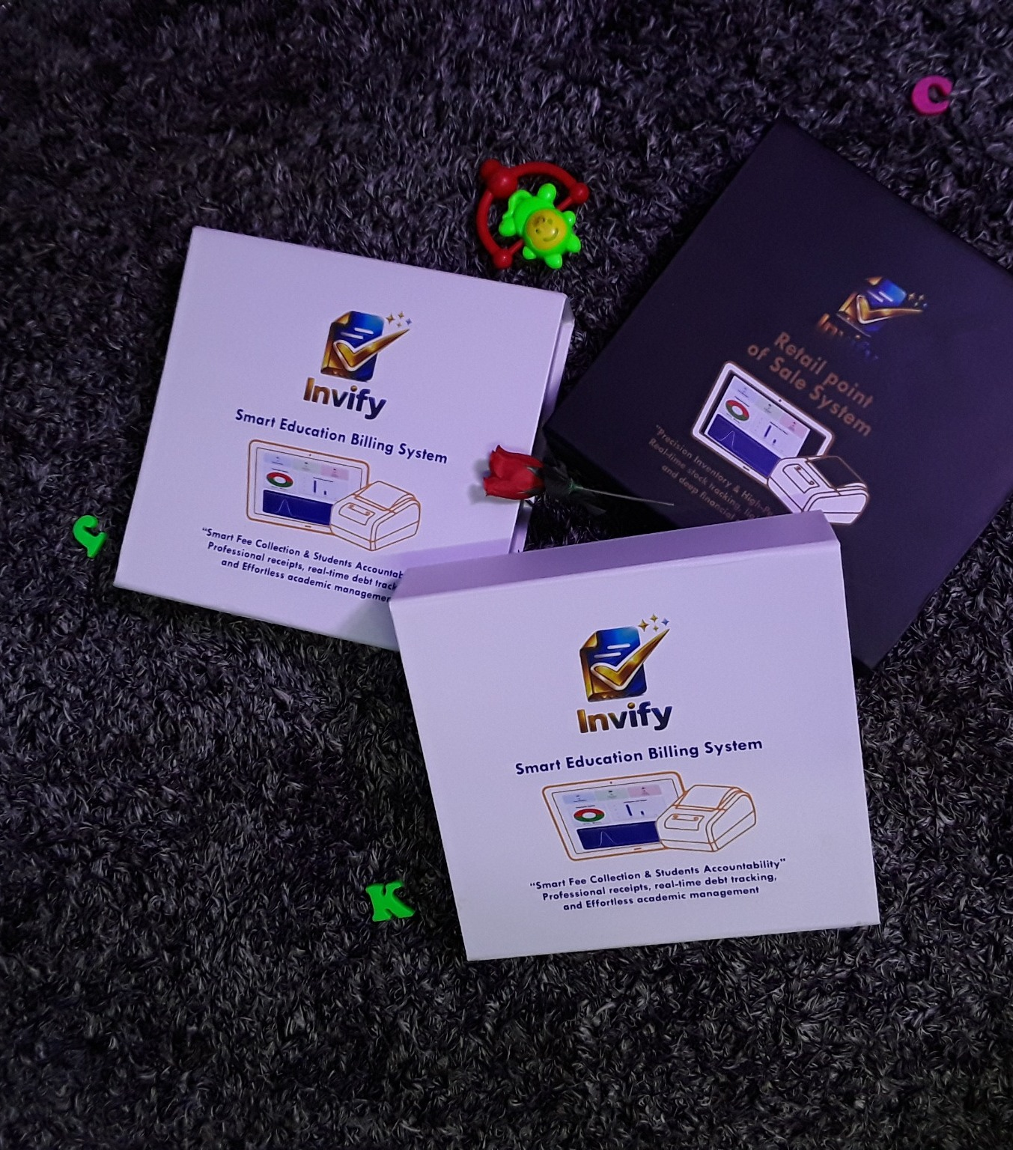
Thank You
We look forward to exploring a practical FCMB × Invify pilot.
Smart mPOS • Digital Collections • Merchant Management
Aramide Adebayo
CEO • IIPS / Invify
www.invify.org | support@iipa.app | 0802355332
Notes:
Closing (Aramide): Thank FCMB. Ask for agreement on the next meeting/workstream owners, the acquiring/API documentation to be shared, and the process for defining a controlled pilot.

