Slide 1
Soft Robotics & AI
Learning to Move with Morphology Inspired by Nature
Presenters: Yijiao Qin,Dongyang Zhu
Date: 09/14/2025

Slide 2
Motivation
Rigid robots: precise, strong, but brittle in unstructured environments
Biology shows soft, compliant, deformable bodies (octopus, elephant trunk, starfish)
AI enables control of these complex, hard-to-model systems

Slide 3
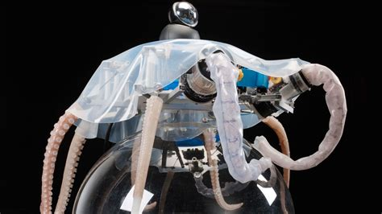
What is Soft Robotics?
Built from compliant materials (silicones, elastomers, textiles)
Properties: deformable, safe, adaptive
Advantages: Safety, Adaptability, Morphological computation

Slide 4
Why AI is Needed
Equations of motion: complex, nonlinear
Traditional control (PID, model-based) struggles
AI approaches: Reinforcement Learning, Evolutionary Algorithms, Differentiable Simulation

Slide 5
Case Study: Evolution Gym (Soft Robotics + RL)
Voxel-based soft robots: bodies built from small blocks (rigid, soft, actuators)
Environments: tasks like Walker, Climber, Pusher — each with rewards (e.g., distance traveled)
Training process:
AI policy controls actuators
Learns via reinforcement learning (trial & error)
Reward improves as robot discovers effective gaits
Outputs:
robot.npz: body morphology
ppo_evogym_walker.zip: learned policy (the “brain”)
Result: robots evolve gaits (walking, climbing, pushing) → AI discovers how to move
Notes:
We place a robot body into an environment (like Walker-v0).
The environment provides observations (state of the body, actuator positions, velocities).
The controller (AI policy) outputs actions (e.g., expand or contract actuators at each timestep).
The environment gives a reward signal (like forward distance traveled, stability, energy efficiency).
Over many rollouts, the AI policy learns to maximize this reward.
👉 In short: training = letting the AI figure out how to move the body to succeed at the task.

Slide 6
Demo
Training: train_evogym_save.py
Play: play_evogym_saved.py

Slide 7
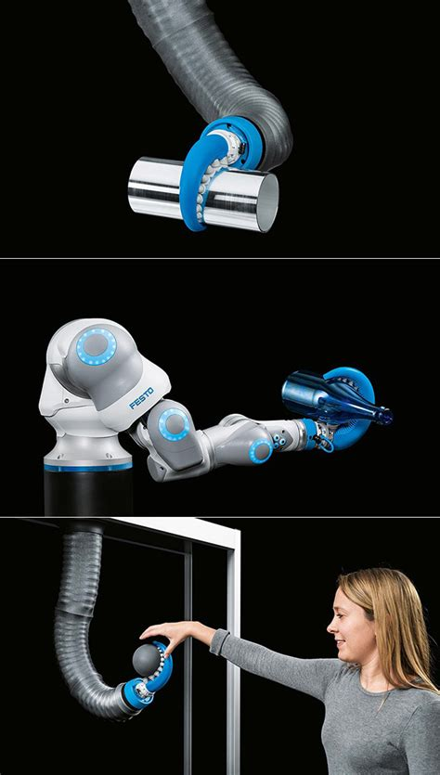
Results
RL learns to control soft morphology
Can adapt to grasping, pushing, locomotion
Demonstrates emergent intelligence from body+brain co-design

Slide 8
Challenges
Sim-to-real gap: policies may not transfer perfectly
Material fatigue & durability issues
RL training time can be long

Slide 9
Future Directions
Differentiable soft-body physics → faster training
AI co-designing bodies + controllers
Medical applications (soft surgical robots)
Environmental robots (soft underwater swimmers)

Slide 10
Conclusion
Soft robotics = safe, adaptive, bio-inspired
AI unlocks their potential by learning complex control
Together → robots that move and adapt like nature

