Slide 1
interim_Project_
Donavan

Slide 2
Issue
Investors often struggle to analyze multiple stocks efficiently and make informed decisions due to the overwhelming amount of data available. Filtering stocks by industry, sector, and other key metrics can be time-consuming.
Why It Matters: Making informed investment decisions is critical for financial success. Without the right tools to analyze historical stock data and key indicators, investors may miss out on important trends or make poor decisions that could result in financial loss.

Slide 3
Solution
The Stock Analysis App
provides a user-friendly platform for investors to analyze stocks from the S&P 500 and Nasdaq. Users can explore stock data, visualize historical performance, track moving averages, and manage portfolios—all in one place.
WebApp
PC , MAC ,phone :OK
web browser : OK

Slide 4
Target Users
Investors and traders interested in analyzing stocks.
Financial analysts who need interactive visualizations.
Beginners looking for a simple tool to understand stock performance.

Slide 5
Aim
Help user to find out the Support and resistance
Help user make decision
Prortfolio manage

Slide 6
Features
Stock Information and Overview: Users can view company details, stock prices, and market data for S&P 500 and Nasdaq companies.
Data Filtering and Visualization: Filter companies based on sectors and sub-industries, and visualize stock performance with candlestick charts and moving averages.
Stock Metrics and Indicators: View key metrics such as 52-week high/low, relative strength index (RSI), and moving averages (MA, EMA).
Portfolio Management: Users can simulate buying and selling stocks, track their portfolio, and view a summary of holdings.

Slide 7
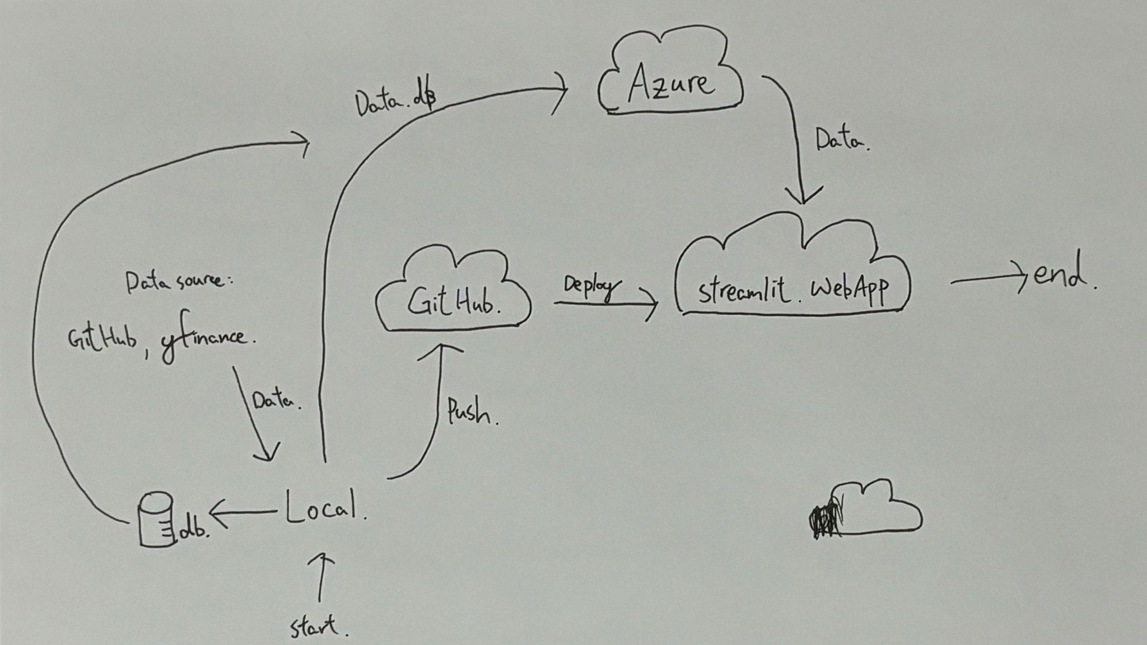

Slide 8
Buy
Buy low sell high
Short
sell high Buy low

Slide 9
Risk
Buying has limited risk (the amount invested), while shorting has unlimited risk (theoretically, prices can rise indefinitely).

Slide 10
Support and resistance

Slide 11
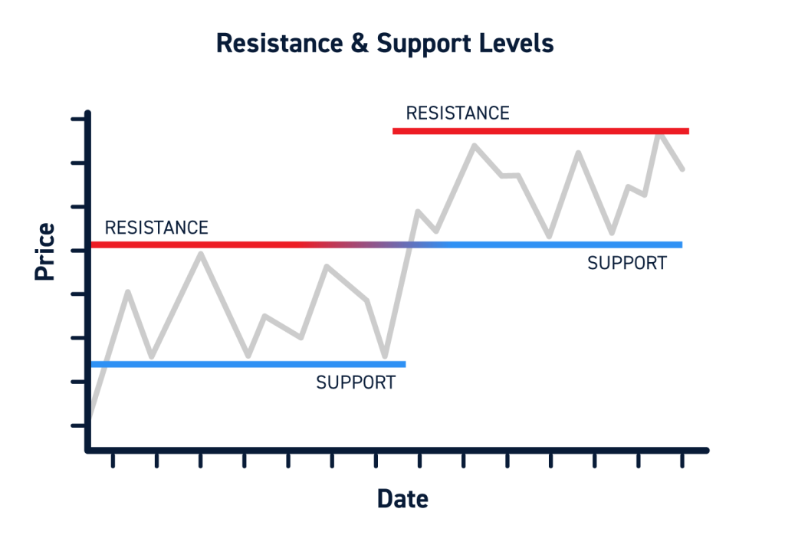

Slide 12
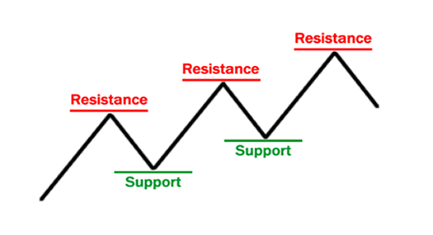

Slide 13
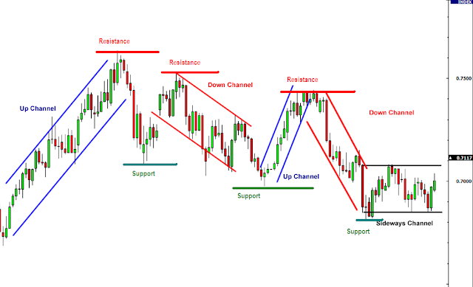

Slide 14
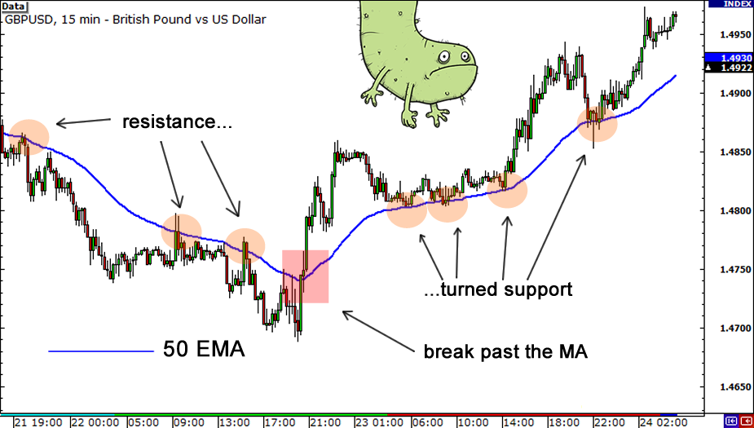

Slide 15
https://donavan02-stock-app.streamlit.app/

