Slide 1

Low Vision Shopping Assistance: Vision Language Model Integrating Image Enhancements and Automatic Speech Recognition
Dong Jieru
ISSE
Visual Information Engineering LAB
Date：2024.12.02

Slide 2
Contexts
01
02
03
04
Background
Literature Review
Model Introduction - Qwen2-VL-
Model Comparison
05
06
07
08
Technical Implementation
Future Work and Improvement Directions
Conclusion
System Architecture
2

Slide 3

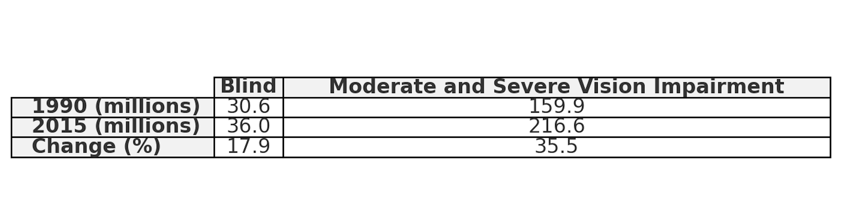
Background
Quantity and Types of Visual Impairments
Blindness and visual impairments affect hundreds of millions worldwide.
Common causes include cataracts, glaucoma, age-related macular degeneration, and diabetic retinopathy (IAPB)​(World Health Organization (WHO)
Data Source:Flaxman, Seth R., et al. "Global causes of blindness and distance vision impairment 1990–2020: a systematic review and meta-analysis" The Lancet Global Health 5.12 (2017): e1221-e1234..
3
Notes:
about 220 million people worldwide experience vision impairment
Research shows that from 1990 to 2015, vision impairment rose by 35.5%, far outpacing blindness. This highlights a growing need, making individuals with vision impairment the focus of my system.

Slide 4
Research Goal
A shopping assistance system for people with low vision
vision-language model (Qwen2-VL)
GPT-SoVITS
To improve accessibility and enhance the shopping experience for visually impaired individuals.
4
Notes:
People with low vision often struggle with accessing information in visually demanding scenarios. I plan to develop a shopping assistance system to improve their accessibility and shopping experience.

Slide 5
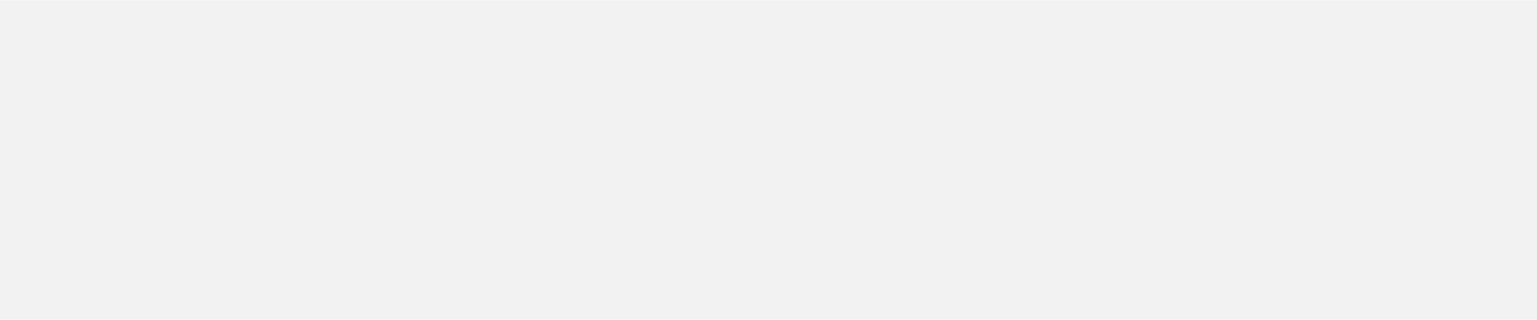
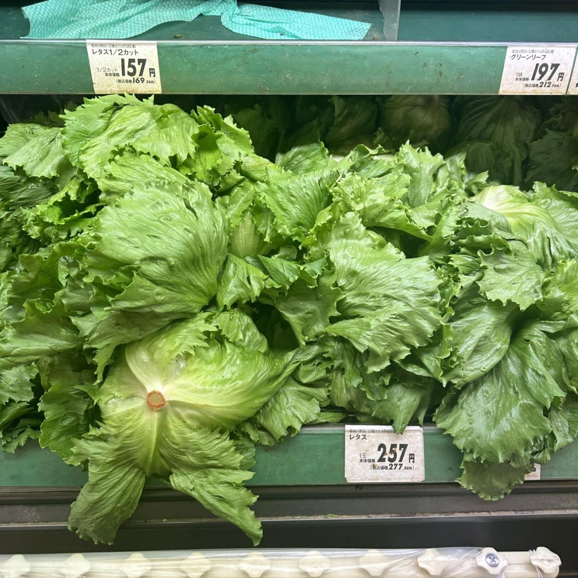
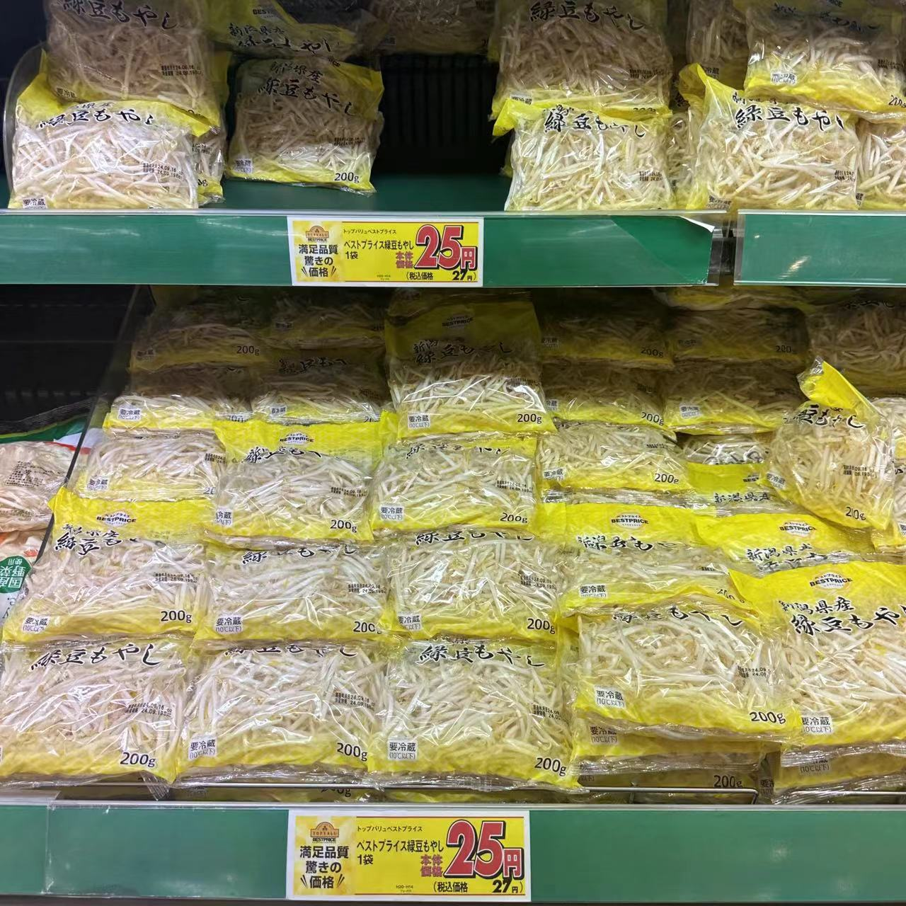
Literature Review
OCR and TTS Challenges in Supermarket Environments
· レタス 1玉
· 157円 (税込169円)
· レタス 1玉
· 257円 (税込277円)
緑豆もやし 200g 25円（税込 27円）
ベストプライス4月号モヤシ 満足品質、納得価格
5
Notes:
for visually demanding scenarios，Most current solutions rely on Optical Character Recognition combined with text to speech
OCR performs well in reading task but struggles with low light, cluttered backgrounds, and unstructured inputs in complex retail settings, limiting its accuracy and usability.
shopping is a far more common daily scenario that heavily relies on visual information. If we apply OCR to this senorio, the resulting text descriptions are as follows:

Slide 6
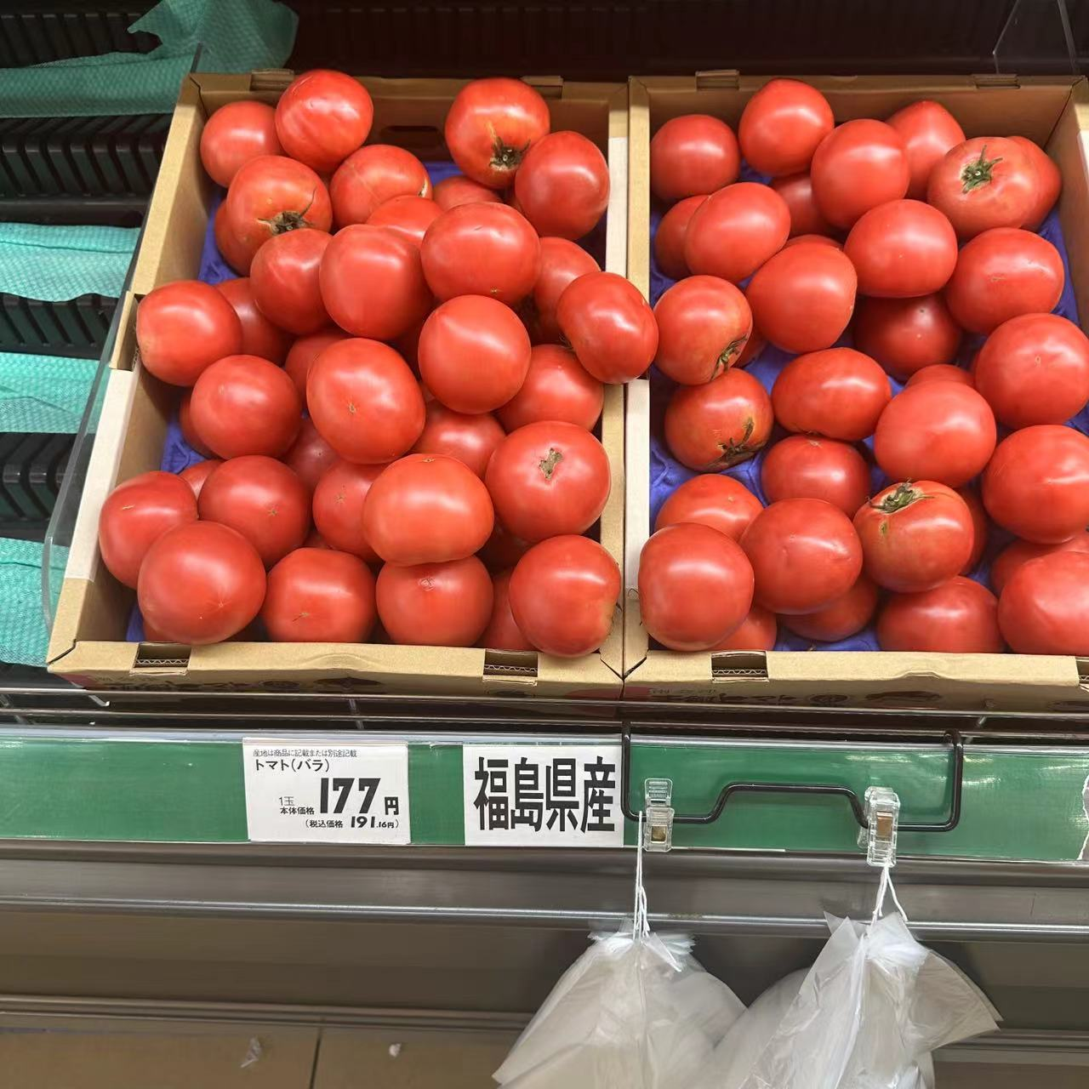
Limitations of Existing Work
When we see a basket of tomatoes in a supermarket
Do we identify them by reading the label?
Their appearance—features like the vibrant red color and round shape
Do we decide to purchase based solely on the label?
Appearance assessment
Price comparison
Usage needs
6
Notes:
OCR alone fails to enhance shopping for the visually impaired, lacking crucial visual and contextual details for decisions
When selecting tomatoes in a supermarket, we rely primarily on their appearance，as these visual cues are more intuitive than reading labels. Similarly, purchase decisions are influenced by factors such as freshness, uniformity, damage, suitability, rather than solely on text information obtained through OCR. In summary, most consumers make purchasing decisions based on the product's visual characteristics and contextual information, rather than relying entirely on textual data.

Slide 7
Literature Review
ChatGPT for Visually Impaired and Blind
Paper Title: ChatGPT for Visually Impaired and Blind
Publication Venue: 2024 International Conference on Artificial Intelligence in Information and Communication (ICAIIC)
Limitations:
1. Data Privacy Risks
2. Voice Function Issues
3. High Cost
4. Restricted Development Access
Open-Source Alternatives
Meta AI's LLaMA and Llama 2 Models
As a large language model, it supports voice interaction only, lacking image input capability.
7
Notes:
When it comes to enhancing the shopping experience, user interaction is just as important as the introduction of suitable models.
A recent study, "ChatGPT for Visually Impaired and Blind," introduced a system enabling natural language interaction with ChatGPT.
The article explores ChatGPT's features and limitations, introducing open-source models as potential alte“rnatives.
As a large language model, it supports voice interaction only, lacking image input capability.

Slide 8
Model Introduction
Vision-Language Model
LLaMa3.2 Qwen2-VL
A multimodal artificial intelligence model
Visual and textual data simultaneously
8
Notes:
After the conference article presented, LLaMa 3.2 was released.
LLaMa 3.2 is a Vision-Language Model.
In addition to LLaMa 3.2，I explored Qwen2-VL, which addresses OCR and llm limitations by excelling in visual QA, image description, and multimodal retrieval with its advanced Transformer-based design.

Slide 9
Model Comparison
BLEU Score Comparison
ROUGE Score Comparison
Recall-Oriented Understudy for Gisting Evaluation
Comprehensiveness
Relevance
Bilingual Evaluation Understudy
Accuracy
Fluency
9
Notes:
To find the best model for a shopping assistance system , I compared Qwen2-VL and LLaMa 3.2 using a supermarket image data by myself to evaluate their performance in this scenario.
These complementary metrics were chosen to evaluate the models: BLEU focus on accuracy and fluency, while ROUGE measures comprehensiveness and relevance.

Slide 10
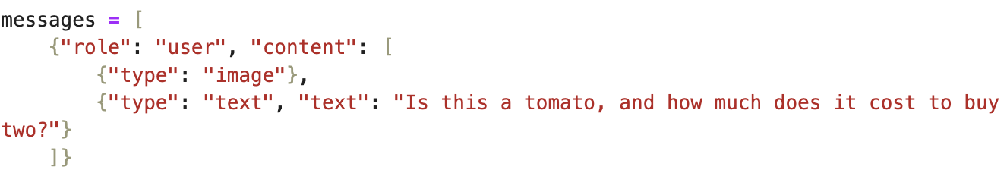
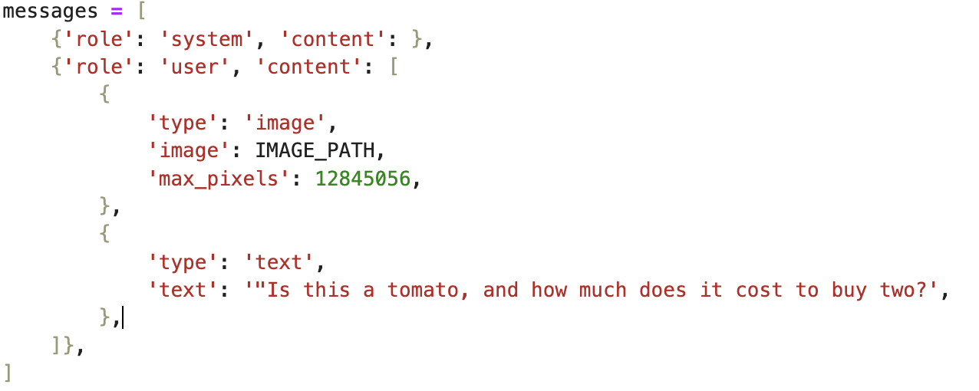
Model Comparison
Example
LLaMa
Qwen2-VL
10
Notes:
Both models compare generated and reference text using a unified dataset. Although this two models have different input processing mechanisms
, I standardized the prompt ，and reference text

Slide 11
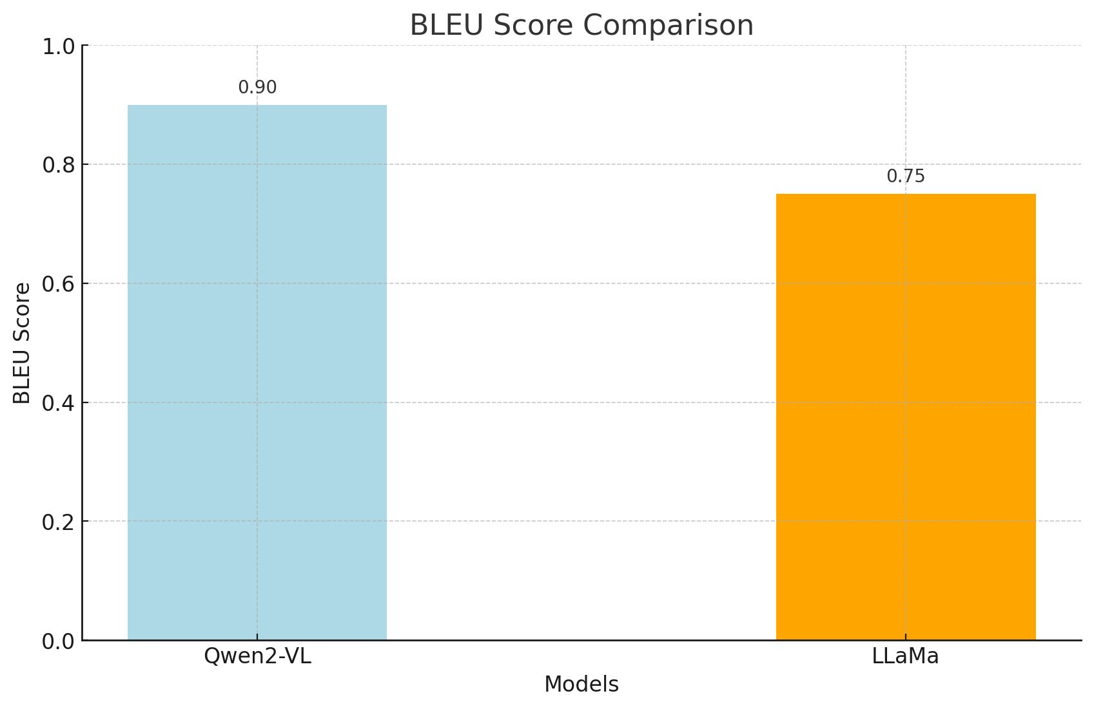
Model Comparison
Example Output
Qwen2-VL：Yes, the image shows tomatoes. The price tag indicates that the price for one tomato is 177 yen. To buy two tomatoes, you would pay 354 yen (177yen*2）
LLaMa3.2: Yes, these are tomatoes. The price is 177 yen for one, so two tomatoes would cost 354 yen
BLEU
Qwen2-VL: 0.90
LLaMa: 0.75
11
Notes:
Qwen2-VL outperforms LLaMa by 0.15 in the BLEU score, indicating that Qwen2-VL generates text with higher accuracy and fluency, making it closer to the reference text.

Slide 12
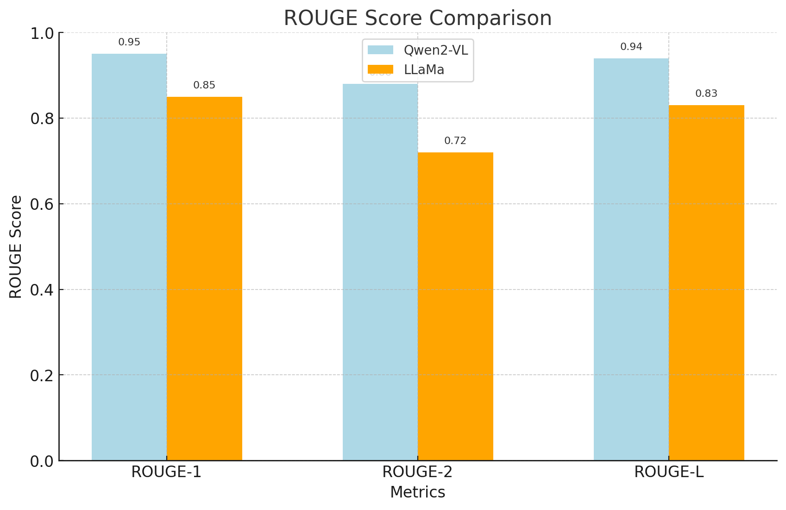
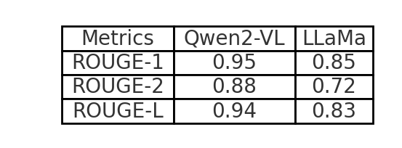
1. ROUGE-N
Definition: Measures the overlap of n-grams (sequences of n words) between the system-generated and reference summaries.
Subtypes:
ROUGE-1: Evaluates the overlap of unigrams (individual words).
ROUGE-2: Evaluates the overlap of bigrams (pairs of consecutive words).
2. ROUGE-L
Definition: Based on the Longest Common Subsequence (LCS), it calculates statistics for the longest shared sequence of words between the system and reference summaries.
3. ROUGE-W
4. ROUGE-S
5. ROUGE-SU
Model Comparison
ROUGE
12
Notes:
I used ROUGE metrics to evaluate models. (there are five aviable indicator for rouge, but to avoid data complexity and provide intuitive conclusions, I chose to compare only R1, R2, and RL for the overall comparison.)
with Qwen2-VL excelling in overall performance, as shown in the charts.
This comparison shows that Qwen2-VL is more suitable for my research goal.

Slide 13
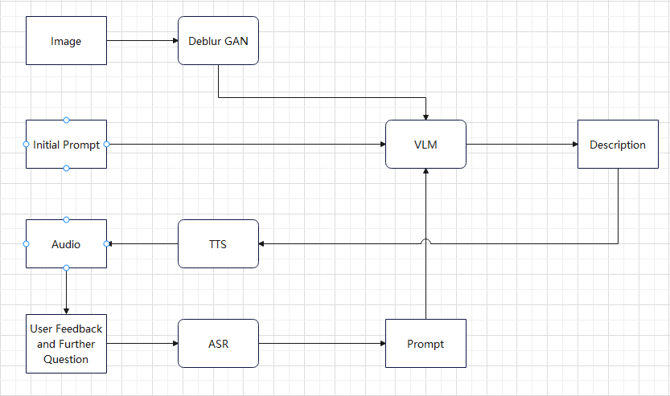
System Architecture
System Architecture Overview
Image Capture Module: Users capture product images using a smartphone
Image Deblurring Module: Enhances image clarity with DeblurGAN
VLM Module: Generates product descriptions with Qwen2-VL
TTS Conversion Module: Converts text to speech using TTS technology
User can ask questions based on the description, microphone module will record the input audio
ASR Module will turn the audio into text
VLM Module will process the further questions based on the chat history
13
Notes:
Next, I will begin designing my overall system.
Referring to the earlier mentioned assistance system utilizing chatgpt models, I designed my own shopping assistance system .
Next, I will explain each component of my system in detail.

Slide 14
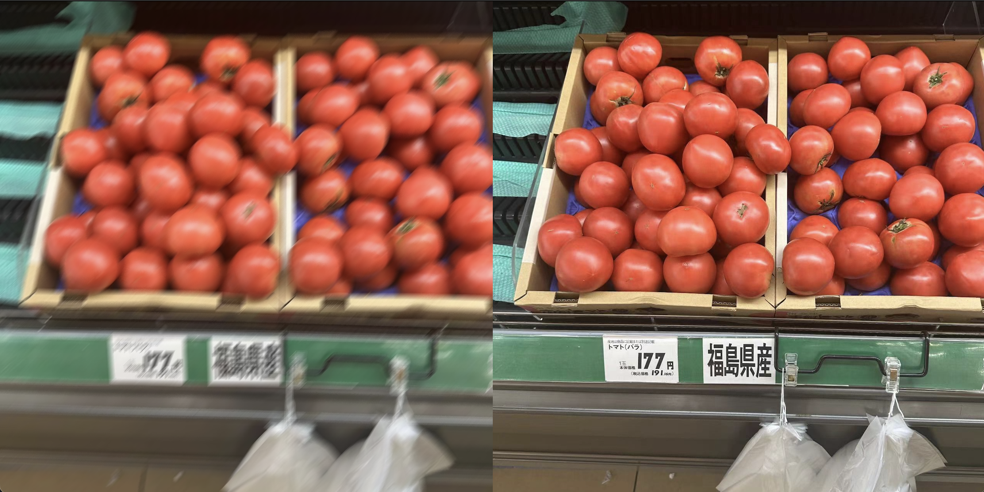
Overview of Deblur GAN
01
02
DeblurGAN is an image deblurring model based on Generative Adversarial Networks (GANs) designed to remove motion blur or camera blur from images
The goal of the model is to recover a sharp image from a blurry one
Data sample
14
Notes:
This model is primarily used to address the issue where visually impaired users may struggle to focus properly, resulting in blurry images.
I trained DeblurGAN using supermarket images and part of the ImageNet dataset, applying a motion blur filter to create paired blurry and sharp images for supervised training. Ensuring perfect pixel-level alignment allowed accurate loss calculation. To optimize, I concatenated blurry and sharp images into a single file, streamlining alignment and improving data loading efficiency.

Slide 15


Overview of Deblur GAN with Qwen 2 VL
Blur
DeBlur
Ground Truth
15
Notes:
To demonstrate DeblurGAN's effectiveness, I compared:
1.Blurred images as input to Qwen2-VL.
2.Deblurred images (processed by DeblurGAN) as input.
3.Clear images as ground truth for reference.
text outputs show that DeblurGAN results are closer to the ground truth than those from blurred images.

Slide 16
Overview of Deblur GAN with Qwen 2 VL
This image shows a pile of tomatoes neatly arranged in two wooden crates, each filled with many red tomatoes. The tomatoes appear fresh and plump.
Below the crates, there is a label with some text and numbers. According to the information in the image, the price of these tomatoes is 177 yen per kilogram. The label also mentions "福島県産" (Fukushima Prefecture), indicating that these tomatoes are produced in Fukushima, Japan.
In summary, this image showcases tomatoes from Fukushima Prefecture being sold at a price of 177 yen per kilogram.
This image shows a bunch of tomatoes neatly arranged in two wooden crates, placed on a supermarket shelf. Each tomato is red and looks very fresh.
Below the shelf, there is a label that reads "福島県産" (Fukushima Prefecture), indicating that these tomatoes are produced in Fukushima, Japan. The label also displays the price, with each tomato costing 177 yen (191.46 yen including tax).
Additionally, there are some plastic bags hanging on the shelf, likely for customers to use for packing the tomatoes. Overall, this is a photo showcasing fresh tomatoes from Fukushima Prefecture for sale in a supermarket.
This is a photo showcasing products on a supermarket shelf. In the image, two wooden crates filled with red tomatoes can be seen. The tomatoes appear fresh and vibrant in color.
Below the shelf, there is a label with price information. Although the image is somewhat blurry, the price of "17.8 yen" is legible. Next to the label, there is a QR code, likely for scanning to obtain more information or for payment.
In summary, this image displays fresh tomatoes on a supermarket shelf, priced at 17.8 yen.
Blur
DeBlur
Ground Truth
19
Notes:
(I trained deblurgan to improve the shopping experience of the blind, so it is more intuitive to directly compare the quality of the output text.)
text outputs show that DeblurGAN results are closer to the ground truth than those from blurred images.
I'll also consider comparing bleu to rogue for this follow-up.

Slide 17
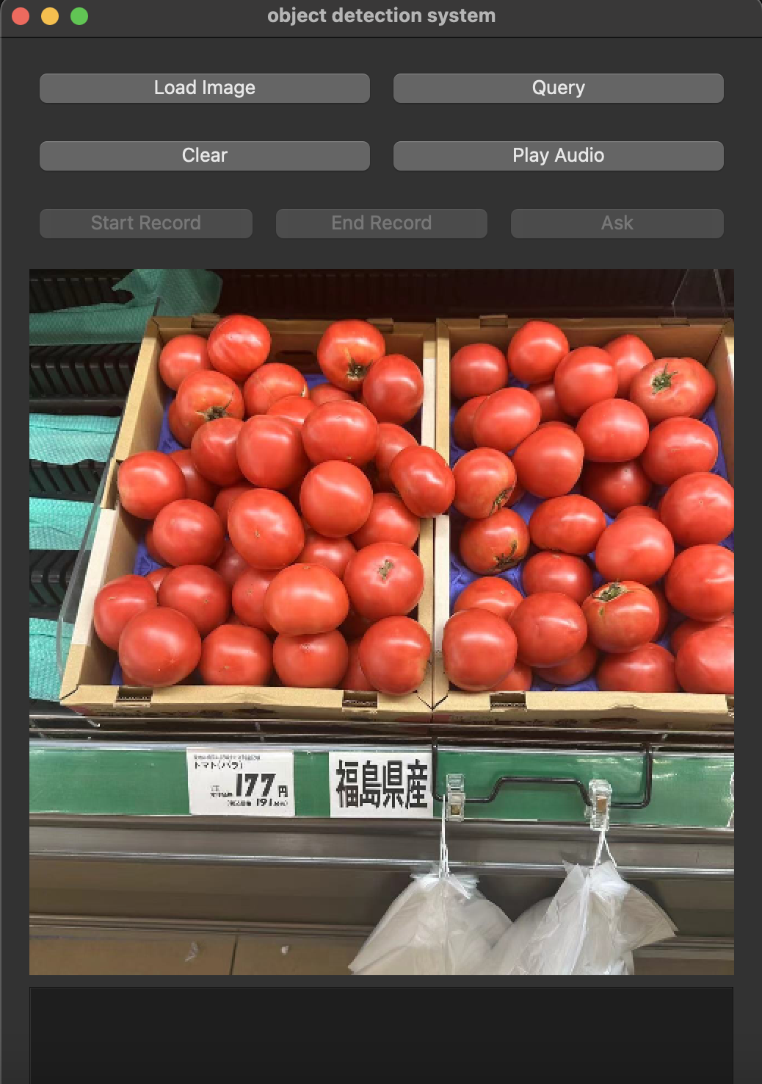
Overview of TTS and ASR
GPT-Sovits is a text-to-speech (TTS) technology
Zero-shot TTS
A 5-second voice
No need for retraining
Whisper is an automatic speech recognition (ASR)
When the user provides a voice command, it is transcribed into text using Whisper.
The text is then input into the GPT-SoVITS model, which generates a corresponding voice response.
16
Notes:
I choose it for its key feature zero-shot TTS: input a 5-second voice sample for instant text-to-speech conversion using GPT-SoVITS, requiring only a pre-trained model and no retraining
User voice commands are transcribed with Whisper and processed by GPT-SoVITS to generate a voice response.
Here is my demo
The client is lightweight, focusing on the graphical interface, web requests, and essential hardware operations for improved system compatibility.

Slide 18
Future Work and Improvement Directions
System Optimization
Image Deblurring Merge
Merge the model into image tokenizer of VLM model.
Increase modility
Combine voice feature into VLM. Make it voice in and voice out.
Expanding Features
Expand Application Scenarios
Explore applying the system in more daily life scenarios, such as traffic guidance, indoor navigation, etc.
Smart Adaptation
Optimize the system's adaptability in dynamic environments like streets, and other complex backgrounds.
17

Slide 19
Conclusion
Key Features
Image Analysis: Accurately recognize image content.
Natural Language Generation: Generate context-appropriate answers.
Voice Output: Deliver information through voice.
Problem Solved
Provide an accessible information interaction solution for visually impaired users facing difficulties in accessing information.
18
Notes:
This project developed image-based voice QA software using the Qwen2-VL model for individuals with visual impairments. Leveraging the model's multimodal understanding, it analyzes images, generates natural language answers, and delivers them via voice, enhancing accessibility. Future plans include improving voice generation and expanding application scenarios to reach more users.

Slide 20
Reference
[1] Flaxman, Seth R., et al. "Global causes of blindness and distance vision impairment 1990–2020: a systematic review and meta-analysis." The Lancet Global Health 5.12 (2017): e1221-e1234.
[2] Bourne, Rupert RA, et al. "Magnitude, temporal trends, and projections of the global prevalence of blindness and distance and near vision impairment: a systematic review and meta-analysis." The Lancet Global Health 5.9 (2017): e888-e897.
[3] Akhil, S. "An overview of tesseract OCR engine." A seminar report. Department of Computer Science and Engineering National Institute of Technology, Calicut Monsoon. 2016.
[4] Partanen, Niko. "Challenges in ocr today: Report on experiences from INEL." Электронная Письменность Народов Российской Федерации: Опыт, Проблемы И Перспективы. 2017.
[5] Oucheikh, Rachid, Tobias Pettersson, and Tuwe Löfström. "Product verification using OCR classification and Mondrian conformal prediction." Expert systems with applications 188 (2022): 115942.
[6] Benedikt, Lanthao, et al. "Optical character recognition and machine learning classification of shopping receipts." Statistics Netherlands, The Netherlands; office for national statistics, United Kingdom; statistics Austria, Austria (2020): 58.
[7] Brown, Tom B. "Language models are few-shot learners." arXiv preprint arXiv:2005.14165 (2020).
[8] Saeki, Takaaki, Shinnosuke Takamichi, and Hiroshi Saruwatari. "Incremental text-to-speech synthesis using pseudo lookahead with large pretrained language model." IEEE Signal Processing Letters 28 (2021): 857-861.

Slide 21
Addtional Slides

Slide 22
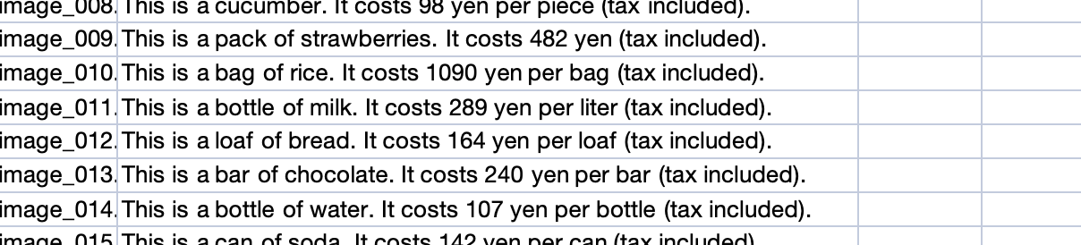
Dataset for the Comparison Task
Data Augmentation
Resolution：384x384
Horizontal Flip
Rotation
Gaussian Blur
Brightness and Contrast Adjustment
Add Noise
min_pixels = 256 * 28 * 28
Notes:
In this task, I only used a small set of images that I took myself in the supermarket, and the quantity is not very large. I annotated the information, converted the data from Excel to JSON, and then applied data augmentation.
Cropping was not used to avoid affecting the image information, such as cutting off price tags.
I have resized all my images to 384x384 ，448x448 meets the min_pixels requirement, 448x448 required too many resources I am using 384x384 instead

Slide 23
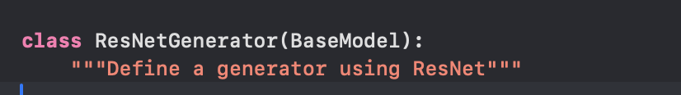


Deblur GAN
Dataset preparation
384x384
Generator：ResNetGenerator
Discriminator：NLayerDiscriminator
Epoch ：300
Learning rate： 0.0001
Notes:
To train DeblurGAN, I used collected supermarket images and a portion of the ImageNet dataset as the training data source.
A motion blur filter was applied to the images via convolution to create a blur effect that simulates linear motion. This paired data serves as the foundation for supervised training of the GAN model. The generator is responsible for producing sharp images from blurry ones, while the discriminator determines whether the generated sharp images resemble real sharp images.
When training DeblurGAN, it is essential that blurry and sharp image pairs are not only present but also perfectly aligned at the pixel level. This ensures that pixel-level loss can be accurately calculated. By applying a motion blur filter directly to sharp images, I ensured that the blurry and sharp images were spatially identical, with the same dimensions, perspective, and content fully aligned.
To further optimize the process, I horizontally concatenated the blurry and sharp images into a single file. This approach guarantees pixel-level alignment while reducing the complexity of file management. It eliminates the need for additional logic to verify whether the filenames of blurry and sharp images match, thereby improving data loading efficiency.
I used a subset of ImageNet, consisting of a total of 5,500 images.

Slide 24
Model Comparison
Relevance to the Scenario
Accurate and fluent descriptions (BLEU) ensure that users can easily understand the information.
Comprehensive and relevant outputs (ROUGE) ensure that important product details are not omitted.
ROUGE-W (Weighted Longest Common Subsequence)
ROUGE-S (Skip-Bigram Co-occurrence)
The task only requires simple prompt sentence, and the generated text is usually just one or two sentences.
Complex metrics like ROUGE-W and ROUGE-S are designed for long-text evaluations, focusing on text sequence or flexibility, and they have no practical significance in my task.
Notes:
ROUGE-Wfocuses on weighted longest common subsequences, primarily used for long-text evaluations to capture sequential consistency.
ROUGE-S measures skip-bigram co-occurrence, which is also more relevant for evaluating flexibility in longer texts.

Slide 25
Qwen2-VL:
Built on a powerful image encoder (e.g., ViT, Vision Transformer).
Focuses on extracting fine-grained features from images (e.g., edge information, object textures), making it suitable for image description generation tasks.
Supports multimodal data alignment, enabling deep matching between images and text.
LLaMa:
Although it also uses a ViT-like encoder, it primarily targets more general visual tasks (e.g., classification or retrieval), with relatively weaker capability in capturing fine-grained features.
ts visual feature extraction may not be as optimized for generation tasks compared to Qwen2-VL.。
Notes:
This design allows Qwen2-VL to handle images of arbitrary resolution without splitting them into patches, ensuring consistency between the model's input and the intrinsic information of the image, which more closely aligns with human visual perception.

Slide 26
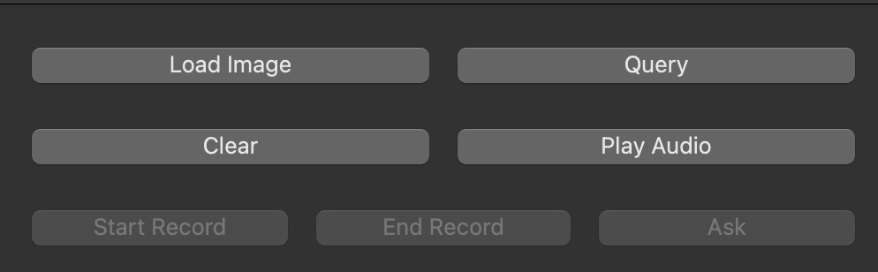
Demo
29
Notes:
The client is built using PyQt5 and includes components such as buttons, text boxes, image display areas, and more.
Its main features are as follows:
Image Loading and Display:
Users can select images to display within the interface.
Images can be loaded, cleared, and sent to a remote server for processing.
Voice Recording:
Supports recording audio through a microphone and saving it as a WAV file.
Provides start and stop recording buttons.
Interaction with Remote Services:
Sends images, text, or audio files to a remote Large Language Model (LLM) service and receives generated responses.
Received responses can be displayed in the log box.
Text-to-Speech (TTS):
Invokes remote TTS services to convert model-generated text into audio files.
Supports playback of the generated audio via an integrated player.
The client is designed to be highly lightweight, retaining only the graphical interface, web requests, and necessary hardware operations. This ensures better compatibility across different systems.

Slide 27
Contributions
Model Comparison
System Design
DeblurGAN Integration
Notes:
: I systematically compared two state-of-the-art models (Qwen2-VL and LLaMa3.2), both of which I identified as highly capable and suitable for this system. My analysis determined which model performs better for the task at hand.
: I developed a unique system that integrates the superior model identified from the comparison.
: To tackle practical challenges, such as blurry images commonly encountered during real-world use, I incorporated DeblurGAN into the system to enhance usability and performance.

Slide 28
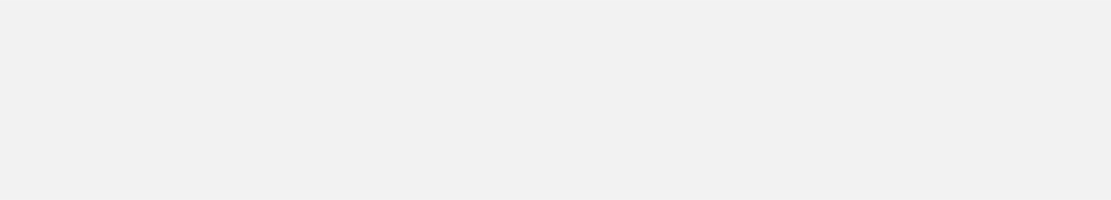
Method comparison
Advantages of OCR+TTS
- Universality
- Real-time Feedback
- Low Cost
Disadvantages of OCR+TTS
- low light
- cluttered backgrounds
- dynamic scenes
5
Notes:
visually demanding scenarios，Most current solutions rely on Optical Character Recognition combined with text to speech
OCR performs well in ideal conditions but struggles with low light, cluttered backgrounds, and unstructured inputs in complex retail settings, limiting its accuracy and usability.

Slide 29
Overview of Qwen2-VL
01
02
Image Captioning
Visual Question Answering (VQA)
Image-Text Matching
Image Classification and Object Detection
Multimodal Translation
Limitations of OCR+TTS and LLM mentioned in the literature review
10
Notes:
A literature review indicates that previous assistive systems for visually impaired users predominantly relied on OCR (Optical Character Recognition) and TTS (Text-to-Speech) technologies. These systems were heavily dependent on textual content in images, primarily designed for reading purposes. However, in real-life scenarios, such as supermarket shopping, text alone often fails to provide sufficient information.
To address this gap, I designed a novel system tailored specifically for this use case.

Slide 30
Overview of Deblur GAN with Qwen 2 VL
Blur
DeBlur
Ground Truth
15
Notes:
To demonstrate DeblurGAN's effectiveness, I compared:
1.Blurred images as input to Qwen2-VL.
2.Deblurred images (processed by DeblurGAN) as input.
3.Clear images as ground truth for reference.
text outputs show that DeblurGAN results are closer to the ground truth than those from blurred images.

Slide 31
Overview of Deblur GAN with Qwen 2 VL
This image shows a pile of tomatoes neatly arranged in two wooden crates, each filled with many red tomatoes. The tomatoes appear fresh and plump.
Below the crates, there is a label with some text and numbers. According to the information in the image, the price of these tomatoes is 177 yen per kilogram. The label also mentions "福島県産" (Fukushima Prefecture), indicating that these tomatoes are produced in Fukushima, Japan.
In summary, this image showcases tomatoes from Fukushima Prefecture being sold at a price of 177 yen per kilogram.
This image shows a bunch of tomatoes neatly arranged in two wooden crates, placed on a supermarket shelf. Each tomato is red and looks very fresh.
Below the shelf, there is a label that reads "福島県産" (Fukushima Prefecture), indicating that these tomatoes are produced in Fukushima, Japan. The label also displays the price, with each tomato costing 177 yen (191.46 yen including tax).
Additionally, there are some plastic bags hanging on the shelf, likely for customers to use for packing the tomatoes. Overall, this is a photo showcasing fresh tomatoes from Fukushima Prefecture for sale in a supermarket.
This is a photo showcasing products on a supermarket shelf. In the image, two wooden crates filled with red tomatoes can be seen. The tomatoes appear fresh and vibrant in color.
Below the shelf, there is a label with price information. Although the image is somewhat blurry, the price of "17.8 yen" is legible. Next to the label, there is a QR code, likely for scanning to obtain more information or for payment.
In summary, this image displays fresh tomatoes on a supermarket shelf, priced at 17.8 yen.
Blur
DeBlur
Ground Truth
19
Notes:
I trained deblurgan to improve the shopping experience of the blind, so it is more intuitive to directly compare the quality of the output text. I'll also consider comparing bleu to rogue for this follow-up.

Slide 32
Why Choose the Supermarket Scenario
Accessibility Beyond Reading Needs
High Visual Dependency with Low Text Dependency
Notes:
### **Why Choose the Supermarket Scenario**
1. **Accessibility Beyond Reading Needs:**
Current technology focuses heavily on high-visual scenarios like reading environments. However, not everyone has the need to read books, but everyone needs to shop. The supermarket scenario ensures inclusivity by addressing a universal activity rather than niche use cases.
2. **High Visual Dependency with Low Text Dependency:**
The supermarket represents a visually demanding environment where users need to identify products, prices, and labels. At the same time, the dependency on complex text-based content is minimal, making it an ideal balance for testing practical and efficient solutions for visually impaired users.

Slide 33
Vision Transformer (ViT) 是一种用于图像处理的深度学习模型，基于 Transformer 架构设计。与传统的卷积神经网络（CNN）不同，ViT 不使用卷积操作，而是采用与自然语言处理任务中 Transformer 类似的机制来处理视觉数据。以下是 ViT 的核心概念和结构：
核心概念：
图像分块 (Patch Embedding):
位置编码 (Positional Encoding):
Transformer 编码器 (Transformer Encoder):
分类令牌 (CLS Token):
全连接层 (MLP Head):
ViT 的工作流程：
输入预处理:
Transformer 操作:
输出处理:
ViT 的优点：
全局特征捕获能力强:
参数共享:
无需设计卷积操作:
ViT 的缺点：
对大规模数据的依赖:
计算资源需求高:
  O(n2)O(n^2)
难以处理局部细节:
ViT 的应用:
图像分类:
目标检测:
图像分割:
多模态任务:
ViT 的引入标志着 Transformer 在视觉领域的成功应用，为图像处理提供了一种新思路，并为后续的多模态模型（如 Qwen2-VL）奠定了基础。

