Slide 1

campusCall
By: Dante, Jonathan, Omar and Chris

Slide 2

New Core Functionalities:
Teacher can create and delete a course
Teacher can add students to the course
Teacher can remove students from courses
Student can access course information (course roster)
Search function for the roster

Slide 3
Challenges
The website was not scaling properly across different sized monitors
Not specifying the scope of the project properly
General communication when not in person
Having most functionalities overlap due to dependencies that ended with unequal workloads

Slide 4
Team contributions
Dante- Worked on the dashboard page HTML and the Add/Remove student, using PHP/HTML along with some SQL.
Jonathan- cPanel migration, HTML clean up. Testing on Safari.
Omar- Full stack, Omar was responsible for the sign in and sign up features including the backend and frontend code. Also, alongside with Chris, created course creation and course deletion as well as the backend and front end code.
Chris- Frontend, Chris created the links between the webpages, cleaned the frontend and worked with Omar through all of the core features. Managed the project through Trello and kept everybody on track.

Slide 5








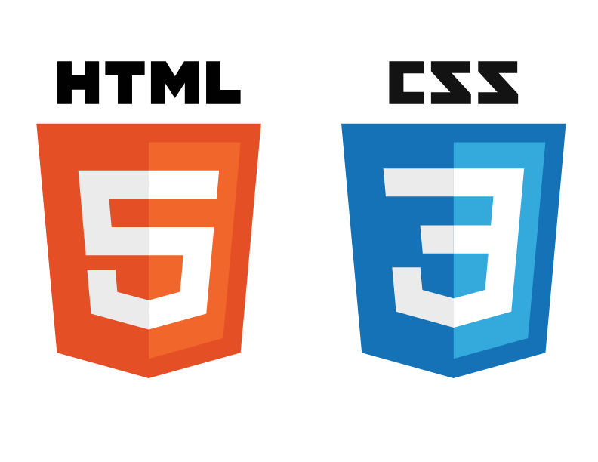

Software we used
Github- Version control and code repository https://github.com/joncvinar/campusCall
Trello – Project management tool, used to assign, manage, and track tasks. Typically updated post weekly standups (using agile methodologies)
cPanel along with XAMPP/MAMP(macOS) for storing MySQL servers. cPanel for cloud hosted, XAMPP/MAMP locally hosted (testing)
VS code along with Atom were our IDE’s of choice for HTML/CSS/PHP/SQL
PHP, SQL, HTML, CSS were the languages used

