Slide 1


Protect Your SPFx Solutions:
Build Secure Backends with Azure Functions
Don Kirkham - Microsoft MVP, M365 Development

Slide 2
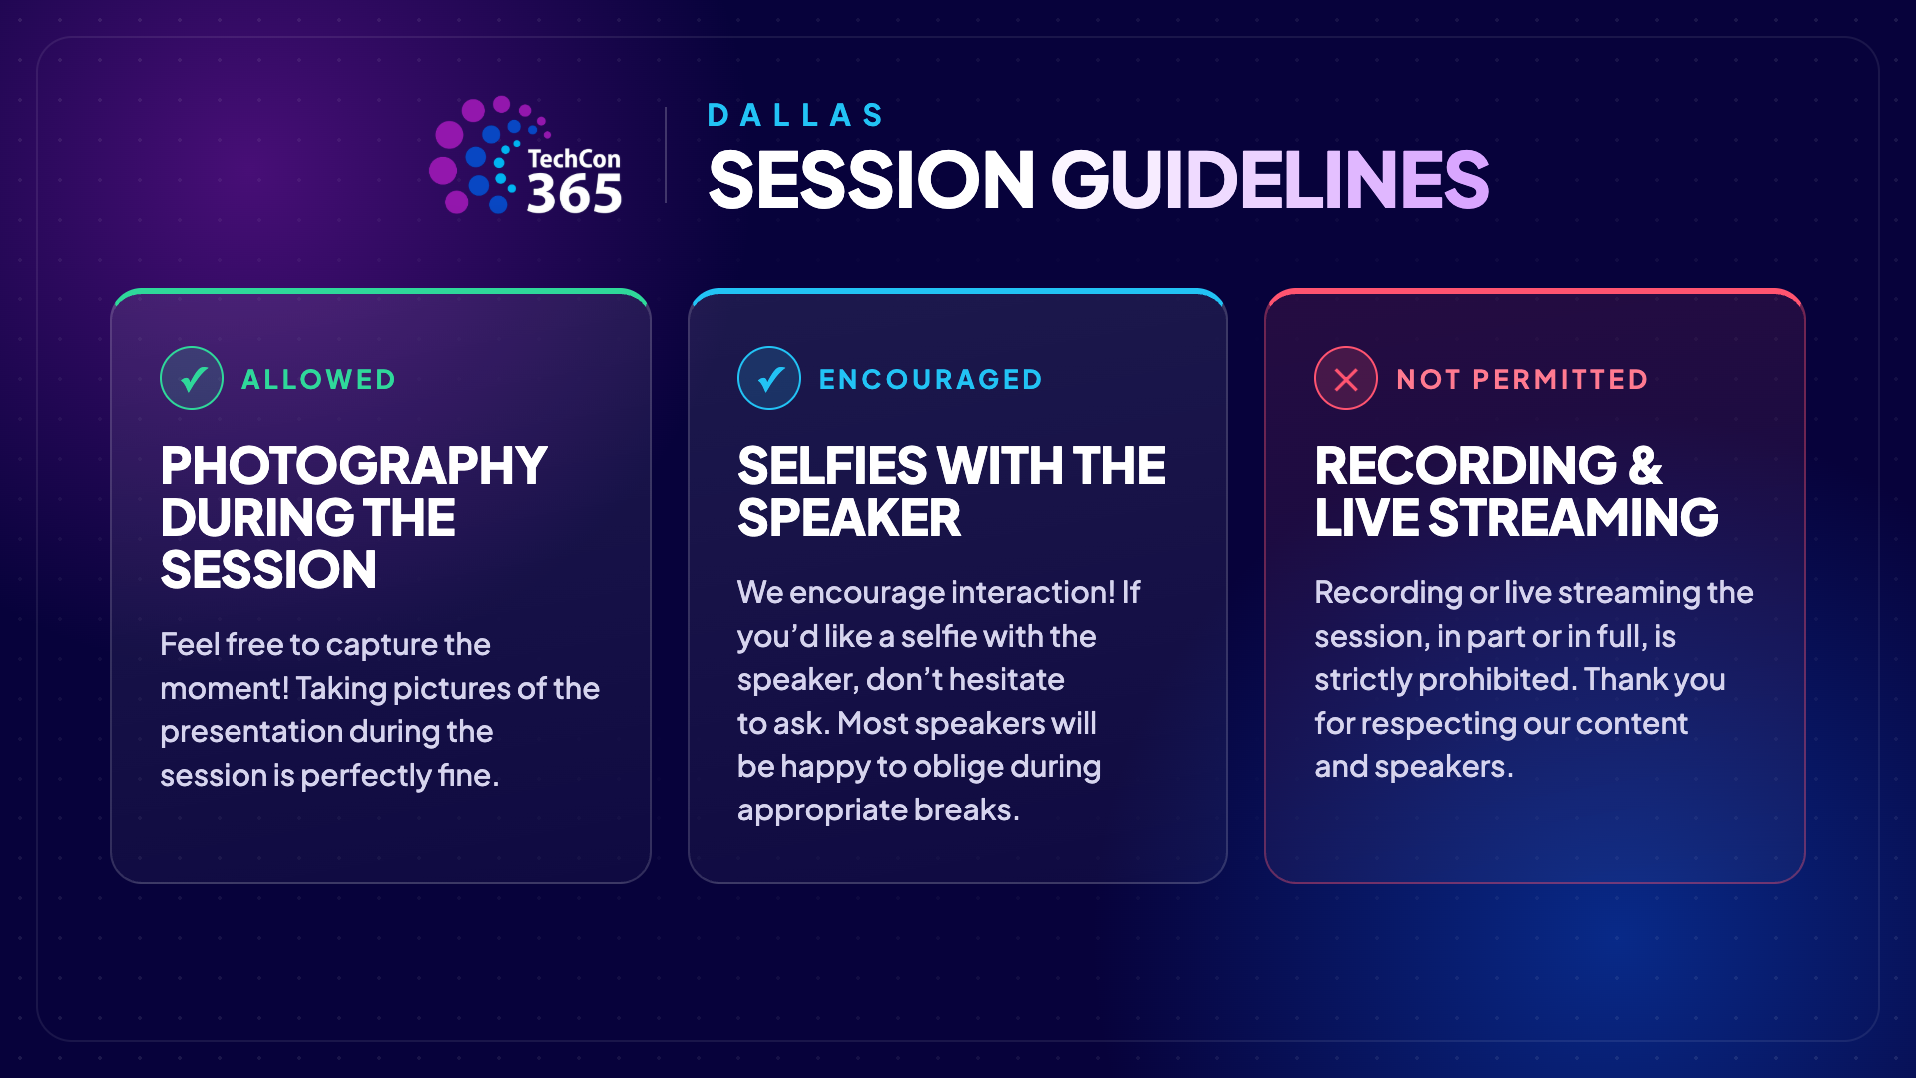

Slide 3
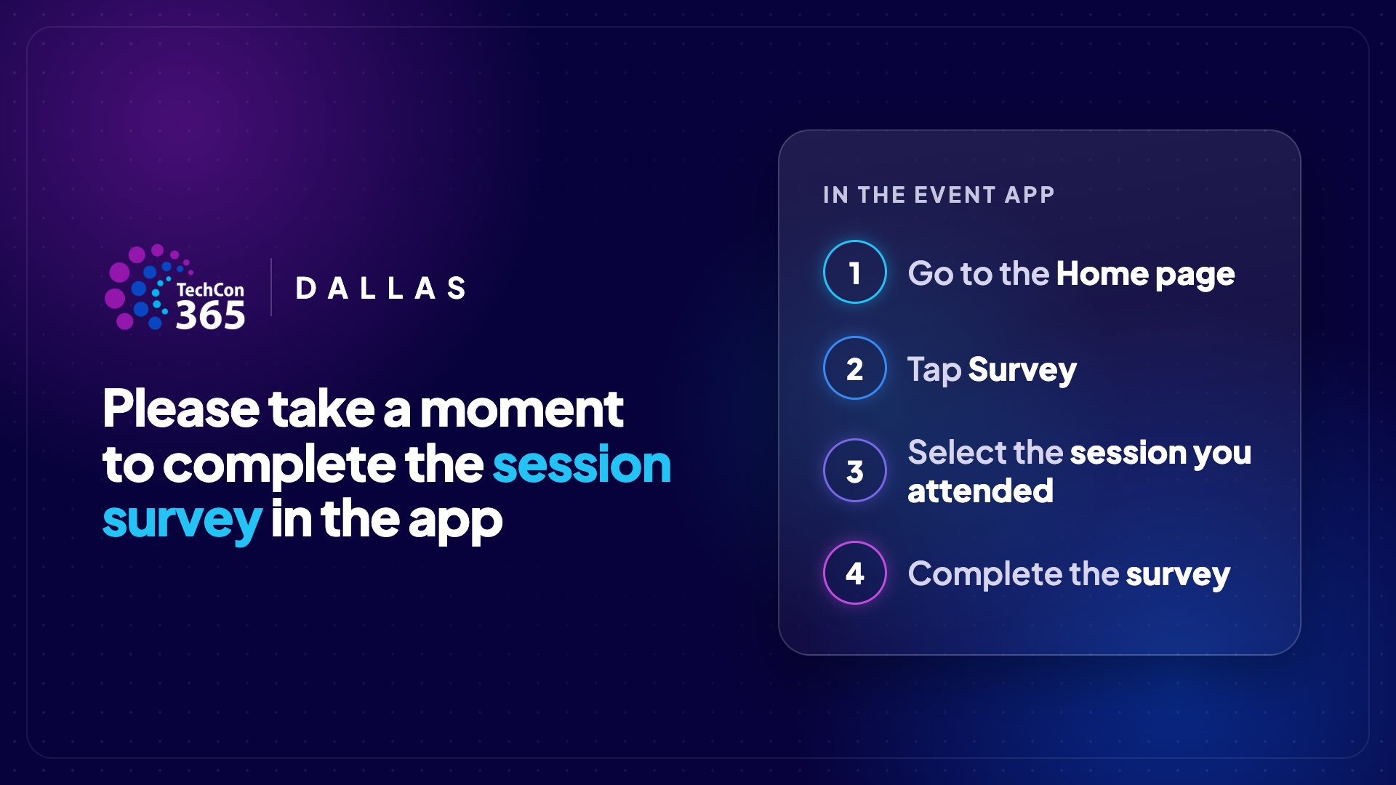

Slide 4













DoN Kirkham
Microsoft MVP, M365 Development
Arlington, Texas, USA
Senior Technology Advisor
https://donkirkham.com
/in/DonKirkham
@DonKirkham
DonKirkham

Slide 5



DoN Kirkham
Microsoft MVP, M365 Development
Arlington, Texas, USA
Senior Technology Advisor
https://donkirkham.com
/in/DonKirkham
@DonKirkham
DonKirkham

Slide 6

 | SolutionFoundry® M365 Solutions and Beyond. Built for your needs. By our experts.
Secure Microsoft 365 modernization, automation, and custom development
Core M365 Services SPFx custom development SharePoint modernization Power BI, Automate, and Apps AI and Copilot integration | Qualifications 30 years of federal contracting Microsoft MVP expertise Trusted advisors embedded in client teams Fluent in federal compliance and security
Federal & Regulated Support Compliance-driven mission systems Enterprise portals and knowledge platforms Three decades in regulated environments | Representative Solutions Portals, dashboards, and reporting Compliance workflows and audit readiness Knowledge and self-service platforms
www.solutionfoundry.com

Slide 7











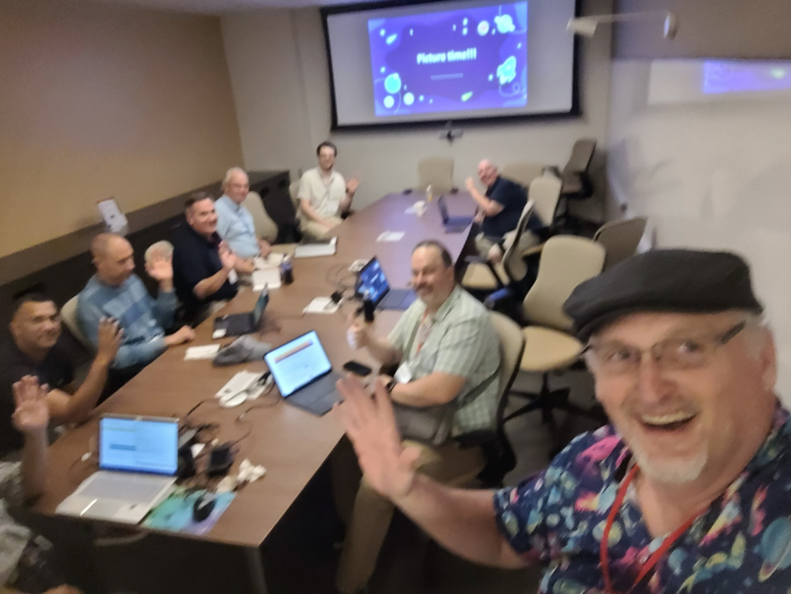



PICTURE TIME!

Slide 8
The Problem
Your SPFx web part reads directly from a SharePoint list.
But not every user who can see the page has permission to that list — and the web part has no identity of its own. It can only act as the signed-in user.
THE CONSEQUENCE
Users without access hit a wall
403 errors, empty lists, or blank cards — the experience silently breaks for a subset of people.
Loosening list permissions is risky
Granting everyone direct access over-shares data and removes your control over who reads what.
User A
Full access
SPFx Web Part
runs AS the signed-in user
SharePoint
List
✓
User B
Read-only
!
✗
User C
No access

Slide 9
DEMO!

Slide 10
Session Roadmap
01
Azure Functions Orientation
02
PnPjs in Node.js
What they are, how they work, local dev loop
App-only auth, SPFI instance, list operations
03
Tier 1: Origin-Validated API
04
Tier 2: Entra ID Protected API
Lightweight protection + CRUD endpoints
Custom app registration + token validation
05
Calling Both APIs from SPFx
06
Deploy & Harden
HttpClient vs. AadHttpClient side by side
Managed identity, least privilege, CI/CD

Slide 11

Azure Functions
Orientation
What they are · How they work · Local dev loop

Slide 12
What Are Azure Functions?
Serverless Compute
Run code on demand — no servers to manage. Azure handles scaling and patching.
Triggers
Pricing
Languages
HTTP request
Timer / CRON schedule
Queue & Service Bus
Blob & Event Grid
Consumption — PAYG, cold starts
Flex Consumption — warm starts
Premium — no cold starts
Dedicated — flat rate
C# / .NET
JavaScript / TypeScript
Python
Java
PowerShell
Our Picks for SPFx
HTTP request trigger + Flex Consumption + TypeScript hosted in Node.js
On Demand, Pay-for-use, and one language across our SPFx web part and API.

Slide 13
The HTTP Trigger — Anatomy of a Function
TypeScript
authLevel: 'anonymous'
import {
app,
HttpRequest,
HttpResponseInit,
InvocationContext
} from '@azure/functions';
app.http('getItems', {
methods: ['GET', 'POST', 'PATCH', 'DELETE'],
authLevel: 'anonymous',
handler: async (req, ctx) => {
// your logic here
return {
status: 200,
jsonBody: data
};
}
});
We handle auth ourselves — don't let Azure add its own key requirement on top.
methods: ['GET', 'POST', 'PATCH', 'DELETE']
Declare which verbs this endpoint accepts. This API registers ONE function per auth tier and lets the HTTP method pick the CRUD action (GET=read, POST=create, PATCH=update, DELETE=delete).
handler async function
All Azure Function logic lives here. Async/await throughout — PnPjs calls are all promises.
Notes:
One combined handler per tier: registerCrudRoutes(prefix, authorize) in helpers.ts registers {prefix}/{itemId?} for GET/POST/PATCH/DELETE, and dispatchCrudOperation switches on the method. No action words in the URL.

Slide 14
Project Structure & Local Dev Loop
Project Structure
VS Code + Functions Extension
1
apiDemo/
├── src/
│ ├── functions/
│ │ ├── domainRestricted.ts
│ │ ├── entraProtected.ts
│ │ ├── health.ts
│ │ └── helpers.ts
│ ├── security/
│ │ ├── domainRestriction.ts
│ │ └── entraAuth.ts
│ ├── sharepointClient.ts
│ ├── config.ts
│ └── httpError.ts
├── .github/workflows/ deploy.yml, infra.yml
├── infra/main.bicep
├── tests/
├── host.json
├── local.settings.json
└── package.json
Scaffolds, runs, and debugs your app locally with breakpoints.
local.settings.json
2
Config only — maps to Azure App Settings. No secrets
CORS origins set under Host.CORS section
Never commit this file
func start
3
Spins up the local HTTP server — test each function URL with Postman before touching SPFx.

Slide 15

PnPjs in a
Node.js Context
App-only auth · SPFI setup · Shared instance pattern

Slide 16
PnPjs: Browser vs. Node.js
In Your SPFx Web Part
In Your Azure Function
Uses @pnp/sp with spfi()
PageContext provides auth context
Runs in the browser — user's session token
SharePoint auth is implicit
@pnp/sp/presets/all or selective imports
Same @pnp/sp package — same API surface
No browser, no page context
Must provide auth explicitly
Uses AzureIdentity (@pnp/azidjsclient) over SPDefault()
App identity — the Function App's managed identity; nothing stored, nothing to rotate
Certificates also work (SharePoint REST rejects client-secret app-only tokens)
💡 Same API calls you already know — just a different auth setup underneath

Slide 17



App-Only Auth: Managed Identity
Turn On the Identity
Grant SharePoint Access
Nothing to Store
Function App → Identity → System assigned: On. Bicep does it with identity: { type: SystemAssigned }. No app registration, no credential.
Give the identity the SharePoint app role Sites.ReadWrite.All — one CLI call; the Portal cannot. Sites.Selected is the least-privilege choice.
Azure issues the token to the identity at runtime. No certificate, no secret, no Key Vault, no expiry to track. The only setting the code needs is SHAREPOINT_RESOURCE.
src/sharepointClient.ts — One SPFI per site
import { spfi } from '@pnp/sp';
import { SPDefault } from '@pnp/nodejs';
import { AzureIdentity } from '@pnp/azidjsclient';
import { ManagedIdentityCredential } from '@azure/identity';
const credential = new ManagedIdentityCredential(); // no tenant, client id, or secret
export function getSp(siteUrl: string) { // *.sharepoint.com hosts only; cached per site
return spfi(siteUrl).using(SPDefault(),
AzureIdentity(credential, [process.env.SHAREPOINT_RESOURCE]));
}

Slide 18
DEMO!

Slide 19

Tier 1: Origin-Validated API
Lightweight protection + SharePoint CRUD via PnPjs

Slide 20


What Is Origin Validation?
What it DOES protect
What it DOESN'T protect
Browsers automatically send the Origin header
Validates the caller is a known SharePoint domain
Rejects unknown/missing origins with HTTP 403
Good guard against casual misuse or accidental exposure
Zero friction for legitimate SPFx callers
Origin headers can be spoofed by non-browser clients
Any server-side tool (Postman, curl) can fake origin
Provides NO identity verification
Not appropriate for sensitive or write-heavy operations
Not a substitute for authentication
When Is This Tier Appropriate?
Read-heavy endpoints that surface non-sensitive SharePoint list data.
Internal tools where the consumer audience is known and trusted.
Stepping stone — add Entra ID when requirements demand it.

Slide 21
Tier 1: CRUD Endpoints with PnPjs
All four verbs hit one route — /api/domain/{itemId?} — dispatched by HTTP method.
GET
Get Items
POST
Create Item
GET /api/domain
-----------------------------
getSp(siteUrl).web.lists.getByTitle(listTitle)
.items() // $select, $filter, $top pass through
POST /api/domain
-----------------------------
getSp(siteUrl).web.lists.getByTitle(listTitle)
.items.add(body.fields)
PATCH
Update Item
DELETE
Delete Item
PATCH /api/domain/{itemId}
-----------------------------
getSp(siteUrl).web.lists.getByTitle(listTitle)
.items.getById(id).update(body.fields)
DELETE /api/domain/{itemId}
-----------------------------
getSp(siteUrl).web.lists.getByTitle(listTitle)
.items.getById(id).delete()

Slide 22
Origin Validation Middleware
src/security/domainRestriction.ts
Environment Variable Allowlist
ALLOWED_CALLER_DOMAINS =
https://contoso.sharepoint.com,...
Comma-separated — no secrets in code.
const ALLOWED = (process.env.ALLOWED_CALLER_DOMAINS ?? '')
.split(',').map(o => o.trim()).filter(Boolean);
export function ensureAllowedDomain(req: HttpRequest): void {
const origin = req.headers.get('origin')
?? (req.headers.get('referer')
? new URL(req.headers.get('referer')!).origin
: null);
if (!origin) throw new HttpError(403,
'Request origin or referer is required.');
if (!ALLOWED.includes(origin)) throw new HttpError(403,
'Caller domain is not allowed.');
}
Check Both Headers
Origin is set by CORS requests. Referer is set by navigation. Checking both handles edge cases.
Throw error if not allowed
On a missing or not allowed origin, it throws new HttpError(403), which runWithErrorHandling turns into the response.
Usage in Handler
ensureAllowedDomain(req);
Interrupts execution with error; otherwise, safe to continue

Slide 23
DEMO!

Slide 24

Tier 2: Entra ID
Protected API
Custom app registration · Token validation · Identity-aware

Slide 25



When to Step Up to Entra ID Auth
Sensitive Data
User Identity Matters
PII, financial records, or data that shouldn't be accessible to anonymous API consumers.
You need to know WHO is calling — for audit trails, row-level permissions, or personalized data.
Write Operations
Non-Intranet Callers
Creating, updating, or deleting data carries more risk. Knowing the caller's identity is essential.
If the API could ever be called from outside your SharePoint domain, origin validation alone isn't sufficient.
Tier 1 and Tier 2 can coexist — use the right tier for each endpoint's risk profile

Slide 26
Custom App Registration: Expose an API
New App Registration
1
Entra ID → App registrations → New registration. Name it something recognizable (e.g. SPFx-SecureAPI-Server). No redirect URI.
Expose an API
2
Set Application ID URI (api://{client-id}). Add a scope — e.g. SharePoint.ReadWrite. Set to 'Admins and users'.
Register Client App
3
Separate app registration for your SPFx solution. This is the CALLER — it requests the scope you defined above.
Grant API Permission
4
In the CLIENT app: API permissions → Add → My APIs → select your server app → check the scope. Admin consent.

Slide 27
Token Validation: What Claims Matter?
iss
aud
azp / appid
scp
Issuer
Audience
App ID
Scope (not enforced)
Must be your tenant's Entra ID endpoint. Rejects tokens from other tenants.
Must match your server app's Application ID URI. Tokens meant for Graph won't pass.
The requesting app. Checked against ALLOWED_CLIENT_APP_IDS when set; empty = any tenant app passes.
This project does NOT check scp today — it relies on the app-ID allowlist. Validating scp too is a reasonable hardening add.
src/security/entraAuth.ts — validateEntraToken()
import jwt from 'jsonwebtoken'; import jwksClient from 'jwks-rsa';
export async function validateEntraToken(req: HttpRequest): Promise<JwtPayload> {
const token = req.headers.get('authorization')?.match(/^Bearer\s+(.+)$/i)?.[1];
if (!token) throw new HttpError(401, 'Authorization bearer token is required.');
// jwt.verify with { algorithms:['RS256'], audience, issuer } + jwks-rsa signing key,
// then check azp/appid against ALLOWED_CLIENT_APP_IDS. Returns the JwtPayload.
}

Slide 28
DEMO!

Slide 29

Calling Both APIs
from SPFx
HttpClient vs. AadHttpClient · webApiPermissionRequests

Slide 30
Tier 1 from SPFx: HttpClient
HttpClient is the standard SPFx HTTP client — no token, no extra config. The browser sends the Origin header automatically. You just call your API URL.
MyWebPart.ts
No Token Needed
const client = this.context.httpClient;
const response = await client.get(
process.env.
API_BASE_URL + '/api/domain',
HttpClient.configurations.v1
);
if (!response.ok) {
// Surface 403 to user
throw new Error(`API error: ${response.status}`);
}
const items = await response.json();
HttpClient sends the browser Origin header automatically. Your origin validation middleware handles the rest.
Store URL in Config
Don't hardcode the function URL. Use web part properties or an environment config so the URL can change per environment.
Error Handling
A 403 from origin rejection should surface a meaningful message — not a generic network error.

Slide 31
Tier 2 from SPFx: AadHttpClient
Step 1: Declare the permission in your web part manifest
"webApiPermissionRequests": [ { "resource": "api://{client-id}", "scope": "SharePoint.ReadWrite" } ]
MyWebPart.ts — AadHttpClient call
Admin Approval Required
const aadClient = await this.context
.aadHttpClientFactory
.getClient(
'api://{your-api-client-id}');
const response = await aadClient.get(
process.env.
SECURE_API_URL + '/api/entra',
AadHttpClient.configurations.v1
);
if (!response.ok) {
// 401 = bad/expired token
throw new Error(`Auth error: ${response.status}`);
}
After deploying your solution package, a SharePoint admin must approve the API permission in the SharePoint Admin Center.
SPFx Handles the Token
AadHttpClientFactory acquires and caches the Bearer token automatically. You never touch the token directly.
getClient = Resource URI
Pass the Application ID URI (api://…) of your SERVER app registration — not the client app.

Slide 32
Side-by-Side: What Actually Changes
Tier 1 — HttpClient
Tier 2 — AadHttpClient
Import
import { HttpClient } from '@microsoft/sp-http'
import { AadHttpClient } from '@microsoft/sp-http'
Get client
this.context.httpClient
await this.context.aadHttpClientFactory
.getClient('api://{client-id}')
Make call
client.get(url, HttpClient.configurations.v1)
aadClient.get(url, AadHttpClient.configurations.v1)
Token
None — browser sends Origin
Auto-acquired Bearer token in Authorization header
Manifest
No changes needed
webApiPermissionRequests entry required
Admin step
None
Admin approves permission in SPO Admin Center

Slide 33
DEMO!

Slide 34

Deploy & Harden
Managed identity · Least privilege · CI/CD

Slide 35


Production Hardening Checklist
Least Privilege: Sites.Selected
Pin the Site and List
Sites.ReadWrite.All reaches every site in the tenant. Grant Sites.Selected and allow only the sites this API needs. This repo still uses ReadWrite.All.
Set SHAREPOINT_SITE_URL and SHAREPOINT_LIST_TITLE so callers cannot choose the target. Unpinned, any authorized caller reaches any list the identity can.
Application Insights
Managed Identity (Done)
One checkbox in the Azure Portal. Gets you request traces, failures, response times, and custom telemetry. Turn it on always.
The Function App's own identity calls SharePoint. No secret, no certificate, nothing in Key Vault, nothing to rotate or expire.
Automate Deployment (CI/CD)
CORS — Lock It Down
Ship through GitHub Actions or Azure DevOps Pipelines, not manual publish. Run two pipelines: one for infrastructure (Bicep) and a separate one for application code, so each can deploy and roll back independently.
In local.settings.json: allow localhost. In Azure Function App: only add your SharePoint domains. Don't use wildcard *.

Slide 36

Recap
Azure Functions: serverless HTTP backends for SPFx
PnPjs works the same in Node — just needs explicit auth
Tier 1: origin validation for low-risk read endpoints
Tier 2: Entra ID + token validation for sensitive ops
HttpClient vs. AadHttpClient — one line of difference
Production Ready: managed identity, App Insights, CI/CD
Resources
Azure Functions Repo: github.com/donkirkham/apiDemo
Data Demo Repo: github.com/donkirkham/dataDemo
Blog: donkirkham.com
Twitter/X: @donkirkham

Slide 37
Q&A
Questions?
Don Kirkham
https://donkirkham.com
@DonKirkham
/in/DonKirkham
github.com/DonKirkham
Notes:
Likely questions to be ready for:
- "Why two identities?" → The managed identity is how the Function calls SharePoint. The app registration is the API the web part gets a token for. They never overlap; the app registration holds no SharePoint credential.
- "Why not a client secret?" → SharePoint REST rejects secret-based app-only tokens (401 Unsupported app only token). Certificates work; managed identity works and stores nothing.
- "Is Sites.ReadWrite.All safe?" → It is tenant-wide. Sites.Selected limits the app to named sites and is the least-privilege answer; the demo repo still uses ReadWrite.All.
- "Can Tier 1 be spoofed?" → Yes. Origin and Referer are plain headers; curl sets them freely. It stops casual cross-site calls from browsers, nothing more.
- "What if ALLOWED_CLIENT_APP_IDS is empty?" → Any app in the tenant that can get a token for this API passes. Set it. Scopes and app roles are not checked in the demo.
- "Does the Function respect the user's list permissions?" → No. It runs app-only, so the Reader and the Outsider can write. That is the point, and the trade-off: per-user rules have to live in the Function.
- "Why did my first deploy register zero functions?" → Remote build was skipped. .funcignore excludes node_modules and dist, and Flex Consumption ignores SCM_DO_BUILD_DURING_DEPLOYMENT, so pass --build remote / remote-build: true.

