Slide 1

INTRO TO reverse ENGINEERING
0:000> da 00d010d8
00d010d8 "Instructor | email"
0:000> da 00d014a0
00d014a0 “William Staud | William.staud@gmail.com
0:000 > da 00d01218
00d01218 “Author | Aaron Bray/Will Staud”

Slide 2
COURSE roadmap
0:000> dt demo!_COURSE_ROADMAP
+0x000 Introduction : Uint4B
+0x004 IntroDynamicAnalysis : Uint4B
+0x008 IntroStaticAnalysis : Uint2B
+0x00a IntroToCompilers : Uint2B
+0x00c WindowsInternalsPrimer : UChar
+0x00d DynamicRuntimeLinking : UChar
+0x00e ExecutableFileFormats : UChar
+0x00f LinkingAndLoading : UChar
+0x010 BinaryAnalysisConcepts : Uint4B
+0x014 CompilerOptimizations : Uint4B
+0x018 CPlusPlus : Uint4B
+0x01c AdditionalTopics : Uint4B

Slide 3
introDUCTION
Beginning RE

Slide 4
OBJECTIVES
Understand the basic goals of RE
Introduce various types of analysis
Identify translation of basic constructs from C to Assembly

Slide 5
reverse ENGINEERING
Process of determining how a program (or set of programs) works (typically without access to source code)
Wide Variety of motivations

Slide 6
TYPES of ANALySIS
Dynamic Analysis
Focus on watching what happens at run time
Debuggers and whole-system monitoring tools (such as procmon/procexplorer) may be utilized
Static Analysis
Focus on looking at disassembly, file sections, headers, etc.
Tools such as IDA Pro, radare2, python libraries such as pefile or elftools may be employed
Other tools such as Strings are frequently used
Combination
May use both static and dynamic analysis to get results

Slide 7
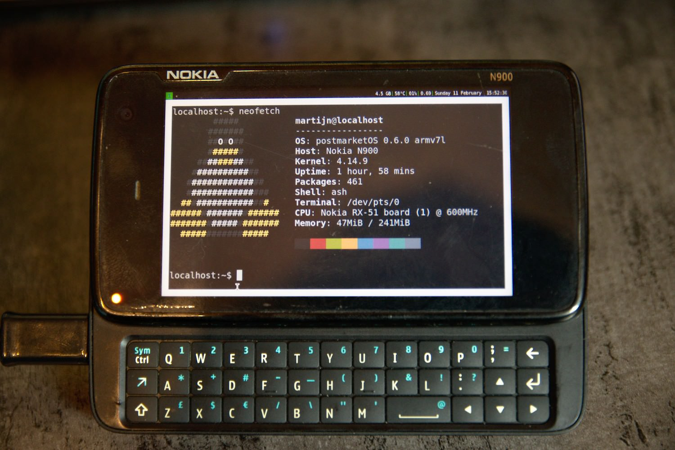
INrTO to Dynamic ANALYSIS

Slide 8
OBjECTIVES
Understand and utilize, at a basic level, principles relating to dynamic analysis
Understand the basic operation of debuggers
Utilize, at a basic level, Windbg for the purpose of dynamic analysis
Utilize, at a basic level, the Sysinternals tools for the purpose of dynamic analysis

Slide 9
DynamiC ANALYSIS TOOLS
*mon tools (Sysinternals) - Rather powerful instrumenting tools that give a good view of resource usage
Debuggers - Allow us to inspect and trace through the execution of a given application
(Linux) strace - Gives a list of system calls used by a given application

Slide 10
PROCMON
Can give lots of good information about process accesses
Lots of filter options that can be leveraged
Provides a good amount of insight into application I/O activity

Slide 11
PROCEss EXPLORER
Gives a great deal of useful information about what system resources a given process is interacting with
Can view lots of good details regarding kernel objects accessed
We will discuss this in greater detail later

Slide 12
Debuggers… How do they work!?
Basic Workflow:
Open Process
Read/Modify memory
Read/Modify register state
Recommended Reading:
Gray Hat Python: Python Programming for hackers and reverse engineers. Justin Seitz, No Starch Press, 2009

Slide 13
Breakpoints
Two Varieties: Hardware and Software

Slide 14
Hardware Breakpoints
Hardware - Utilizes Debug Registers
Limited in number (DR0-3 on x86)
Each register holds a linear address
DR7 (the control register) dictates the condition to break on (read/write/execute)
On some platforms (e.g., Linux), they require running in kernel mode to set/modify

Slide 15
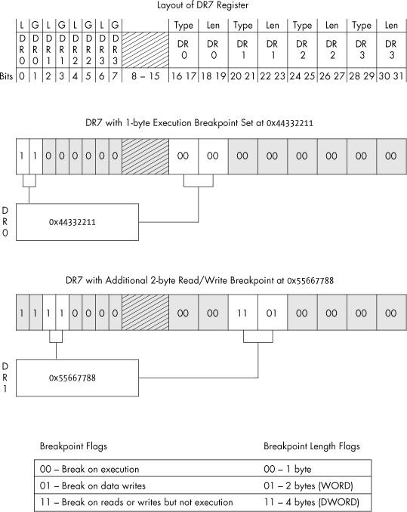
Seitz, Justin. Gray Hat Python: Programming for hackers and reverse engineers. No Starch Press, 2009.

Slide 16
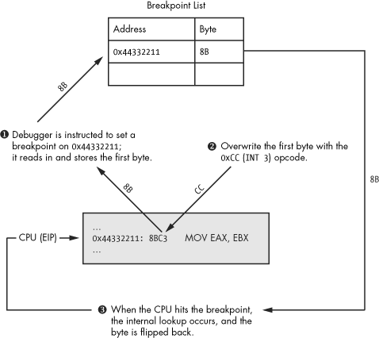
Software Breakpoints
Software – the int3 (0xCC) instruction
Seitz, Justin. Gray Hat Python: Programming for hackers and reverse engineers. No Starch Press, 2009.

Slide 17
Windbg
The debugger we'll focus on in this course
Doubles as both a user and kernel mode debugger
Somewhat steep learning curve, but very aware of Windows internal state
Lots of extremely useful extensions built-in

Slide 18
Windbg Displays
All available via the "View" menu
All act as snap-ins for the Windbg console
Many times commands exist to display the same information
Workspace can be saved/loaded between debugging sessions

Slide 19
Windbg View List
Command - Interactive Command Prompt
Watch - Watch window for manually specified/defined variables (castable to other types)
Locals - Local variables visible in the current scope
Registers - Editable register display
Memory - An editable memory view; can display in a variety of formats (defaults to hex bytes)
Call Stack - Displays the call stack relative to the current location
Disassembly - Disassembly Window

Slide 20
Windbg - Breakpoints
Hardware: ba [Access: r|e|w] [Size: 1|2|4] <address>
Software: bp <address/location>
Listing: bl
Disable: bd
Enable: be
Clearing: bc <breakpoint number>

Slide 21
Symbols and Debugging
What are debugging symbols?
Symbolic information normally discarded during the compilation process
Typically used to aid in debugging
Microsoft provides stripped-down symbols for _most_ windows binaries
Many otherwise-undocumented structures are exposed this way
PDB - Documentation available via github: https://github.com/Microsoft/microsoft-pdb
DWARF - http://dwarfstd.org

Slide 22
Symbols and Modules
Handout on symbol configuration and issues
Looking at Modules in a Process
lm - Lists the loaded modules (executable files) in a process
x <module>!<pattern> - Lists symbols exported by <module> that match <pattern>

Slide 23
Example: Examining Exported Symbols
0:000> lm
start end module name
006a0000 006a5000 demo (deferred)
744c0000 7463e000 KERNELBASE (deferred)
74730000 74810000 KERNEL32 (deferred)
77090000 7714e000 msvcrt (deferred)
771f0000 7736b000 ntdll (pdb symbols) <path>
0:000> x ntdll!ZwQuerySystem*
77266f30 ntdll!ZwQuerySystemInformation (<no parameter info>)
77267170 ntdll!ZwQuerySystemTime (<no parameter info>)
77268050 ntdll!ZwQuerySystemEnvironmentValue (<no parameter info>)
77268060 ntdll!ZwQuerySystemEnvironmentValueEx (<no parameter info>) 77268070 ntdll!ZwQuerySystemInformationEx (<no parameter info>)

Slide 24
Displaying Data
Dumping data at a location:
db <location> - dump as bytes
dw/d/q <location> - dump as WORDs/DWORDs/QWORDs
da <location> - dump as ASCII
du <location> - dump as Unicode

Slide 25
Searching
s - Search memory

Slide 26
Registers and Pointers
Register information:
r - Displays the current values stored in registers
Dumping Pointer Data:
dp <location> - Dump as pointer
poi(<location>) - Dereference pointer
Examining a pointer in a register:
0:000> r
eax=00d610bc ebx=00000000 ecx=771049b3 edx=00000000 esi=00000001 edi=00d6367c eip=00d61251 esp=000cfc58 ebp=000cfc58 iopl=0 nv up ei pl nz na po nc
cs=0023 ss=002b ds=002b es=002b fs=0053 gs=002b efl=00000202
demo!main+0x31:
00d61251 cc int 3
0:000> da @eax
00d610bc "abcdef"

Slide 27
Disassembling
In addition to the disassembly window, Windbg has the ability to disassemble both forward and backward
u <location> - unassemble forward
ub <location> - unassemble backward
uf <location> - unassemble function
0:000> x ntdll!ZwQuerySystem*
77266f30 ntdll!ZwQuerySystemInformation (<no parameter info>)
77267170 ntdll!ZwQuerySystemTime (<no parameter info>)
77268050 ntdll!ZwQuerySystemEnvironmentValue (<no parameter info>)
77268060 ntdll!ZwQuerySystemEnvironmentValueEx (<no parameter info>)
77268070 ntdll!ZwQuerySystemInformationEx (<no parameter info>)
0:000> u 77266f30
ntdll!NtQuerySystemInformation:
77266f30 b836000000 mov eax,36h
77266f35 bab0b52777 mov edx,offset ntdll!Wow64SystemServiceCall (7727b5b0)
77266f3a ffd2 call edx
77266f3c c21000 ret 10h
77266f3f 90 nop ntdll!NtOpenSection:
77266f40 b837000000 mov eax,37h
77266f45 bab0b52777 mov edx,offset ntdll!Wow64SystemServiceCall (7727b5b0)
77266f4a ffd2 call edx

Slide 28
Stepping
Single step-in/over:
t - Trace - Single Step/step in
p - Step Over
More complex step operations:
tc/pc - Trace or Step to Call
tb - Trace to next branch (jmp or jcc)

Slide 29
Patching Memory
Windbg can directly edit memory during operation
Bytes can be overwritten in the memory view window
Windbg can also assemble in-place (essentially replacing instructions)
a <location> - Allows us to begin assembling starting at the given <location>
Once you start, you can continue to assemble you hit enter on an empty line
There is also an "edit memory" command:
e(b|d|w) <location> <value>

Slide 30
Hypothetical Crackme
demo!main:
00ac1200 8bff mov edi,edi
00ac1202 55 push ebp
00ac1203 8bec mov ebp,esp
00ac1205 cc int 3
00ac1206 b801000000 mov eax,1
00ac120b 85c0 test eax,eax
00ac120d 7402 je demo!main+0x11 (00ac1211)
00ac120f eb14 jmp demo!main+0x25 (00ac1225)
00ac1211 6a00 push 0
00ac1213 68cc10ac00 push offset demo!`string' (00ac10cc)
00ac1218 68bc10ac00 push offset demo!`string' (00ac10bc)
00ac121d 6a00 push 0
00ac121f ff153c10ac00 call dword ptr [demo!_imp__MessageBoxA (00ac103c)]
00ac1225 33c0 xor eax,eax
00ac1227 5d pop ebp
00ac1228 c3 ret

Slide 31
Patching Some Bytes
One option:
How can we make this case true?
00ac1206 b801000000 mov eax,1
00ac120b 85c0 test eax,eax
00ac120d 7402 je demo!main+0x11 (00ac1211)

Slide 32
Patching Some Bytes
If we can make eax equal to zero, the jump will get taken
We now need to make this:
Look like this:
00ac1206 b801000000 mov eax,1
00ac1206 b800000000 mov eax,0

Slide 33
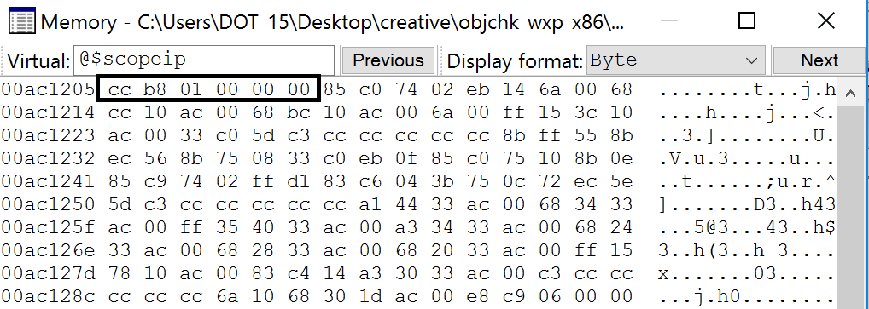
Memory Window

Slide 34
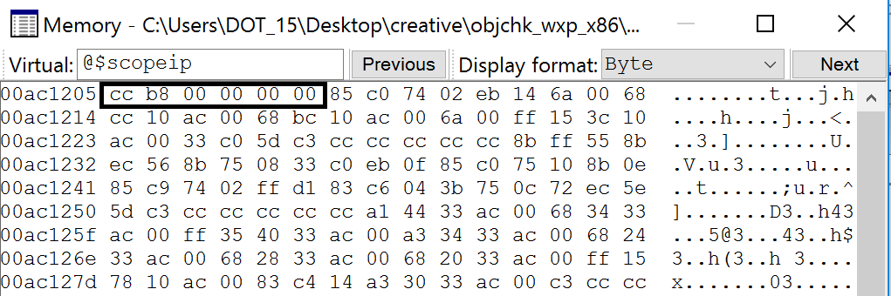
Memory Window (Part 2)

Slide 35
Result
demo!main:
00ac1200 8bff mov edi,edi
00ac1202 55 push ebp
00ac1203 8bec mov ebp,esp
00ac1205 cc int 3
00ac1206 b800000000 mov eax,0
00ac120b 85c0 test eax,eax
00ac120d 7402 je demo!main+0x11 (00ac1211)
00ac120f eb14 jmp demo!main+0x25 (00ac1225)
00ac1211 6a00 push 0
00ac1213 68cc10ac00 push offset demo!`string' (00ac10cc)
00ac1218 68bc10ac00 push offset demo!`string' (00ac10bc)
00ac121d 6a00 push 0
00ac121f ff153c10ac00 call dword ptr [demo!_imp__MessageBoxA (00ac103c)]
00ac1225 33c0 xor eax,eax
00ac1227 5d pop ebp
00ac1228 c3 ret

Slide 36
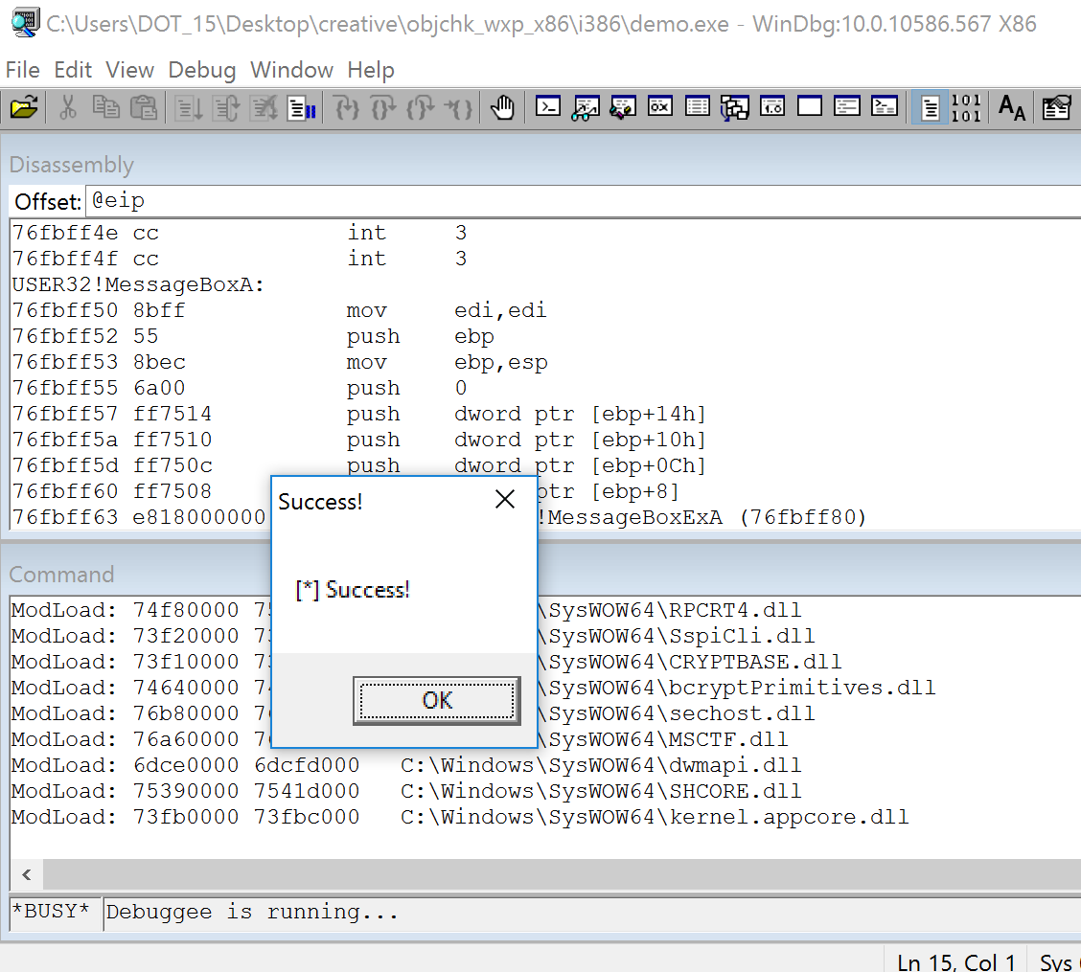
And Finally…

Slide 37
Alternatively
Once we get here:
demo!main+0x5:
00ac1205 cc int 3
0:000> u
demo!main+0x5 [c:\users\dot_15\desktop\creative\main.c @ 9]:
00ac1205 cc int 3
00ac1206 b801000000 mov eax,1
00ac120b 85c0 test eax,eax
00ac120d 7402 je demo!main+0x11 (00ac1211)
00ac120f eb14 jmp demo!main+0x25 (00ac1225)
00ac1211 6a00 push 0
00ac1213 68cc10ac00 push offset demo!`string' (00ac10cc)
00ac1218 68bc10ac00 push offset demo!`string' (00ac10bc)

Slide 38
Assembling
We could:
Which would also yield the same result:
***Caution: be cautious when doing this, as it can change the meaning of adjacent instructions ***
0:000> a 00ac1206
00ac1206 mov eax, 0
mov eax, 0
00ac120b
00ac1206 b800000000 mov eax,0
00ac120b 85c0 test eax,eax
00ac120d 7402 je demo!main+0x11 (00ac1211)

Slide 39
Problems with this demo
This entire demo is predicated on having symbols
Many times, symbols will not be available
Program's real entry point (e.g., main) will have to be located

Slide 40
How to Proceed
$exentry will give the target binary's entry point
Getting to main will require wading through crt startup code
Fortunately, CRT source is provided via Visual Studio
Initialization steps are fairly similar
mcrtexe.cpp - under "vcruntime" (VS2015)
Other files exist, for other subsystems

Slide 41
Other Suggestions
Look for functions that will likely be called sometime during CRT initialization and set breakpoints
Be aware of differences between XP and Windows Vista+ - some Kernel32 functions now live in KERNELBASE
Good targets might be environment and command line setup (e.g., GetCommandLineA|W, GetEnviron)
Can also look for CRT methods that may be equivalent, if those methods are not in the imports list
__getmainargs
Examining the number of args in the string (e.g., "da <arglist>" after GetCommandLineA returns) yields argc
Tracing to next call (tc or pc), and examining args passed to function will help to locate entry point

Slide 42
Additional Dynamic Analysis Tools
Visual Studio Debugger
Similar to Windbg (can actually setup to use Windbg by default)
OllyDbg
1.1 vs 2.0
Immunity Debugger
Radare2
GDB
IDAPro
Debugger built in (Pro versions) or select your own

Slide 43
Lab 1
Patch2Win!

