Slide 1
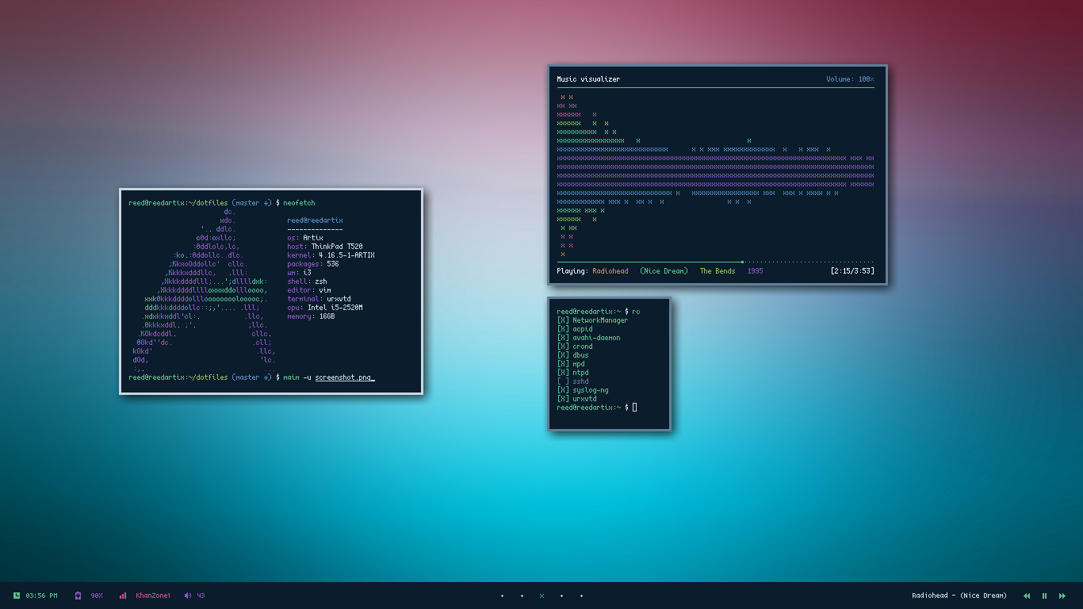
Intro to STATIC ANALYSIS

Slide 2
Objectives
Understand and utilize, at a basic level, principles relating to static analysis
Utilize, at a basic level, IDA Pro for the purpose of static analysis

Slide 3
Static Analysis Tools
Strings - A very useful tool for dumping things that *look* like printable ASCII or Unicode strings
For Windows: Ships with Sysinternals
Linux/Unix: Typically a strings application exists
Hex Editors - Sometimes useful
Executable file explorers - CFF Explorer, dumpbin, objdump, otool, etc
Lots of detail about sections and layout of a binary
Will discuss in greater detail in later sections
Disassemblers - IDA Pro, radare2, etc.
IDA will be our focus for the course
It is an extremely powerful tool, provides lots of useful features for annotating and investigating various binary formats

Slide 4
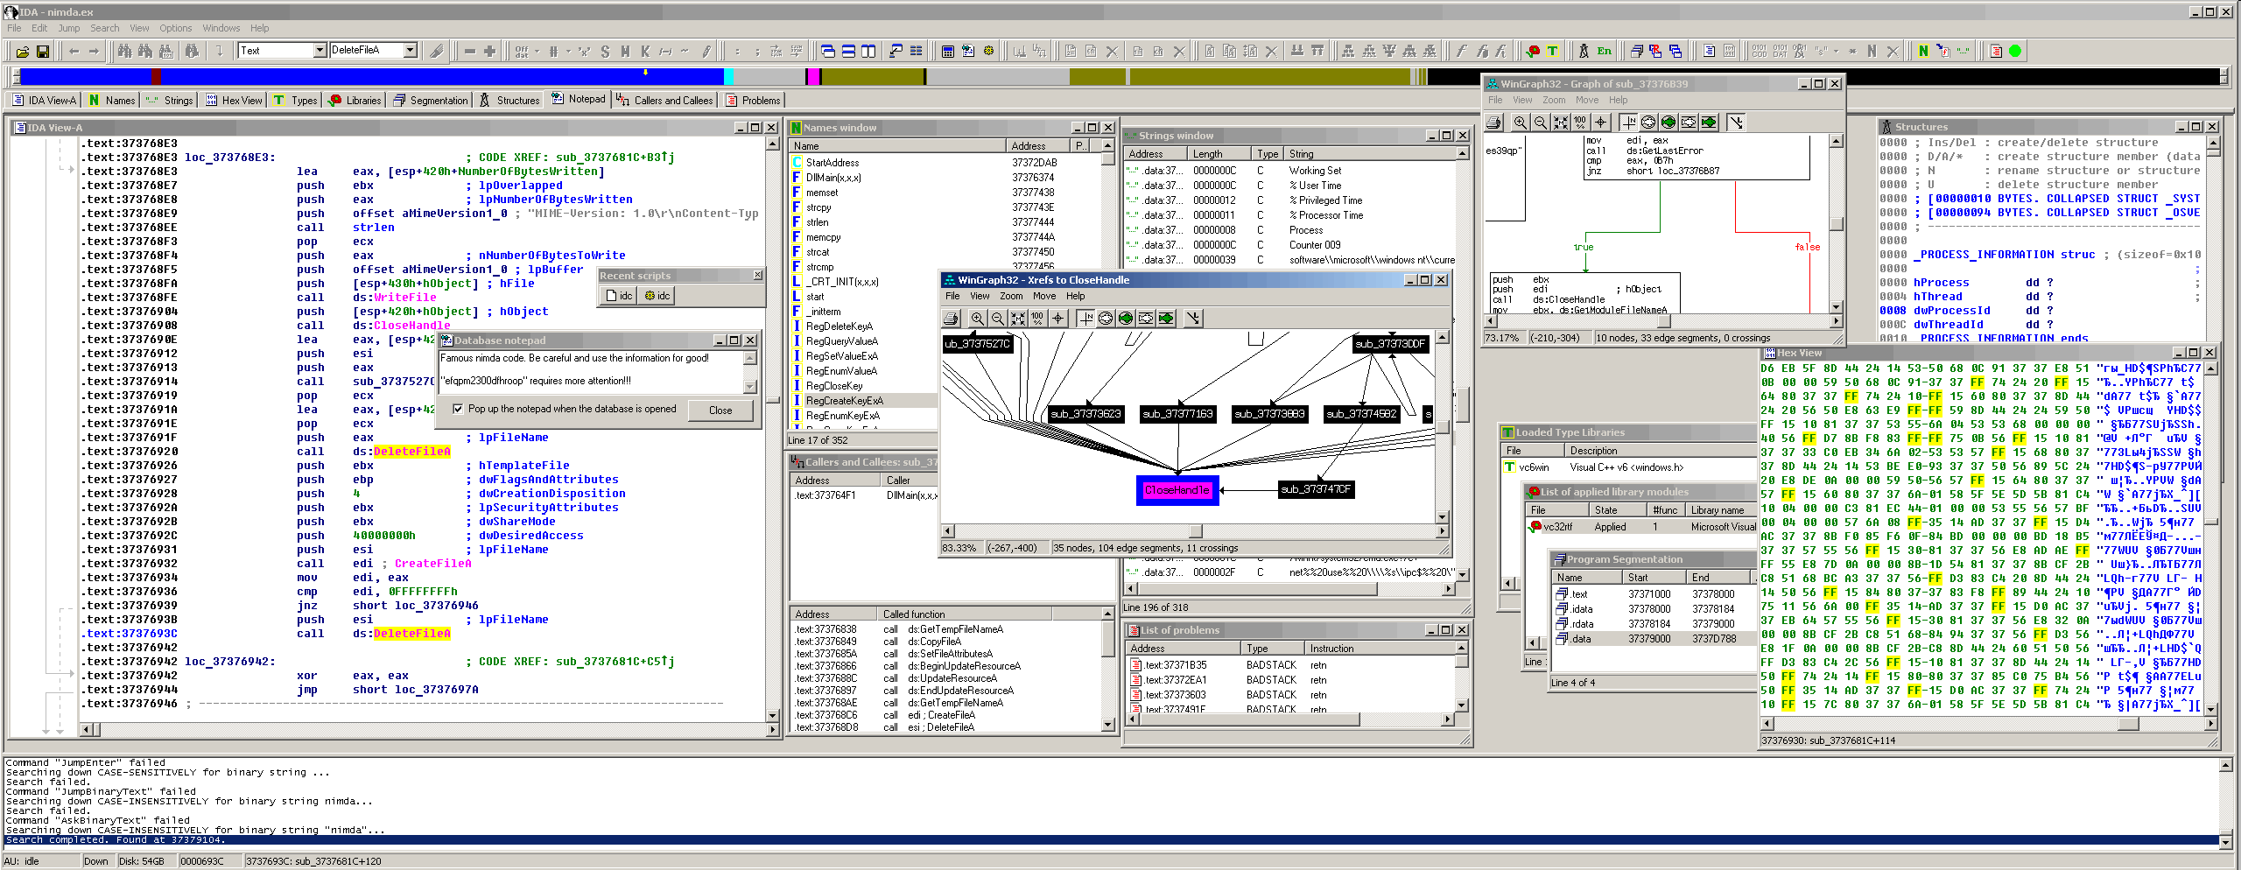
Intro to IDA Pro

Slide 5
Starting Up
IDA Allows you to save and load work between sessions via database files
Annotations and other items can be stored and distributed this way

Slide 6
Basic Areas
Functions Window
Overview Navigator
Graph Overview
Views section

Slide 7
Functions Window
IDA will load blocks of code that resemble functions here
Many of them will initially be named "sub_*"
Can be renamed later, as functionality is uncovered
A subset may have specific names on load, from symbols, functionality, etc

Slide 8
IDA View and Hex View
Provides a disassembly view of a section of code
Can toggle between viewing the disassembly via text view and graph view
Hex view gives a view in hex bytes, or other formats
Selecting a block of opcodes highlights the whole instruction (if in hex)
Can synchronize selections with IDA View

Slide 9
Structures and Enums
Sections let you define structures and enum values
Some structure definitions may be populated via type libs and symbols
Many Windows functions and parameters, for example, may be annotated in this fashion

Slide 10
Imports and Exports
Imports indicate libraries and external functions a binary relies on
Exports denote exported symbols
May identify methods exported for use by other modules
Various other entry points, such as the CRT entry point or TLS callbacks, may appear here
This topic will be covered in greater depth when discussing executable file formats

Slide 11
Useful Features
XREFS
Annotations
Comments
Renaming
Mapping Structure Definitions
Jump to location

Slide 12
XREFS
Hotkey: x (from IDA View)
Gives a list of references to an item from the binary
Double-clicking entries in the list will jump to that location

Slide 13
Renaming
Hotkey: n (from IDA View)
Allows symbols to be renamed as functionality is discovered
Makes it easy to refer back to blocks of code
Functions (in the Functions Window) can also be renamed via right-click and edit (or Ctrl+E)

Slide 14
Comments
Hotkey: ; or
(from IDA View)
; - Repeatable comments
: - Single comment
Repeatable comments will appear at each occurrence of the symbol
Single comments will only appear where designated

Slide 15
Structure Definitions
Hotkey: t (from IDA View)
Maps a structure definitions (from the Structures tab) to a particular location in memory
Additionally, you can import .h files to use custom defined structures

Slide 16
Jump to Location
Hotkey: enter (from IDA View)
Jumps the focus of the IDA View window to the definition of the symbol
This includes functions and jump targets
Uninitialized data from other sections in the file (such as .data or .bss) can be viewed in this fashion
As can global constants, such as strings

Slide 17
Other Useful Things
Clicking a symbol or register highlights its use
Can edit opcodes via hex view
Can generate a graph of uses for a particular symbol
Same principles discussed in previous section applies in terms of identifying user-defined entry point

Slide 18
Labs 1a & 1b
From Assembly to C

Slide 19
Binary Analysis

Slide 20
Objectives
Discuss and Understand, at a basic level, some strategies for approaching RE
Understand, at a basic level, some ways of identifying and applying structure to data

Slide 21
Looking for Clues
Imports
Exports
Strings

Slide 22
Applying Structure to Data
Locate data structures in disassembly
Identify structures, arrays, and constituent data members

Slide 23

Structure Identification

Slide 24
Structures
Telltale signs include:
Grabbing a pointer parameter or local variable
Accessing offsets into that variable
Pointer additions/subtractions into a buffer
; Copying a param
mov edx, [ebp + 8]
; Loading a value 12 bytes into the buffer
mov ecx, [edx + 0xC]

Slide 25
More Structure Examples
mov eax, [ebp + 0x08]
lea eax, [eax + 0x0c]
mov edx, [ebp + 0x0c]
push edx
push eax
call _strcpy
add esp, 0x08
struct MyStruct {
DWORD firstField;
DWORD secondField;
char buf[MAX_PATH];
};

Slide 26
Arrays
Same-sized accesses into a buffer might indicate an array
All accesses into the buffer only read or write same sized values
Most structures have some variance in data size
Other clues might include
Accesses to sequential offsets in a loop
Use of string instructions (e.g., "rep movs*" or "rep scas*", etc.)

Slide 27
Structures and Arrays
Look at how fields are used in other parts of the program
OS-provided function calls with known input params
Other typelib provided function definitions (e.g., static libs)
Make use of xrefs (where possible)
Annotations are very useful in getting a good feel for control flow

Slide 28
Structures and Arrays – Cont’d
Applying dynamic analysis can also be useful
Hardware breakpoints may be especially helpful
If point of allocation can be found, break on read/write can identify what gets copied into the buffer
Various memory printing options (Windbg/gdb) with offsets can also assist with this

Slide 29
Finding Allocations
Heap Allocations
Look for calls to heap allocation methods
malloc/calloc/etc
HeapAlloc
VirtualAlloc
Example:
push 0x30
call _malloc
mov dword [eax + 0x08], ecx

Slide 30
Finding Allocation
Stack Allocations
sub esp, 0x30

Slide 31
Lab 2
Crackme Part 2
From Assembly to C
Labs 2a & 2b

