Slide 1

COMPILERS – an Introduction

Slide 2
Objectives
Understand fundamental concepts pertaining to how the compilation process works
Understand and identify security mechanisms implemented by compilers
Understand and identify some features and minor optimizations performed by compilers
Understand and identify intrinsic methods

Slide 3
The Compilation Process
How do we get from a text file to a binary?

Slide 4
Lexing: The First Step
Text is broken into tokens
The "how" is based on language contraints (e.g., whitespace, semicolons, etc)

Slide 5
Parsing
The next step in interpreting text
Stream of tokens created from lexing are examined here
Abstract Syntax Tree (AST) gets built from this

Slide 6
Where to go from here?
Several transformations typically applied
the original AST gets changed a bit, losing context
Sometimes something that resembles a pseudo-assembly gets produced here (e.g., llvm ir)
Typically still has more "intent" (e.g., what the programmer intended to do) encoded than raw assembly/opcodes
Optimizations get added here
Register spills and variable lifecycle gets analyzed/calculated at this point

Slide 7
… And out comes a binary?
Various sections get generated (more on this topic later)
Compilation finishes, assembly gets produced, and assembling happens
Object files get created
Linking occurs
And finally....
A binary gets created!

Slide 8
Compiler Features
A number of security features exist (and are now usually implemented by default) for compilers
Some are specific to vendors/file formats

Slide 9
Stack Canary
A "cookie" that is added to the stack inside of a function call to indicate that the stack has been corrupted
Generally set at function prologue (on stack)
Typically checked just prior to function return

Slide 10
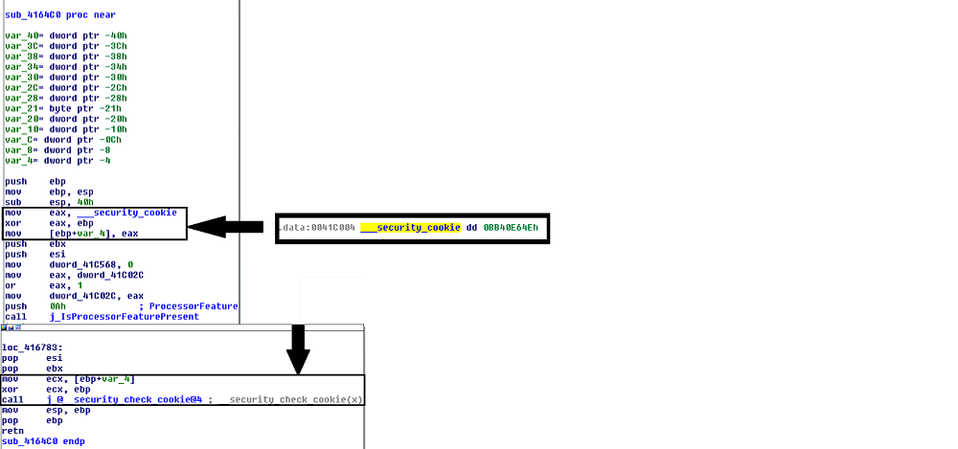
Stack Canary

Slide 11
Relocations
PE-specific
Provide information to fix up addresses on load (more on this topic later)
Makes PE files (which are not position-independent) work with ASLR

Slide 12
Patch Points
Microsoft originated
GCC extension - ms_hook_prologue - will provide
Implementation that allows for hotpatching
Provides a 2-bytes, idempotent function prelude that can overwritten with a jmp
Typically preceded by a 5 byte (in x86, anyhow), writable area to add a bigger jmp

Slide 13
Patch Point
; patchable area... 5 bytes of space
winfunc:
mov edi, edi ; two byte reserved patch point
After patch:
patched:
jmp newloc ; 5-byte jump to real destination
winfunc:
jmp patched ; 2-byte relative jump (backward)

Slide 14
Patch Point (cont’d)
Looking at disassembled bytes we’d get something like:
Before:
After:
0xcc 0xcc 0xcc 0xcc 0xcc ; the prologue
0x89 0xff ; the patch point
0xe9 0xf3 0xf9 0xff 0xff ; the jmp newloc bytes
0xeb 0xf9 ; the short jmp

Slide 15
Intrinsic Functions
Intrinsic functions are special functions implemented directly by the compiler
Intrinsic offerings vary by compiler
They typically map directly to a small number of assembly instructions
Typical use cases are to expose functionality provided by assembly that doesn't exist in the C (or C++) standard library, such as access to SIMD operations.

Slide 16
Intrinsic Funtions (cont’d)
Example (Microsoft):
Maps directly to:
__debugbreak();
int3

Slide 17
Intrinsic Function (cont’d)
Comprehensive lists for supported intrinsic functions should be provided as part of compiler documentation
MSDN: https://msdn.microsoft.com/en-us/library/26td21ds.aspx
GCC (4.2.4): http://gcc.gnu.org/onlinedocs/gcc-4.2.4/gcc/X86-Built_002din-Functions.html
Clang: http://clang.llvm.org/docs/LanguageExtensions.html#introduction

Slide 18
Compiler-implemented Functions
A number of common functions may be implemented directly by the compiler inline
Methods such as strlen, memcpy, etc may fall into this category
As such, disassembly may not contain a "call" to these methods, but rather something like:
In place of memcpy
mov ecx, 0x30
mov esi, [ebp - 0x0c]
mov edi, [ebp + 0x08]
rep movsb

Slide 19
Lab 3
Crackme
From Assembly to C
Lab 3a

Slide 20
Dynamic and Runtime Linking

Slide 21
Objectives
Understand and utilize Dynamic and Runtime loading techniques
Understand and utilize Dynamic and Runtime linking techniques

Slide 22
What is Dynamic Linking?
Allows binary data to be distributed as a DLL or Shared Object file
Has the same general attributes as a standard executable (including the same file format)
Provides common library services for multiple executables without having to increase size as much as static linking
Loaded into process space at runtime, as part of dependency resolution
When target executable is run, its imports are examined by the operating system
Dynamic libraries it depends on are loaded prior to execution

Slide 23
Dynamic Linking (cont’d)
Typically requires a static library and a header file
Most (read: nearly all) applications implicitly do this in one way or another
C(++) Runtime code is often dynamically linked (e.g., glibc)
Ancillary, OS-provided code (e.g., kernel32) works in this fashion also
Loading will fail if the required dynamic library is not present

Slide 24
Runtime Linking
Similar to dynamic linking, but with a key difference
No extra lib/header generally required
Onus is entirely on end user (e.g., the executable) to ensure that things go smoothly when loading/linking
Exported functions must be located by end user

Slide 25
Runtime Linking – How to load a library
Windows
LoadLibrary(A|W) - Provides the interface for loading a DLL from disk into the current process
GetProcAddress - Given an HMODULE (returned by LoadLibrary or GetModuleHandle), it will attempt to locate an exported function.
Linux
dlopen - Similar in function to LoadLibrary, it will load a shared object into the current process.
dlsym - As with GetProcAddress, it will attempt to locate an exported symbol on the provided library

Slide 26
Windows Exports
Can be exported either by name or ordinal
Name - string; may (or may not) be mangled according to calling convention
Ordinal - Simply a number - Must be WORD-sized or smaller
Both are really just methods of finding exported symbols
Exports can also forward to other DLLs

Slide 27
int main(int argc, char** argv)
{
// Our module
HMODULE hm = NULL;
// Our dynamic function pointer
int (__stdcall *dynamicFunction)(int) = NULL;
int result = 0;
// try to load a dll,return if we can't find it!
if(NULL == (hm = LoadLibraryA("MyLib.dll"))) {
printf("Failed to load library! %d\n",GetLastError());
return -1;
}
// Try to find an exported function.If it were exported by ordinal, the 2nd
// param would change to: (char*)n, where n is the ordinal number. This is a
// bit strange,but is the way the API works.
dynamicFunction = (int(__stdcall*)(int))GetProcAddress(hm, "MyFunction@4");
if(NULL == dynamicFunction) {
printf("Failed to find func! %d\n", GetLastError());
return -2;
}
result = dynamicFunction(10);
// Now we FreeLibrary (since we are done with it now)
FreeLibrary(hm);
return result;
}

Slide 28
int main(int argc, char** argv)
{
void* hm = NULL;
int (*myexport)(int) = NULL;
int result = 0;
// As with LoadLibrary, we pass the path to load
if(NULL == (hm = dlopen(“./mylib.so“, RTLD_NOW))) {
printf("Failed to load library! %s\n",strerror(errno));
return errno;
}
// again, we get our function pointer
myexport = (int(*)(int))dlsym(hm, “myExportedFunction");
if(NULL == myexport) {
printf("Failed to find func! %s\n", strerror(errno));
return errno;
}
// call and close!
result = myexport(10);
dlclose(hm);
return result;
}

Slide 29
Python
The ctypes library in Python provides an easy way to load and call exported methods
Note that the architecture of Python (32 vs 64 bit) MUST match the architecture of the DLL
import ctypes
c = ctypes.CDLL("mydll.dll")
c[1]() # Calling the method exported at ordinal 1
c["MyFunc"]() # calling the method "MyFunc" exported by name

Slide 30
Lab – Runtime Linking
Labs 4, 4a, & 4b

