Slide 1
Loading and Linking

Slide 2
Objectives
Understand, at a high level, the process of loading and running executables
Understand some of the actions performed by the C Runtime (CRT) during initialization

Slide 3
What Happens at Load Time
File gets mapped into memory
(PE) Relocations get fixed up
Imports get resolved
Entry point gets called (if applicable)

Slide 4
Dynamic Libraries
Dynamic Link Libraries (DLLs) and Shared Objects (SOs) typically provide shared functionality
glibc (*nix)
Kernel32/KERNELBASE/ntdll (Windows)
Dynamic (NOT runtime) linking implies a dependency
Exported functions from DLLs and SOs generate import table entries

Slide 5
Entry Points
Typical exported entry points may not necessarily be called "main"
_start
_DllMainCRTStartup/_mainCRTStartup
Other methods - such as TLS callbacks (Windows) may also be invoked

Slide 6
Import Resolution
Import table entries are resolved
Copies of required libs provided to process
Addresses of loaded functions added to table
Loading fails if imports cannot be satisfied

Slide 7
Some Additional Points
Often copies of mappings are provided for common libs
Mappings provided as Copy On Write
Reduces overhead of process creation/loading process
Other steps may be accomplished, depending on platform
Runtime linking allows dynamic checks to see if imports exist or not, without preventing loading

Slide 8
Compilers - Optimizations

Slide 9
Objectives
Understand and identify a number of optimizations performed by compilers

Slide 10
Jump Tables
Often produced for switch statements
A table of offsets to jump to based on the result of a comparison
Used as an optimization to avoid lots of conditional branches and comparisons

Slide 11
Jump Tables – Example C
switch (x) {
case 10:
if (NULL == (f = fopen("tmp1.txt", "w"))) {
printf("Allocation failed!\n");
goto Cleanup;
}
fprintf(f, "%s", GetCommandLineA());
break;
case 20:
MessageBoxA(NULL,
"Second option selected!",
"TITLE", MB_OK);
break;
case 30:
if (NULL == (f = fopen("tmp2.txt", "w"))) {
printf("Opening tmp2 failed!");
goto Cleanup;
}
fprintf(f, "%d:%s", __COUNTER__, __TIMESTAMP__);
break;
case 40:
case 50:
MessageBoxA(NULL, "Last option selected!",
"ANOTHER TITLE", MB_OK);
default:
MessageBoxA(NULL, "Unknown option selected!",
"That didn't work!", MB_ICONERROR);
}

Slide 12
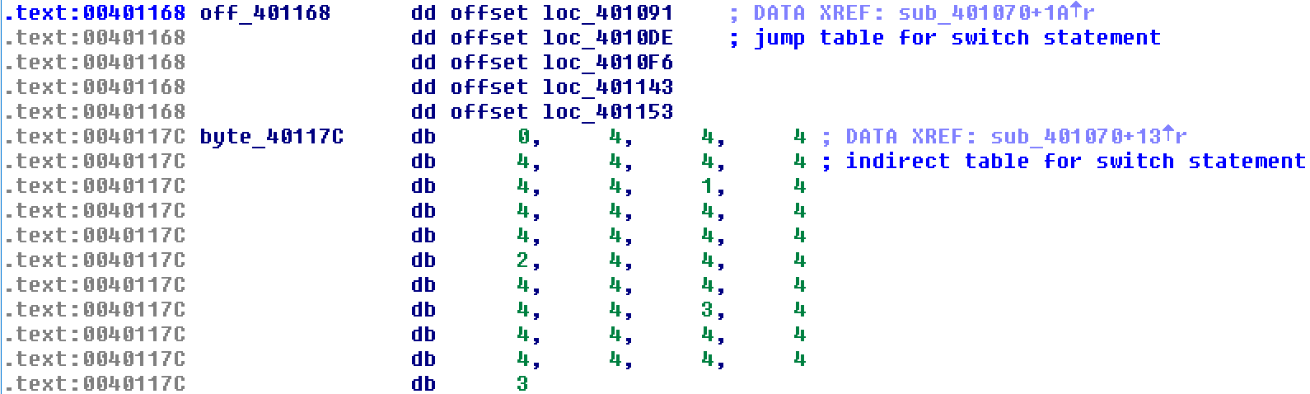
Jump Tables – Example ASM

Slide 13
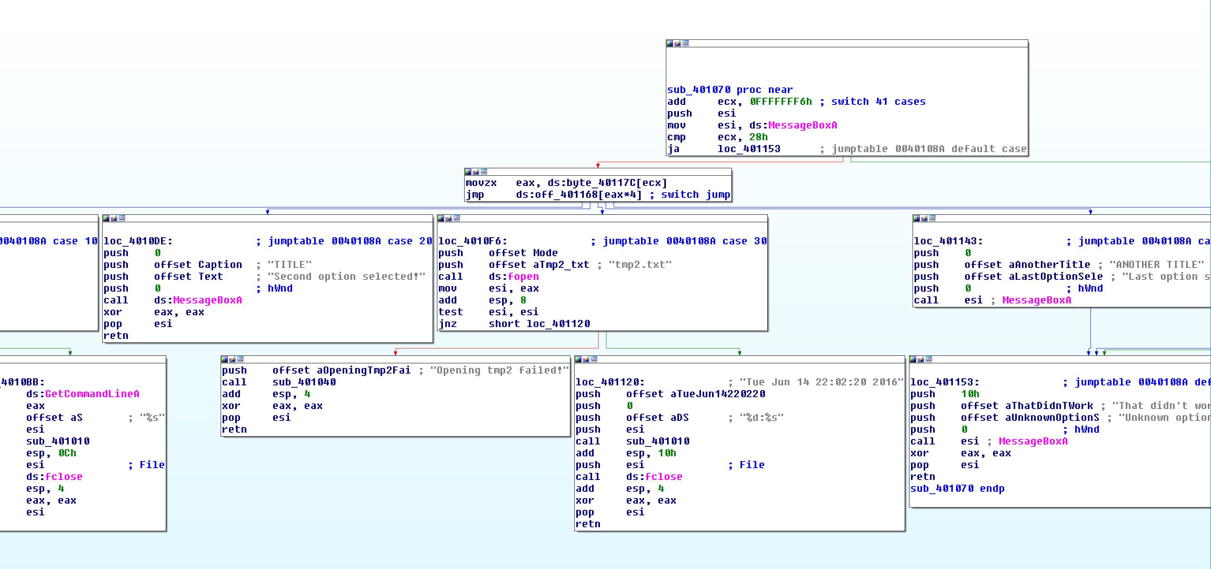
Jump Tables – Example ASM (cont’d)

Slide 14
Function Inlining
Function code is copied inline each time it is used
Reduces overhead of function calls at cost of space
Code is copied rather than reused, resulting in bigger binary
No additional overhead for calls

Slide 15
Function Inlining – Example C
BOOL __forceinline func1(int x)
{
return x % 10 ? FALSE : TRUE;
}
// ...
int main(int argc, char** argv)
{
const char* tmp = func1(atoi(argv[1])) ? "Yes" : "No";
printf("Is the cmdline param a multiple of 10? %s\n", tmp);
return 0;
}

Slide 16
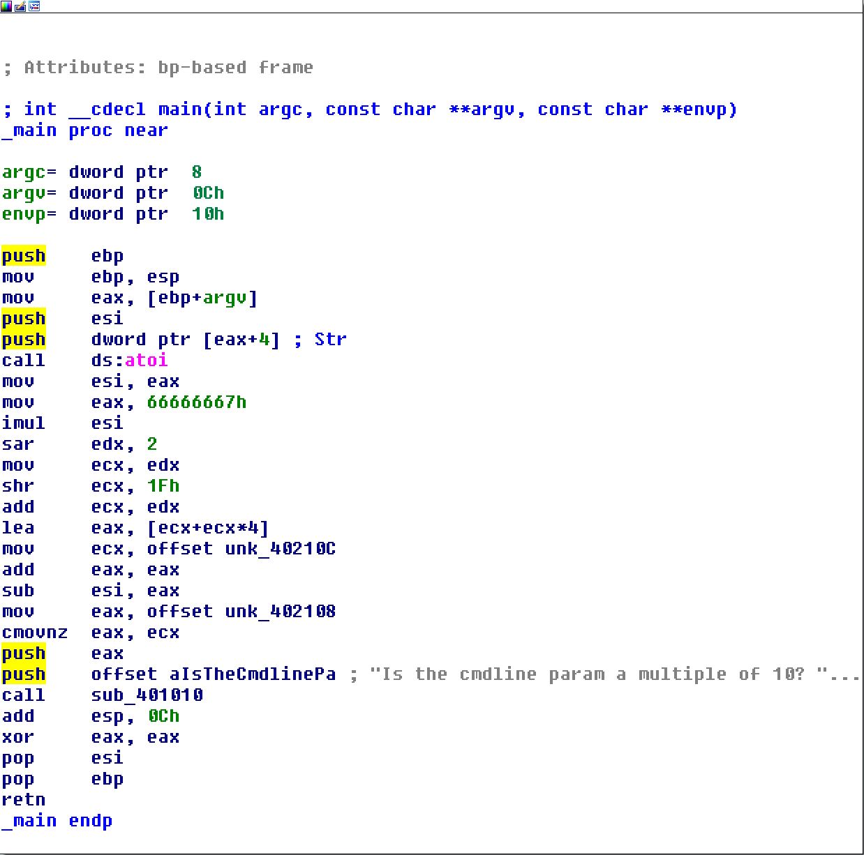
Function Inlining – Example ASM

Slide 17
Frame Pointer Optimization/Omission
Tells the compiler not to use the base pointer (EBP/RBP) as normal
Frees it up to be used as another general purpose register
Can make debugging more difficult (harder to reason about call stack)

Slide 18
Loop Unrolling
Instructions within loop body are copied for each iteration
Larger resulting binary size, but without overhead of branching

Slide 19
A Tale of Duff’s Device
Concept code courtesy of Tom Duff, 1983
Good case study, though likely no longer significantly performant with modern compilers
Original requirement involved copying 16-bit units from an array to a memory-mapped register
Naive approach suffered from performance issues
Thus, unrolling to blocks of 8 yielded significant improvements

Slide 20
Duff’s Device - Initial
send(to, from, count)
register short *to, *from;
register count;
{
register n = count / 8;
do {
*to = *from++;
*to = *from++;
*to = *from++;
*to = *from++;
*to = *from++;
*to = *from++;
*to = *from++;
*to = *from++;
} while (--n > 0);
}

Slide 21
Initial Effort Issues
This approach works - with one small problem
Always assumes that the copy target is evenly divisble by 8

Slide 22
Duff’s Device – The Solution
send(to, from, count)
register short *to, *from;
register count;
{
register n = (count + 7) / 8;
switch (count % 8) {
case 0: do { *to = *from++;
case 7: *to = *from++;
case 6: *to = *from++;
case 5: *to = *from++;
case 4: *to = *from++;
case 3: *to = *from++;
case 2: *to = *from++;
case 1: *to = *from++;
} while (--n > 0);
}
}

Slide 23
Structured Exception Handling (SEH)
Provides a mechanism for managing exceptional conditions via C
Has some semantic differences from C++ style exception handling
Can allow recovery from events such as:
Bad memory accesses (e.g., segmentation faults)
Divide by zero errors
...

Slide 24
SEH Examples
Output:
char* badptr = NULL;
__try {
printf("We're trying to do some stuff here...\n");
printf("Bad memory access: %c\n", *badptr);
}
__except (EXCEPTION_EXECUTE_HANDLER) {
printf("An exception occurred! 0x%x\n", GetExceptionCode());
}
We're trying to do some stuff here...
An exception occurred! 0xc0000005

Slide 25
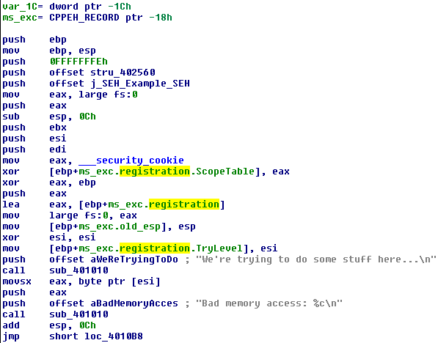
SEH Details
The stack frame disassembly:

Slide 26
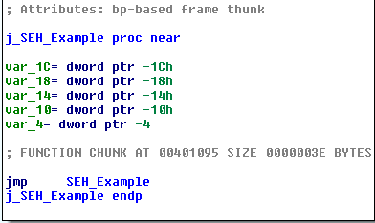
SEH Details (cont’d)
SEH Thunk (w/ jump to supporting method)

Slide 27
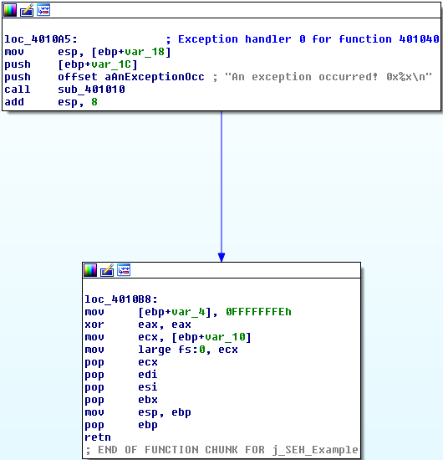
SEH Details (cont’d)
Exception Handler:

Slide 28
SEH Details (cont’d)
Stack frame layout is much further complicated with this construct
Implementation actually varies a bit between VS compiler versions
Newer SEH versions (such as the one we see here) provide additional buffer overrun protections

Slide 29
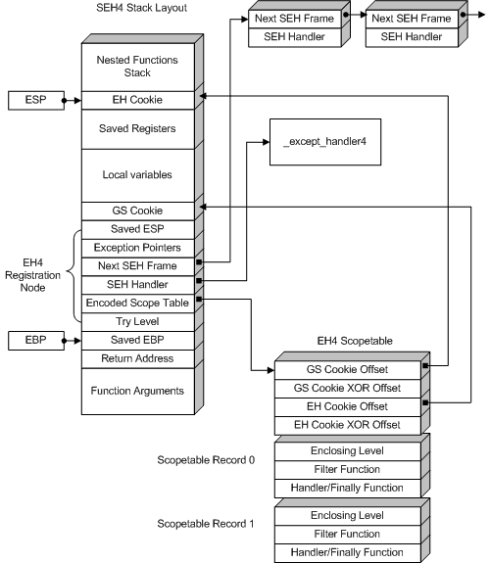
SEH Stack Layout
Image Credit: igorsk - http://www.openrce.org/articles/full_view/21

