Slide 1
C++ and You
How C++ Works Under the Hood

Slide 2
Objectives
Understand and Identify Run Time Type Information (RTTI), and its uses
Understand and Identify C++ Class Layouts in memory
Understand how Inheritance Affects C++ in-memory structure
Understand the composition of C++ class memory functions and vtables
Understand and Identify the effect of C++ Templates on generated code

Slide 3
Approaching C++
Compiler-generated C++ tends to be complex
Classes and inheritance create complex structures
Member functions may lack direct calls of any kind

Slide 4
Functions in C++
Function implementation in C++ can vary rather widely
Overloading
Templates
Member Functions and Inheritance
Also features differences in calling convention and implicit arguments

Slide 5
A Note on Name Mangling
Name mangling in C++ tends to be much more complex than in C

Slide 6
Classes
C++ Class structure can vary a bit based on composition
Plain Old Data (POD) types tend to be roughly analagous to C
Inherited classes and virtual methods can make class composition quite a bit more complex

Slide 7
Identifying Classes
Member functions tend to make heavy use of ECX*, especially if it does not appear to have been initialized
The this pointer (passed either via ECX or as the first argument to the function) is a pointer to the top of the current class object.
* NOTE: this is only true for Microsoft x86 - __thiscall on SYSTEM V and all x86_64 platforms simply pass the this pointer as an implicit first argument

Slide 8
Constructors
Constructors may get called in different contexts depending on how the object they back is allocated
Global objects get initialized during CRT startup (before main)
If stack allocated, call to ctor will be preceded by sub esp, <sizeof(class)>
If heap allocated, call to ctor will be preceded by a call to new()
In all cases, there will be a mov into ECX

Slide 9
Constructors (cont’d)
Given this class:
class TestClass {
private:
uint32_t inner_;
public:
TestClass() : inner_(20) { }
TestClass(uint32_t t) : inner_(t) {}
~TestClass() {}
uint32_t get() const { return inner_; }
void message(const std::string& val) {
std::cout <<
val << std::endl;
}
}

Slide 10
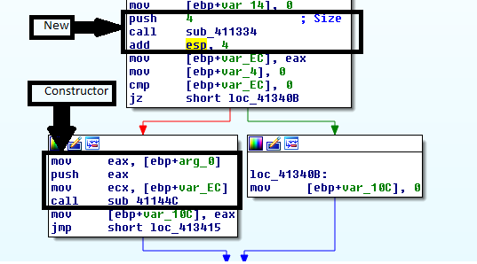
Constructors: Dynamic
TestClass* t = nullptr;
t = new TestClass(v)

Slide 11
Constructors: Stack
void func()
{
TestClass t;
std::cout << "Value from func: " << t.get()
<< std::endl;
}

Slide 12
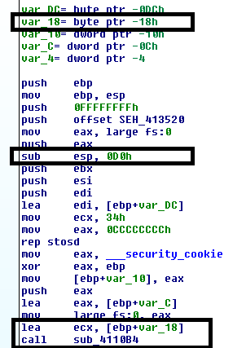
Constructors: Stack

Slide 13

Constructors: Global
TestClass gTest(40);
int main(int argc, char** argv)
{
std::cout << "Value from global: " << gTest.get()
<< std::endl;
return 0;
}

Slide 14
Destructors
Compiler ensures they get called when an object is destroyed
In a stack allocated object, the dtor will be called prior to stack frame collapse
With heap allocated objects, the dtor will be called as part of the delete process, prior to the backing memory getting freed
The dtor of global objects gets called during process cleanup, after "main" (or equivalent) returns.

Slide 15
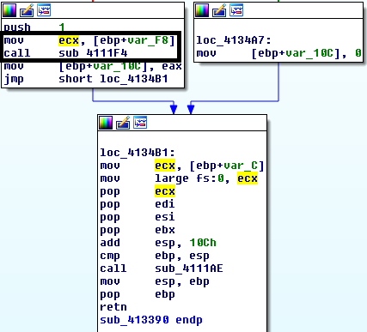
Destructors (cont’d)
TestClass* t = nullptr;
t = new TestClass(v);
// ...
delete t

Slide 16
Member Functions
Non-virtual member functions use the __thiscall calling convention (MS x86)
The "this" pointer, which points to the top of object currently being operated on, is passed via ECX (or as the implicit first argument)
TestClass* t = new TestClass();
t->get();

Slide 17
Static Methods
Generally, these follow somewhat more standard rules regarding calling convention
No "this" pointer is passed to static methods
TestClass::message("Test");

Slide 18
Thunks
A small chunk of code that is called by a function, but will not return
Instead it performs some small action, and jumps to a "real" function
Target function will return to original calling code
May be used to fix up calling conventions, implement closures, or, in some cases, manage virtual function selection (among other things)

Slide 19
Clear Memory Layout
Classes containing virtual member functions get an extra hidden structure member
The vfptr (top of structure) points to the class's vtable, which contains pointers to virtual member functions.
*** Important Note: The given examples are x86 based, and NOT portable to x64 without changes **

Slide 20
Class Layout: NormalClass
class NormalClass {
private:
uint32_t a_;
public:
NormalClass(uint32_t v) : a_(v) {}
uint32_t get() const { return a_; }
}
NormalClass -> size(4)
----------------------
0x00: | a_

Slide 21
Class Layout: NormalClass
In action:
Output:
NormalClass n(20);
std::cout << "Size: " << sizeof(NormalClass) <<
"\nFirst element: " << *((uint32_t*)&n)
<< std::endl;
Size: 4
First Element: 20

Slide 22
Class Layout: VirtualClass
class VirtualClass {
private:
uint32_t a_;
public:
virtual ~VirtualClass() {}
VirtualClass(uint32_t v) : a_(v) {}
virtual uint32_t get() const { return a_; }
};
VirtualClass -> size(8)
-----------------------
0x00: | (vfptr)
0x04: | a_
VirtualClass Vtable
-------------------
0x00: | &VirtualClass::get

Slide 23
Class Layout: VirtualClass2
class VirtualClass2 {
private:
uint32_t b_;
public:
virtual ~VirtualClass2() {}
VirtualClass2() : b_(20) {}
virtual void stuff() {}
virtual uint32_t getB() const { return b_; }
};
VirtualClass2 -> size(8)
------------------------
0x00: | (vfptr)
0x04: | b_
VirtualClass2 Vtable
--------------------
0x00: | &VirtualClass2::stuff
0x04: | &VirtualClass2::getB

Slide 24
Class Layout: Inherited Class
class InheritedClass :
public VirtualClass,
public VirtualClass2
{
private:
uint32_t c_;
public:
InheritedClass() : c_(10), VirtualClass(30) {}
virtual void stuff() {
MessageBoxA(nullptr, "Stuff", "Stuff", MB_OK);
}
};
InheritedClass -> size(20)
--------------------------
| [Base Class VirtualClass]
0x00: | VirtualClass::(vfptr)
0x04: | VirtualClass::a_
| [Base Class VirtualClass2]
0x08: | VirtualClass2::(vfptr)
0x0c: | VirtualClass2::b_
0x10: | c_

Slide 25
Class Layout: InheritedClass (cont’d)
InheritedClass's VirtualClass Vtable
------------------------------------
0x00: | &VirtualClass::get
InheritedClass's VirtualClass2 Vtable
-------------------------------------
0x00: | &InheritedClass::stuff
0x04: | &VirtualClass2::getB

Slide 26
InheritedClass in Action
InheritedClass h;
uint32_t a, b, c;
a = *(((uint32_t*)&h)+1); // VirtualClass::a_
b = *(((uint32_t*)&h)+3); // VirtualClass2::b_
c = *(((uint32_t*)&h)+4); // InheritedClass::c_
std::cout << "Size: " << sizeof(h) << "\nA: "
<< a << "\nB: " << b << "\nC: " << c
<< std::endl;
Size: 20
A: 30
B: 20
C: 10

Slide 27
Inheritance and Virtual Functions
Calling virtual member functions means first looking up the appropriate vtable entry
Translates to:
InheritedClass* h = new InheritedClass();
auto a = h->get();
mov eax, [ecx] ; vtable
call [eax] ; first method

Slide 28
Inheritance and Virtual Functions
Similarly,
Translates to:
InheritedClass* h = new InheritedClass();
h->stuff();
lea eax, [ecx + 0x0c] ; Find the right vtable
mov eax, [eax] ; Fetch function ptr
call eax ; call

Slide 29
Templates
Templated code will at least be copied once for each implementation type
Often inlined

Slide 30
Run Time Type Information
Structure information generated by the compiler to support some C++ operations:
Exceptions
dynamic_cast
typeid
type_info
Typically only required for polymorphic classes (i.e., classes with virtual member functions)

Slide 31
RTTI (cont’d)
Often results in string and type information being embedded in the binary
Type descriptions tend to be compiler specific

Slide 32
References
OpenRCE Article on Exception Handling and C++ Class composition by Igor Skochinsky –
http://www.openrce.org/articles/full_view/21
A bit dated now, but still somewhat relevent - C++ Under the Hood by Jan Gray - Archived at:
http://www.openrce.org/articles/files/jangrayhood.pdf
The Old New Thing article about member function pointers https://blogs.msdn.microsoft.com/oldnewthing/20040209-00/?p=40713
Sabanal/Yason (IBM) Presentation from Blackhat 2007 - Reversing C++ - https://www.blackhat.com/presentations/bh-dc- 07/Sabanal_Yason/Paper/bh-dc-07-Sabanal_Yason-WP.pdf
The C++ Standard –
https://isocpp.org/std/the-standard (current);

Slide 33
Additional Topics
Anti-debugging Techniques
Many good references available
Some techniques more obscure/harder to identify than others
Some good compendiums on the topic:
http://pferrie.host22.com/papers/antidebug.pdf http://www.openrce.org/reference_library/anti_reversing

Slide 34
Review

