Slide 1
Kubernetes Lab & Workshop
2017-07-21 – Martin Danielsson, Haufe-Lexware

Slide 2
Objectives for the Workshop
Get to know Kubernetes concepts – in theory and practice
Deploy a Kubernetes cluster on Azure Container Services
Working with a Kubernetes Cluster
Deploy a multi tier application using real-world techniques
Few slides, more hands-on
In: Deployments, Services, Ingress Controllers, ConfigMaps, Secrets
Out: Namespaces, Storage, RBAC, Helm

Slide 3
What we’ll deploy…
Resource Group
Agent Load Balancer
Kubernetes Cluster (1 Master, 2 Agents)
Ingress Controller
“Markdown Notes” nginx SPA
SPA Backend (API)
Master
Load Balancer
API Gateway
API Portal

Slide 4
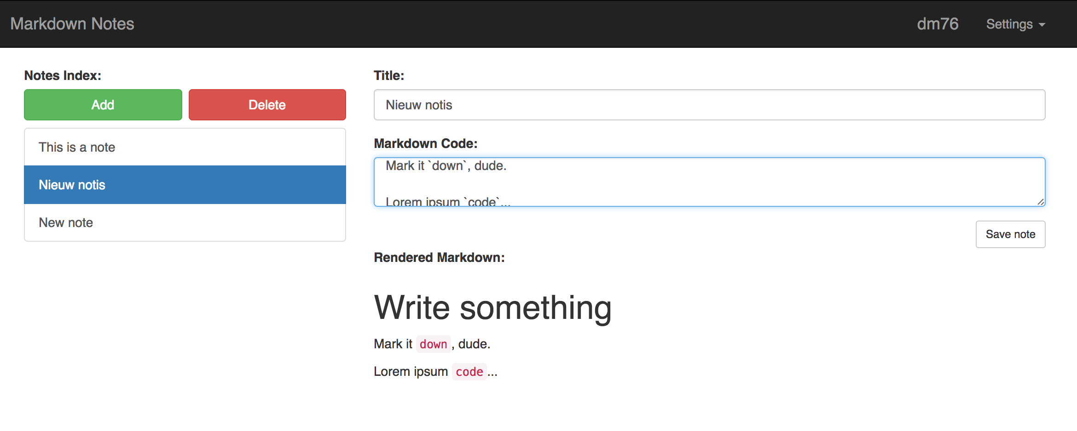
Screenshot

Slide 5
Kubernetes Basics

Slide 6
You might have figured,
this is the Kubernetes logo

Slide 7
What is Kubernetes?
“Kubernetes is an open-source platform for automating deployment, scaling, and operations of application containers across clusters of hosts, providing container-centric infrastructure.”
http://kubernetes.io/docs/whatisk8s/
Holy smokes!
Which means?
We’ll find out today!

Slide 8
We get to run Containers!
Provide a runtime environment for Docker containers
Scale and load balance docker containers
Abstract away the infrastructure containers run on
Monitor/health check containers
Declarative definition for running containers
Update containers (also rolling updates)
Storage mounting (allow abstracting infrastructure)
Service discovery and exposure
Labelling and selection of any kind of object (we‘ll get to this)

Slide 9
We get to run containers!
Kubernetes adds functionality to Docker/Container runtimes (containerd, rkt,…)
Manages a set of (Docker) Hosts, forming a Cluster
Takes care of Container scheduling
Supervises containers
Kubernetes is an alternative to Docker Swarm

Slide 10
Deployment Architecture
All blue boxes are Docker Hosts (VMs)
Kubernetes Components are also running as stateless containers!
Often deployed alongside on the Master Node(s)
Kubernetes Master(s)
Node
workload
apiserver
workload
Node
etcd (cluster)
workload
workload
scheduler
Node
workload
workload
workload
workload
controllers
workload

Slide 11
Kubernetes Runtime
Node 1
Node 2
Node 3
Pod X
Pod Z
Pod Z
Container
A
Container
B
Container
D
Container
D
Pod Y
Pod Y
Pod X
Container
C
Container
C
Container
A
Container
B

Slide 12
Working with kubectl
kubectl is a convenient way to talk to the Kubernetes API
Uses kubeconfig for AuthN/Z
$ kubectl apply -f deployment.yml
Created deployment “nginx”
$
Kubernetes Master(s)
apiserver
~/.kube/config
scheduler
Authentication/
Authorization

Slide 13
LAB 1 Provision a Cluster

Slide 14
Use Wifi
“HG Mobile”

Slide 15
Lab 1 – Objectives
Make sure you can connect to Azure
Provision a 1 Master, 2 Agent Kubernetes Cluster
Install kubectl (Kubernetes CLI)
Ensure connectivity

Slide 16
State after Lab 1
Resource Group
Kubernetes Cluster (1 Master, 2 Agents)
Master
Load Balancer

Slide 17
Pods and Deployments

Slide 18
Abstractions – Boxes in Boxes
How are updates handled?
Rolling/recreation
Deployment
Replica Set
How many Pods should run?
Pod Spec
Node selector
Service labels
Container
Spec
Container
Spec
Docker image
Environment variables
Storage Claims

Slide 19
Example Deployment YAML file
Deployment
apiVersion: extensions/v1beta1 kind: Deployment metadata: name: notes-app spec: replicas: 2 template: metadata: labels: service: notes-app spec: containers: - env: - name: API_GATEWAY_HOST value: api.donmartin76.com - name: CLIENT_ID value: "ad283bd8273bdbe9a72bdef” image: ”donmartin76/notes-app:v1” name: notes-app ports: - containerPort: 80 protocol: TCP restartPolicy: Always
Replica Set
$ kubectl apply -f notes-app.yml
Created deployment “notes-app”
$ kubectl get pods
NAME READY STATUS RESTARTS AGE
notes-app-abc 1/1 Running 0 10s
notes-app-def 1/1 Running 0 10s
$
Pod
Container(s)

Slide 20
Lab 2 Deploy a simple App

Slide 21
Lab 2 – Objectives
Deploy a simple “Deployment”
Get some experience with kubectl
Play whack-a-pod
Trying out the Kubernetes Dashboard

Slide 22
State after Lab 2
Resource Group
Kubernetes Cluster (1 Master, 2 Agents)
“Markdown Notes” nginx SPA
Master
Load Balancer

Slide 23
Services and Ingress

Slide 24
Abstractions – Services
A
Services …
Offer discoverability via internal DNS (kube-dns)
Do automatic pod load balancing
Can be re-routed dynamically
Can be defined without backing pods
Select pods by label matching
Service A,
select “A”
e.g., http://service-a
Pod
Pod
B
A
Pod
Service B,
select “B”, http://service-b
B
Pod
A
Pod

Slide 25
Service Type: Cluster
Node 1
Node 2
Node 3
Service A
Service can be accessed only from inside the cluster (default mode)

Slide 26
Service Type: NodePort
31234 (non-privileged)
31234
31234
Node 1
Node 2
Node 3
Service A
Can be used to manually put an external Load Balancer in front of a service
Common for on-prem clusters leveraging existing load balancers

Slide 27
Service Type: LoadBalancer
LB
Node 1
Node 2
Node 3
Service A
Depends on Cloud Provider (Azure, AWS, Rancher,…)
Will provision a Load Balancer with the cloud provider’s infrastructure (e.g. Elastic LB, Azure LB,…)
Only works if you really have a cloud provider… ☺

Slide 28
Exposing Services – Ingress
LB
Kubernetes Cluster
Pod
Service A
Pod
Pod
Pod
Ingress
Controller (SNI, TLS)
Pod
Service B
Pod
Ingress Definition
Pod
Pod
Service C
Pod
…
E.g., “route Host x.y.z to Service A”, “Use TLS Certificate abc for host x.y.z”
Abstract definition of rules
Implemented by Ingress Controller
Flexible; leverages “LoadBalancer” on cloud provider
Can provide SNI (Server Name Indication) and TLS termination

Slide 29
Example Service YML
apiVersion: v1 kind: Service metadata: labels: service: notes-app name: notes-app spec: type: ClusterIP ports: - name: “http” port: 80 protocol: TCP targetPort: 80 selector: service: notes-app
Reachable within cluster as http://notes-app:80
Select pods with this label

Slide 30
Example Ingress YML
apiVersion: extensions/v1beta1 kind: Ingress metadata: name: notes-app spec: rules: - host: notes.donmartin76.com http: paths: - path: backend: serviceName: notes-app servicePort: 80
Routes to the service with
this name and port

Slide 31
Lab 3 Services and Ingress

Slide 32
Lab 3 – Objectives
Deploy a default backend for the cluster
Create self signed certificates for TLS
Deploy an nginx Ingress Controller
Get the load balancer’s IP
Create DNS entries for our application
Configure a first ingress resource

Slide 33
State after Lab 3
Resource Group
Agent Load Balancer
Kubernetes Cluster (1 Master, 2 Agents)
Ingress Controller
“Markdown Notes” nginx SPA
Master
Load Balancer

Slide 34
Configmaps and Secrets

Slide 35
Configmaps and Secrets
Stores cluster wide configuration and secrets
Can be used to inject information to pods
Useful for externalized configuration
… and secrets, like credentials
Usually referred to from within Deployments
env:
- name: CLIENT_ID
valueFrom:
secretKeyRef:
name: notes-app-secrets
key: client_id
env:
- name: API_HOST
valueFrom:
configMapKeyRef:
name: apim-config
key: PORTAL_NETWORK_APIHOST

Slide 36
Gotchas: Secrets (<=1.7.x)
Currently, secrets aren’t really secret
Different resource
Almost same mechanism
Work in progress
Use with care, only in non-shared-cluster situations

Slide 37
Example ConfigMap YAML
apiVersion: v1 kind: ConfigMap metadata: name: apim-config namespace: default data: APP_HOST: notes.martin.k8s.donmartin76.com GIT_REPO: github.com/DonMartin76/k8s-workshop-apim-config PORTAL_NETWORK_APIHOST: api.martin.k8s.donmartin76.com PORTAL_NETWORK_PORTALHOST: portal.martin.k8s.donmartin76.com

Slide 38
Lab 4 Deploy the full Stack

Slide 39
Lab 4 – Objectives
Get GitHub client id and secrets for OAuth2 log in
Add config maps and secrets
Deploy the rest of the app in one go
Try out the app

Slide 40
State after Lab 4 (full deployment)
Resource Group
Agent Load Balancer
Kubernetes Cluster (1 Master, 2 Agents)
Ingress Controller
“Markdown Notes” nginx SPA
SPA Backend (API)
Master
Load Balancer
API Gateway
API Portal

Slide 41
Lab 5 Scaling and Updating

Slide 42
Lab 5 – Objectives
Scaling a deployment via command line
Updating an image via command line
Demonstration of rolling updates

Slide 43
Topics not covered

Slide 44
App and Cluster Monitoring
Standard solution: Prometheus for both App and Infra monitoring
Paired with AlertManager and Grafana
Additionally do e2e testing from outside cluster (to detect complete failures)
Could be subject to own workshop/lab

Slide 45
Namespaces & RBAC (1.6+)
Split workloads into namespaces
Assign roles to namespaces
Let specific roles just read, others admin a namespace

Slide 46
Persistent Storage
Entire deployment is deployed as if stateless
Corollary: Kill the Notes API and all data is gone
Kubernetes plays well with
NFS
GlusterFS
CephFS
Node storage (dangerous, not recommended)
Quobyte
… more, and more are being added
Nonetheless: No silver bullet for storage (yet) available
Aurora uses a self-managed NFS server on Azure – not optimal!

Slide 47
Helm – Kubernetes templates
“Kubernetes Package Manager”
What we did with bash – Helm (mostly) does better
Deployment templating
Standard deployments with slight adaptions
Parametrization
Template sharing, also online ( “docker hub” like)
Upgrading procedures implementable
Yes, this would be awesome for wicked.haufe.io
Another level of abstraction (I wanted to spare you for now)

Slide 48
Kubernetes “Operators”
Components which act as “operators” for service
E.g., “etcd” operator handles operation of an etcd cluster on Kubernetes
In the works: “Prometheus” operator, “Postgres” operator
Typical tasks:
Log rotating/pruning
Sharding, balancing
Scaling out, joining pods to a cluster and vice versa
Create new instances of a service (PaaS-like)

Slide 49
Kubernetes API
Everything (and more) which can be done with kubectl can be done with the API
Each Pod can (optionally) have access to the API
This is also how operators (in parts) work
Self-configuring services, services administrating other services

Slide 50
Lab 6 Cleaning up

Slide 51
Lab 6 – Objectives
Clean up the mess we made on our subscription

Slide 52
State after Lab 6 (☺)

Slide 53
Wrapup

Slide 54
What’s next?
Read even more on http://kubernetesbyexample.com
Roam the documentation at https://kubernetes.io
Check out Prometheus, it’s complex but cool
Continue containerizing – Kubernetes is a robust way of running them

Slide 55
That’s all, Folks!
Please fill in the netigate survey, or just give me feedback straight away. Thanks!

