Slide 1
Risk factors for mental health issues in students

Slide 2
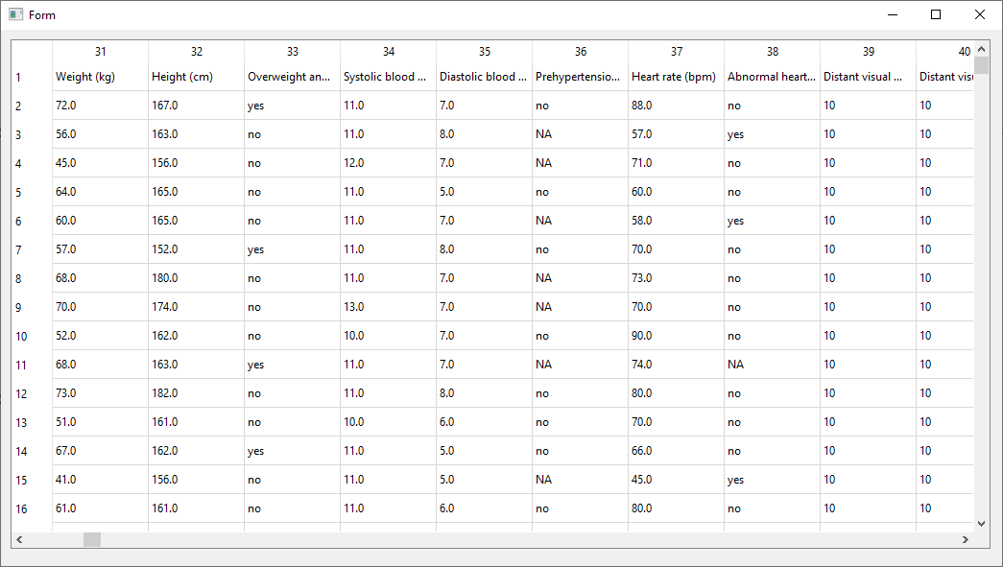
Data overview
Mental health issues among French university students
4185 samples
60 variables
Questionaire
Variables: questions
Phenotype/class: mental health issues

Slide 3
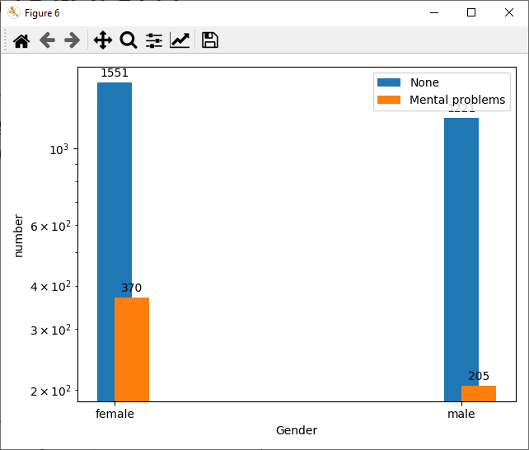
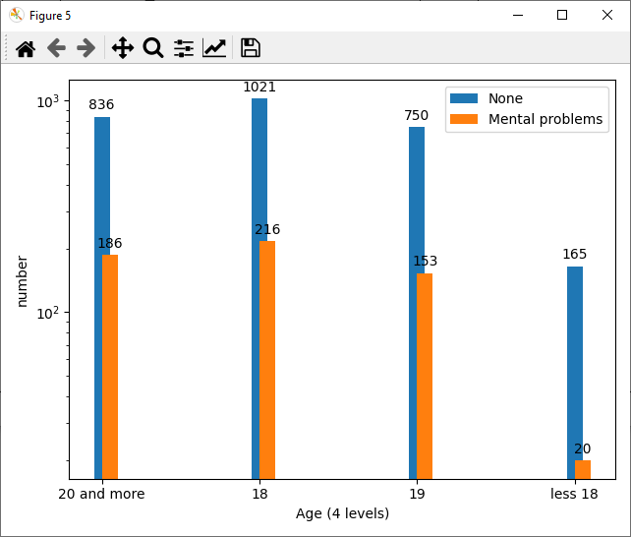
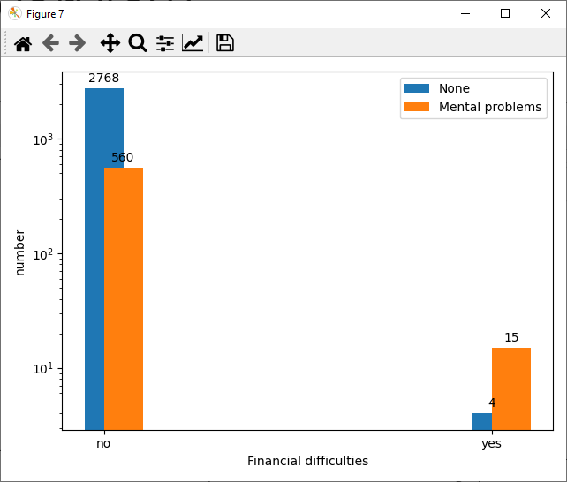
Data overview

Slide 4
Research question
Can we find risk variables for mental health issues in students?

Slide 5
Pre-processing pipeline
Categorical data
Impute cat data
Normalize and scale cat data
Validation/test set
Split data type
Use fitted normalizer and scaler
Use fitted imputer
Impute num data
Normalize and scale num data
Numerical data
Data
Split data
Categorical data
Impute cat data
Normalize and scale cat data
Use fitted normalizer and scaler
Use fitted imputer
Split data type
Training set
Impute num data
Normalize and scale num data
Numerical data

Slide 6
Pre-processing pipeline p2
Test set
Normalize and scale cat data
Combine cat and num data
Models validation
Normalize and scale num data
Train set
Normalize and scale cat data
Combine cat and num data
Resample
Models input
Normalize and scale num data

Slide 7
Pre-processing pipeline
Categorical data
Impute cat data
Normalize and scale cat data
Validation/test set
Split data type
Use fitted normalizer and scaler
Use fitted imputer
Impute num data
Normalize and scale num data
Numerical data
Data
Split data
Categorical data
Impute cat data
Normalize and scale cat data
Use fitted normalizer and scaler
Use fitted imputer
Split data type
Training set
Impute num data
Normalize and scale num data
Numerical data

Slide 8
Splitting data
Validation/test set 20%
Training set 80%
Sklearn test-train split function
Does the test set represent the data correctly
Reject KS-test null hypothesis distributions

Slide 9
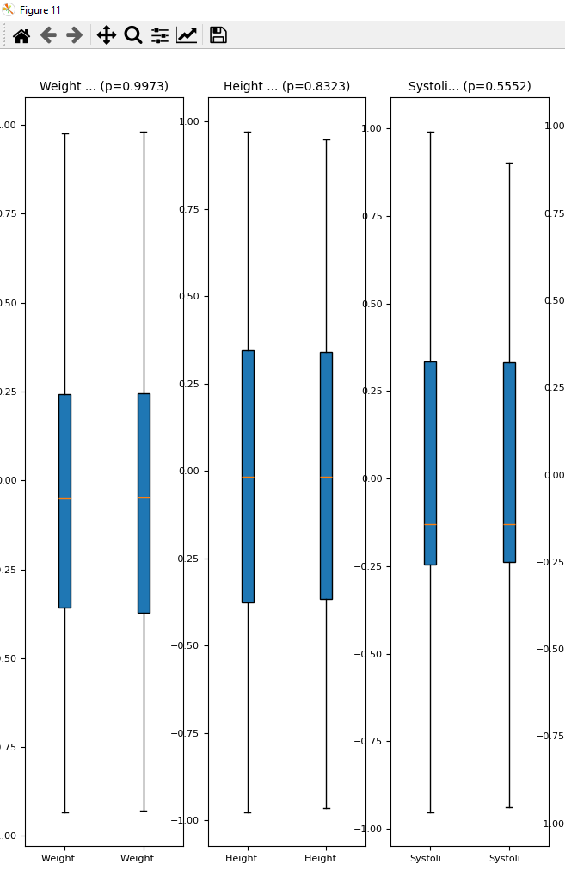
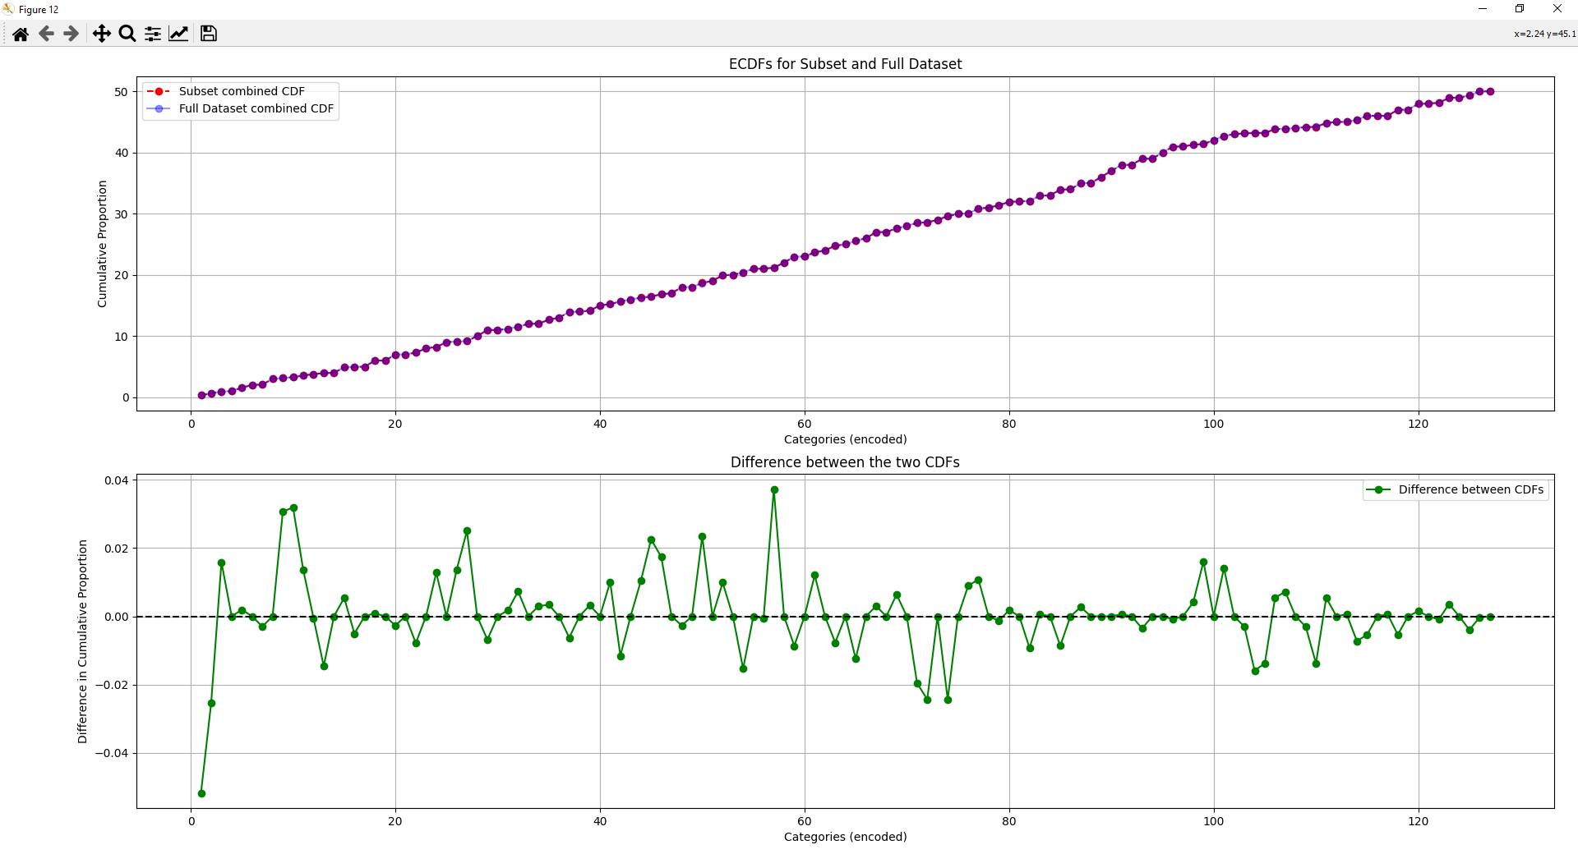
Compare distributions
Numerical variables
Categorical variables

Slide 10
Pre-processing pipeline
Categorical data
Impute cat data
Normalize and scale cat data
Validation/test set
Split data type
Use fitted normalizer and scaler
Use fitted imputer
Impute num data
Normalize and scale num data
Numerical data
Data
Split data
Categorical data
Impute cat data
Normalize and scale cat data
Use fitted normalizer and scaler
Use fitted imputer
Split data type
Training set
Impute num data
Normalize and scale num data
Numerical data

Slide 11
Split data based on type
Split data based on string or numerical (float/integer)
Categorical or numerical
For test and train set

Slide 12
Pre-processing pipeline
Categorical data
Impute cat data
Normalize and scale cat data
Validation/test set
Split data type
Use fitted normalizer and scaler
Use fitted imputer
Impute num data
Normalize and scale num data
Numerical data
Data
Split data
Categorical data
Impute cat data
Normalize and scale cat data
Use fitted normalizer and scaler
Use fitted imputer
Split data type
Training set
Impute num data
Normalize and scale num data
Numerical data

Slide 13
Impute data
Start with train set
Categorical:
Fill NaN values with ‘not applicable’
Numerical:
Fill NaN values with mean of column
Continue with test set
Categorical:
Fill NaN values with ‘not applicable’
Numerical:
Fill NaN values with mean of train set column

Slide 14
Pre-processing pipeline
Categorical data
Impute cat data
Normalize and scale cat data
Validation/test set
Split data type
Use fitted normalizer and scaler
Use fitted imputer
Impute num data
Normalize and scale num data
Numerical data
Data
Split data
Categorical data
Impute cat data
Normalize and scale cat data
Use fitted normalizer and scaler
Use fitted imputer
Split data type
Training set
Impute num data
Normalize and scale num data
Numerical data

Slide 15
Normalize and scale data
Start with train set
Categorical:
One hot encode
Normalize
Standard scale
Numerical:
Normalize
Standard scale
Continue with test set
Categorical:
One hot encoding
Normalize using fitted train set
Standard scale using fitted train set
Numerical:
Normalize using fitted train set
Standard scale using fitted train set

Slide 16
Pre-processing pipeline p2
Test set
Normalize and scale cat data
Combine cat and num data
Models validation
Normalize and scale num data
Train set
Normalize and scale cat data
Combine cat and num data
Resample
Models input
Normalize and scale num data

Slide 17
Resampling
Random resampling
Downsampling majority class
Does the random subset represent the complete data well?

Slide 18
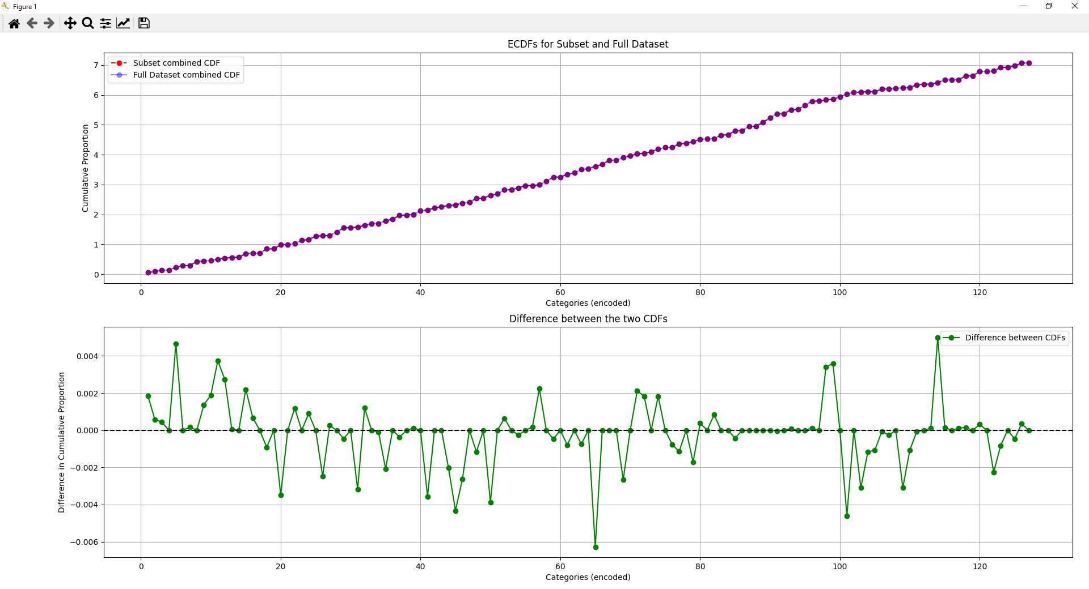
Compare distributions
Numerical variables
Categorical variables

Slide 19
Models
PCA
Neural network

Slide 20
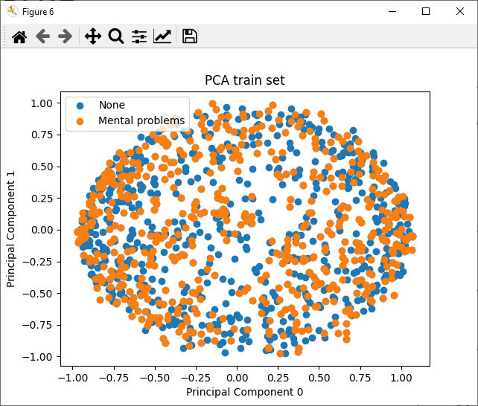
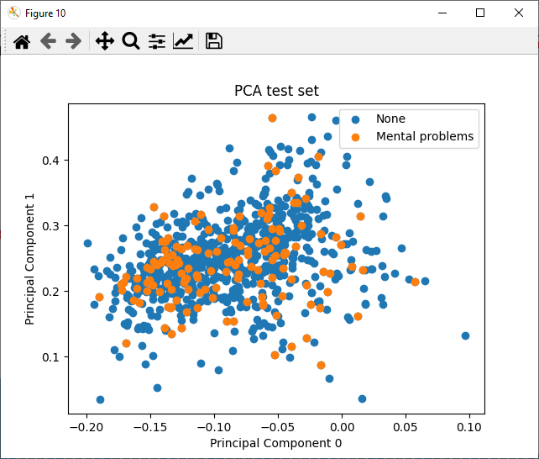
PCA result

Slide 21
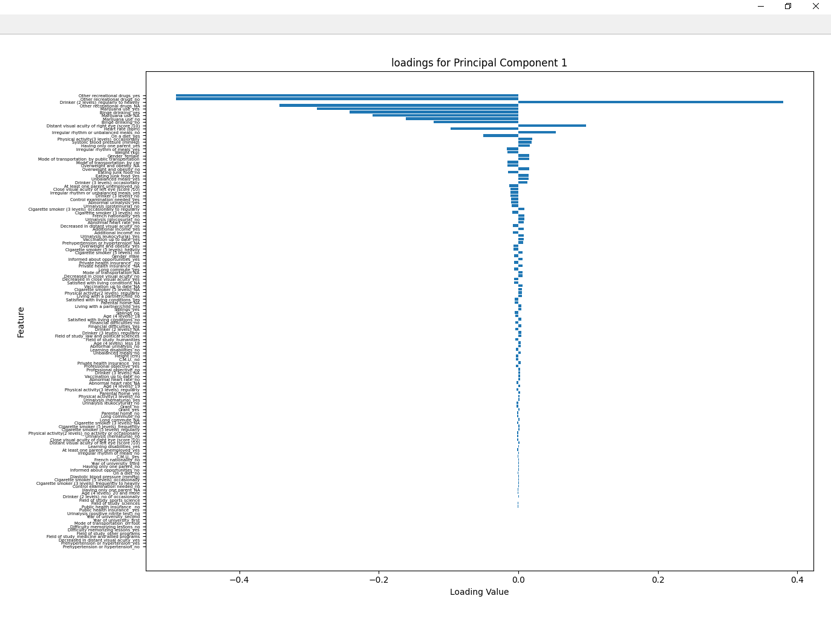
PCA result

Slide 22
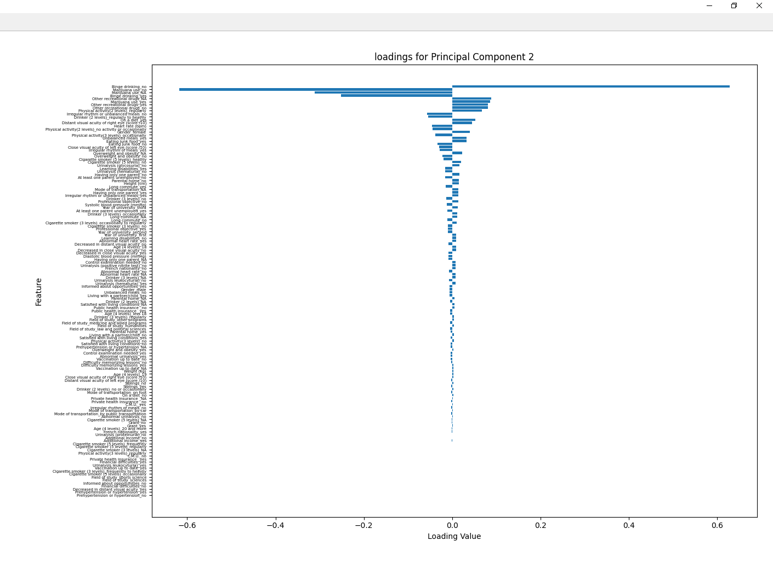
PCA result

Slide 23
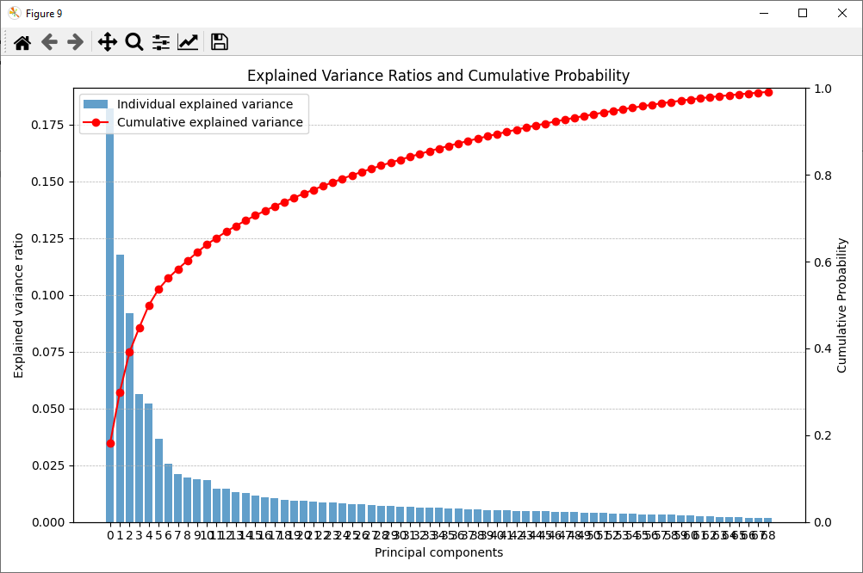
PCA result

Slide 24
PCA
Conclusion: Not great

Slide 25
Neural network
Model summary:
Input layer
Batch normalization
Dense layer
Dropout layer
Repeat from step 1 until number of layers satisfied
Final dense layer (number of nodes equal to number classes)

Slide 26
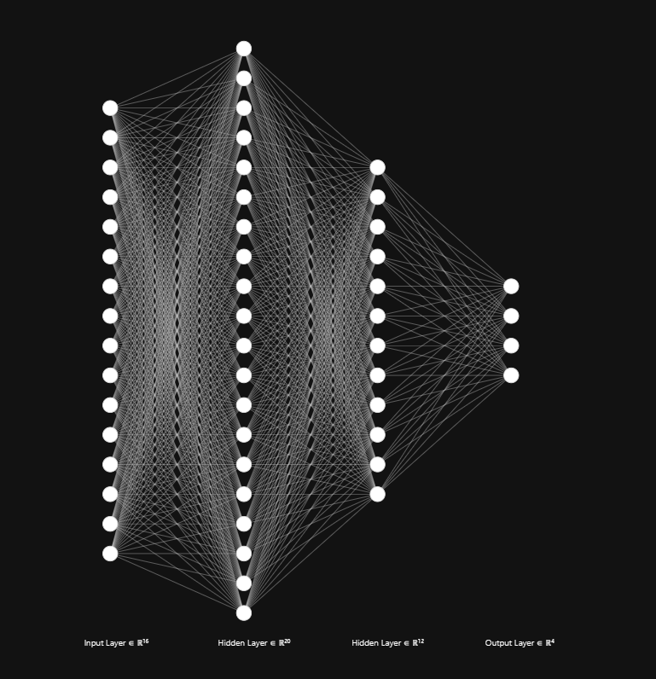
Network visualization
Example topology shown
Real topology
(input, 40,20,output)
Drop-out = 0.2

Slide 27
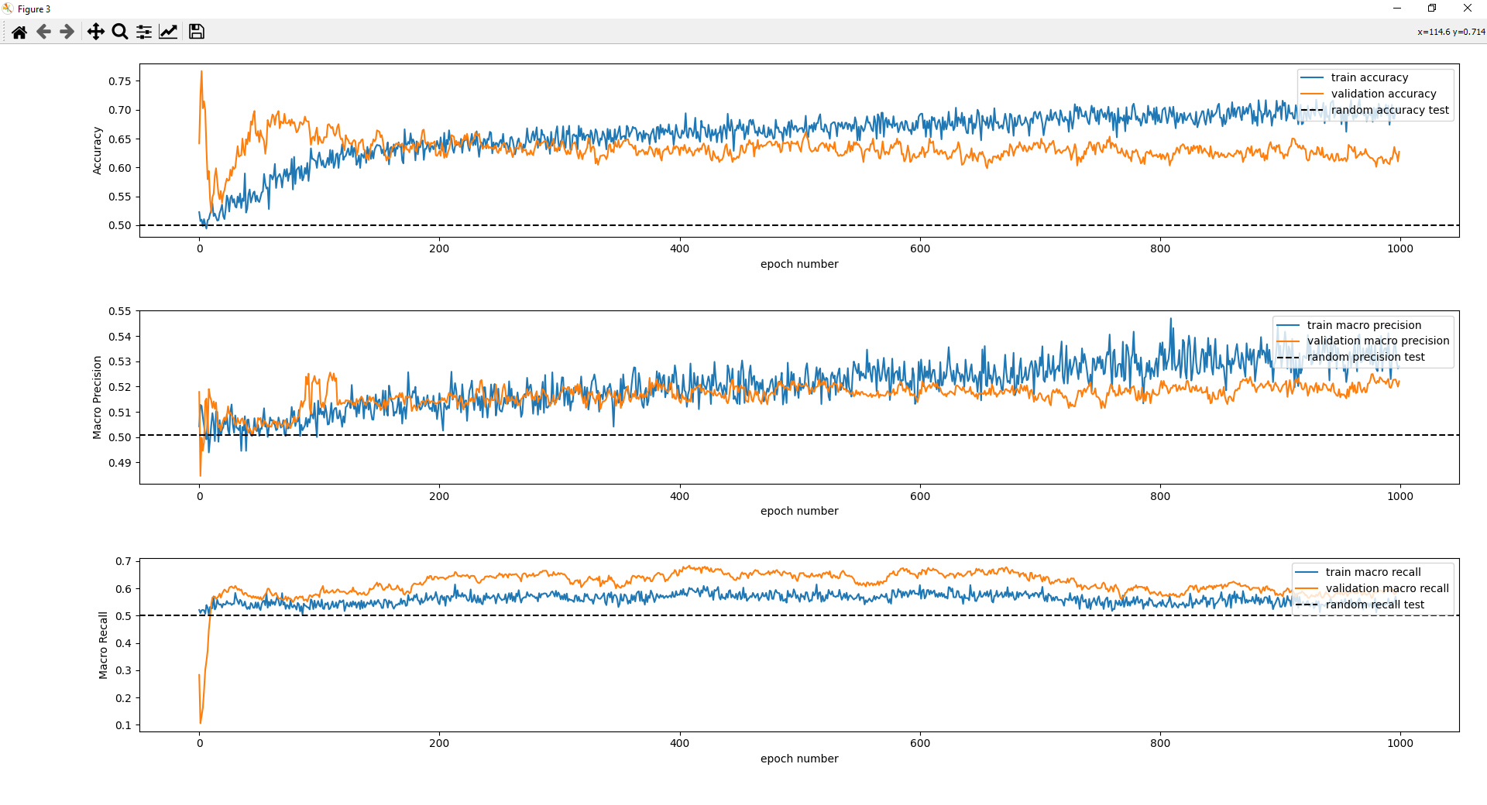
Results neural network

Slide 28
Results neural network
Dotted line gives results by chance
Not very clearly above chance for any of the metrics

Slide 29
Infer variable importance
Random shuffling of samples for one variable
Check loss of the model
High loss change indicates high importance

Slide 30
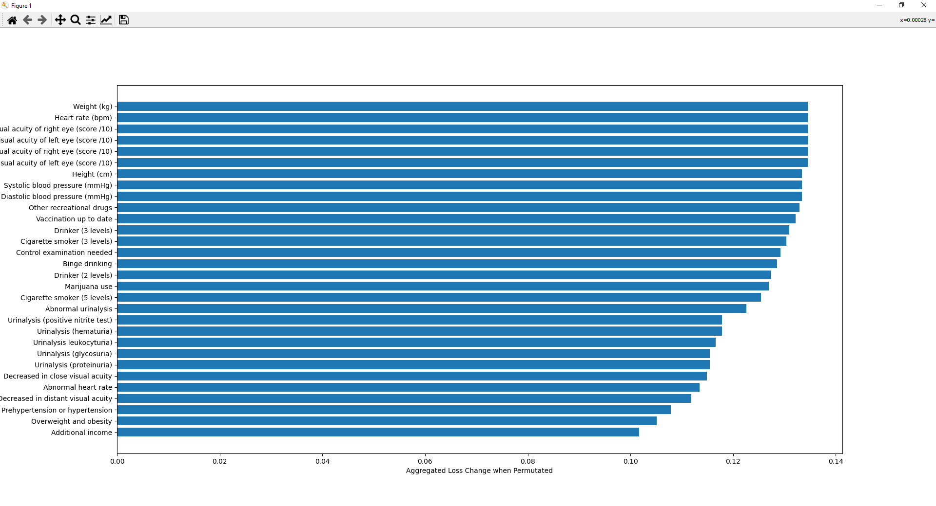

Slide 31
Discussion
Not very convincing results for finding risk variables
Why?
People might be lying (taboo) 🧢
Mental health issues in general are too broad
Mental health issues don’t have risk factors as general as these
Mental health issues can affect anyone regardless of status or lifestyle
I did something wrong

