Slide 1
Video Conference App
邱仁豪 102502542
Dept of Computer Science & Information Engineering
National Central University, Taiwan

Slide 2
https://github.com/DonQuijoTeDe/Final-Project

Slide 3
Outline
Introduction
Method
Debug
Future work

Slide 4
Introduction
Video conference is a web app that can enable a local user to communicate with a remote user
It does not have echo problem
It is real time

Slide 5
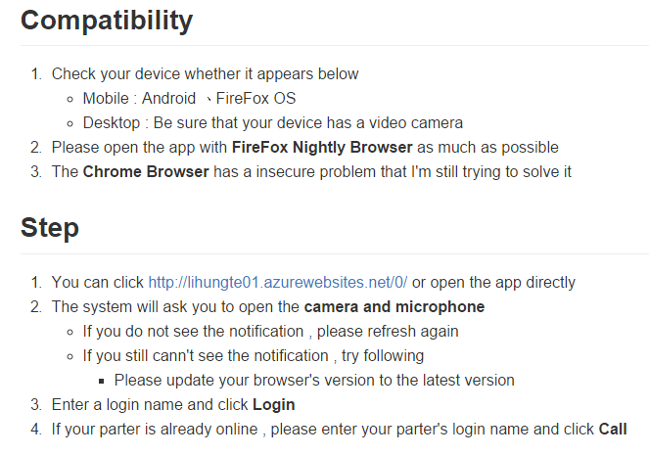

Slide 6
Method
MediaDevices.getUserMedia
https://developer.mozilla.org/en-US/docs/Web/API/MediaDevices/getUserMedia
PeerJS
http://peerjs.com/

Slide 7
Debug
Compatibility :
Chrome (requested contents insecure problem)
FireFox (still debugging)

Slide 8
Future work
Real time user list
Chat with 2+ people
e.g. Skype
Streaming games
e.g. Twitch
Across IOS and Android

Slide 9
Thank you for listening !

