Slide 1

Health expenditure in Mexico

Slide 2
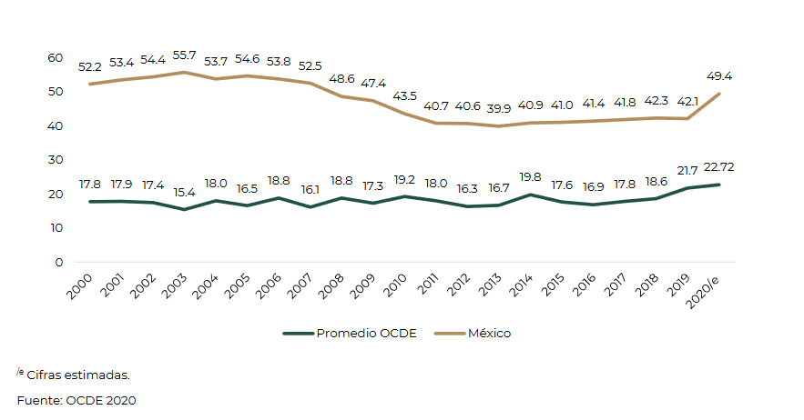
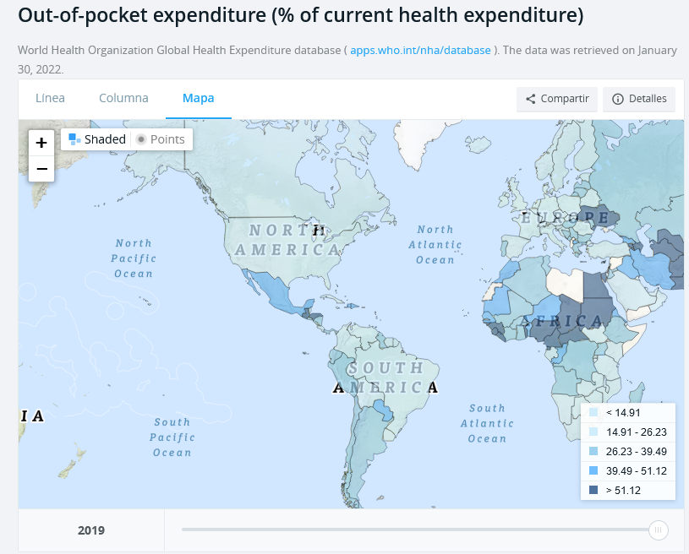
Evolution of out-of-pocket spending on health as a percentage of total spending on health
Evolution of out-of-pocket spending on health as a percentage of total spending on health
2000-2020
Health expenditure
Despite almost universal health coverage in México, out-of-pocket payments are an important source of health financing, being almost 50% of total health spending, ranking as one of the highest in the region.
Understanding the concept 'out-of-pocket payments' as the proportion of spending that households allocate directly to solving the requirements for their health care, once they have satisfied their food needs.
Distribución del Pago de Impuestos y Recepción del Gasto Público por Deciles de Hogares y Personas, 2020. SHCP
Notes:
In Mexico, in theory, most of the health services should be covered by public spending, however in Mexico almost 50% of the total of these expenses are covered by the monetary income of the households, positioning our country only for below countries in Central America and Africa, according to data from the World Bank. Although out-of-pocket spending on health was reduced with the implementation of the initiative called "popular insurance", in 2020 it returned to values of 50%. The concept of "out-of-pocket expenditure on health" is defined as the ratio between the expenditure on health divided by the monetary income of the household, after covering their food needs.

Slide 3
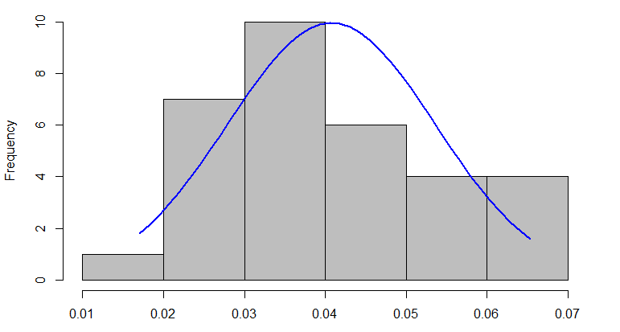
Elaboration with data from the ENIGH survey
Out-of-pocket health expenditure by state
Out-of-pocket health expenditure in Mexico
Distribution out-of-pocket health expenditure
2020
Source: ENIGH survey 2016, 2018, 2020
Deflated prices based on 2016
Notes:
The database that we use for our analysis is the ENIGH "National Household Income and Expenditure Survey", where we can find a great detail of the expense concepts to be able to separate spending on health, food, education, entertainment, beverages alcoholic, tobacco The survey unit is the household, but there is a string column of length 5, where the first two numbers represent the state and the last 3 numbers represent the municipality. Income and expenditure prices were deflated based on the year twenty-sixteen and we can see this important increase for the year twenty-twenty, due to the double effect of the increase in health spending and the reduction in per capita income.

Slide 4
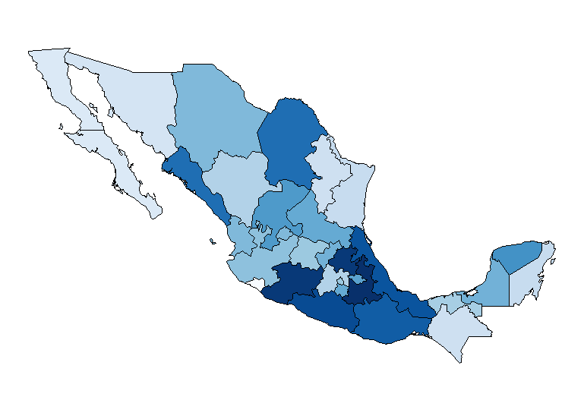
Distribution of out-of-pocket health expenditure across mexican states in 2020
Out-of-pocket health expenditure
2020
Larger expenditure in southern states
States with more vulnerable population.
Since health in Mexico is public, we would expect that poorer states have to expend less in health.
Notes:
When we analyze health spending by state, we can see that those with the highest health spending (those with darker colors) are the southern states such as Michoacan, Guerrero, and Oaxaca, and some states in the metropolitan area such as Hidalgo and Puebla, except for the state of Mexico and the Mexico City, where out-of-pocket spending on health is lower

Slide 5
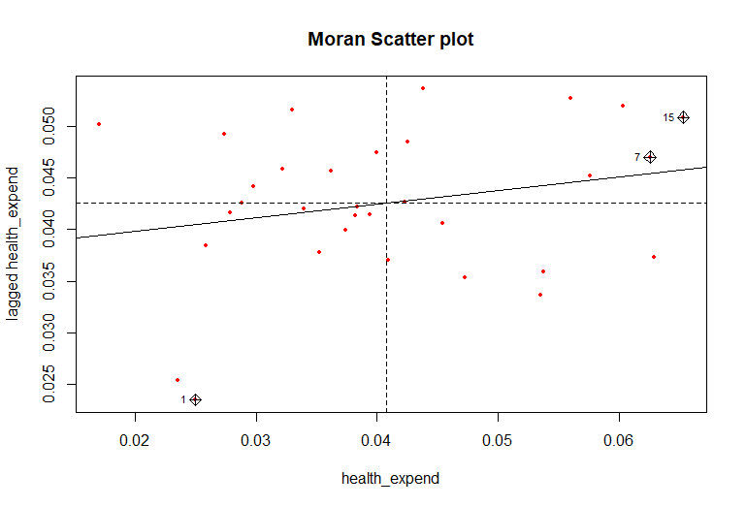
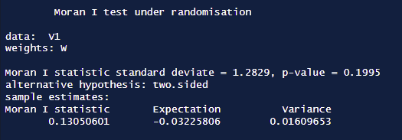
Moran’s I Test
MÃ©xico
Chiapas
Not significant, p value > 0.05.
No spatial autocorrelation.

Slide 6
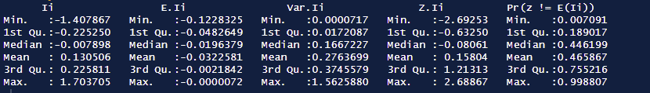
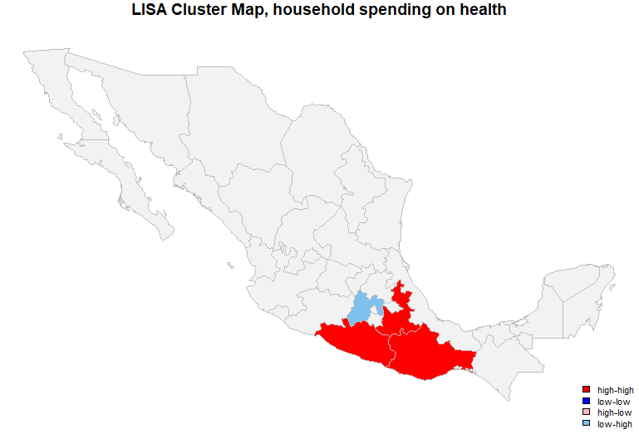
require(sp) || install.packages("sp", dependencies = T)require(spdep) || install.packages("spdep", dependencies = T)require(ape) || install.packages("ape", dependencies = T)require(gstat) || install.packages("gstat", dependencies = T)require(MASS) || install.packages("MASS", dependencies = T)require(devtools) || install.packages("devtools")require(spgwr) || install.packages("spgwr", dependencies = T)require(spData) || install.packages("spData", dependencies = T)require(Matrix) || install.packages("Matrix", dependencies = T)require(psych) || install.packages("psych", dependencies = T)require(tmap) || install.packages("tmap")require(readr) || install.packages("readr")require(stargazer) || install.packages("stargazer")require(automap) || install.packages("automap")require(spatialEco) || install.packages("spatialEco")require(SpatialKDE) || install.packages("SpatialKDE")require(smacpod) || install.packages("smacpod")require(lme4) || install.packages("lme4")
LISA Test
According to the map, there is spatial autocorrelation in the states of Oaxaca, Guerrero and Puebla.
In the chorophlet map, some of these states showed high levels of health expenditure.
Puebla
Guerrero
Oaxaca

Slide 7
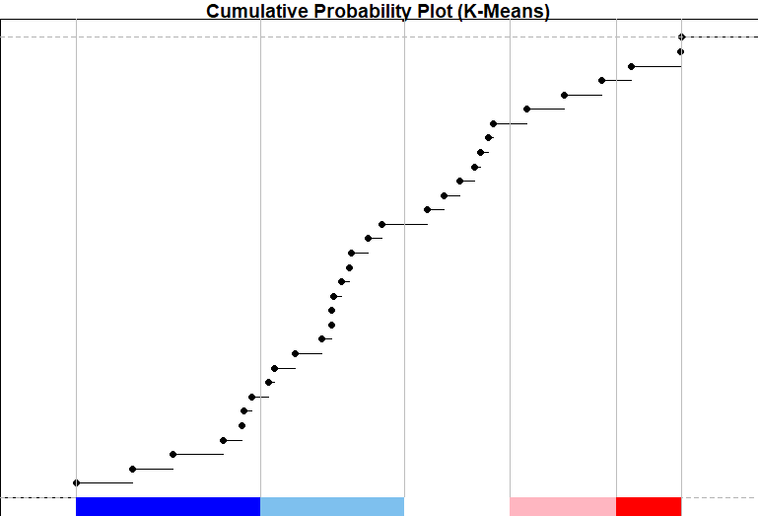
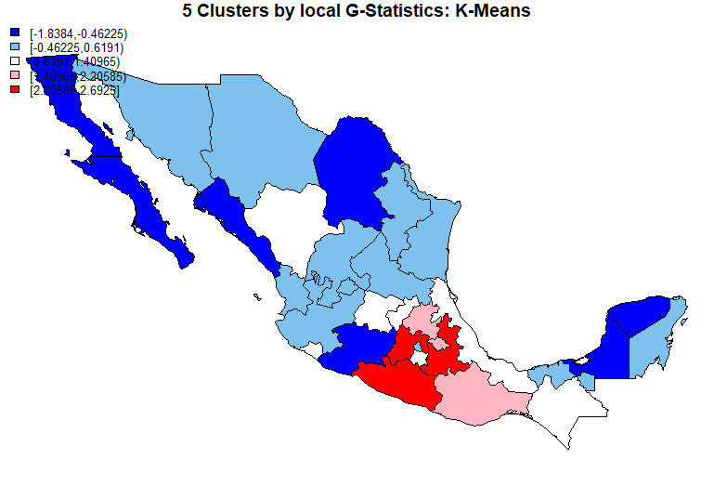
G-Statistics K-Means
Similar clusters as shown in LISA.
Some low-low clusters appear, specially for the Baja Californias and Yucatán and Campeche

Slide 8
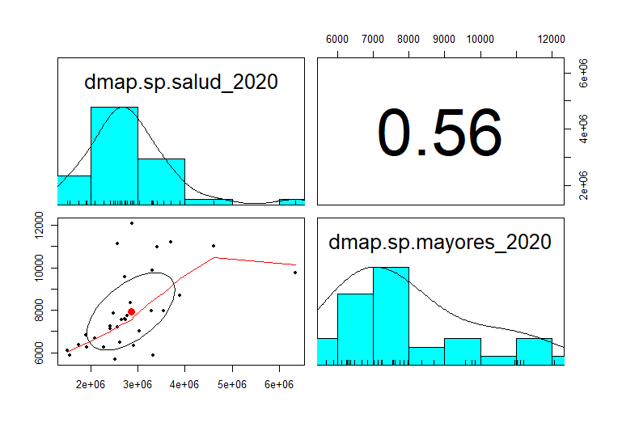
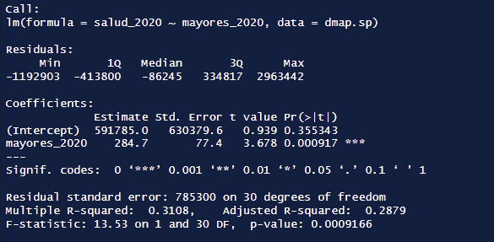
OLS
Linear Regression model
Number of people over 60 years old as independent variable
Significant with a p-value < 0.001
R-squared = 0.3108

Slide 9
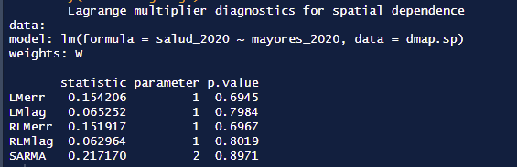

LM Diagnostics and Heteroskedasticity Test
None of the LM diagnostics parameters were significant, theroefore a spatial regression is not necessary. However, we ran the models.
We don’t have heteroskedasticity. P-value > 0.05

Slide 10
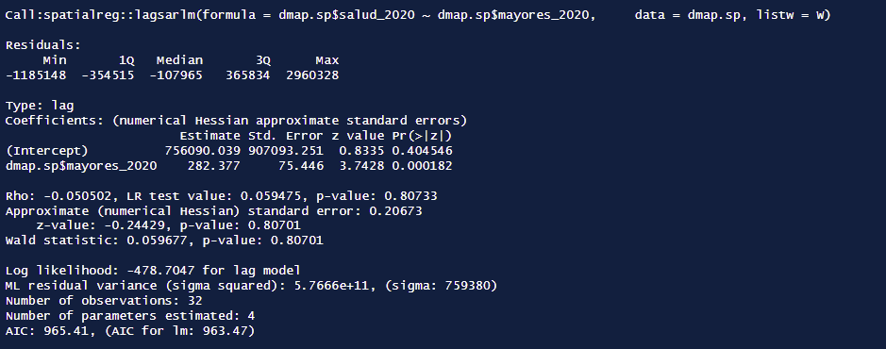
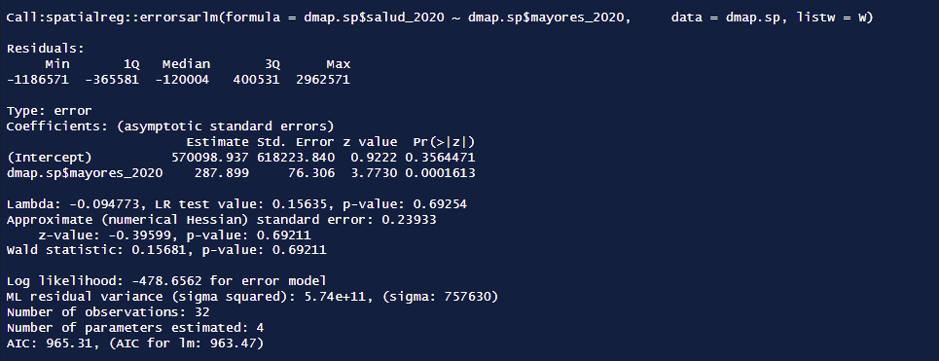
Spatial Regression Models
Spatial Lagged Model (SLM)
AIC criteria for both SLM and SEM shows poorer performance than the AIC for OLS.
This results are consistent with the LM diagnostic tests
Spatial Error Model (SEM)

Slide 11
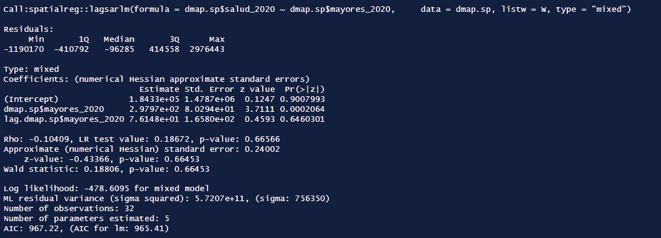
Spatial Durbin Model (SDM)

Slide 12
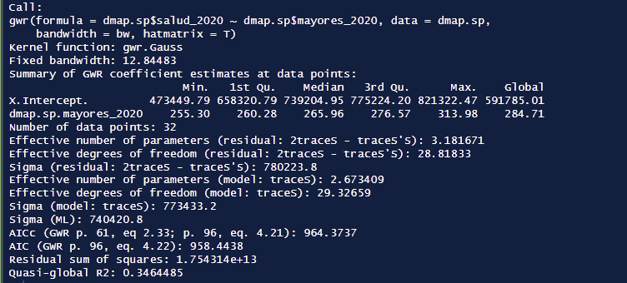
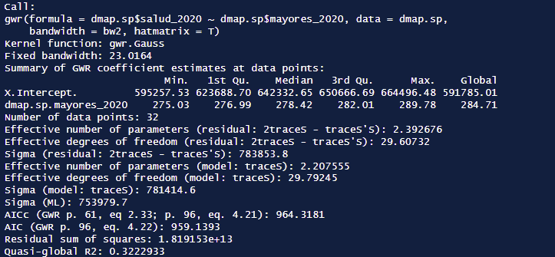
Geographically Weighted Regression
The GWR with the smaller bandwith has a better performance.
The AIC is smaller than in the SLM, SEM and SDM.
Also, the R squared is higher than in OLS.
R squared = =.3464
Consistent with LISA tests and G-statistics. There is only spatial autocorrelation in some areas of the country.

Slide 13
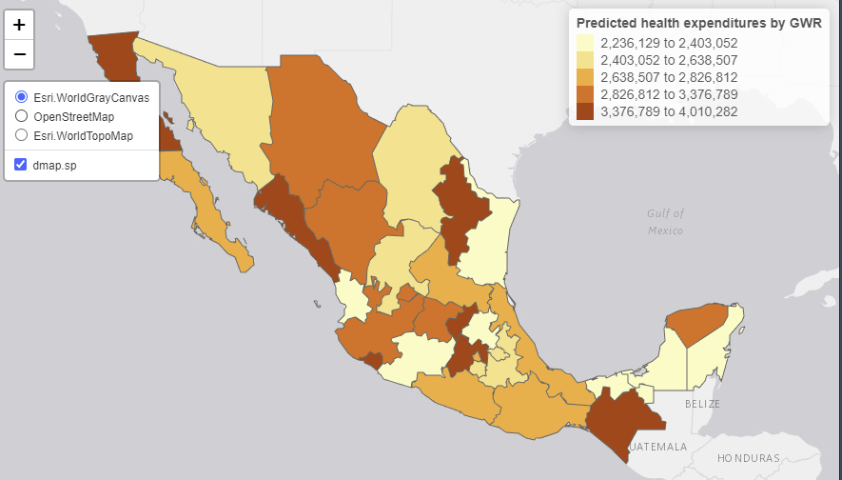
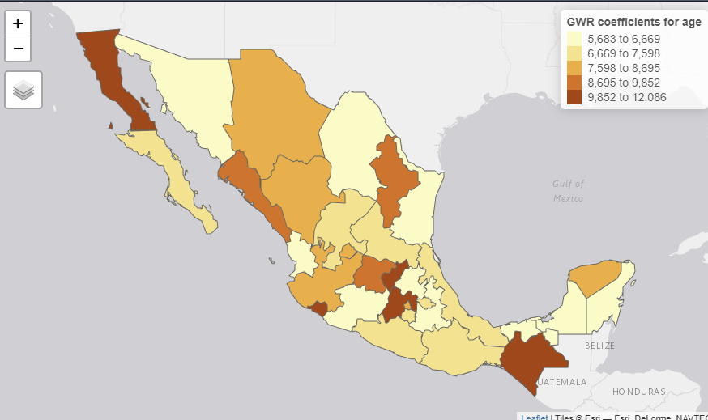
Predicted health expenditures by GWR
The states where the greater expenditure was predicted are not the same as the states with the gretest expenditure shown in the chorophlet map. However, this prediction is also a function of age. It would be very interesting to map the distribution of adults over 60 years old to analyze the relationship.
GWR coefficients for age

