Slide 1
Shopify Sales &
Customer Analysis
By
Dona Merlin M

Slide 2
Objective
The objective of this project was to analyze e-commerce sales data from Shopify to uncover insights into customer behavior, time-based trends, regional performance, and product-level insights using Power BI.
"The dataset was sourced from Kaggle and contains detailed information on 7,431 customers, order-level details, product info, tax, region, and payment methods, contributing to a total revenue of $4.6 million."

Slide 3
Tools and Techniques used
Tools Used: Power BI, Excel, DAX for calculated measures.
Key Metrics/DAX: Net Sales, Avg Order Value, Repeat Rate, LTV, Purchase Frequency.
Dynamic Dashboards: Show slicers, dynamic titles, time-based and regional trends.

Slide 4
Summary
Content:
Revenue: $4.6M Total, Avg Order: $618.89
Customers: 7,431 Total, 46% Repeat Rate
Top Products: Running & Tennis Shoes
Time Insights: Peak Hour 10–3 PM, Day 24 best sales
Regions: Top – California, Texas, Florida
LTV: $943.6 | Purchase Freq: 1.68

Slide 5
Customer Behaviour Insights
Repeat Rate: 46% (3,000 of 7,431)
Single-Order Customers: 4,431
LTV: $943.60 | Purchase Freq: 1.68
Recommendation: Launch loyalty/referral programs, retarget single-order buyers with email automation and offers

Slide 6
Product, Pricing & Time Trends
Content:
Top Products: Running & Tennis Shoes
Avg Subtotal: $562.63; Stable pricing near $537
Time Trends:
Peak Hours: 10 AM – 3 PM
Best Day: Day 24 ($683K sales)
Recommendations:
Promote during peak hours
A/B test premium bundles

Slide 7
Regional & Payment Insights & Recommendations
Content:
Top Regions: California, Texas, Florida
Top Cities: Washington, Houston, New York
Payments: 76% via Gift Cards + Manual
Recommendations:
Expand logistics to top cities
Promote gift cards more prominently
Optimize tax-inclusive pricing

Slide 8
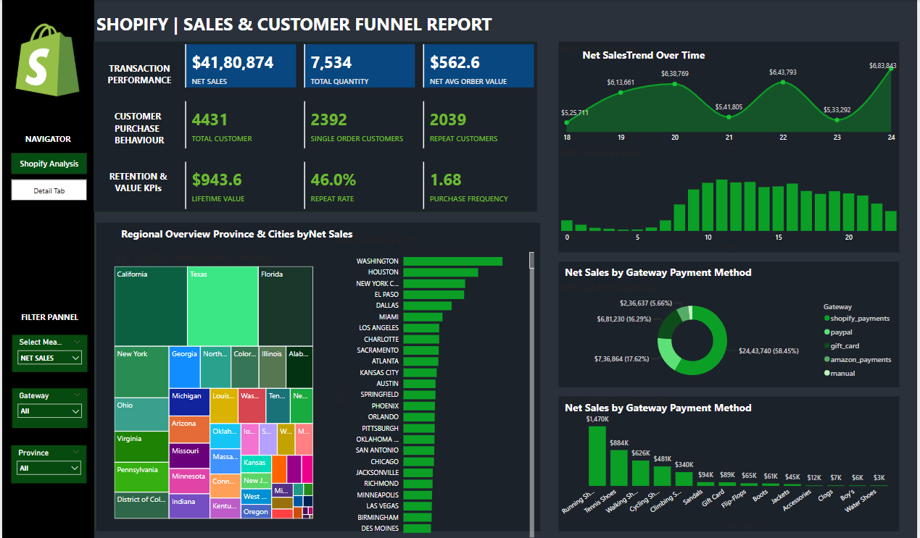
Dashboard

Slide 9
ANY QUERIES ?
THANK YOU

