Slide 1
Workshop 4 – Creating a simple cluster

Slide 2
Agenda
Docker cluster

Slide 3
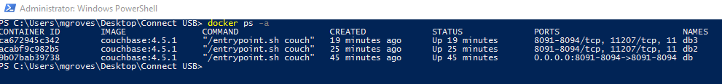
Create docker images
docker run -d --name db couchbase:4.5.1
docker run -d --name db2 couchbase:4.5.1
docker run -d --name db3 couchbase:4.5.1
Notes:
If you haven’t already created db in docker, go ahead and do that now.
Set up it like we did in part 1 of the lab
Create another image and give it the name db2 (and you can create another one db3)

Slide 4
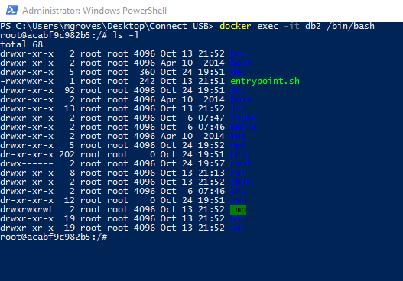
Run bash on the image
docker exec -it db2 /bin/bash
Notes:
This will execute the bash command shell within the docker image, you should get a command prompt

Slide 5
Within bash
Get the IP: /sbin/ifconfig
Notes:
This will tell you the IP address of the image you’re in right now

Slide 6
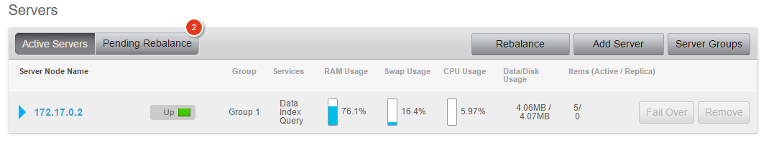
Connect to cluster
Notes:
You should already have created a cluster with one node, db
Notice that in this screenshot, there are 6 items on one node

Slide 7
Connect to cluster
couchbase-cli
server-add -c 172.17.0.2:8091
--server-add=172.17.0.3:8091
--server-add-username=Administrator
--server-add-password=password
-u Administrator -p password
Notes:
Execute this in bash
The first IP address is the IP address of db
The second on is from db2 (the one you found with /sbin/ifconfig)

Slide 8
Repeat for db3
couchbase-cli
server-add -c 172.17.0.2:8091
--server-add=172.17.0.4:8091
--server-add-username=Administrator
--server-add-password=password
-u Administrator -p password
Notes:
Note that the first IP address is the same, the second one is the IP address of db3
couchbase-cli server-add -c 172.17.0.2:8091 --server-add=172.17.0.5:8091 --server-add-username=Administrator --server-add-password=dhsieh -u Administrator -p dhsieh

Slide 9
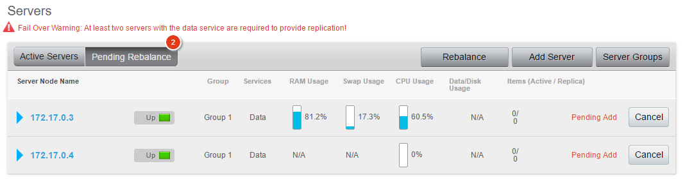
New nodes
Notes:
Click rebalance

Slide 10
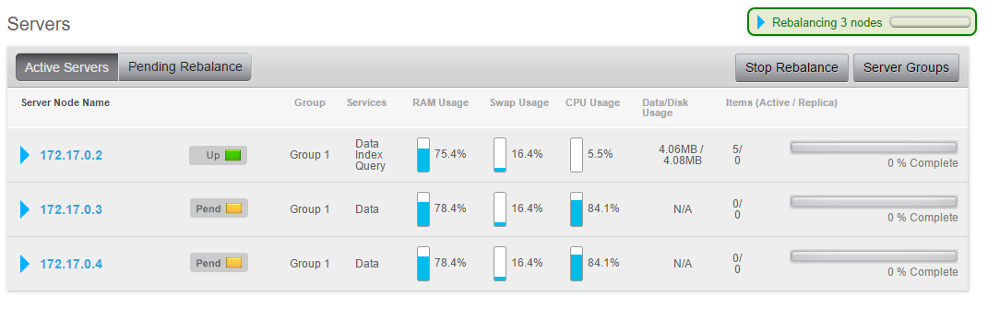
Rebalance
Notes:
Rebalance will take time, but it happens in the background, meanwhile your cluster is still available

Slide 11
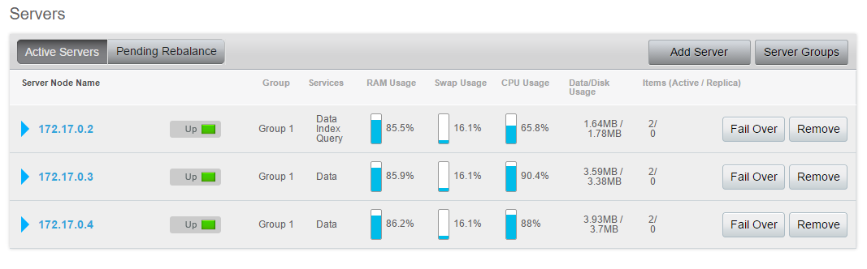
Rebalance complete
Notes:
Notice that there are 2 items on each node, so the documents were evenly distributed
Mathematically even distribution is not guaranteed, so it’s possible that it could be 3,1,1, for instance
But generally the documents will be distributed evenly, and remember this is a very small amount of documents

Slide 12
Questions

Slide 13


Share your opinion on Couchbase
Go here: http://gtnr.it/2eRxYWn
Create a profile
Provide feedback (~15 minutes)

