Slide 1
Mca MAIN project
Presented By
dona siby
s4 MCA-a
roll no:46

Slide 2
Project title
SUPERR.
A Parentry app

Slide 3
Relevance of topic
To provide solutions to help parents stay aware of good parenting techniques in this digital age while providing them with tools to ensure that their children are safe and productive online.
Parent can learn to manage their child's online classes, social media usage and gaming habits by using Superr.
It helps to make informed choices for your child’s digital activities and it will helps to balance the parent's work and their child’s schooling efficiently.
Superr. provides services from parenting lessons and digital monitoring tools to mentorship and professional help.

Slide 4
Description of the project
7-day Insights
Within just minutes of installing Monitory by Parentry on their child’s device, parents will be able to get insights and detailed info about the child’s digital habits starting with
Protection
Preventing premature exposure to adult content when browsing
Controlling access to newly installed apps so parents can ensure it’s appropriateness
Giving a complete view of the child’s activities on their device to equip parents with the information required to protect their child from harm’s way

Slide 5
Description of the project
Filtering
Safe Browsing
Safe Search
YouTube Protection
App Shield

Slide 6
Description of the project
Supervision
Browsing Supervision
App Supervision
Search Supervision
YouTube Monitoring

Slide 7
Description of the project
Social-media Monitoring
WhatsApp Monitoring
Instagram Monitoring (Working on it)
Snapchat Monitoring (Working on it)

Slide 8
Objective of the study
To Make a reliable, secure software to help parents monitor students' daily activities and progress through a web and mobile app.
To find out if a child's development is on track.

Slide 9
Existing system
Monitor by Parentry
Used to monitor the activities of kids
Features:3 modes, call and SMS blocking, instant mode, lock mode
Drawbacks: Not user friendly, Chances to get frustrated

Slide 10
Proposed system
Superr.
Ease of use
Lots of features for kids
Parents can choose a plan based on their kid’s online activities
Kids will get rewards
Kids can explore the world

Slide 11
modules
Module 1:Account creation and login
Module 2:Onboarding
Module 3:Restrictions setup
Module 4:Data overview

Slide 12
Onboarding process
Account creation by parents and login to the account
How
It works
Select a plan and Setup the restrictions based on the 7 day insights
Track the location
Schedule a day
Safe searching and app and website blocking
Explore and encourage modes to be focused and productive

Slide 13
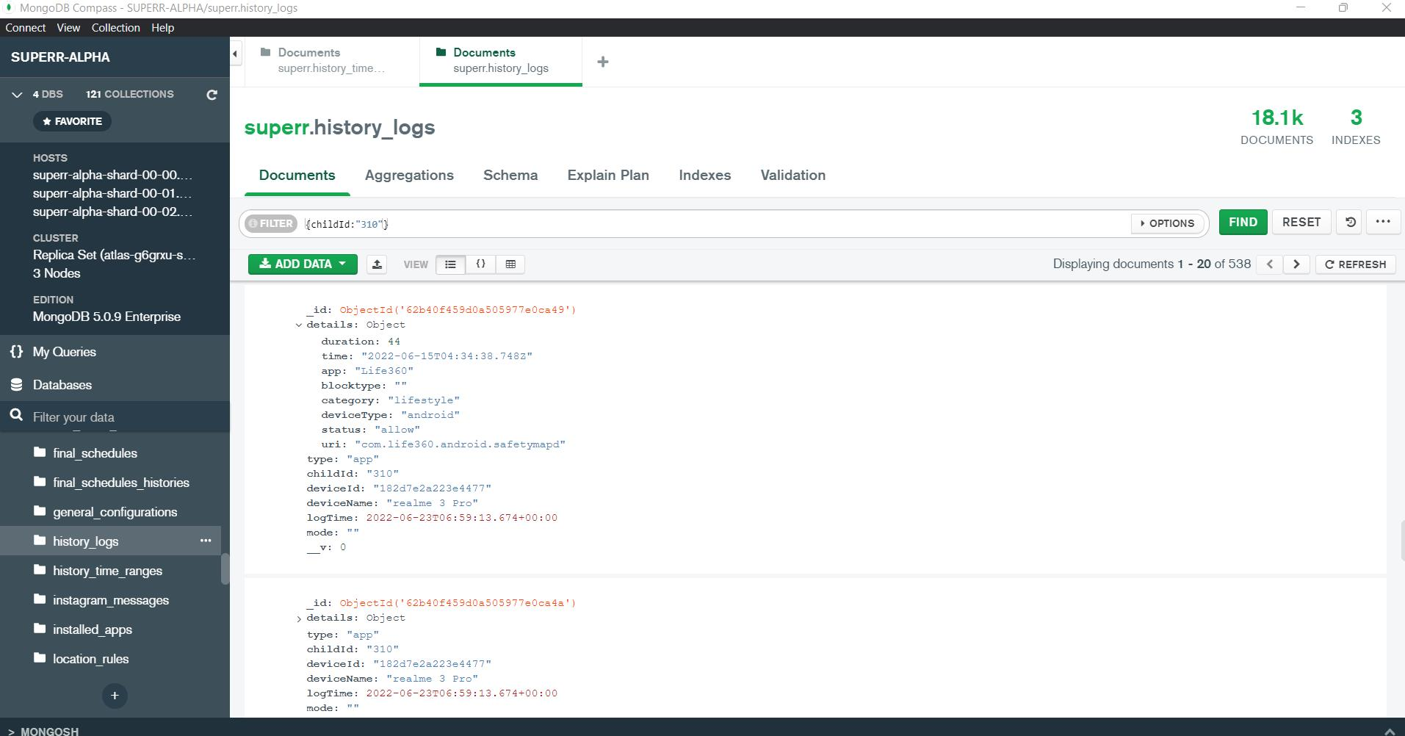

Slide 14
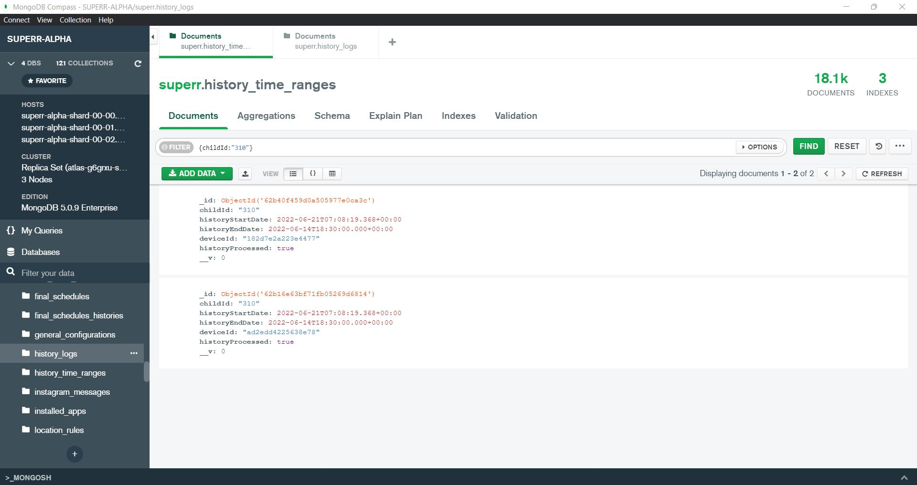

Slide 15
DESIGN

Slide 16
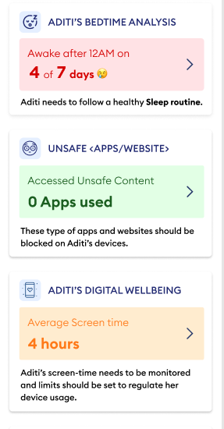

Slide 17
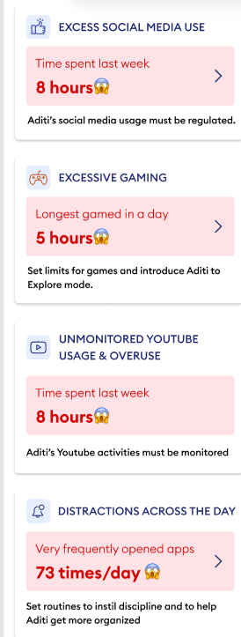

Slide 18
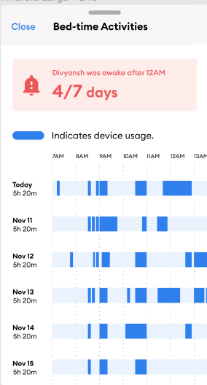

Slide 19
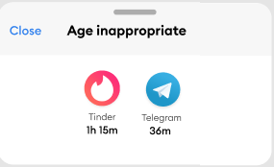

Slide 20
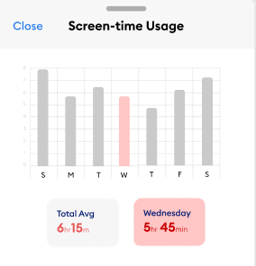

Slide 21
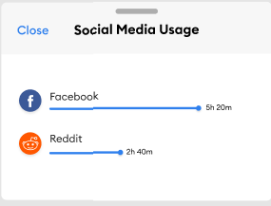

Slide 22
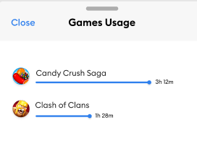

Slide 23
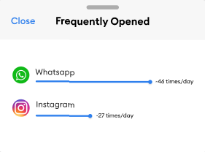

Slide 24
7 Insight API

Slide 25
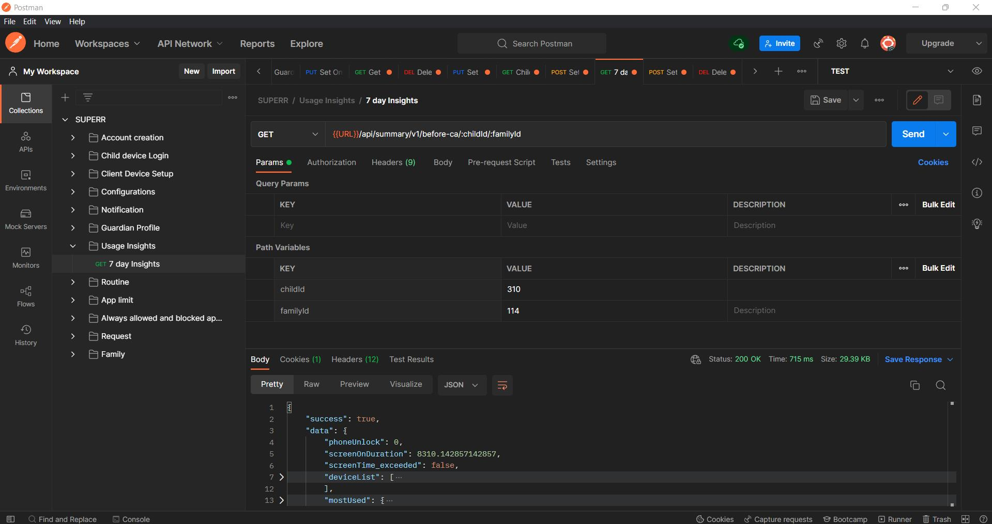

Slide 26
