Slide 1
Project title
SUPERR.
A Parentry app

Slide 2
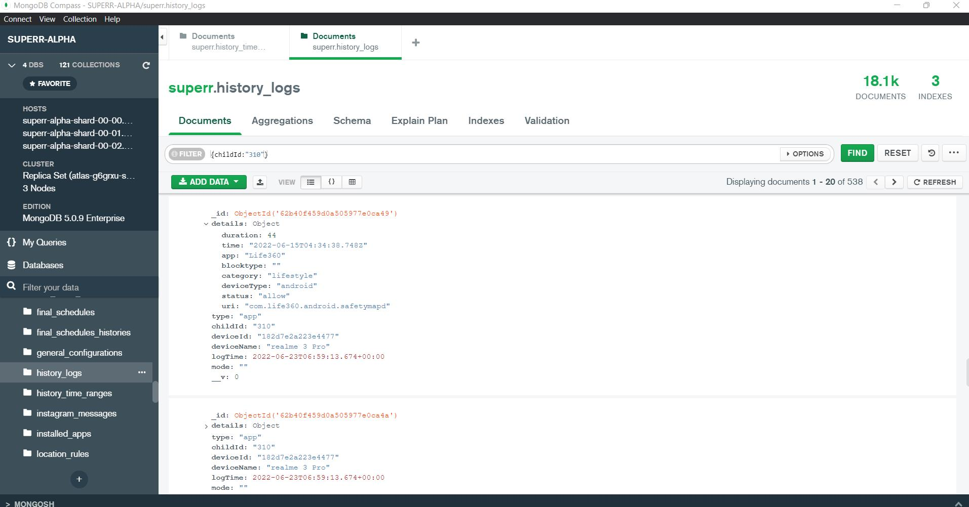

Slide 3
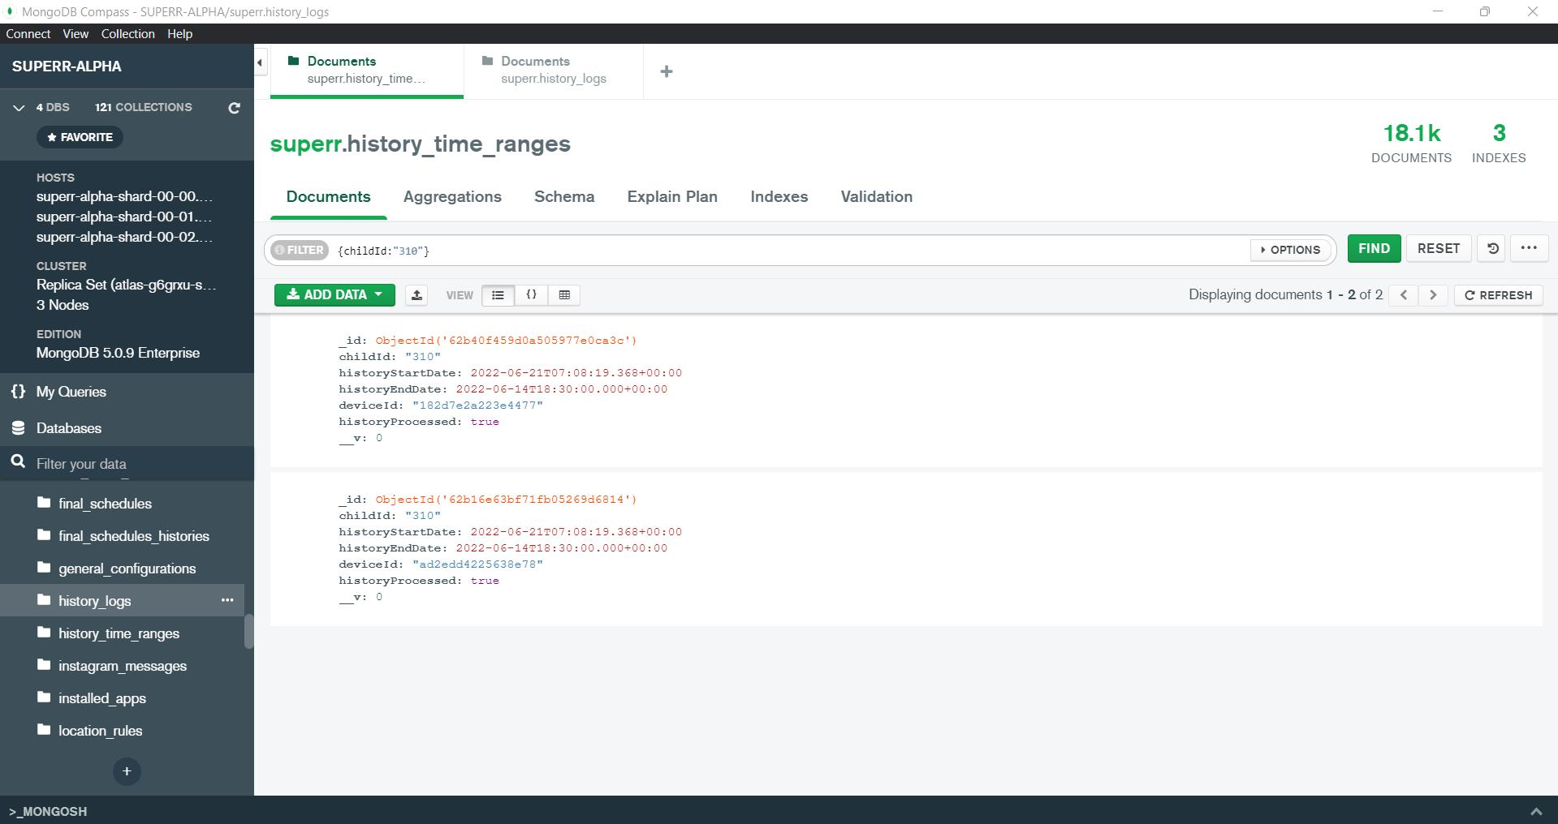

Slide 4
DESIGN

Slide 5
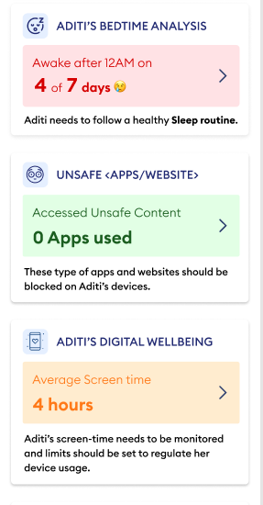

Slide 6
7 Insight API

Slide 7
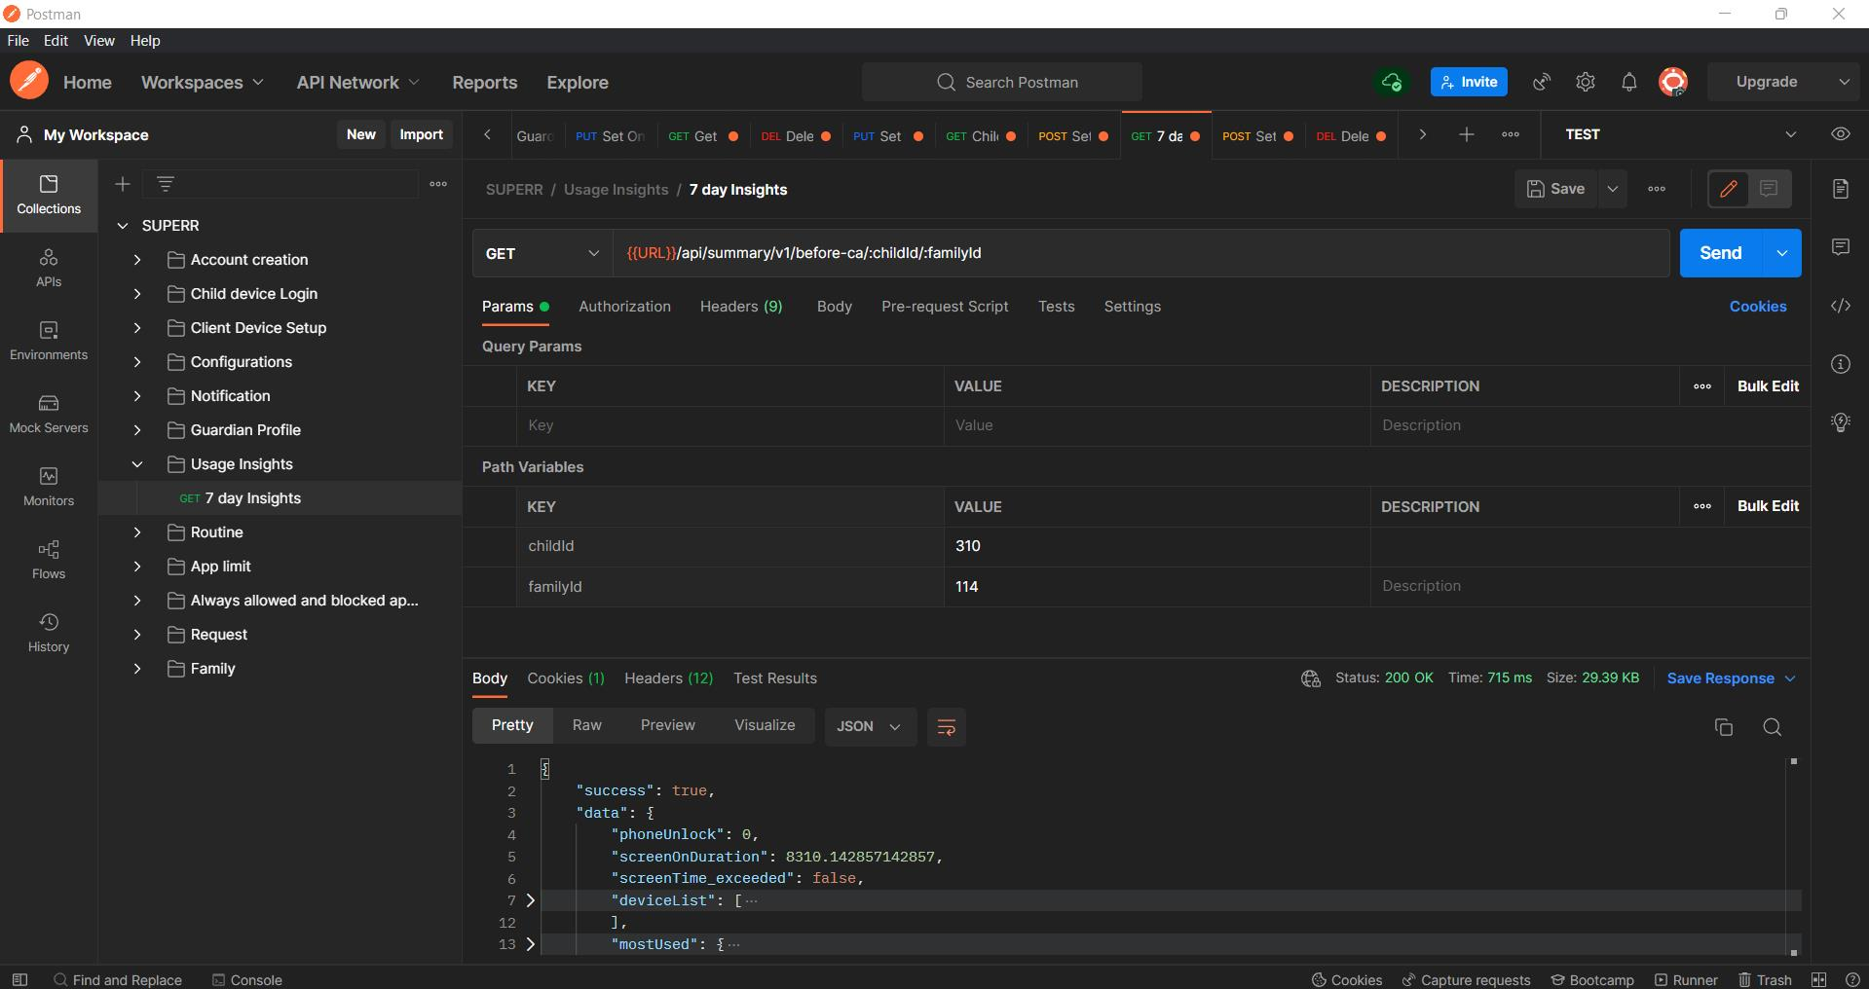

Slide 8
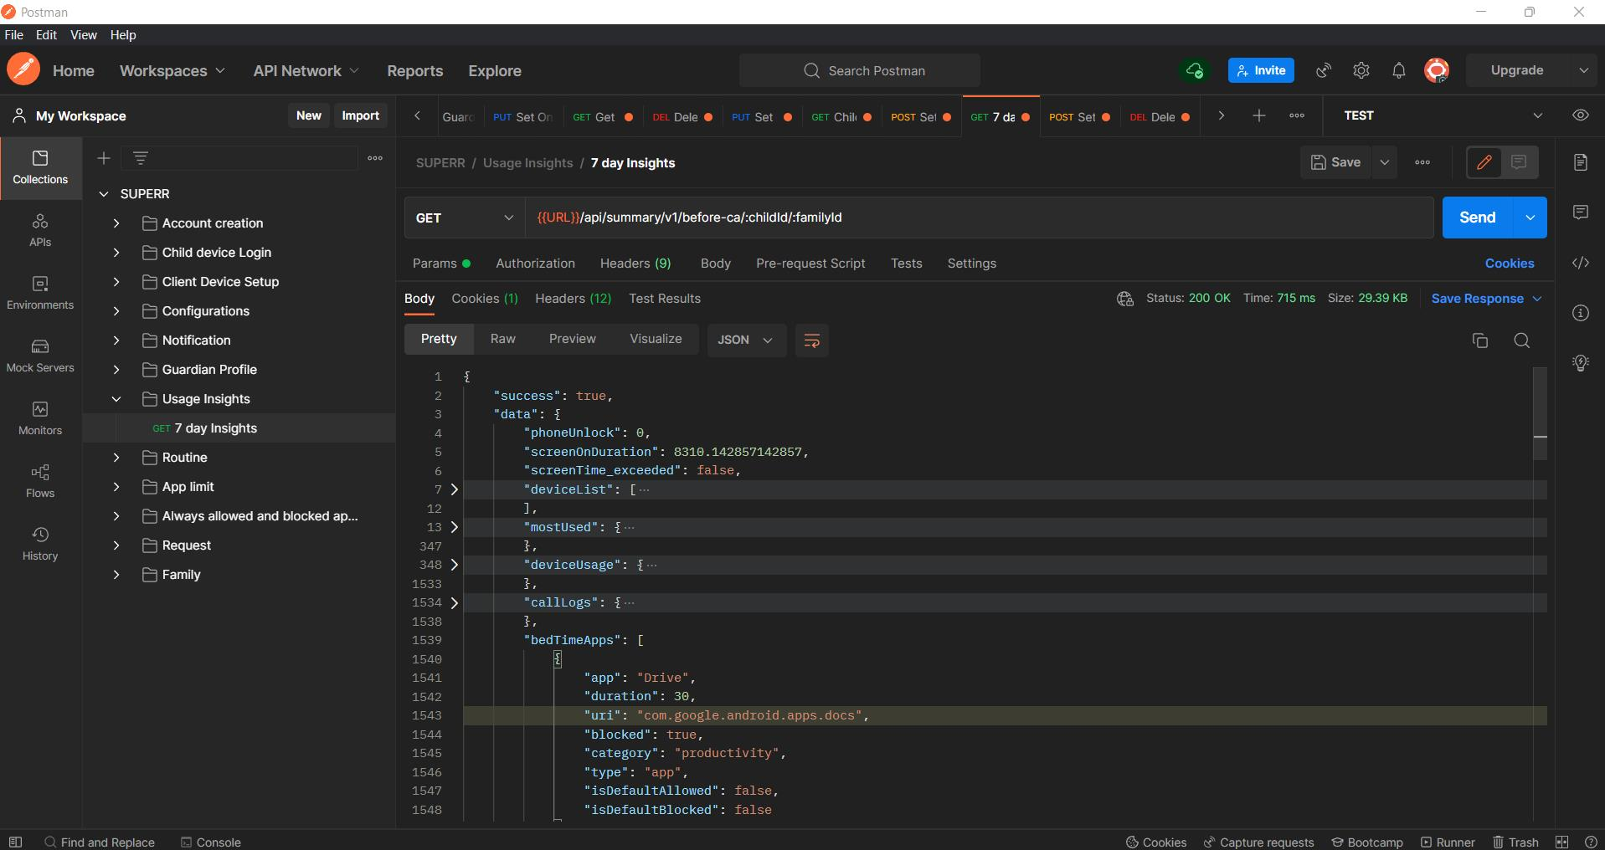

Slide 9
Thank you

