Slide 1
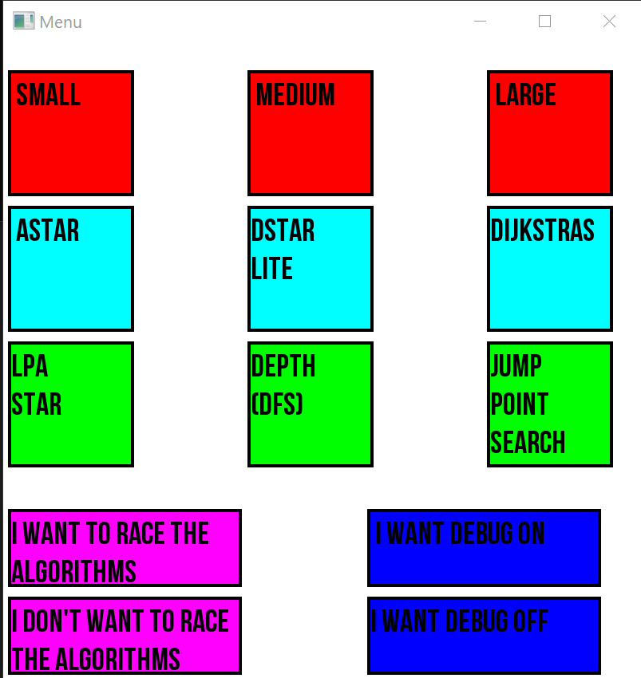
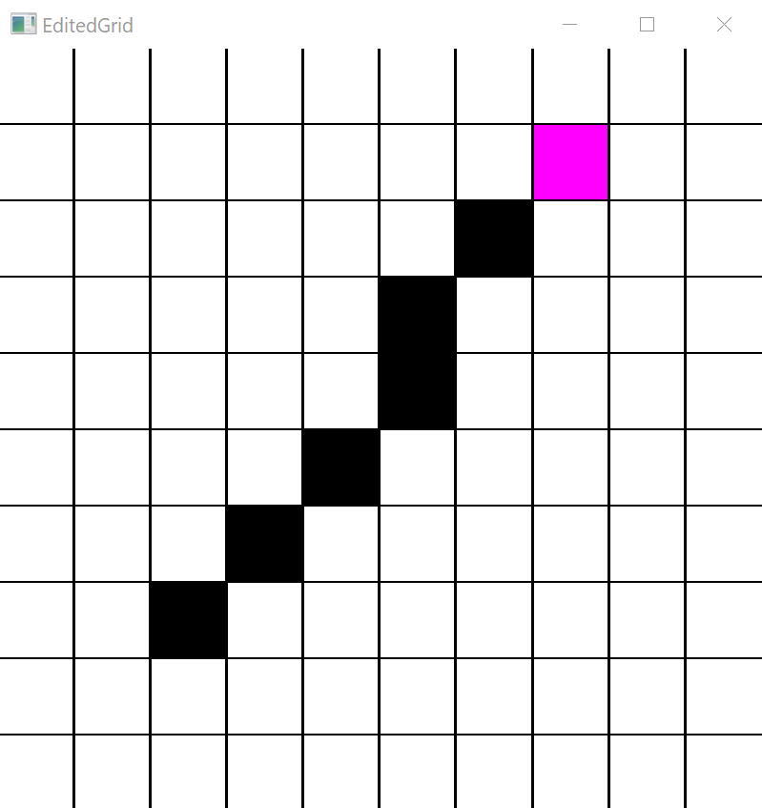
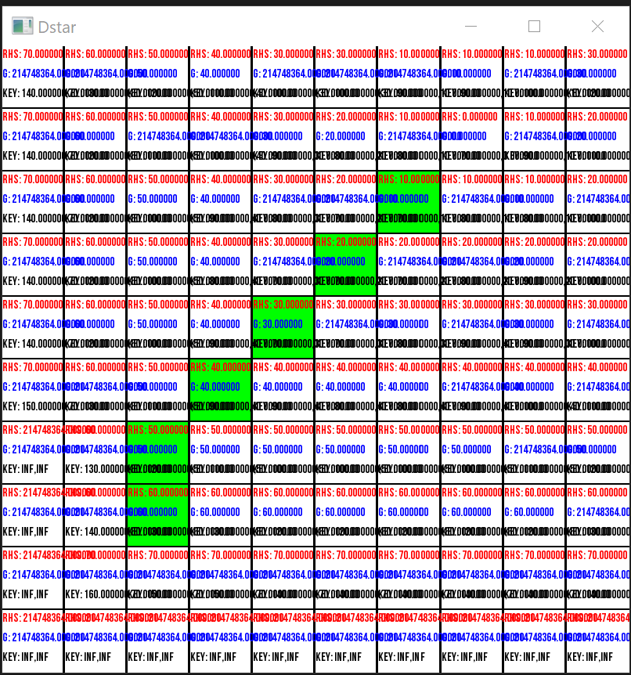
A comparison of Dstar lite against various guided and non-guided pathfinding algorithms
A comparison of the different algorithms under a games development context to help developers make a more informed choice on what algorithm to implement into their games
Donal Howe
C00249662

