Slide 1
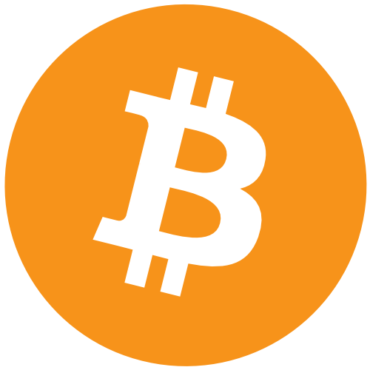
User friendly Bitcoin Wallet
MEAN STACK PROJECT

Slide 2
Project Objective:
Our goal is to make a Bitcoin Wallet using the MEAN stack by combing of NodeJs,Angular2,ExpressJs and MongoDB
Make the UI user friendly and appealing to new users of Bitcoin.
Educate user on the technology bitcoin and how it works, display real time value.
Strong authentication that’s simple to use yet secure so users will trust us with there coins.
Google Maps integration to show users bitcoin related locations like exchanges or stores that accept the currency.
Use QR codes to easily send and receive coins.

Slide 3

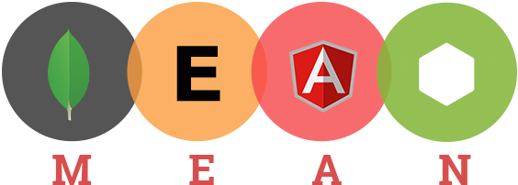

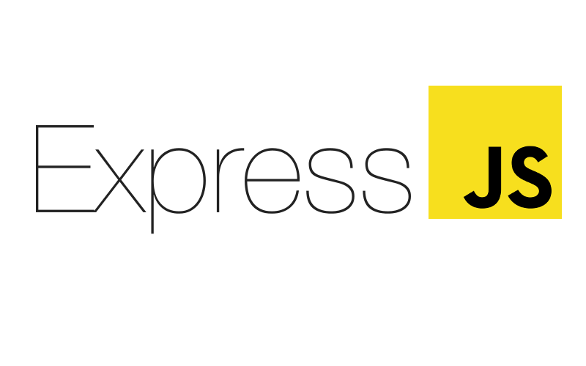

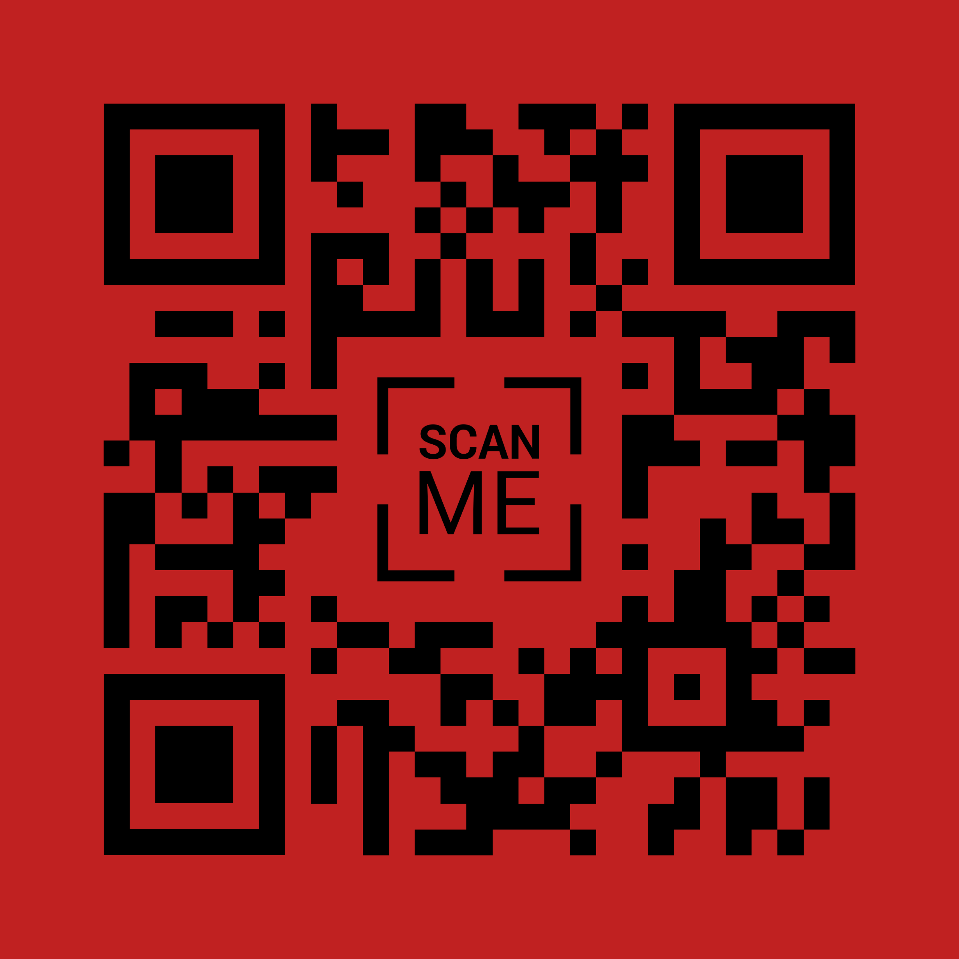
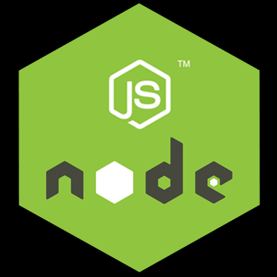
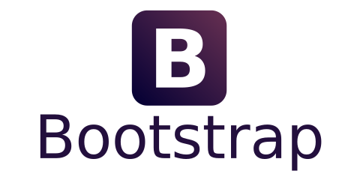
Bitcoin wallet powered by

Slide 4
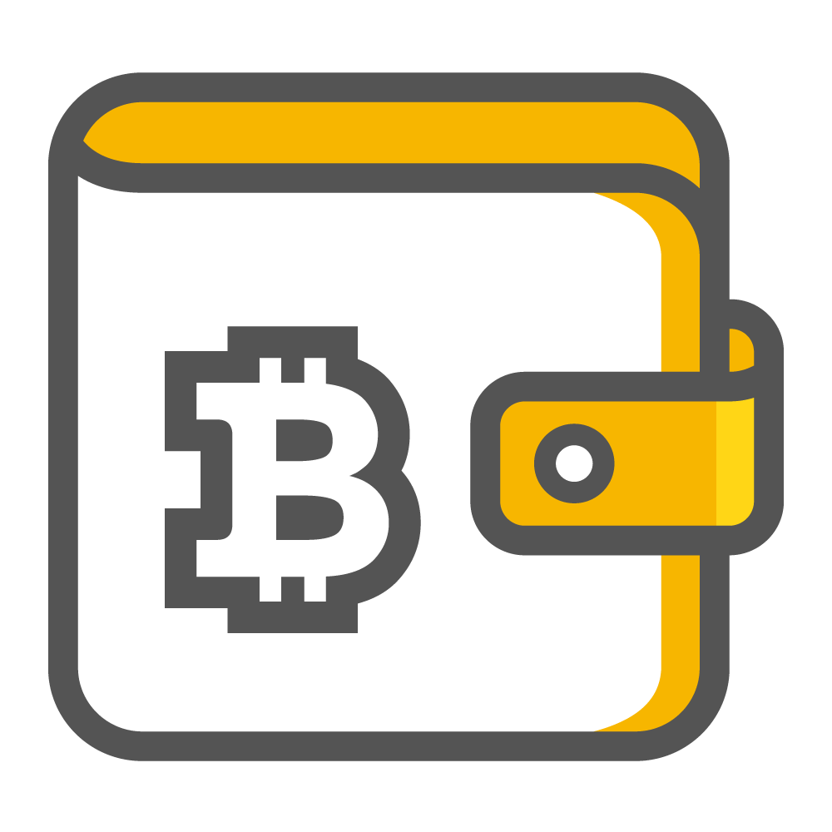
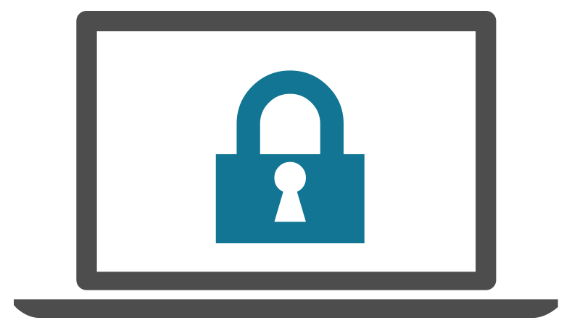
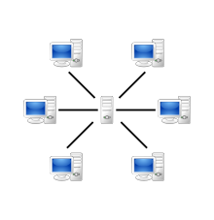
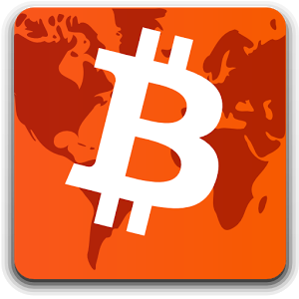
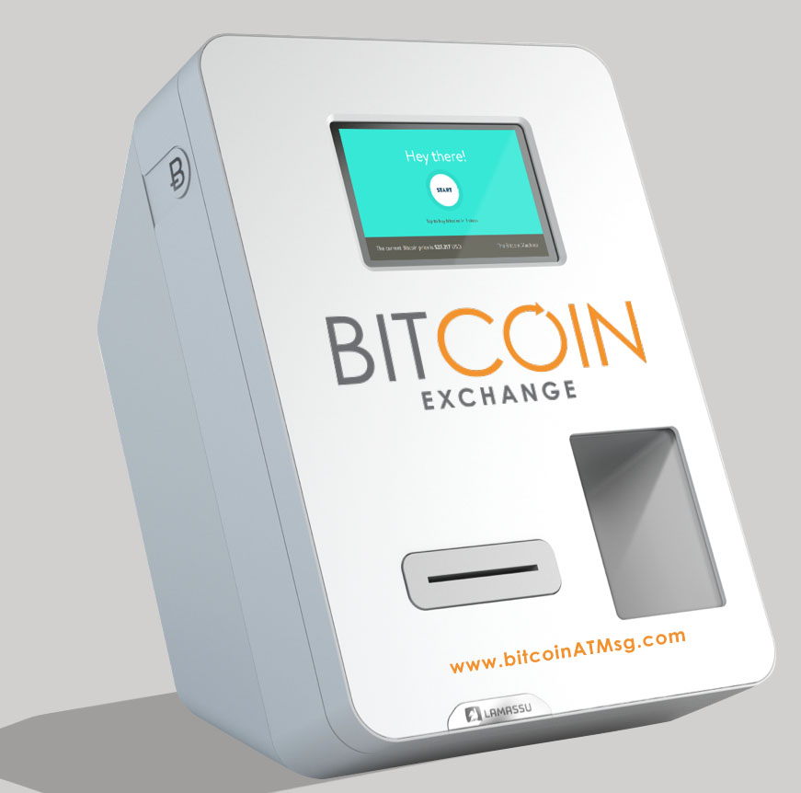
Scope/Work Breakdown
Work Breakdown
Security/User Authentication
QR Code Scanning and Data.
Server Hosting.
Bitcoin Mapping
Wallet capabilities and bitcoin storage
Bit coin Vending and transactions
Conor
Donal
Stephen

Slide 5
