Slide 1
CovCo Writing Workshop
Session Six: Plagiarism and References

Slide 2
Plagiarism
What is plagiarism?
to steal and pass off (the ideas or words of another) as one's own
to use (another's production) without crediting the source
to commit literary theft
to present as new and original an idea or product derived from an existing source
How to avoid accidental plagiarism:
Do not copy and paste sentences directly from other articles (even if you intend to change later!)
If you use an exact phrase from another article, put the phrase in citations
Avoid forgetting references! If you get an idea from another paper, put the reference down first, then write
If you are using similar information from a prior publication where you were a co-author, state “More details described in (ref)” with citation
https://www.plagiarism.org/article/what-is-plagiarism

Slide 3
References
In addition to preventing plagiarism, references are important!
Complete, up-to-date references are imperative for crafting compelling Introduction and Discussion sections
Do a thorough literature review before manuscript drafting
If you make statements that require support, spend time searching for related papers to ensure you cite most up-to-date evidence!
Correct formatting is also very important – signs of quality!
You want to make sure that Reviewers can easily find your referenced articles, websites, etc.

Slide 4
Reference styles
Each journal has its own reference styles
This includes preferences for in-text citation and the reference section (list of full references at end of paper)
In-text citation
Reference section
Most journals will ask that citations be either numbered in order of presenting (included as superscripts or within brackets or parentheses) or by last name and year (included within parentheses).
There are also guidelines for when there are multiple authors or references corresponding to one sentence.
The format of in-text citation will correspond to how the reference list is presented
If numbered, the reference list will also be numbered in order
If last name, typically listed in alphabetical order
Journals typically have guidelines about the style used for the references (e.g. AMA, MLA)

Slide 5
Example – numbered references
In-text citation
Reference section

Slide 6
Example – named references
In-text citation
Reference section

Slide 7
References during manuscript drafting
Use a reference software (Mendeley, EndNote)
This will be difficult with multiple people working on the paper, so we do not recommend for this activity.
If you are the only one working on paper and there are A LOT of citations, this is a great way to add citations and format them from the start.
During writing of manuscript and editing:
Show in text as (last name, YYYY)
Make reference list in alphabetical order
To make your life easier, format in reference list according to journal specifications from the start

Slide 8
References for submission
As a last step before submission, format according to journal specifications
If last name and year is format, you are good to go!
If numbered style required, you will need to update:
Change names to numbers (in order of presentation)
Put reference list in order of numbering
This should be the very last step before submitting because if co-authors re-order, then numbering will become out of order

Slide 9
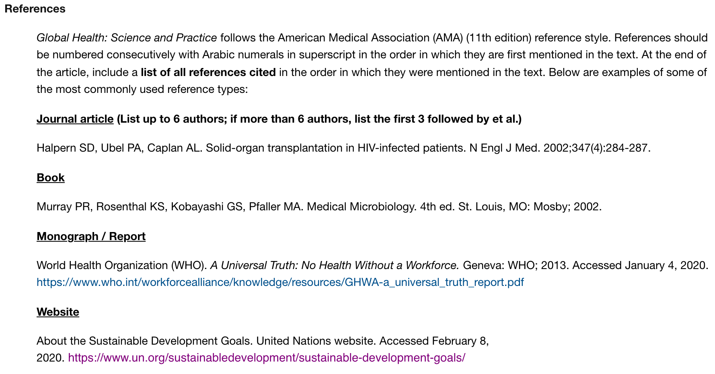
Formatting references to journal style

Slide 10
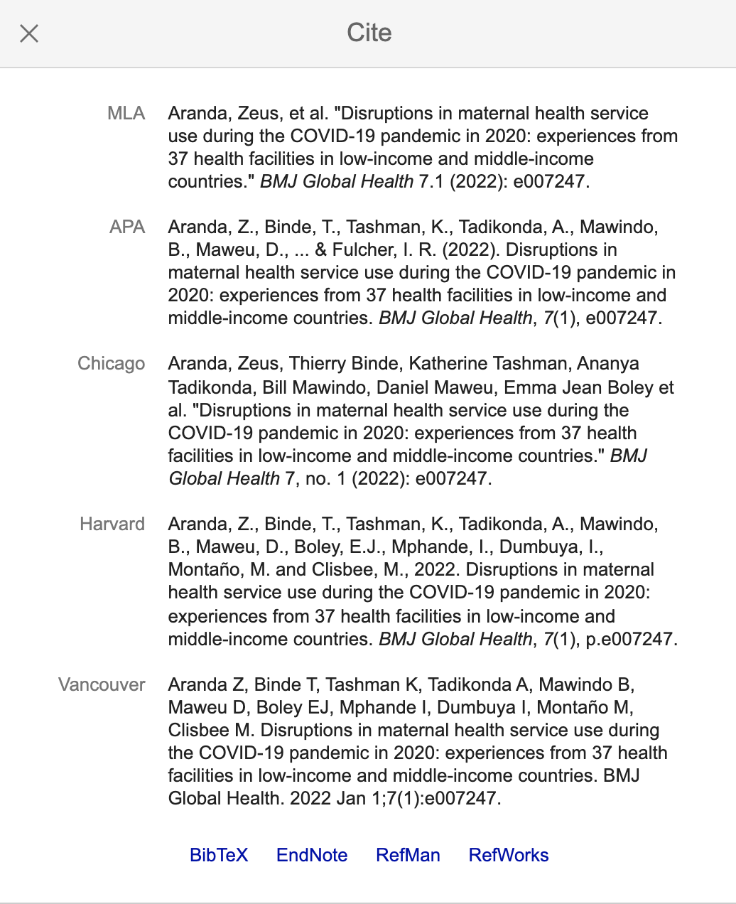
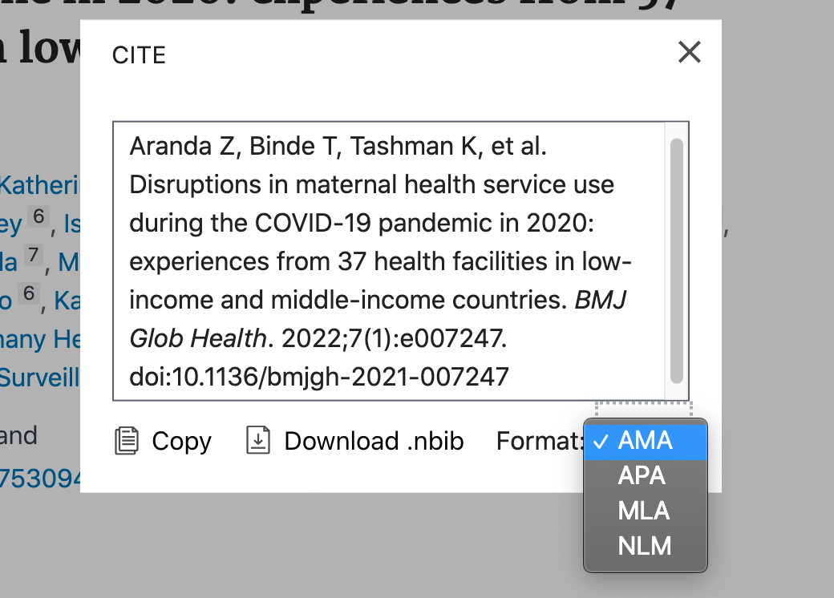
Some reference tips: Quick formatting
You can use Google Scholar or PubMed to format most references!
https://pubmed.ncbi.nlm.nih.gov/
https://scholar.google.com/

Slide 11
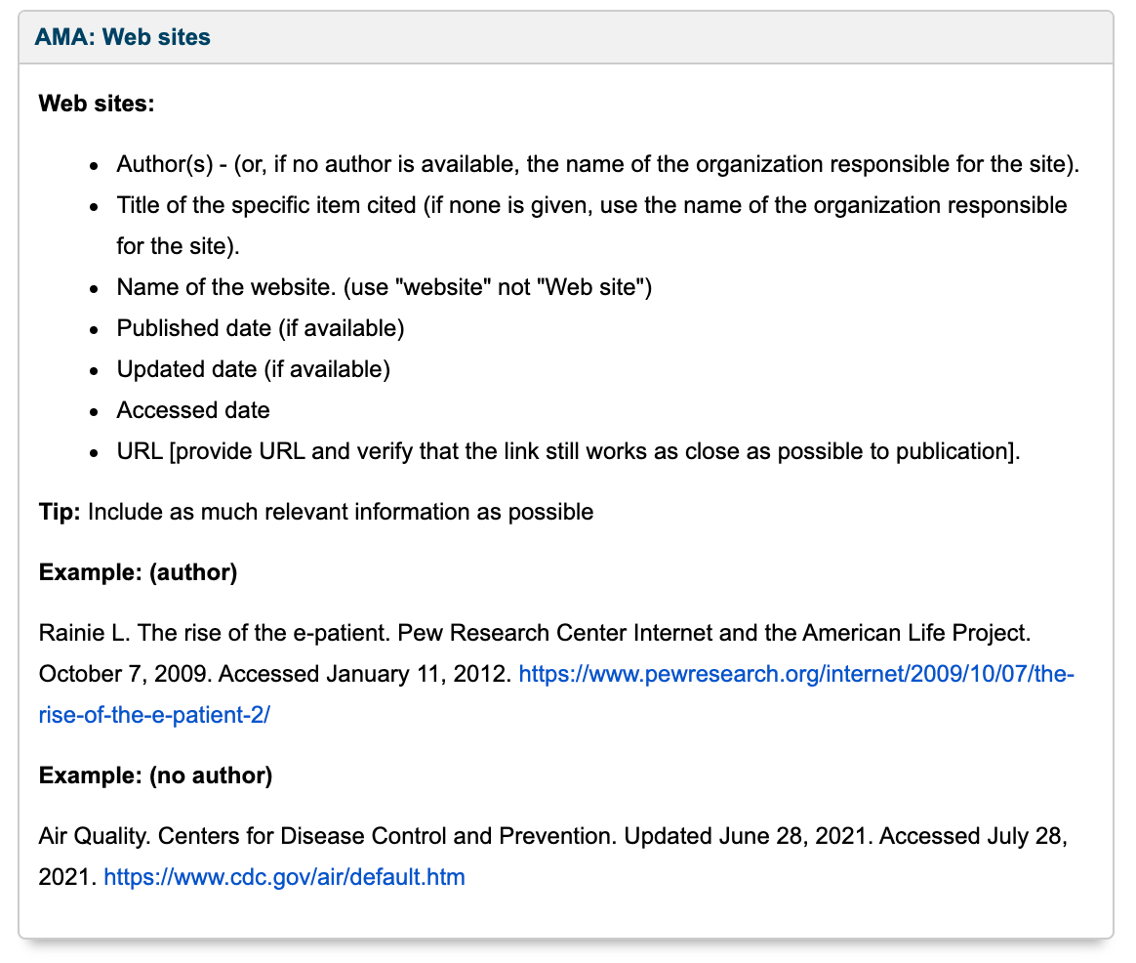
Some reference tips: Websites
During the draft stage, put URL and the date that you accessed the webpage in the reference
Always print the website to .pdf and save with the rest of your references
Websites may update over time, so it will be important to have the original source!
Journals may have specific guidelines for websites
If not, I typically use AMA format

Slide 12
Some reference tips: Too many references!
Situation 1: Some journals have maximum number of references, and you are currently over the limit!
Try looking for “Review” or “Meta-analysis” articles that summarize existing evidence to avoid citing numerous papers, that may often have conflicting findings
Choose the most current and up-to-date reference
Situation 2: There are WAY too many published articles about a specific topic, and you have no idea how to choose.
Try looking for “Review” or “Meta-analysis” articles that summarize existing evidence to avoid citing numerous papers, that may often have conflicting findings
However, if your statement is specific, then make sure you have the specific reference (vs. a Review article where the point may be buried)

