Slide 1
CovCo Writing Workshop
Lecture 11: Steps to Publication

Slide 2
Preparing for Submission
Identify a target journal
Format final manuscript to journal specifications
Finalize manuscript – circulated and approved by all co-authors & local research boards
Customize cover letter
Identify recommended reviewers
Signatures from authors (sometimes)

Slide 3
Choosing a journal
Scope of the Journal: Is you paper relevant to the journal’s audience
Open access: Do readers have to pay to access you paper?
Publication fees: Do you have to pay to publish? Is there a wavier?
Impact Factor: How widely cited is the journal?
Review your works cited, work with mentors co-authors, or use the Journal/Author Name Editor to make a list of candidate journals.
https://jane.biosemantics.org/
Find our more detailed information on a journal’s website
https://bmcinfectdis.biomedcentral.com/about

Slide 4
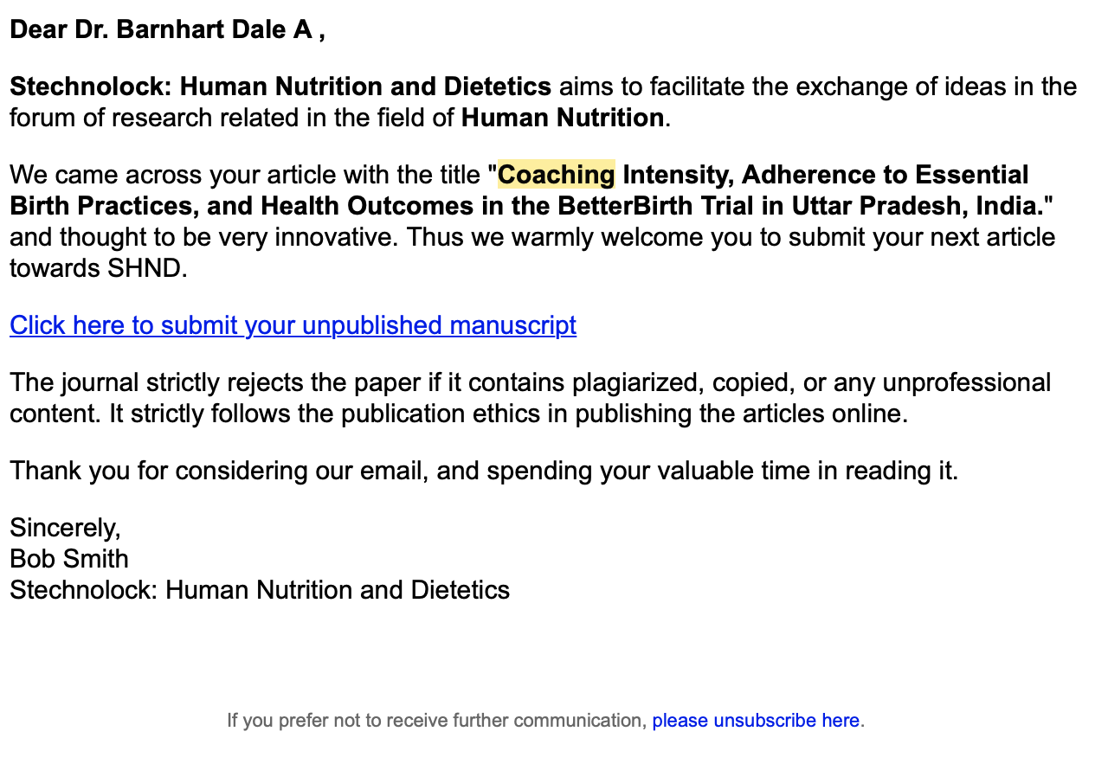
Caution: Predatory journals
Fraudulent journals:
Actively search for articles
Charge publication fees, but mention after paper is accepted
Accept articles speedily, without peer review
Imitate name/website of established journals
Verify you are using a legitimate journal
Conduct a web search
Beall’s List of Predatory Open Access Publishers
Discuss with mentors
“If it seems too good to be true, it probably is.”

Slide 5
Format final manuscript
Key formatting details also include:
Title page contents
Abstract and Main Text word count
Location of tables and figures
In Text?
At the end?
Separate files?
Specific text required in Declarations sections
Reference style
Details are provided on the journal’s website

Slide 6
Recommend Reviewers
Most journals will ask (some require) that you provide the names, affiliations, and emails of 2-4 suggested reviewers.
Look at your cited publications to find first, senior or corresponding authors publishing on similar work
Do not suggest people that you or co-authors actively publish with
Do not suggest our friends, family, etc.
Avoid people who are too senior (they won’t have time)

Slide 7
Online Submission!
Make a user name for corresponding author
Upload files
Manuscript
Tables and figures
Cover letters
Enter basic details about the paper
Title
Keywords
Funding
Enter details about co-authors & reviewers
Can take 1-2 hours → Need good internet connection, but you an save progress and return

Slide 8
Reject
Draft Paper
Submit Paper
Editorial Review
Peer
Review
Revise and resubmit
Accept
Proofs
Publish

Slide 9
Next Steps
Present Abstract at CovCo Writing Groups
Send draft to your paper mentors/RAs/course mentors Give one week to respond
Send to co-authors to all co-authors Give one week to respond Remind co-authors! Give non-responders a 2nd chance
Circulate final draft Give last chance to authors who have not responded (schedule a call/meeting to get their feedback) Give one week to respond.
Send to Research Committee
Submit!! – must submit by this deadline to get your “real” certificate.

