Slide 1
Cover letters
PIH Cross-site COVID-19 Writing Workshop

Slide 2
Cover letters
Required for article submission in all journals
A formal letter meant to influence the decision of the editor to send your manuscript for peer review
Highlights your most important findings
Explains why the manuscript fits the journal you are submitting to
Write it carefully

Slide 3
Sections of a cover letter
Parts of the letter
Introduction
Rationale for your study
Key findings and implications
Why manuscript is good fit for the journal
Signature
Use a letter head for the corresponding author

Slide 4
Introduction
Address editors formally
First paragraph: states the name of the manuscript, type of manuscript (research article, short report) and summary of what your paper does.
Mention manuscript publication history
16 January 2015
To the Editors of the Global Health Action,
We are pleased to present to you our research paper titled “Dental caries management in rural Rwanda: a neglected disease in Africa”. This paper describes the presentation and management of dental caries in a rural hospital. This manuscript has neither been published nor is it under consideration for publication elsewhere.

Slide 5
Study rationale
Second paragraph: describe the rationale behind your study
Dental caries is a public health problem for both developed and developing countries. Over the last few years, statistics show that there is an increasing and high prevalence of dental caries in sub-Saharan Africa. However, there is little information about who is presenting for dental care and how it is managed at rural hospitals. This is particularly an issue in Rwanda, where oral problems is the top presentation at district hospitals.

Slide 6
Key findings and implications
Third paragraph: summarize key results and implications
This article highlights gaps in dental care that we believe are experienced with other African countries beyond Rwanda. The first is that dental caries management remains poor at rural hospitals as tooth extraction occurs in over 95% of cases. Also a lack of instruments at rural hospitals to provide other care contributes to the poor management. Furthermore, most cases presented with a chronic stage leading to the recommendation of developing community oral health program that may raise awareness on the prevention measures and oral health promotion generally.

Slide 7
Why did you choose that journal
Fourth paragraph: Explain how your manuscript is a good fit for the journal and its readers
Focus on aspects of the journal’s aims & scope, use key words from the journal that relate to your manuscript
Also welcome comments from the editors
Given the Global Health Action’s interest in research that address the global health challenges in practical ways, we think this article will be of interest to your readership. Please let me know if you have any questions and we look forward to your feedback.

Slide 8
Add ons as per journal specification
Some journals will require that you mention the following in the cover letter, see journal guidelines for the cover letter
The manuscript is original
The manuscript has not been published before, nor is it under consideration for publication at another journal
There are no conflicts of interest to disclose

Slide 9
Sign off
Sign in the document directly and save as pdf.
Sincerely,
Clarisse Mukashyaka
Corresponding Author
Monitoring and Evaluation Officer
Partners In Health-Inshuti Mu Buzima

Slide 10
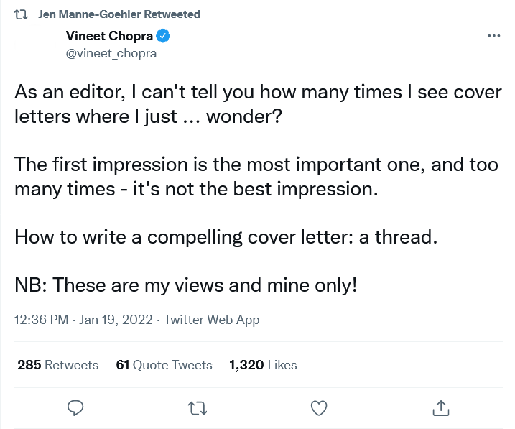
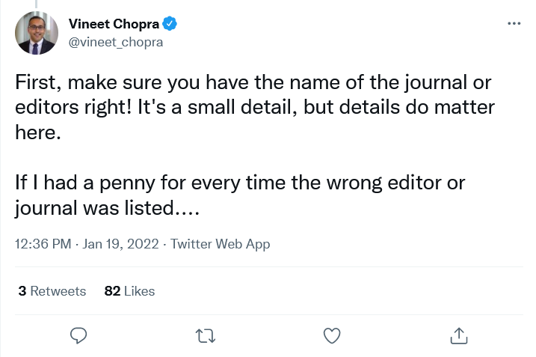

Slide 11
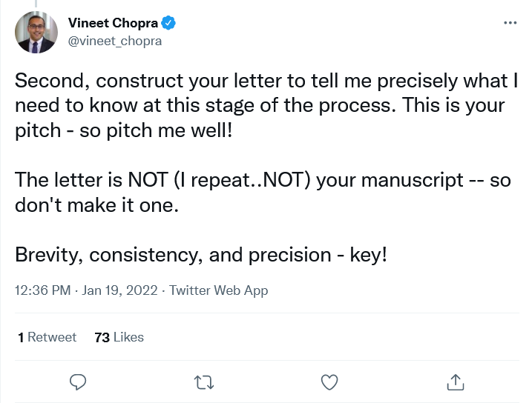
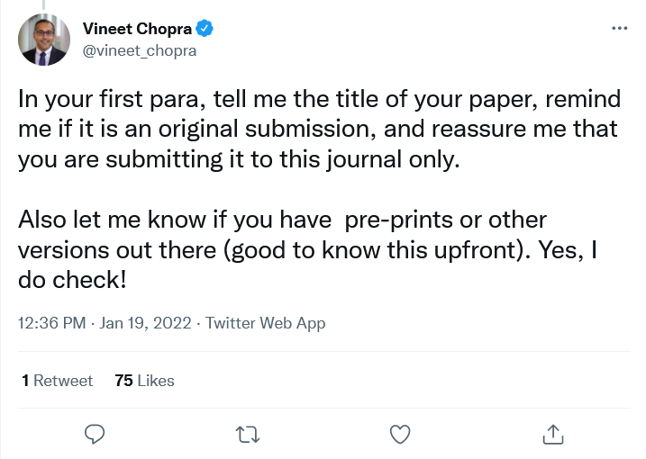

Slide 12
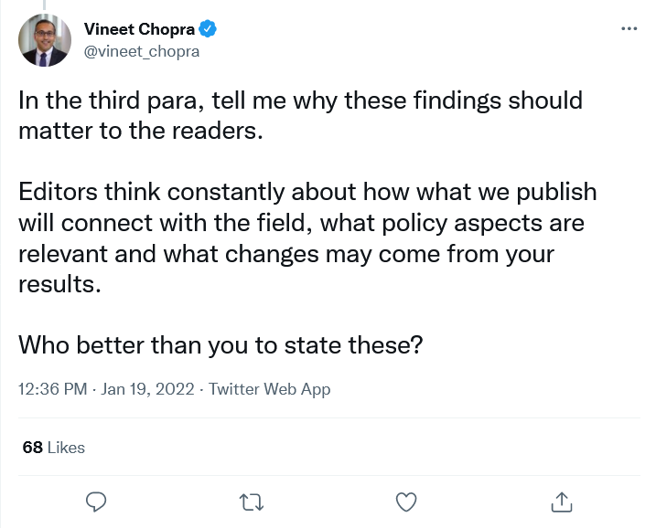
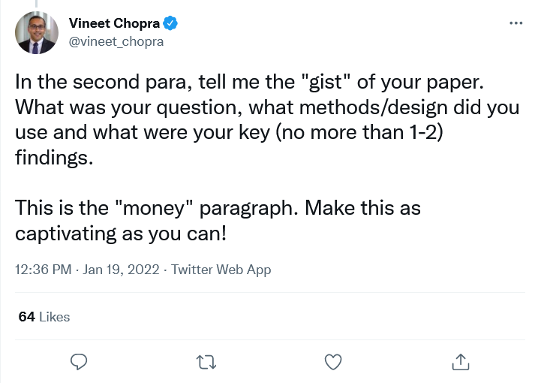

Slide 13
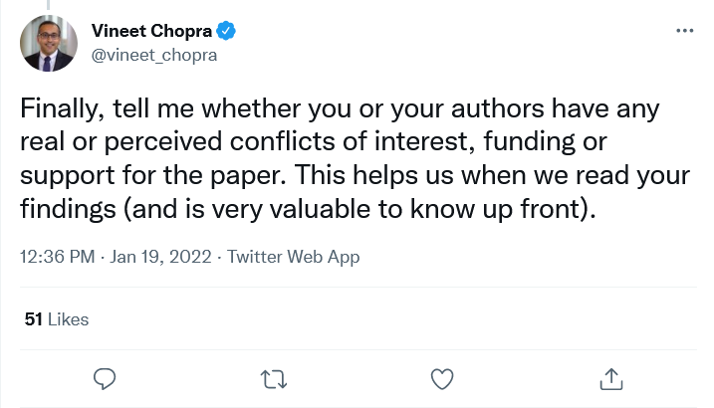

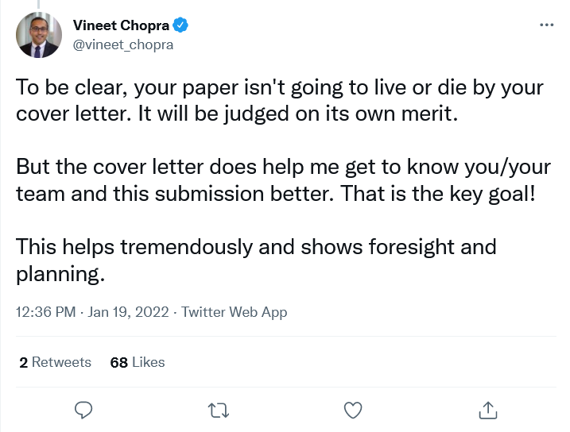

Slide 14
Questions

