Slide 1


Slide 2
About:
As the name suggest, the course management system is an online application designed for educational institutions.The primary goal of the project is to facilitate seamless interaction between students and instructors concerning the submission of projects,assignments and receiving feedback from instructors
Modules:
This project has three interlinked modules. They are,
Admi nistrator module, Students module, Instructor module.

Slide 3
Administ rator module:
This module is designed exclusively for managing administrative functions like creatingaccounts for students and instructors,managing the empleyees, and so on. Basically this module lays the ground work for the other two modules.
Students module:
This module is designed for students. They can login to their accounts to veiw their coursework, submit their projects, get feedback from instructors, etc.
Mainy students can learn new courses by enrolling
themselves in new courses
Instructors module:
This module is for instructors who can login in to their accounts and check the projects submitted by students, and offer guidance to them.

Slide 4

Aim:
'\ I I
Our Aim is to create a fully-functioned website for Online Courses -'Q"-
/
which will benefit our students to learn new skills and develop their -- skills.
--
What we've seen:
Ok, As of now we have seen about 'Course Management System' and the modules present under it.They are the main contents for a website to work good.
Now let us see about 15% of the project ,that is basic frontend development for our website.

Slide 5

Wor k:
In our project we are going to work with 'HTML language and also we' ll be playingwith 'CSS' stylesheet to make our webpage attractive.Now let us see the basic doctype of an html file,
< !Doctype htmI>
<html>
<head >
< link rel="stylesheet" href="stylesheet.css>
<title> </title>
</head>
< body> </body >
</html>

Slide 6


Tools required:
To develop a basic front-end webpage we require,
VSCode ( It is a software used to code mutiple programming language.)
Browser
Contents:
Our webpage consists of the following pages,
Home
Courses
About Us
Contact Us
Login
Registration

Slide 7


Header & Footer:
A website header is the top section of the web page that contains logo, search bar, and other elements.
A footer is an area located at the bottom of every page on a
website, below the main body content,it typically contains fl fl
copyright notice,social media icons, help center,etc. l.j
ede
COURSES
ABOUT US
CONTACT US
LOGIN
REGISTIR

Slide 8



Horne:
A home page is the first main concern to create any website.
It consists of all the details of the webpage init.
Generally as soon as we click any link we will be navigated to homepage only.
Below is our home page model,
ed
COURSES
ABOUT US
CONTACT US
LOGIN
REGISTER
Our placement team helps you to get placed in top companies.
After successful completion of courses students will rccci\·e "Course Completion Certificate"recognized by top Companies
Modes Of Learning
Mode Of Learning
In our website \\·e haYe m·o types of "Leaming Method"
Our students can choose Self Leam meth::>d as \\'ell as Instmctor based Method

Slide 9

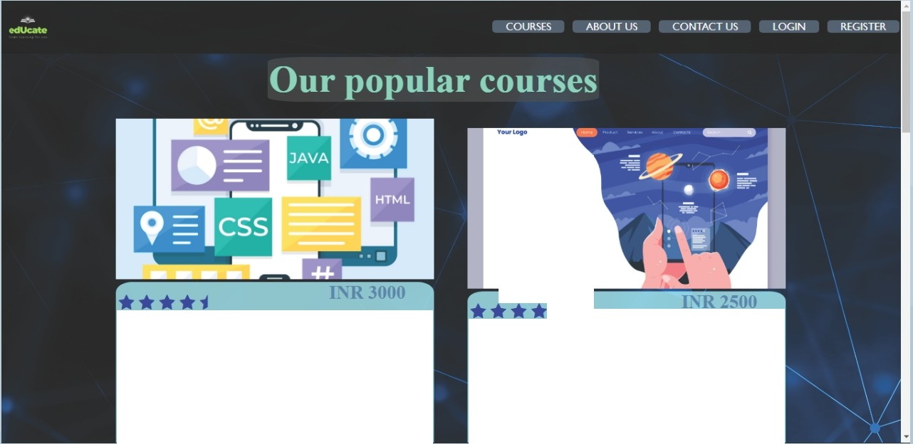
Courses:
In this page of our website it consists of some list of courses offered by our educational staffs.
• • •
Students according to their interests can enroll themselves in the course.
Augmented reality
lO-lc-in'IOOkw •t- •11
8\lii-c....,, .....o-.....o;-.i11111""'°­
...... .. llNClttlla
+iii!II.ii+
Learn AP-P- DeveloP-tnent
Learn the fondamentals of the app development p10cess. Leam how to create an app, how the)
\\ ark, their basic components and what is
involved in app deign and development.
Learn Augmented Reali!Y.
ihis class will teach yon the fundamentals of au!tmented reality (AR). and how to build an AR experience nsmg ARC ore

Slide 10

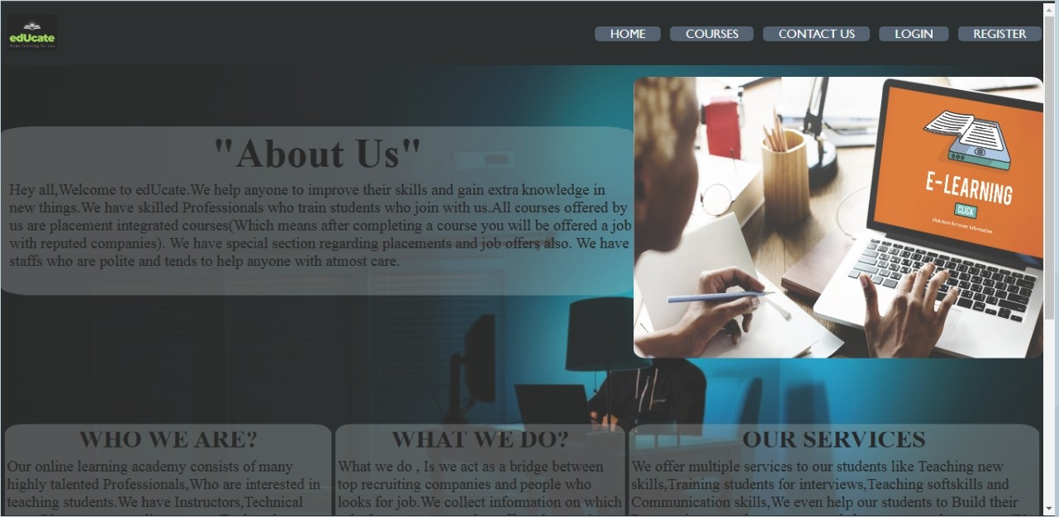
About Us:
The about us page consists of every details of the website like what does the page do, what is the motive,why is this website to be choosed,etc.

Slide 11

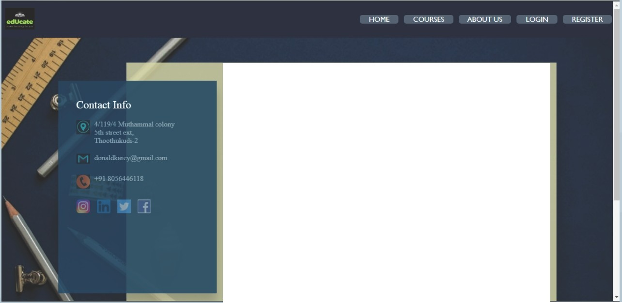
Contact us:
In this page we will be having the contact details of the admin if any queries, also the social media links will be there to.
This page also has a message box through which our queries can
[!] be sent to admin later will be connectingwith us or answeringto
our questions.
Send a Message
irst Name
ast ame
mail Address
Fobile Number
rite your message here...
Send

Slide 12

Login:
In this page we will be able to login to our user account in which our progress will be saved.
-::>
D
n_
If not having a user account the user can register and create a account for themselves, either they can create a new account or login with their social media account.
Login Form
Email or Username
Password
II
LOGIN
Or loginwith
rJ Facebook
Cl Google

Slide 13
Registration Form:
With the help of this page the user can register themselves to the page and their user account will be created.

Slide 14


Slide 15
powered by
E;> PIKTOCHA RT

