Slide 1
The PPT for CPT111 CW3
Lizheng.Miao
2253592

Slide 2
Object-Oriented Principles
1.1 Inheritance
public class cw3 extends Application {
public static void main(String[] args) {
launch(args);
}
public class NumWords extends Pane {
//Read the data in the txt file and store it in the map
static Map<String, Integer> map = new HashMap<>();

Slide 3
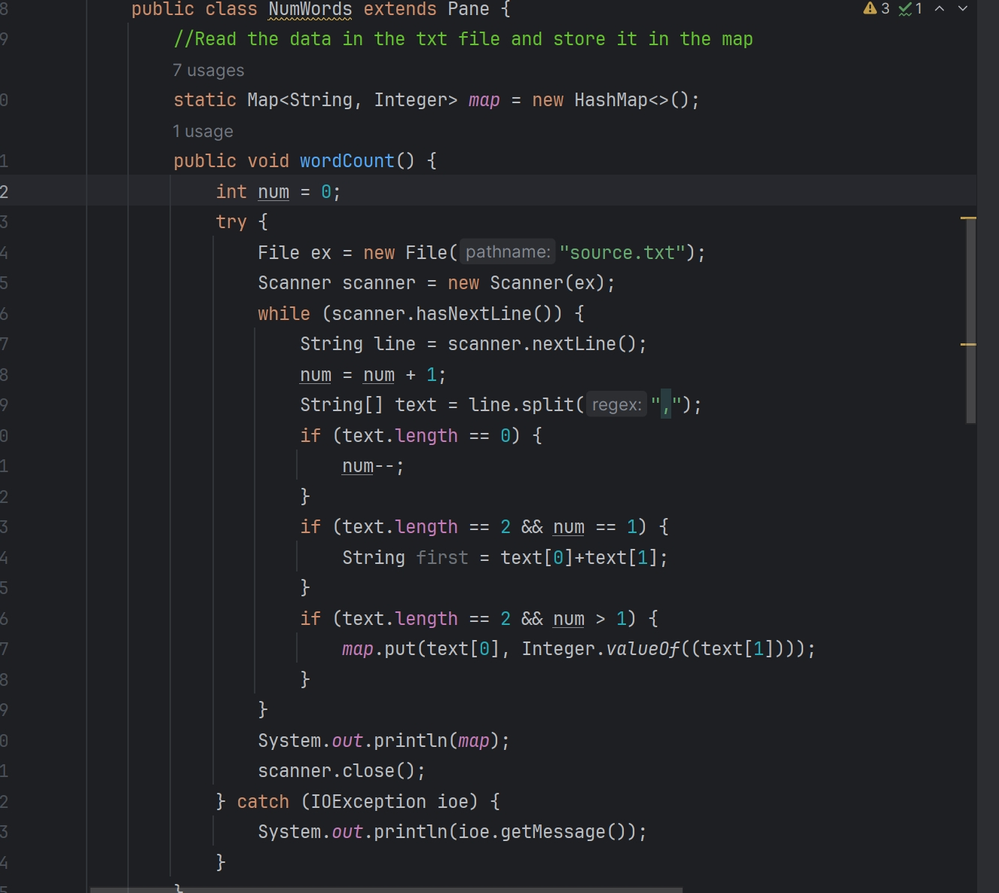
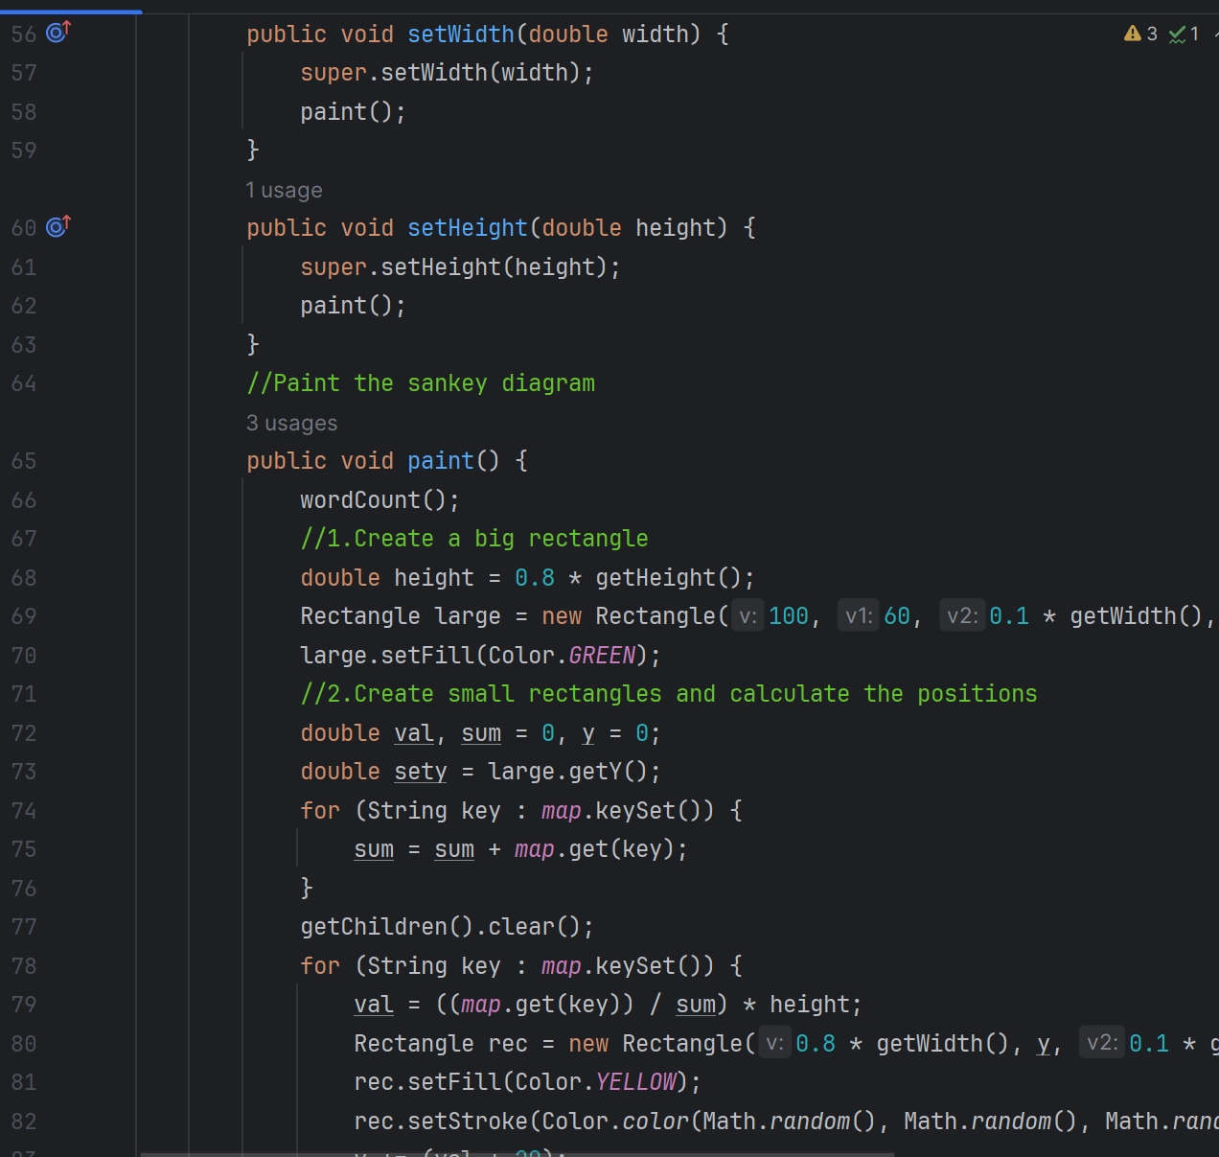
Object-Oriented Principles
1.2 Encapsulation

Slide 4
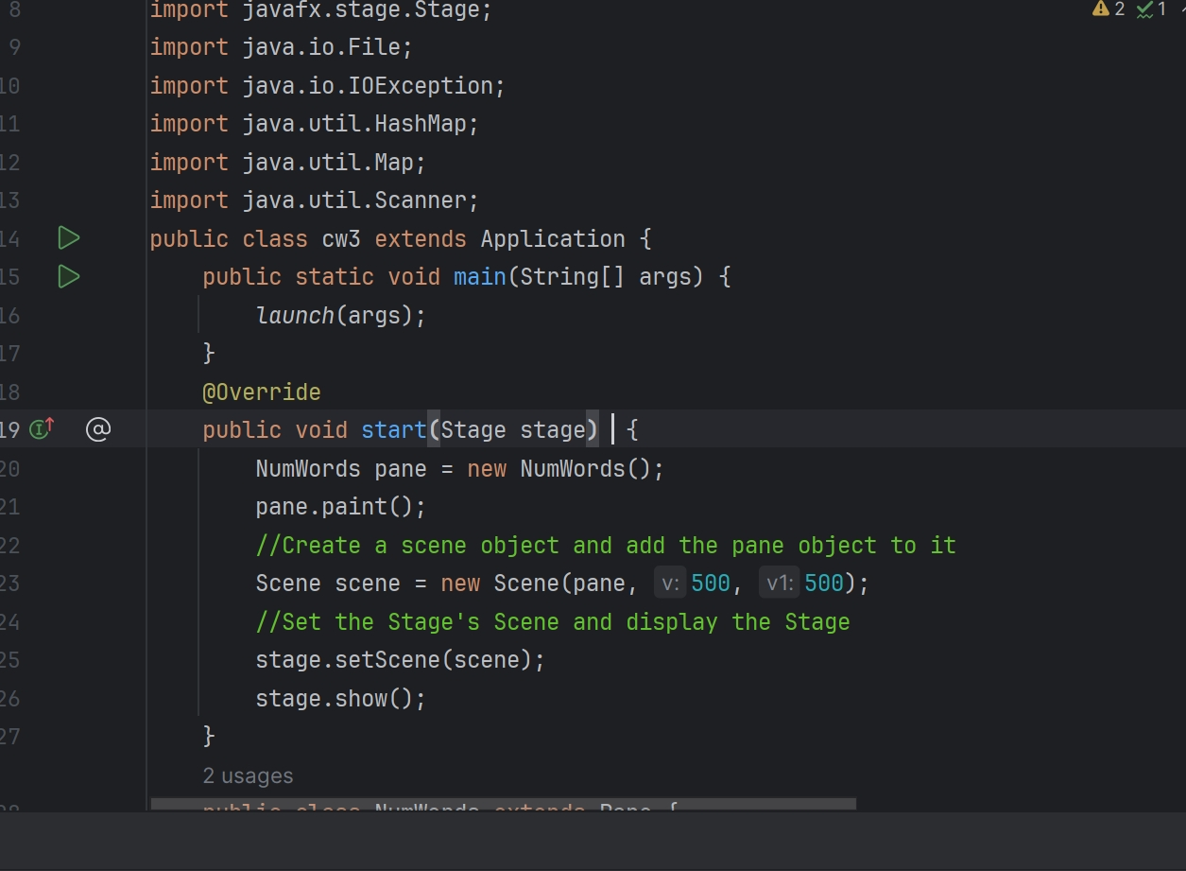
Object-Oriented Principles
1.3 Polymorphism

Slide 5
Algorithms
Initial Setup
Rectangle Creation
Bezier Curve Drawing
Data Addition

Slide 6
File Handling
Opening and reading the file line by line
splitting each line to extract relevant information
storing the extracted data in a Map

Slide 7
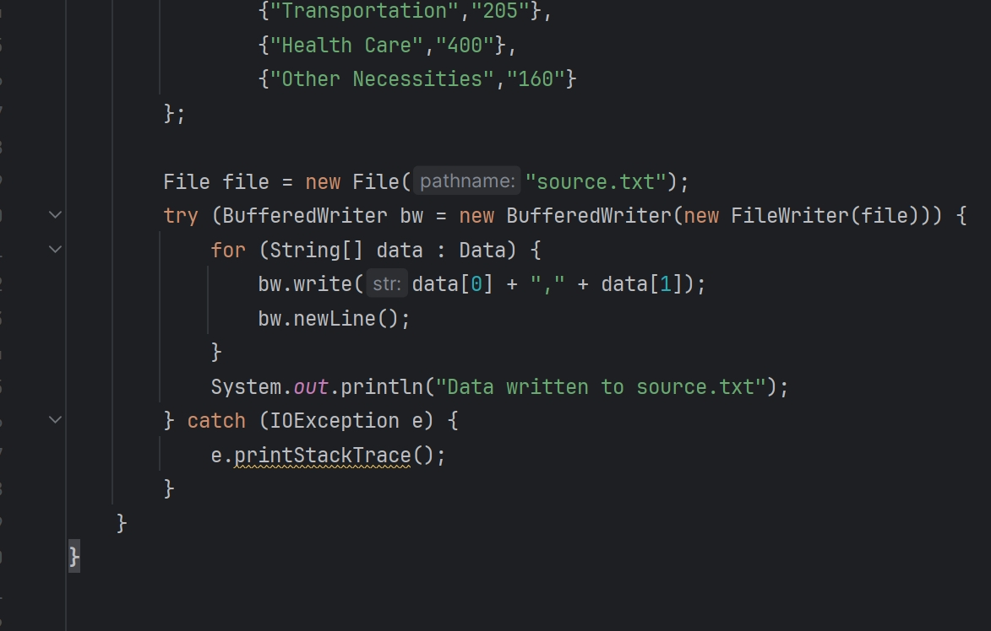
Error Handling

Slide 8
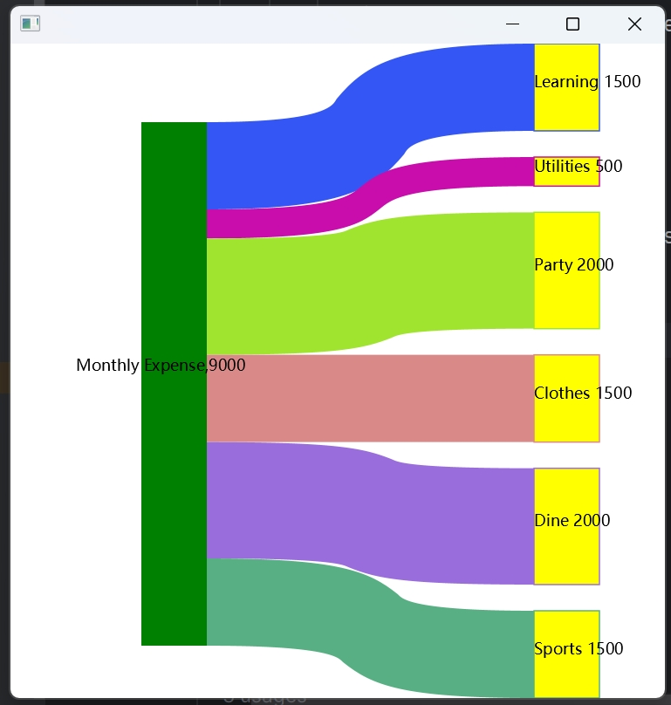
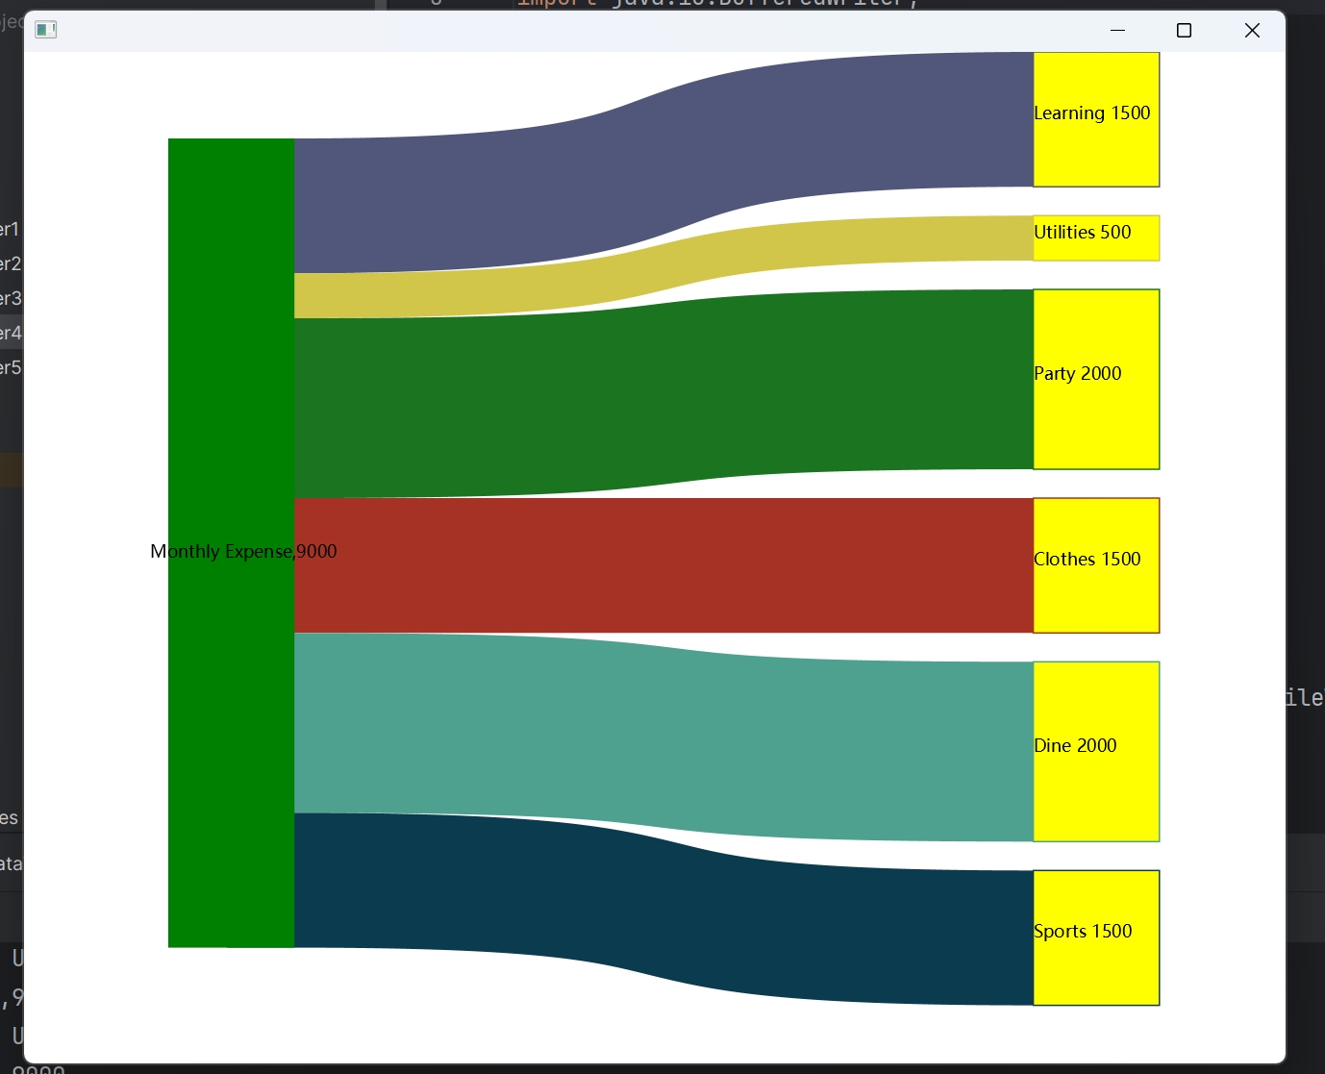
Display features
The paint() method is designed to be responsive when the size of the window changes. It recalculates the positions and sizes of diagram elements based on the new dimensions, ensuring a visually appealing display even during resizing.

Slide 9
Additional Features
Dynamic Coloring
Clearing Old Data

