Slide 1
Predictive Sales R Model
How to Engineer a Model in R
Slides | Topic | Description
2 – 3 | Understanding the modeling process | Historical data exploration and (Mathematical) model formulation
4 – 5 | Mathematical Model Specification | Example of a Linear Model specification
6 – 7 | Data Examination | R example showing exploration of the simulated unit sales data (1,925 unit sales records.)
8 | Fit a Model | The model, the computed means, and “goodness of fit” criteria (note ease of model specification.)
9 – 10 | Validation of Model Fit | Scatter plot of residuals showing no outliers with respect to size of predicted value, or order of prediction
11 | Comparison of Fit Techniques | Manual technique vs. various Linear Model approaches (note ease of trying a model and concrete model evaluation methodology [goodness of fit])
12 | Vocabulary | Short explanation of modeling concepts

Slide 2
Predictive Sales R Model
How to Engineer a Model in R
Before mathematical modeling, one must:
Understand the mechanics of the Sales process being modeled
Understand the goal of the model (e.g., predict future sales)
Express the model in Mathematical terms
Express the objective in Mathematical terms (e.g., Goodness of Fit)
Understand the input data (missing values, range errors, inconsistent data)
Understand the scaling, calculation, and numerical stability problems in computing the solution

Slide 3
Predictive Sales R Model
Mechanics of The Simplified Sales Process
And the Analytic Goal
The Sales Process:
Items are sold I transactions occurring in a store
Stores are managed by Departments
Items have a style and color
A number of units of items are sold in a week period
The Analytic Goal:
Predict Average number of units sold Per Store
Prediction based on assumption that past time period APS predicts future time period APS
The predictor characteristics are Department, Store and Style-Color combination

Slide 4
Predictive Sales R Model
Mathematical Model
E(…) – linear model estimate per store and cc (style-color.)
U(store,cc) – units sold for a given store and cc.
I(store,cc) – factor for a specific store and cc; 1 if this observation is this store and cc, zero otherwise.
Β(store, cc) – linear model computed coefficient for this store and cc.
ε – error term, errors are uncorrelated, normally distributed with zero mean and uniform σ.

Slide 5
Predictive Sales R Model
Data Frame Model
Units Sold | 1|1 | 1|2 | 1|3 | 2|1 | 2|2 | 2|3 | 2|4 | . . . | N|M
3 | 0 | 0 | 0 | 1 | 0 | 0 | 0 | . . . | 0
5 | 0 | 0 | 1 | 0 | 0 | 0 | 0 | . . . | 0
2 | 0 | 1 | 0 | 0 | 0 | 0 | 0 | . . . | 0
6 | 1 | 0 | 0 | 0 | 0 | 0 | 0 | . . . | 0
1 | 0 | 0 | 0 | 0 | 1 | 0 | 0 | . . . | 0
7 | 0 | 0 | 0 | 0 | 0 | 1 | 0 | . . . | 0
4 | 0 | 0 | 0 | 0 | 0 | 0 | 1 | . . . | 0
N|M – Indicator variable for the N-th store and M-th CC
S|C – 1 if the units sold at store S were style-color C, else 0
Β_{sc} – The model coefficient for store s and style-color cc
Exp(Units Sold) = (1|1)β₁₁ + (1|2)β₁₂ + . . . + (N|M)β_{nm}

Slide 6
Predictive Sales R Model
Understanding the Sales Data
Numeric fields have no missing data and ranges make sense:
Dates between 2015000 and 2018564
Units sold are between 0 and 6.
Zero valued units sold are counted as NULL
> library(pastecs)
> stat.desc(sample1aData)
time dept store stylecolor units
nbr.val 1.925000e+03 NA NA NA 1.925000e+03
nbr.null 0.000000e+00 NA NA NA 4.900000e+01
nbr.na 0.000000e+00 NA NA NA 0.000000e+00
min 2.015000e+07 NA NA NA 0.000000e+00
max 2.015238e+07 NA NA NA 6.000000e+00
range 2.379000e+03 NA NA NA 6.000000e+00
sum 3.879104e+10 NA NA NA 5.297000e+03
median 2.015119e+07 NA NA NA 3.000000e+00
mean 2.015119e+07 NA NA NA 2.751688e+00
SE.mean 1.566260e+01 NA NA NA 2.656301e-02
CI.mean.0.95 3.071746e+01 NA NA NA 5.209532e-02
var 4.722354e+05 NA NA NA 1.358268e+00
std.dev 6.871938e+02 NA NA NA 1.165447e+00
coef.var 3.410190e-05 NA NA NA 4.235390e-01

Slide 7
Predictive Sales R Model
Better understanding Sales Data
> library(Hmisc)
describe(sample1aData)
sampleData: 5 Variables 1925 Observations
--------------------------------------------------------------------
dept
n missing unique
1925 0 5
D01 D02 D03 D04 D05
Frequency 385 385 385 385 385
% 20 20 20 20 20
--------------------------------------------------------------------
store
n missing unique
1925 0 7
S0001 S0002 S0003 S0004 S0005 S0006 S0007
Frequency 275 275 275 275 275 275 275
% 14 14 14 14 14 14 14
--------------------------------------------------------------------
stylecolor
n missing unique
1925 0 55
lowest : D0001|Y001 D0001|Y002 D0001|Y003 D0001|Y004 D0001|Y005
highest: D0014|Y003 D0014|Y004 D0014|Y005 D0015|Y002 D0015|Y004
--------------------------------------------------------------------
units
n missing unique Info Mean
1925 0 7 0.93 2.752
0 1 2 3 4 5 6
Frequency 49 220 511 652 379 101 13
% 3 11 27 34 20 5 1

Slide 8
Predictive Sales R Model
Find Per-Store/Per-Style-color Means with Linear Model
Load Simulated Data | Simulated data with 1,925 rows required < 300 ms
linearModel(formula = units ~ store:stylecolor - 1, df ) | Goodness of Fit N : 1925. N Singular: 0. dfP : 385. dfR : 1540. Residual_SE: 0.9501880 R-Squared : 0.9191111 Adj-R-Sqr : 0.8988888
Model Coefficients (store, cc) | key estimate std.error t.value p.value 1 S0001:D0001|Y001 1.4 0.424937 3.294606 1.007982e-03 2 S0002:D0001|Y001 2.2 0.424937 5.177238 2.548720e-07 3 S0003:D0001|Y001 2.6 0.424937 6.118554 1.195350e-09 4 S0004:D0001|Y001 3.2 0.424937 7.530529 8.564407e-14 5 S0005:D0001|Y001 3.0 0.424937 7.059871 2.512662e-12 . . .
 | key estimate std.error t.value p.value 380 S0003:D0015|Y004 2.6 0.424937 6.118554 1.195350e-09 381 S0004:D0015|Y004 2.6 0.424937 6.118554 1.195350e-09 383 S0005:D0015|Y004 2.8 0.424937 6.589213 6.053692e-11 384 S0006:D0015|Y004 3.6 0.424937 8.471845 5.560104e-17 385 S0007:D0015|Y004 1.4 0.424937 3.294606 1.007982e-03 385 Coefficients
> summary(fit$residuals) Min. 1st Qu. Median Mean 3rd Qu. Max. -2.4 -0.6 0.0 0.0 0.6 3.0

Slide 9
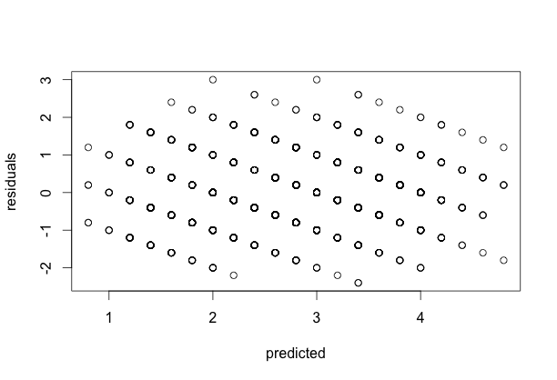
Predictive Sales R Model
Evaluate Per-Store/Per-Style-color Means from Linear Model

Slide 10
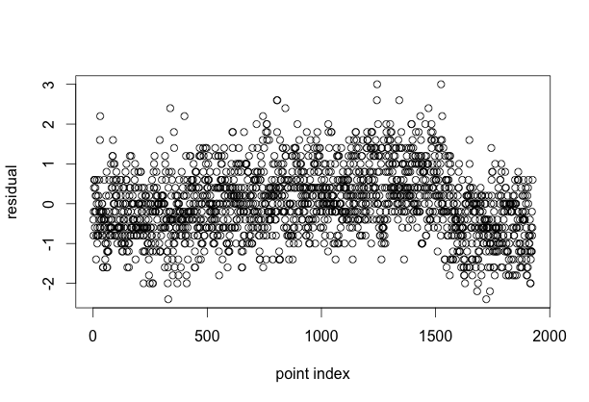
Predictive Sales R Model
Evaluate Per-Store/Per-Style-color Means from Linear Model

Slide 11
Predictive Sales R Model
Ease of Linear Model Construction and Validation
Model | Description | Quality
Aggregation | Manually computed averages | No built-in Goodness of Fit (but fast, ~ 20 ms)
linearModel(formula = units ~ store:stylecolor - 1, df ) | Predicted by store and cc, no intercept | Goodness of Fit N : 1925. N Singular : 0. Residual_SE: 0.9501880 R-Squared : 0.9191111 Adj-R2: 0.8988888
linearModel(formula = units ~ store:stylecolor, df ) | Predicted by store, cc, and intercept; intercept is an average base units per store | Goodness of Fit N : 1925. N Singular 1. Residual_SE: 0.9501880 R-Squared : 0.4679538 Adj-R2: 0.3352878
linearModel(formula = units ~ stylecolor - 1, df ) | Predicted by cc only, no intercept | Goodness of Fit Residual_SE: 1.08128 R-Squared : 0.8728 Adj-R2: 0.8691
linearModel(formula = units ~ store - 1, df ) | Predicted by store only, no intercept | Goodness of Fit Residual_SE: 1.02609 R-squared : 0.8825 Adj-R2: 0.8821

Slide 12
Predictive Sales R Model
Modeling Vocabulary
Term | Definition
Coefficients | In the case of our linear model, these would be the desired average unit sales per store and cc.
Standard Error of Estimate | The standard error of estimate is a measure of the accuracy of model predictions. Prediction errors are larger than static standard errors.
Standard Error | The standard error (SE) is the standard deviation of the sampling distribution of a statistic, most commonly of the sample mean.
Goodness of Fit | An assessment of how well a mathematical model predicts the observed data (see https://en.wikipedia.org/wiki/Goodness_of_fit.)
R-Squared | A commonly used measure of goodness; 0 <= R² <= 1.0, with larger values indicating a better fit than smaller values (see http://web.maths.unsw.edu.au/~adelle/Garvan/Assays/GoodnessOfFit.html.)
Response and predictor variable(s) relationship | For a linear model used to obtain averages in our case, the coefficients of fitted model and their standard errors assess the comparative relationship. Response of predicted Units = LinearModel(predictors: store, cc)

