Slide 2
Actual Circuit Diagram

Slide 3
SIMULINK Schematic

Slide 4
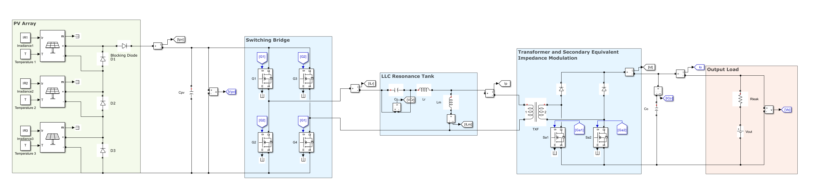
SS-PSM

Slide 5
SS-PSM Result

Slide 6
Actual PFM Result

Slide 7





















Peak 1
T=35 degree
Irradiance=50, 300, 1000
$$2$$
$$3$$
$$5,…$$
$$I_{nn1}$$
$$I_{nn2}$$
$$5,…$$
$$3$$
$$GMPP$$
$$4$$
$$4$$
$$I_{nn3}$$
$$2$$
$$1$$
$$1$$
$$5$$
$$6,…$$
$$3$$
$$4$$
$$2$$
$$1$$
Predicted Outputs:

Slide 8
Phase Shift Modulation using microcontroller

Slide 9
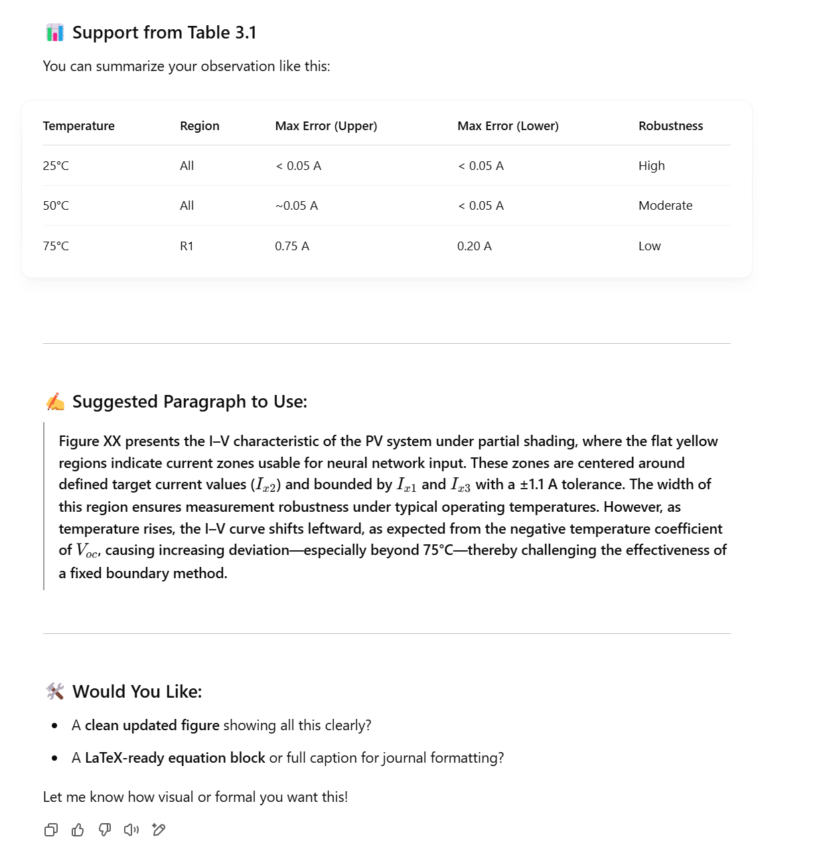
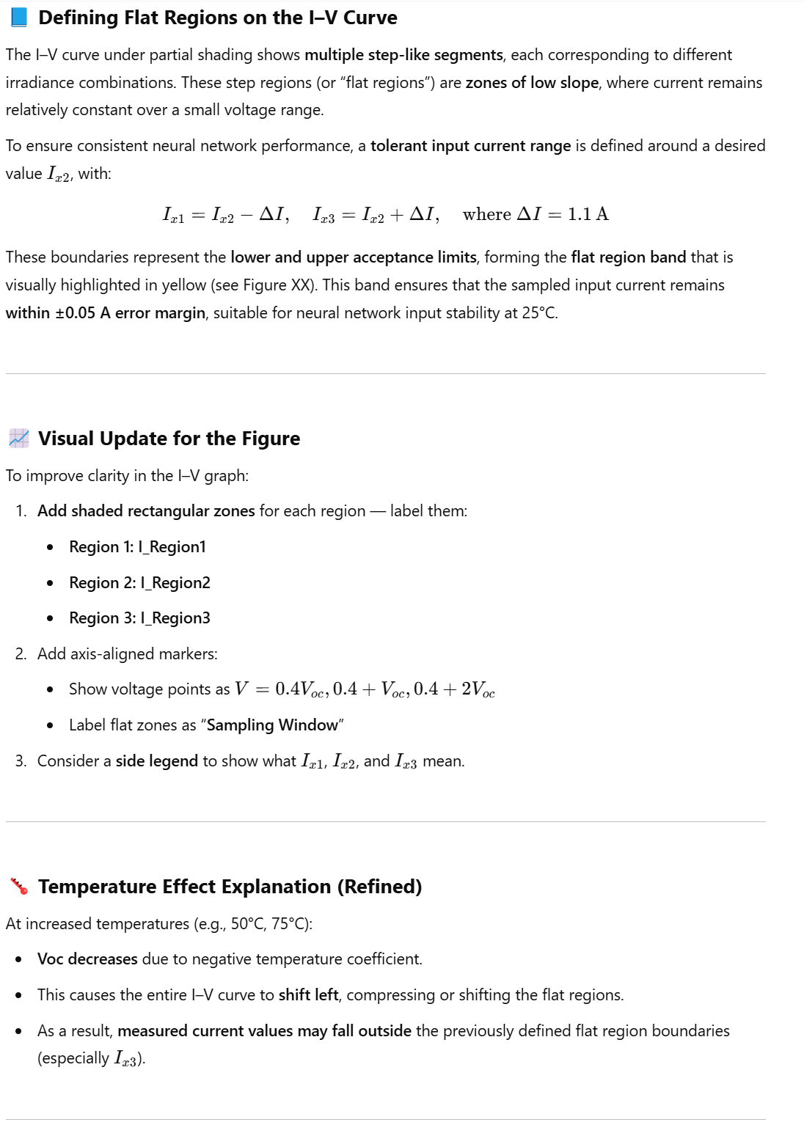
Sampling Inn

Slide 10
Sampling Algorithm

Slide 11
Literature Review

Slide 12
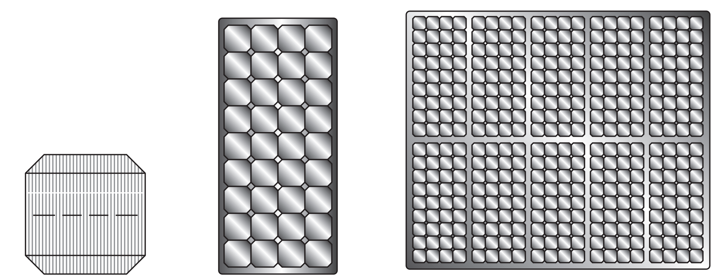
Cell
Module with m cells
Array with n modules

Slide 13

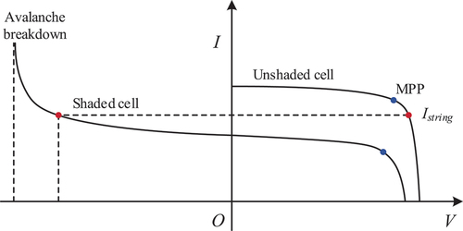


Current
Avalanche breakdown
Unshaded cell
Shaded cell
$$MPP$$
$$I_{module}$$
Voltage

Slide 15
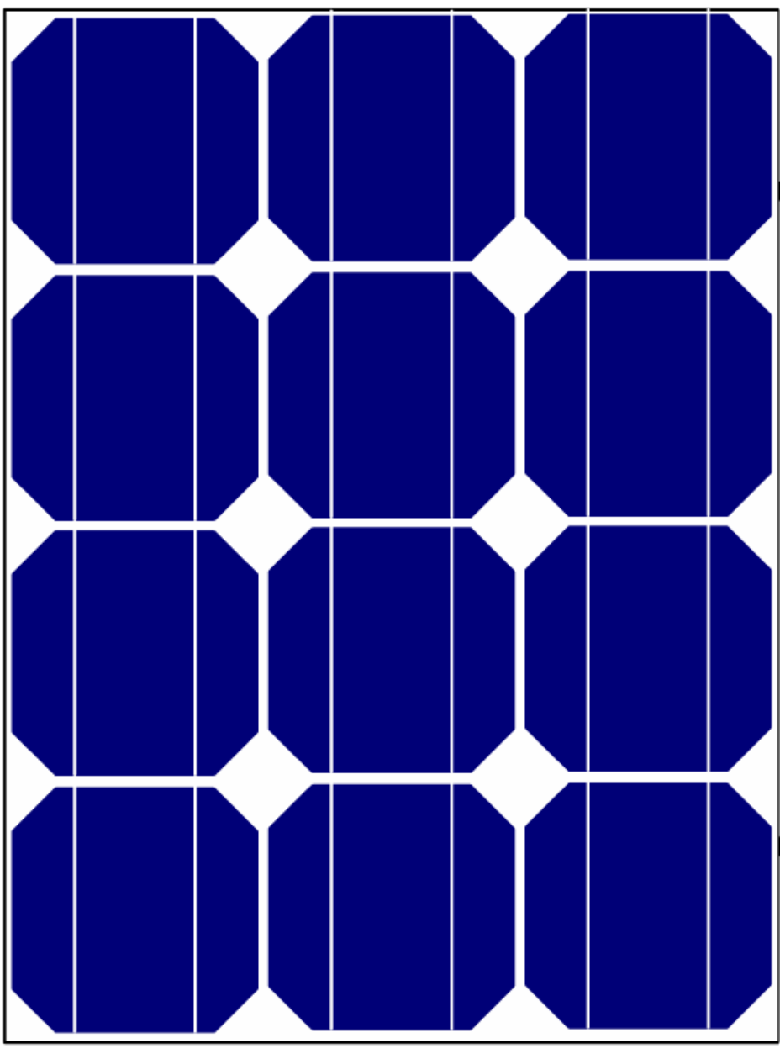
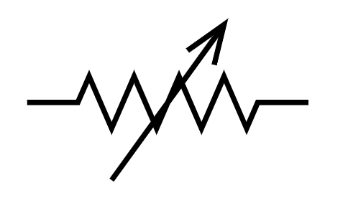
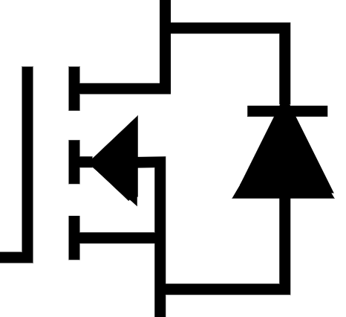
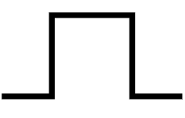




PV Array
DC / DC Converter
Load
$$I_{load}$$
$$I_{pv}$$
$$V_{pv}$$
$$V_{load}$$
MPPT Algorithm
Pulse
Generator

Slide 16
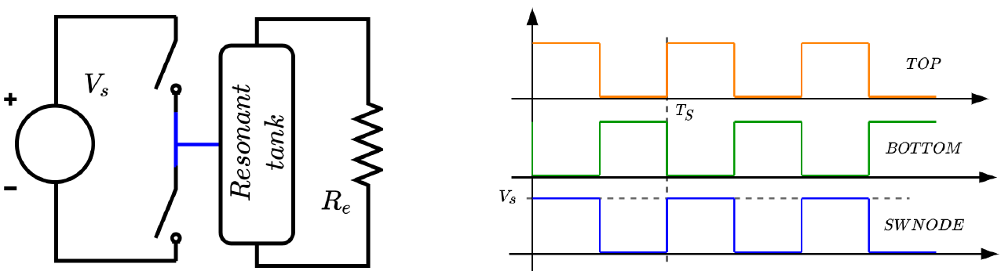

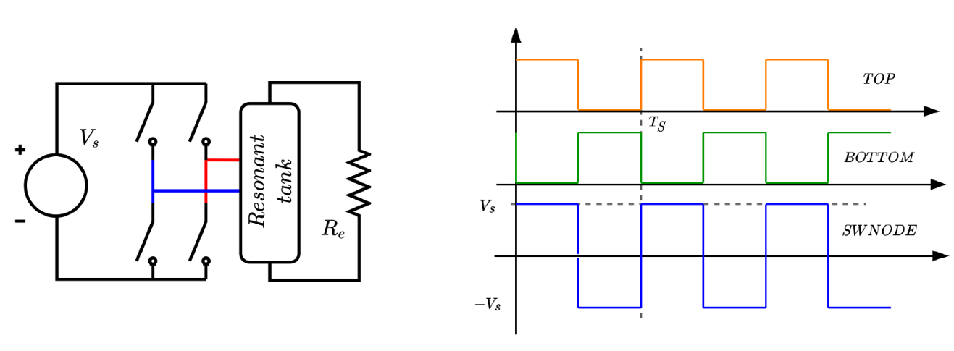




















$$S_{1}$$
$$V_{s}$$
$$S_{1},S_{4}$$
$$T_{s}$$
$$S_{2},S_{3}$$
$$V_{S}$$
Resonant tank
$$R_{load}$$
$$V_{s}$$
$$T_{s}$$
$$S_{2}$$
$${+V}_{s}$$
$$V_{s}$$
$$S_{1},S_{4}$$
$$S_{1}$$
$$S_{2}$$
$$V_{s}$$
$$T_{s}$$
$$S_{2},S_{3}$$
$$V_{S}$$
Resonant tank
$$R_{load}$$
$${+V}_{s}$$
$$S_{4}$$
$$S_{3}$$
$${−V}_{s}$$

Slide 17
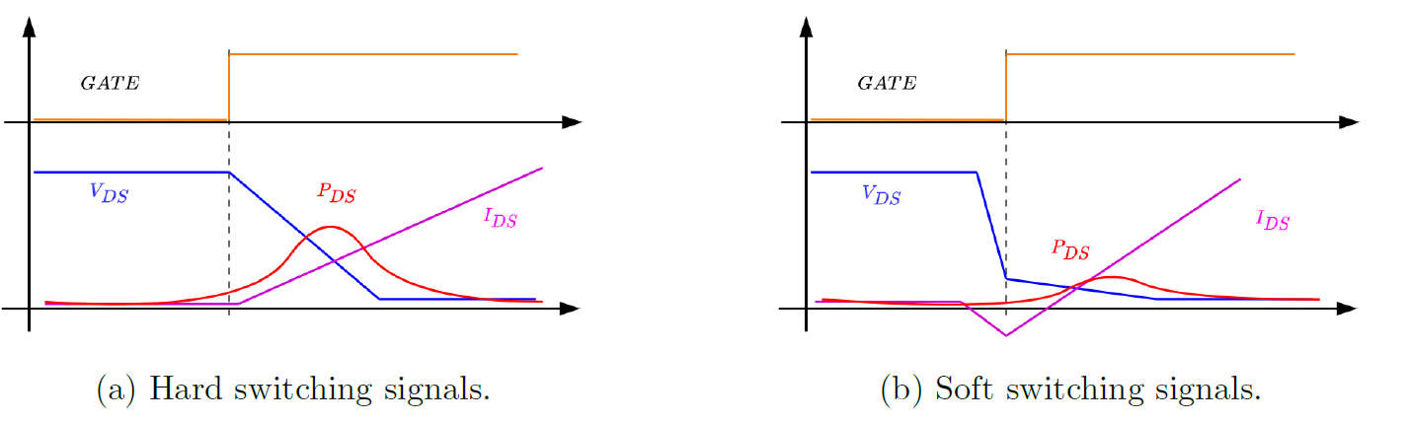







Gate signal
Gate signal
$$V_{DS}$$
$$P_{DS}$$
$$I_{DS}$$
$$V_{DS}$$
$$I_{DS}$$
$$P_{DS}$$

Slide 18

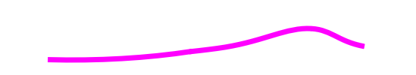


Gate signal
Gate signal
$$V_{DS}$$
$$I_{DS}$$
$$V_{DS}$$
$$I_{DS}$$
$$P_{DS}$$
$$P_{DS}$$

Slide 19
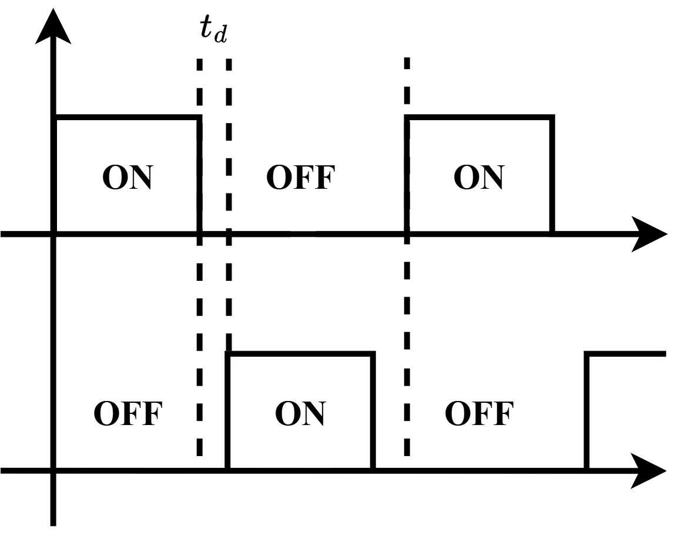

Slide 20

Capacitive
Region
Inductive Region
Lightly loaded
$$G_{r}=1$$
Heavily loaded

Slide 21
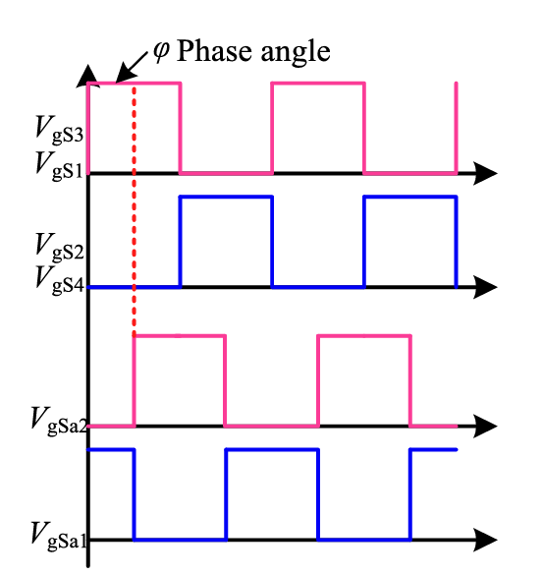







Phase shift $φ$
$$Q_{1},Q_{4}$$
$$Q_{2},Q_{3}$$
$$Q_{o2}$$
$$Q_{o1}$$

Slide 22
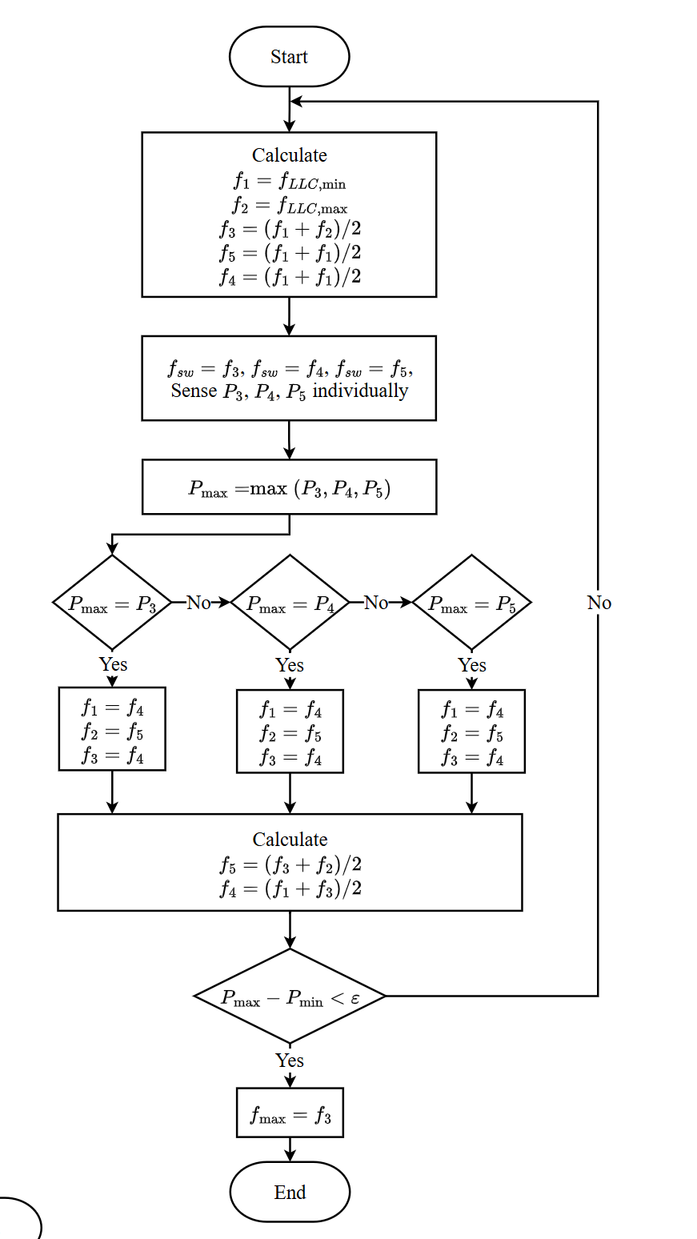

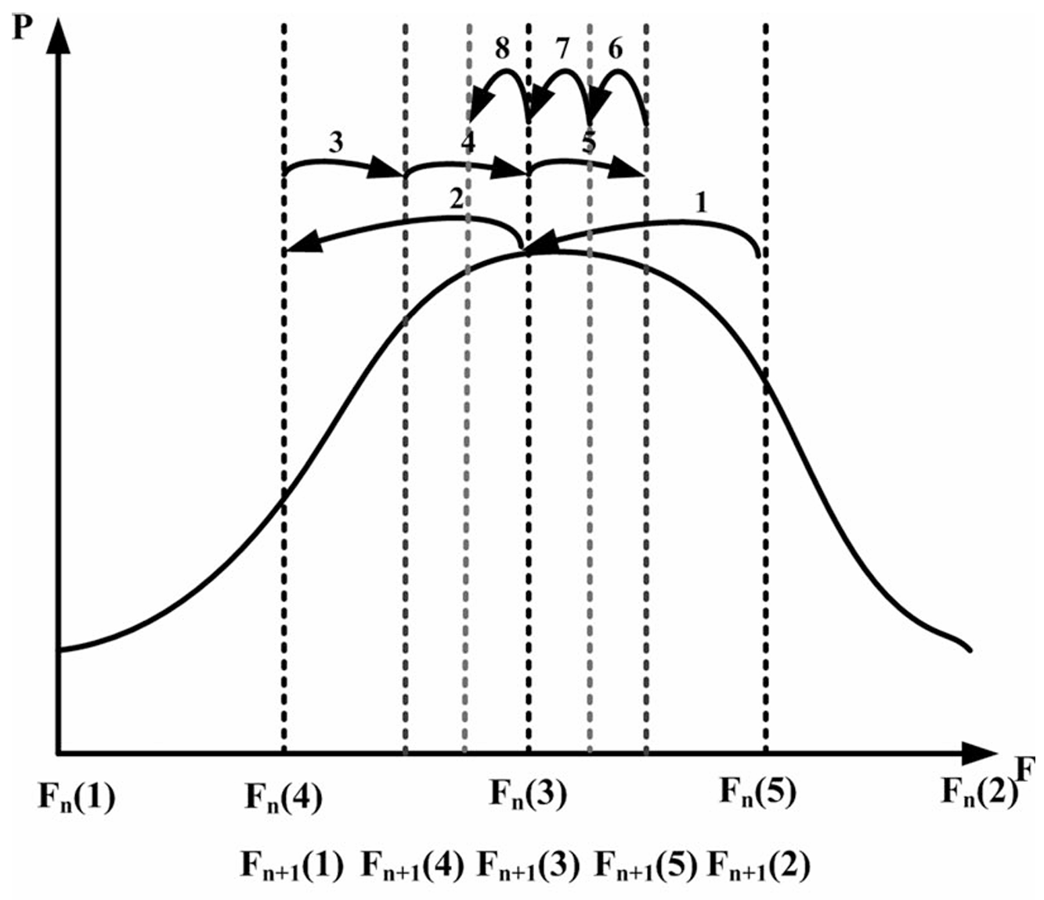
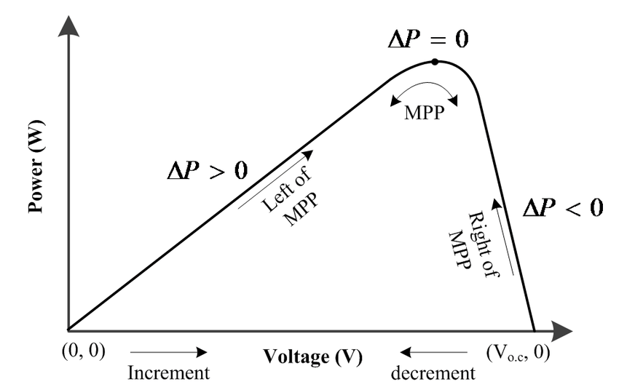













$P$
$$ΔP=0$$
$f$
$$f_{1}$$
$$f_{4}$$
$$f_{3}$$
$$f_{5}$$
$$f_{2}$$
$$(0,0)$$
Voltage (V)
$$(V_{oc},0)$$
Increase $f_{sw}$
Decrease $f_{sw}$

Slide 23
Methodology

Slide 24
25 Degree
GMPP
LMPP

Slide 25
50 Degree
GMPP
LMPP

Slide 26
75 Degree
GMPP
LMPP

Slide 27
Defined clearer the region how to explain
I₁₂
I_{13,End}
I_{11,Start}
Region 1
I_{21,Start}
I_{23,End}
I₂₂
Region 2
I_{31,Start}
I_{33,End}
I₃₂
Region 3

Slide 28
I₁₂
I_{13,End}
I_{11,Start}
Region 1
I_{21,Start}
I_{23,End}
I₂₂
Region 2
I_{31,Start}
I_{33,End}
I₃₂
Region 3

Slide 29
I to collect for
PSC1, PSC2, PSC3
Region 1
Region 2
Region 3
I to collect for PSC1 and PSC2
I to collect for PSC1
I to collect for PSC3
I to collect for PSC2
I to collect for PSC3
Region 1
Region 2
Region 3

Slide 30
Epoch 70
Epoch 37
Early stopping at epoch 87 and
restoring model weights from the end of the best epoch: 37.

Slide 31
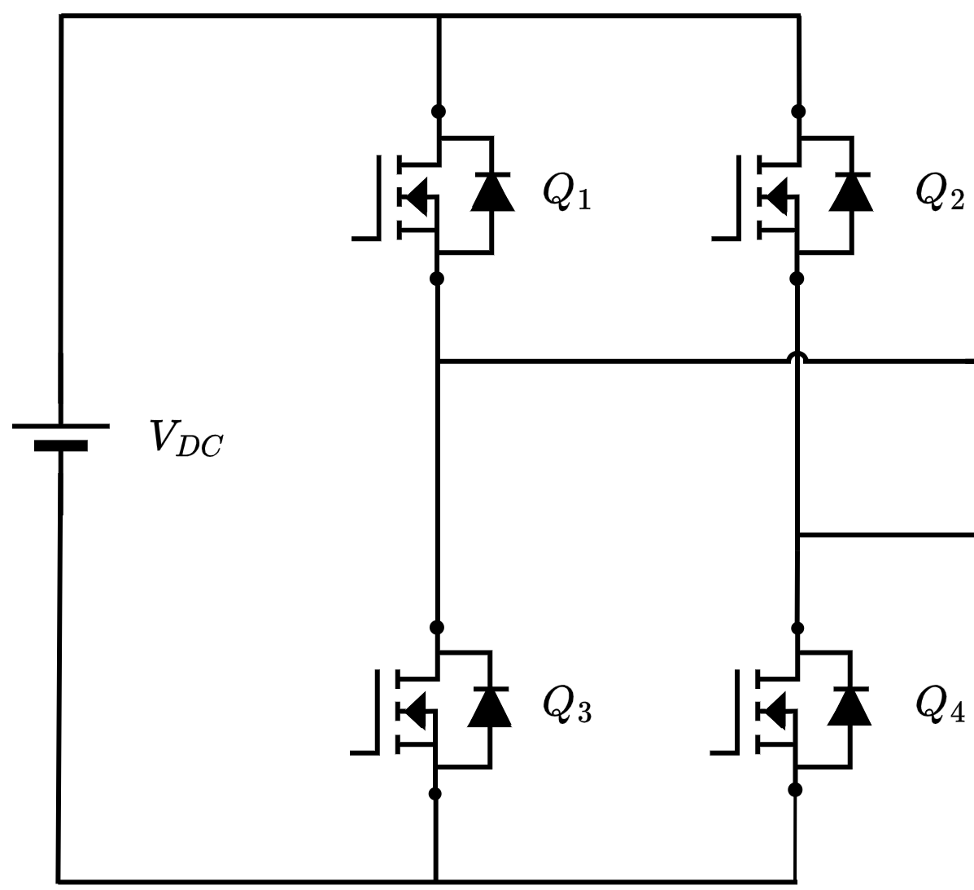
Open switch
21-40 cell
1-20 cell
+
41-60 cell
PV Voltage
Input side to LLC converter
Close switch
-

Slide 32
MATLAB Graph for Gain

Slide 33
SS-PSM

Slide 34





FB + Q = 4
$$f_{sw}=50kHz$$
$$f_{sw}=100kHz$$
$$f_{sw}=150kHz$$
$$f_{sw}=200kHz$$
$$f_{sw}=250kHz$$

Slide 35





FB + Doubler = 2
$$f_{sw}=50kHz$$
$$f_{sw}=100kHz$$
$$f_{sw}=150kHz$$
$$f_{sw}=200kHz$$
$$f_{sw}=250kHz$$

Slide 36

HB + Doubler = 1
$$f_{sw}=50kHz$$
$$f_{sw}=100kHz$$
$$f_{sw}=150kHz$$
$$f_{sw}=200kHz$$
$$f_{sw}=250kHz$$

Slide 37





SS-PSM
$$φ=10\%$$
$$φ=30\%$$
$$φ=50\%$$
$$φ=70\%$$
$$φ=90\%$$

Slide 38
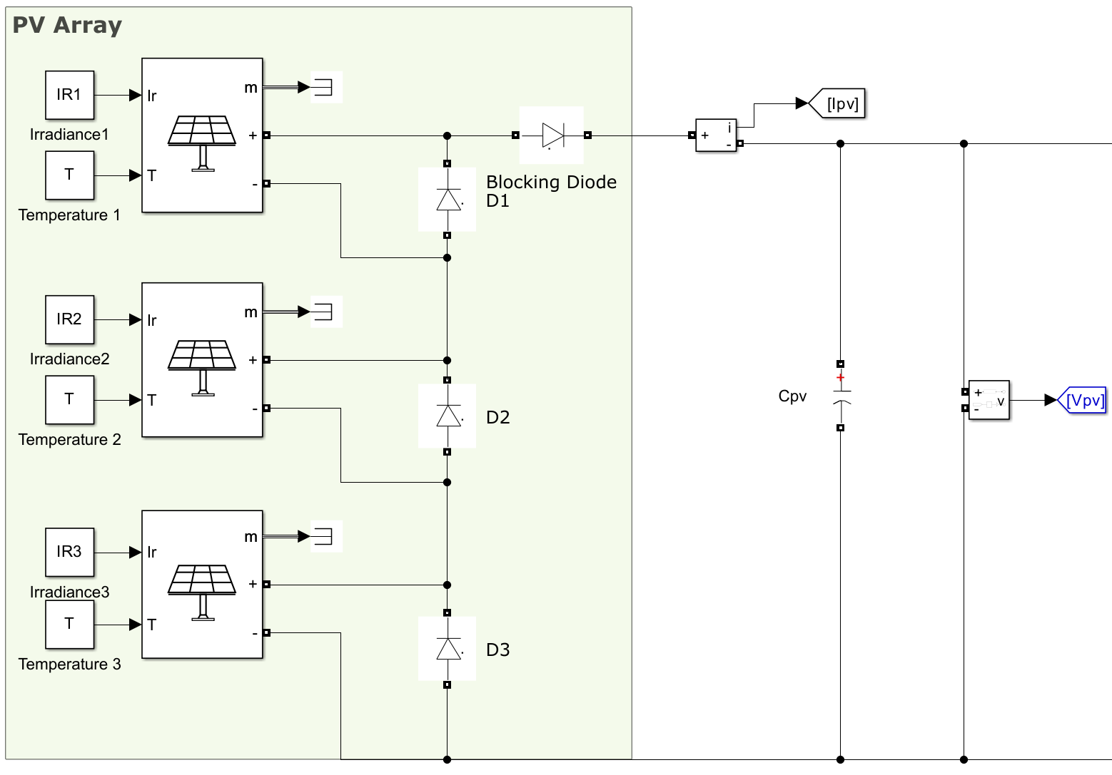
PV Current
+
1-20 cell
PV Voltage
Input side to LLC converter
21-40 cell
41-60 cell
-

Slide 39
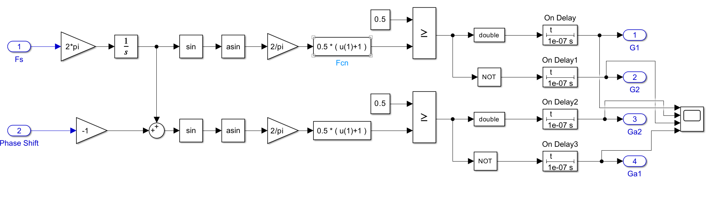

100ns Dead Time

Slide 40
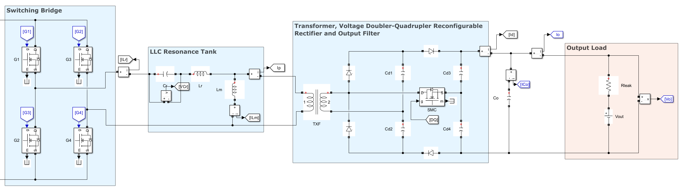
Switch to select between doubler or quadrupler rectifier circuit
+
Input side to LLC converter
-
Output clamped at 120V

Slide 41
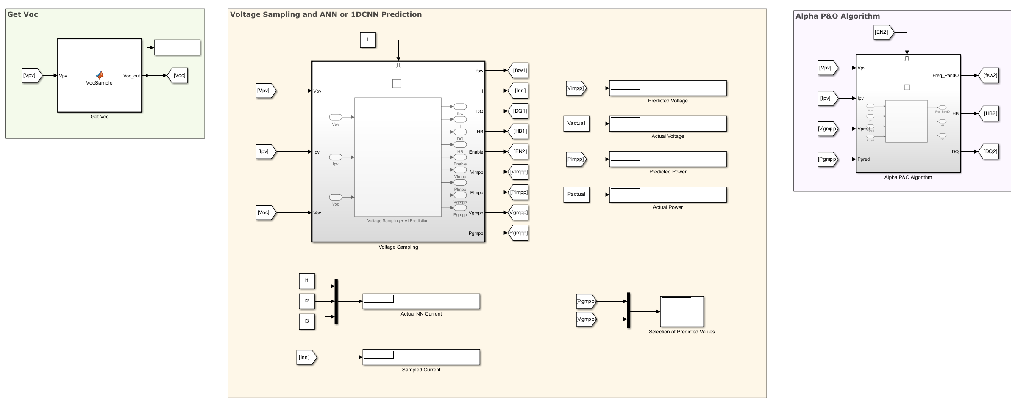


Block to measure $V_{OC}$
Stage 1 algorithm
Stage 2 algorithm
Predicted Voltage
Actual Voltage
Predicted Power
Actual Power
Sampling Current
Calculated $P_{GMPP}$ and $V_{GMPP}$

Slide 42
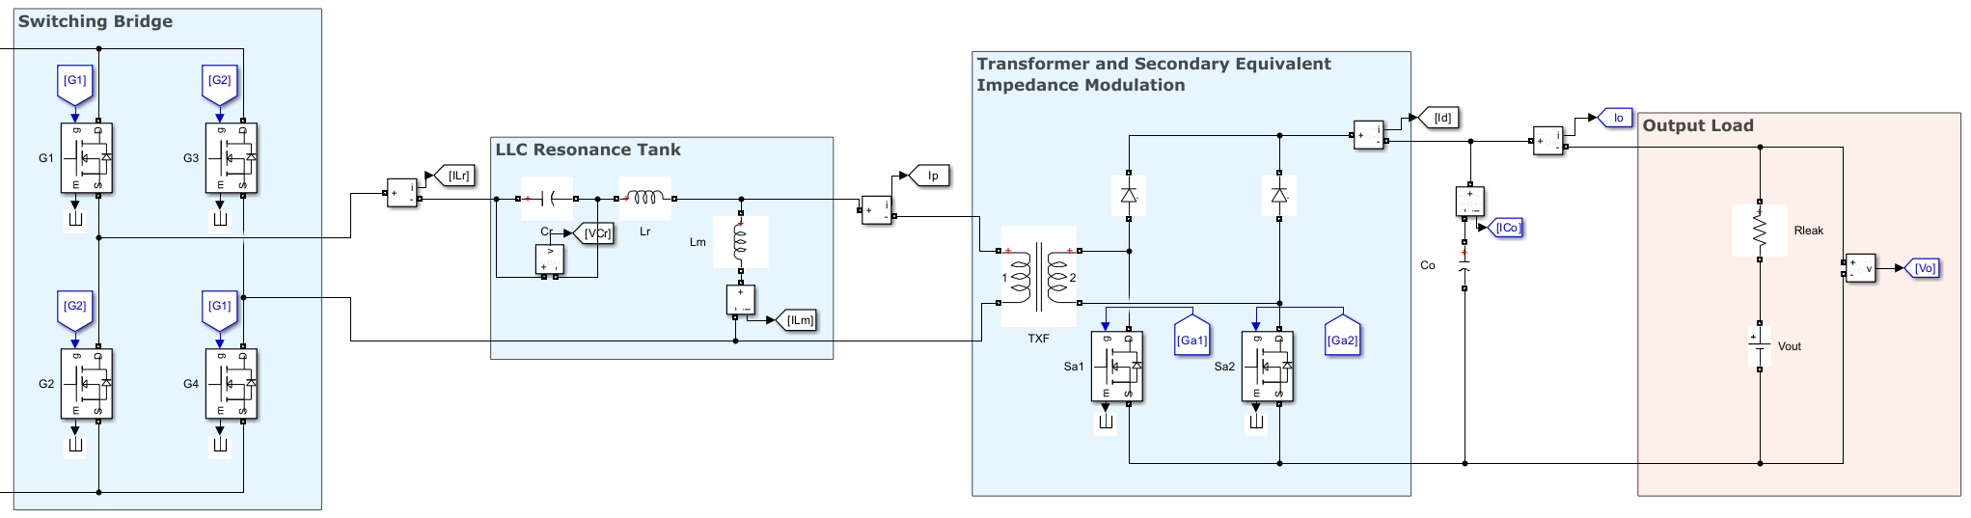
+
Output clamped at 120V
Input side to LLC converter
-
Switches for phase shift modulation

Slide 43
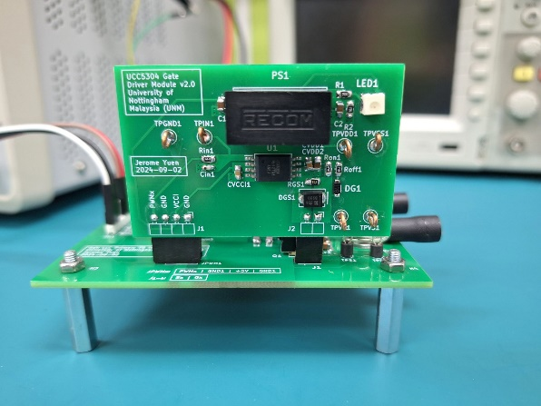
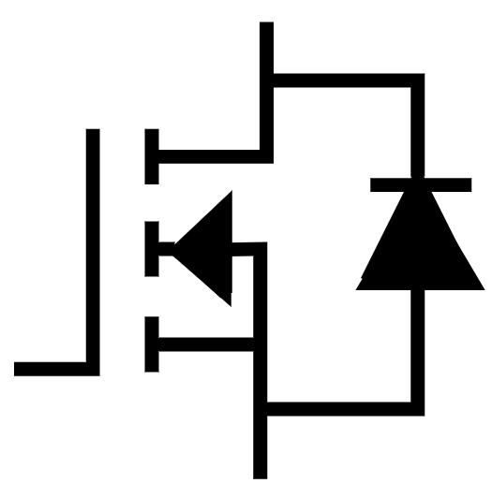


Power On LED Indicator
Gallium Nitride (GaN) FET
Test Point of
PWM from
Microcontroller
Drain
Test Point of
Drain Source
Voltage, $V_{DS}$
Gate
Free-whelling diode
Auxiliary 5V
Power Supply
Test Point of
Gate Source
Voltage, $V_{GS}$
Source

Slide 44
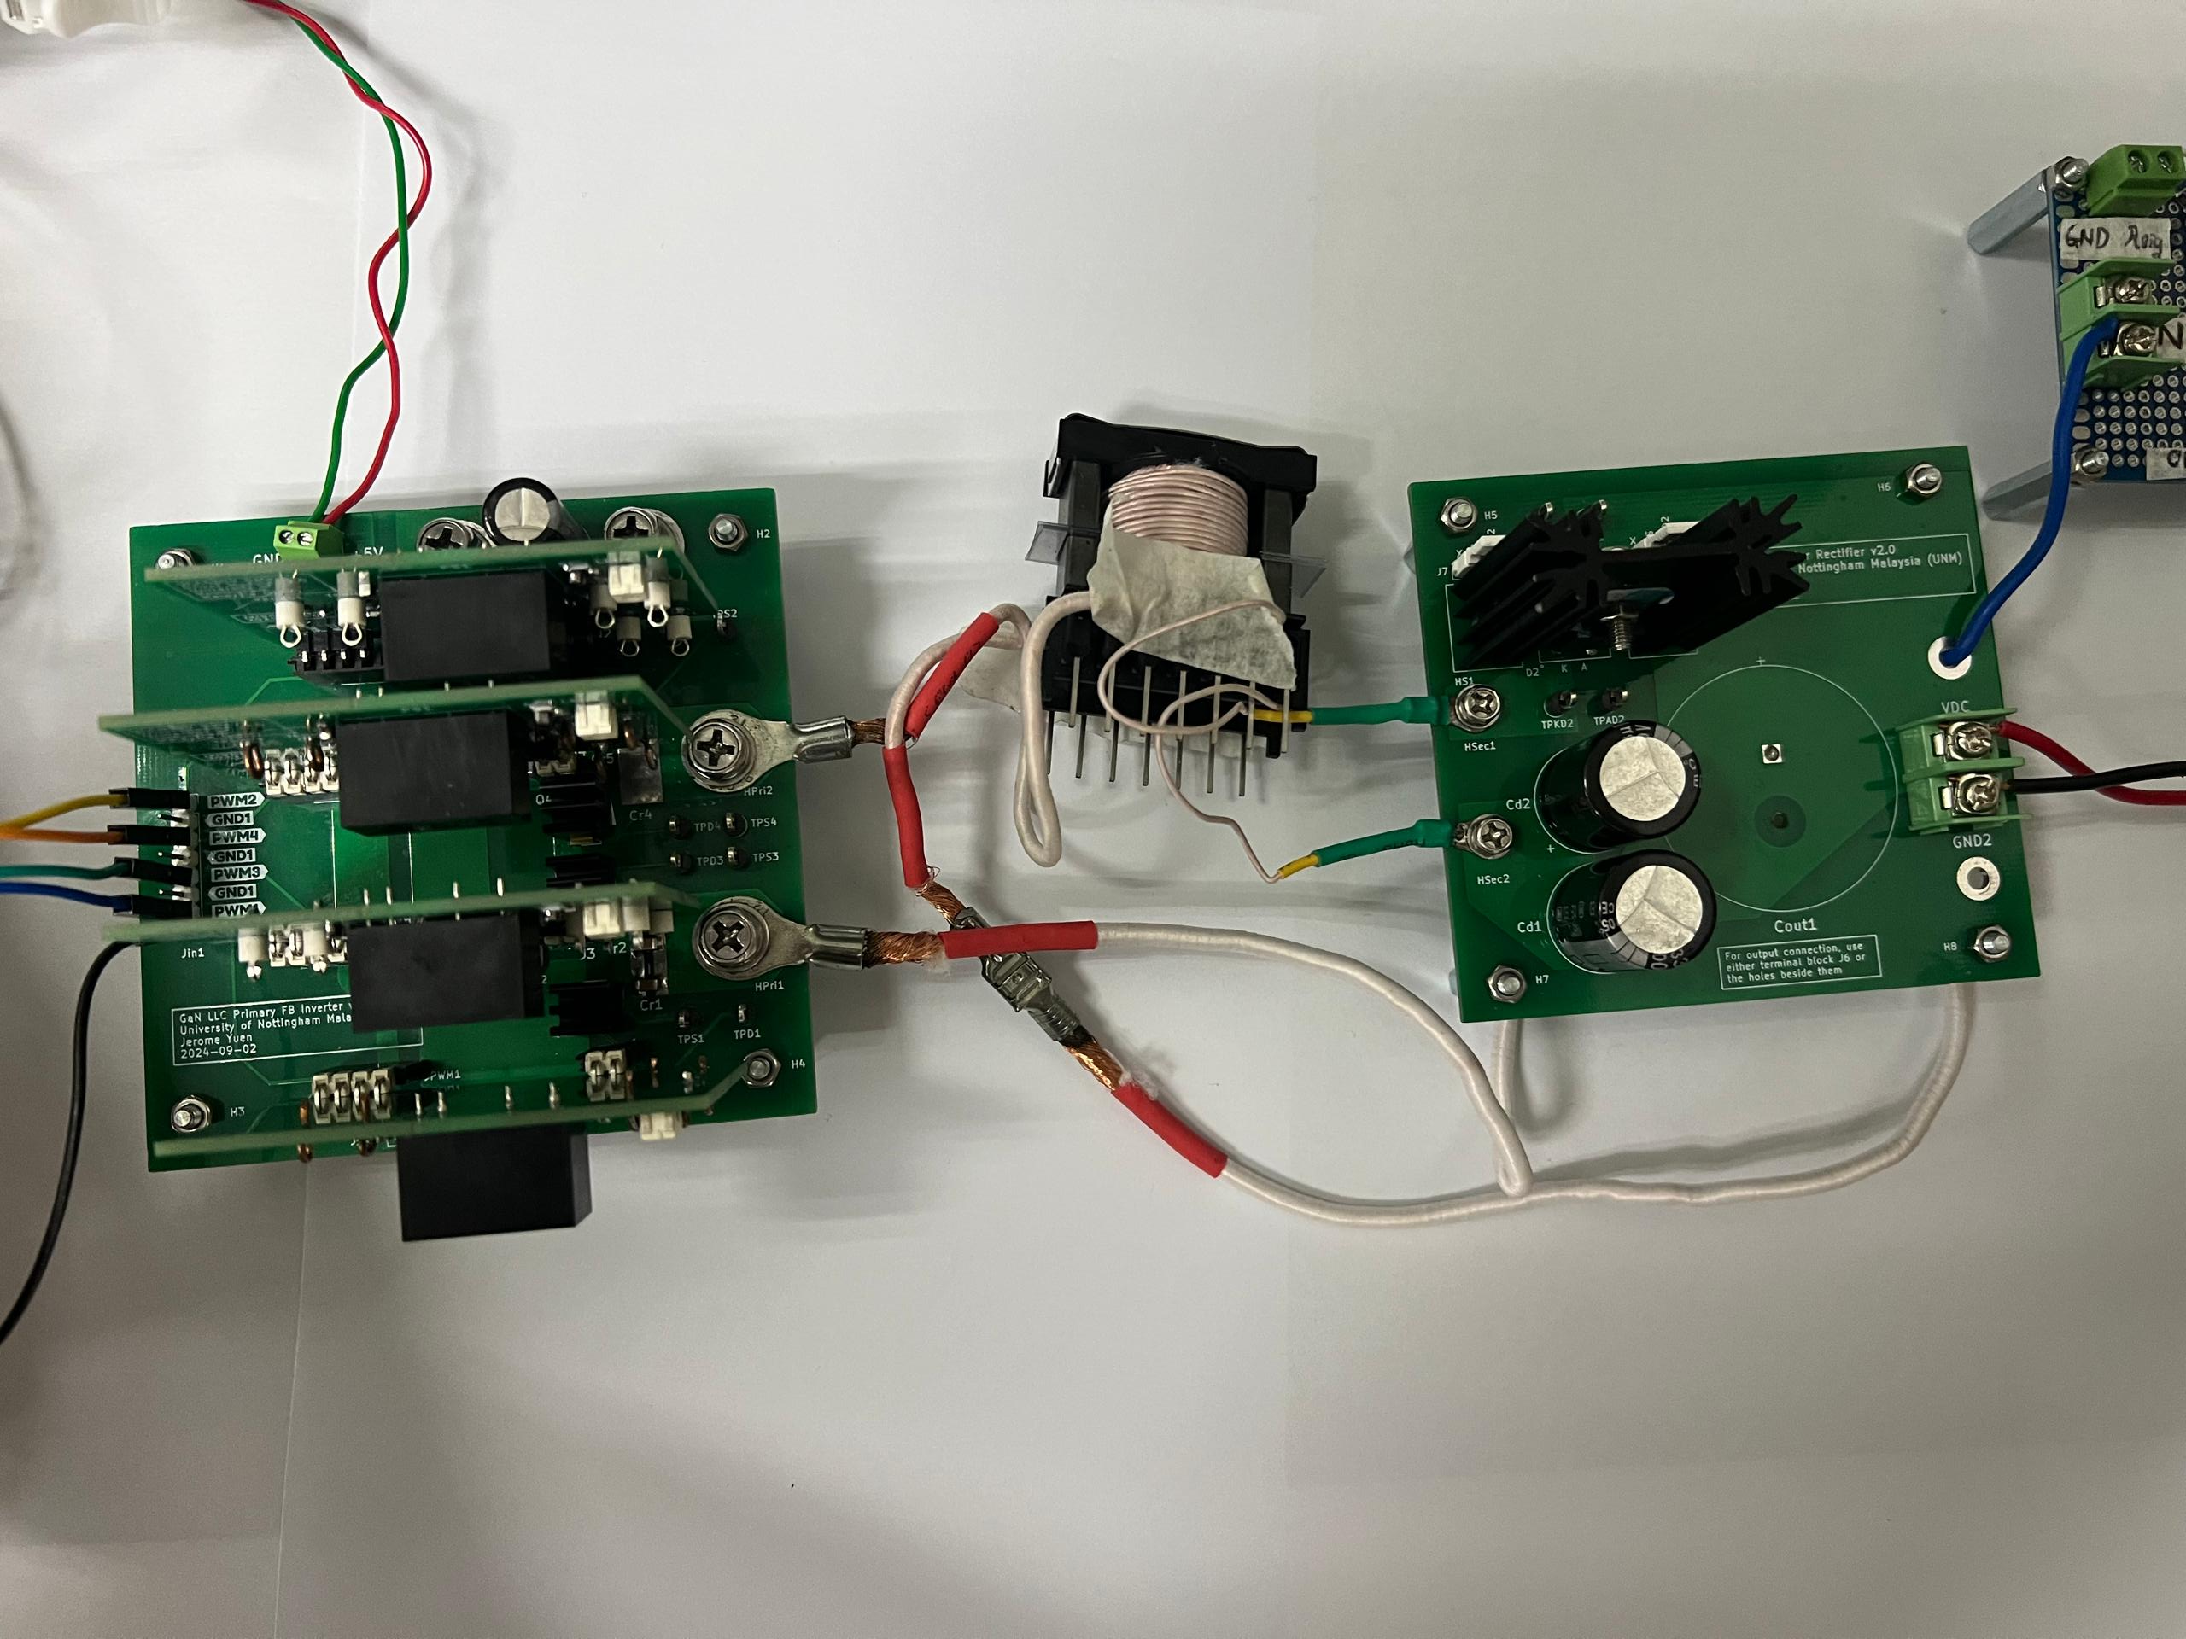
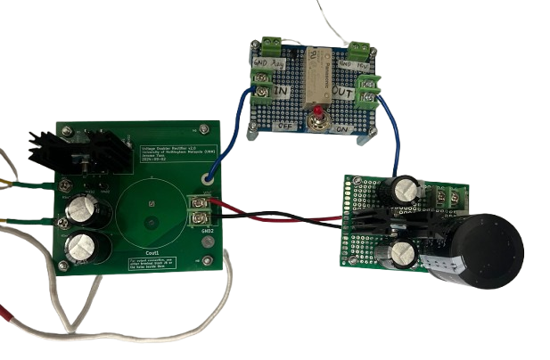

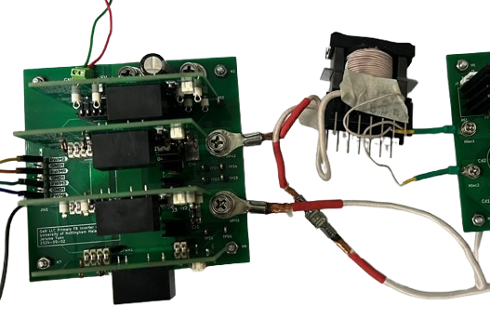
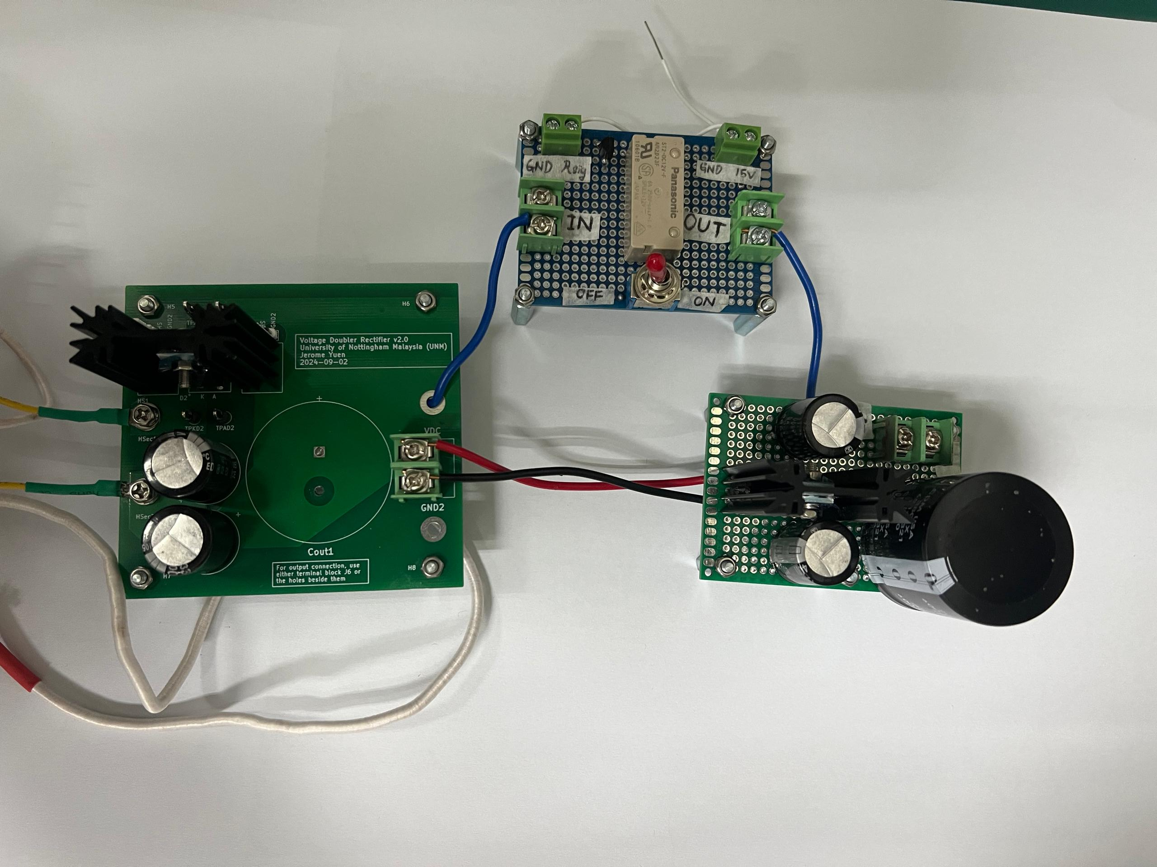
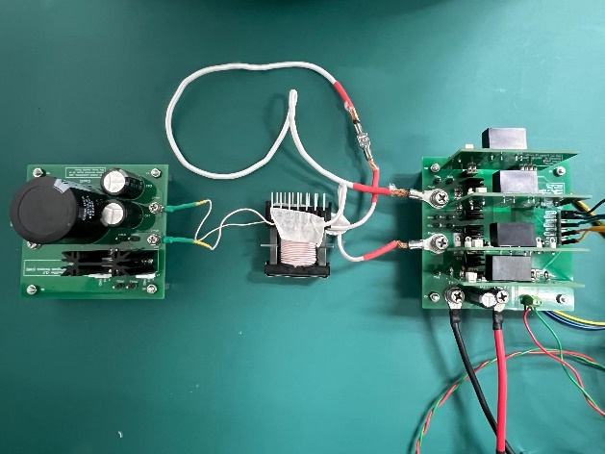









Switch $Q_{MC}$
Voltage doubler circuit board
$$V_{in}$$
High frequency transformer
$$V_{out}$$
$$+$$
$$+$$
$$−$$
$$−$$
PWM from microcontroller
Switching Network
Transformer
Rectifier Network
Input Voltage, $V_{pv}$
RM34
Auxiliary 5V Power Supply
PWM from Microcontroller
Input Voltage, $V_{pv}$
Gate Driver Circuit

Slide 45
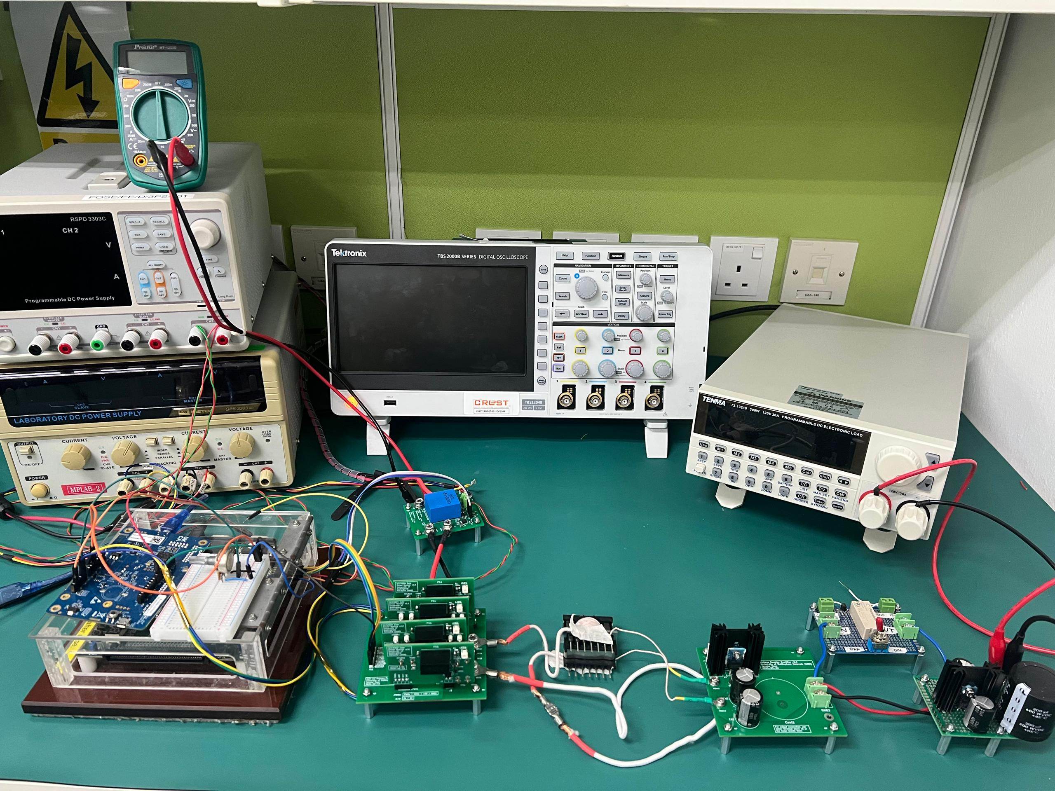
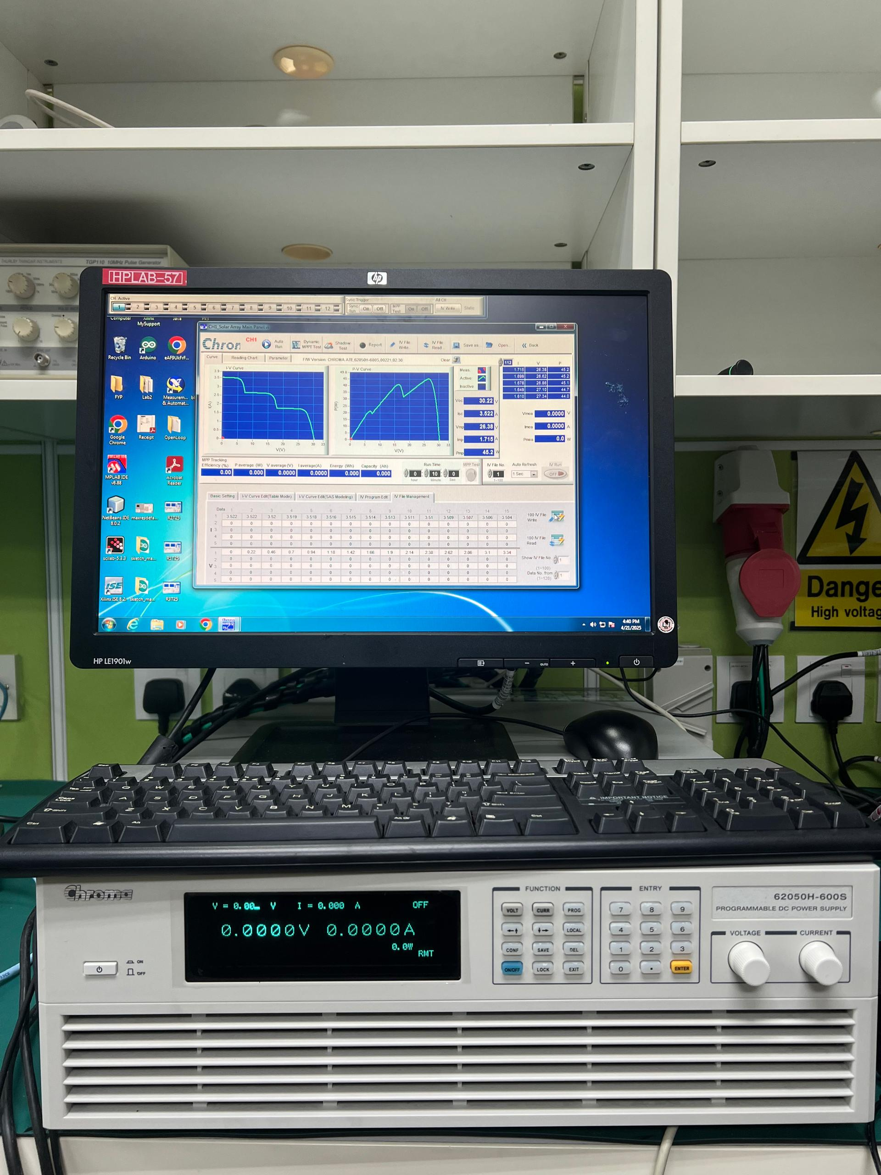


Softpanel software
DC linear power supply
Voltmeter
Oscilloscope
Programmable Electronics Load
$$V_{pv}$$
+
-
+
$$V_{PV}$$
-
Programmable DC power supply (Chroma 62000H Series)
STM32-B-U585I IOT02A microcontroller
FPGA
LLC Resonance Converter Prototype

Slide 46
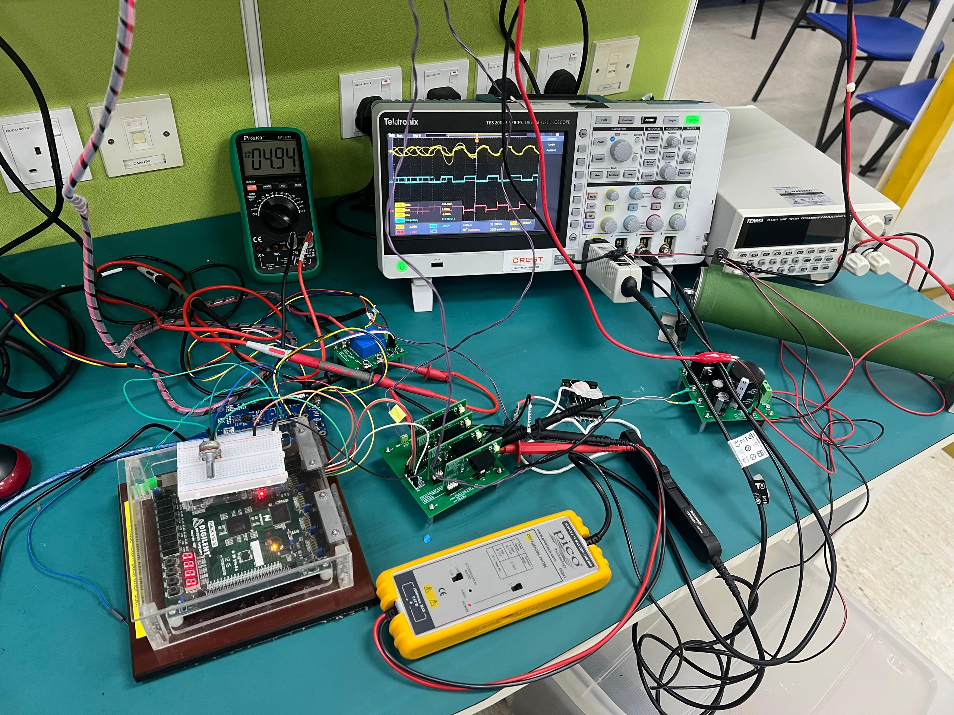
Oscilloscope
Voltmeter
Programmable Electronics Load
LLC Resonance
Converter Prototype
STM32-B-U585I-
IOT02A
microcontroller
FPGA

Slide 47
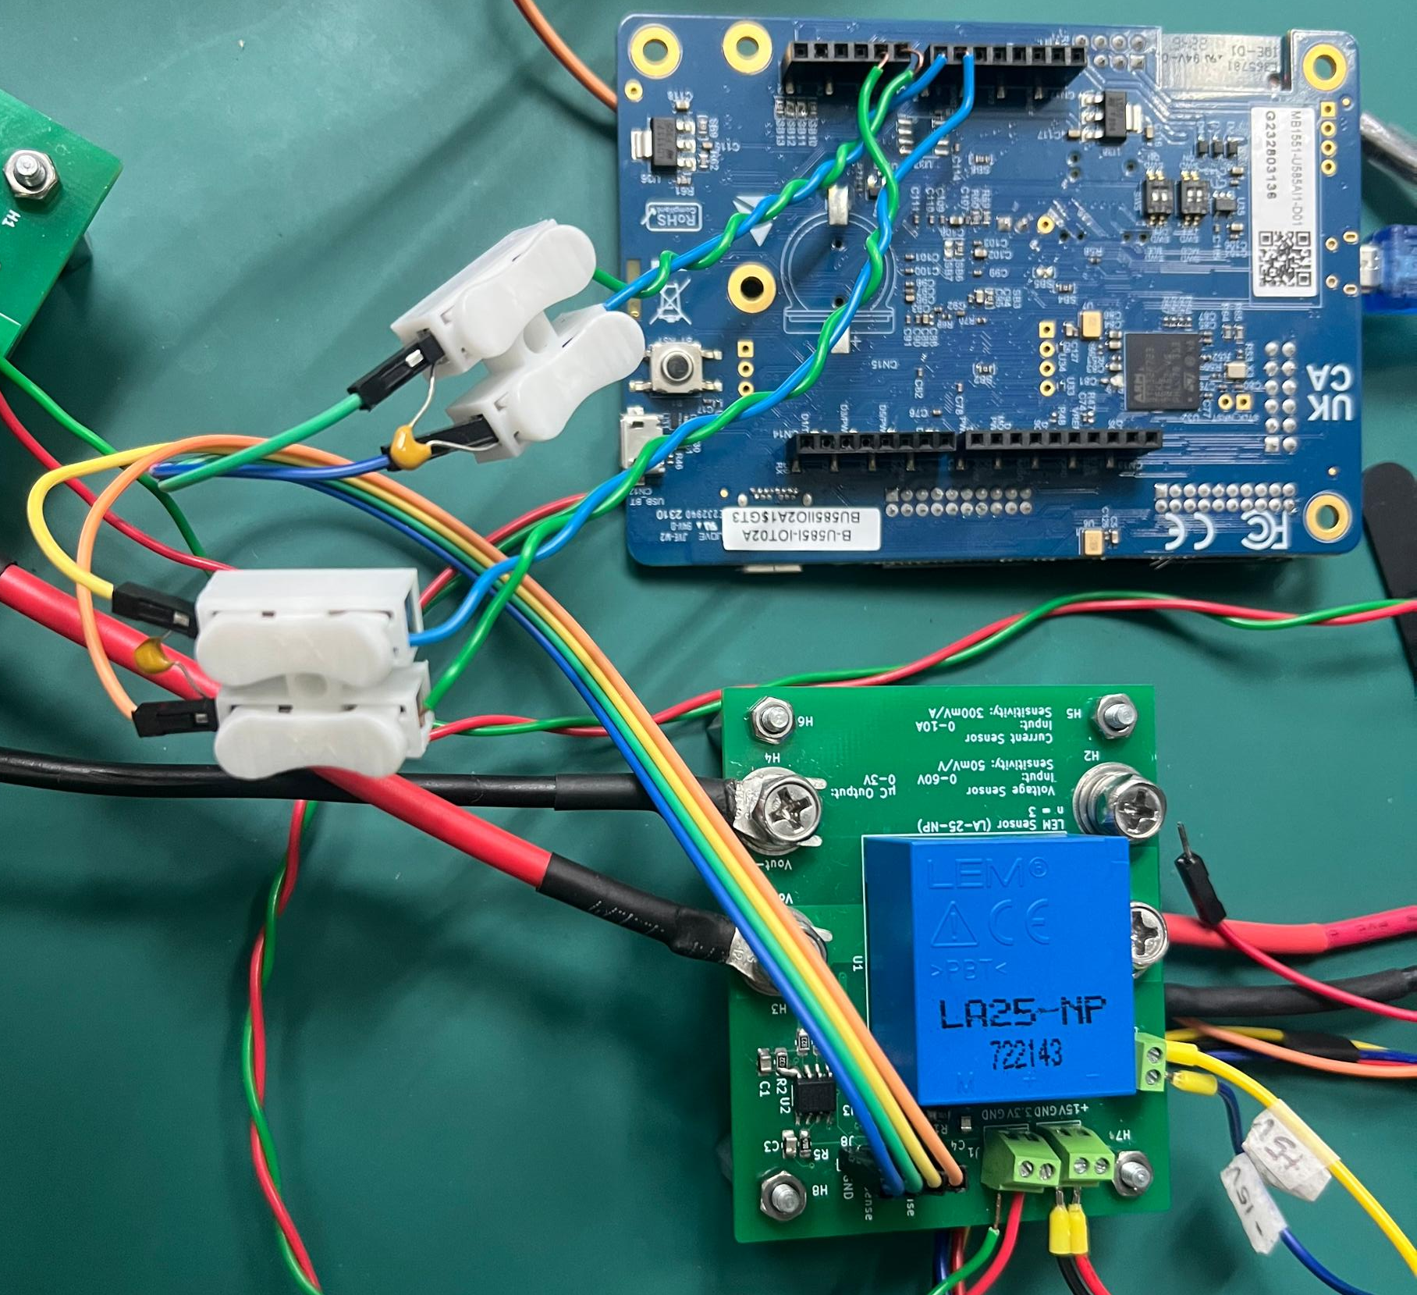







$$I_{sense}^{in}$$
$$V_{sense}^{in}$$
Decoupling capacitor
STM32-B-U585I-IOT02A microcontroller
Output voltage from sensor
Voltage and current sensor
Input voltage from PV array
$$−15V$$
$$V_{sense}^{out}$$
$$I_{sense}^{out}$$
$$3.3V$$
$$+15V$$

Slide 48
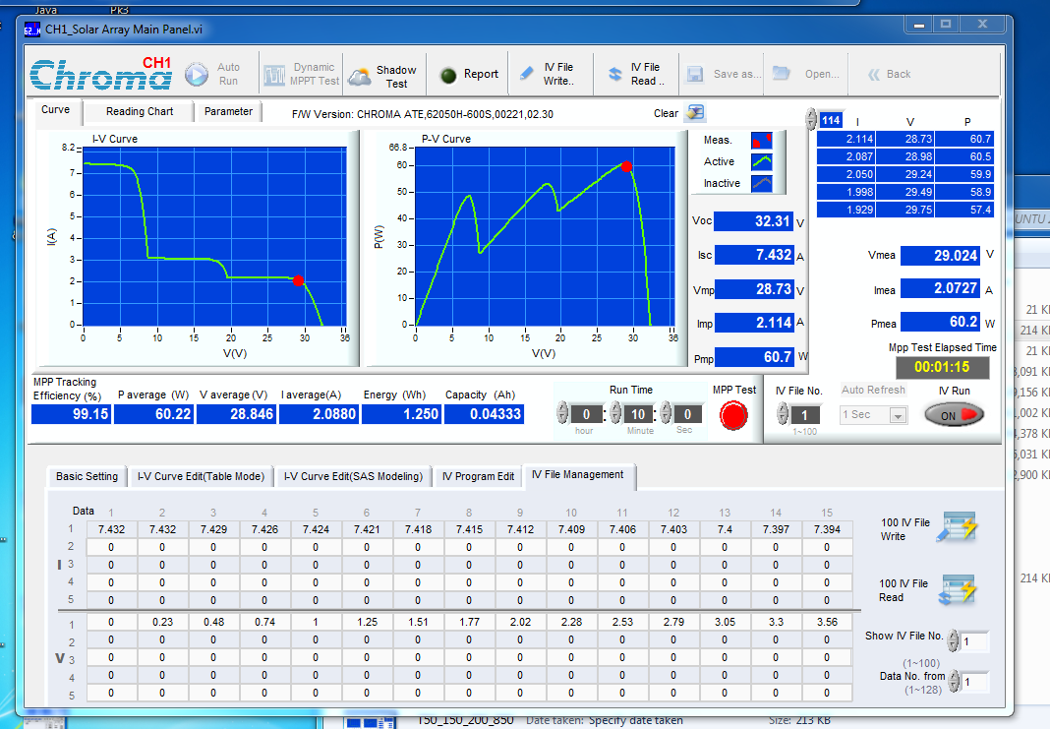
Key PV parameters
Average tracking voltage, current and power
MPPT tracking values
Uploaded I-V and P-V curve

Slide 49
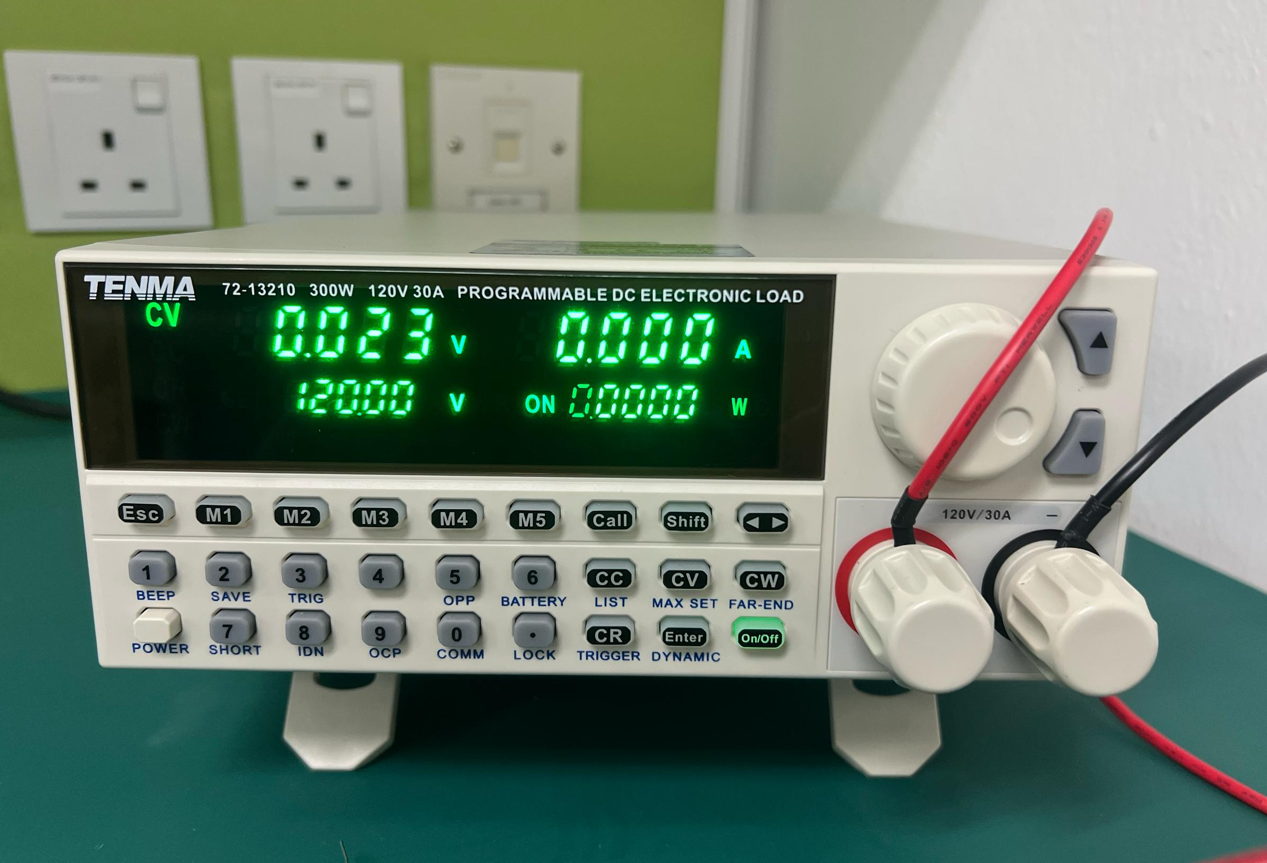
120V to emulate DC link
Input terminal
Constant Voltage (CV)

Slide 50




$$V_{PV}=20.019V_{sense}−0.619$$
$$I_{PV}=3.3207V_{sense}−0.0491$$
$$R^{2}=0.9999$$
$$R^{2}=0.9999$$

Slide 51
Results

Slide 52
NN Quantitative Result

Slide 53


$$ΔP=1.36W$$
$$ΔP=13.41 W$$
IRR = 75 200 525
Index = 799-1
$$ΔP=0.79W$$
$$ΔP=0.93W$$
IRR = 75 125 325
Index = 689-1

Slide 54
Wrong Region
Prediction
Wrong Region
Prediction

Slide 55








IRR = 75 75 500
Index = 623-1
$$Actual$$
$$ANN$$
$$CNN$$
$P_{GMPP}=34.21$W
$$V_{GMPP}=8.03V$$
$$P_{GMPP}=31.53W$$
$$V_{GMPP}=8.33V$$
$$P_{GMPP}=33.15$$
$$V_{GMPP}=30.48V$$
$$P_{GMPP}=30.16$$
$$V_{GMPP}=8.58V$$
$P_{LMPP}=25.27$W
$$V_{LMPP}=30.00V$$
$P_{LMPP}=23.98$W
$$V_{LMPP}=18.32V$$
$P_{LMPP}=18.70$W
$$V_{LMPP}=30.28V$$

Slide 56
GMPP
GMPP
LMPP
LMPP

Slide 57
Ripple in Vpv and Ipv

Slide 58
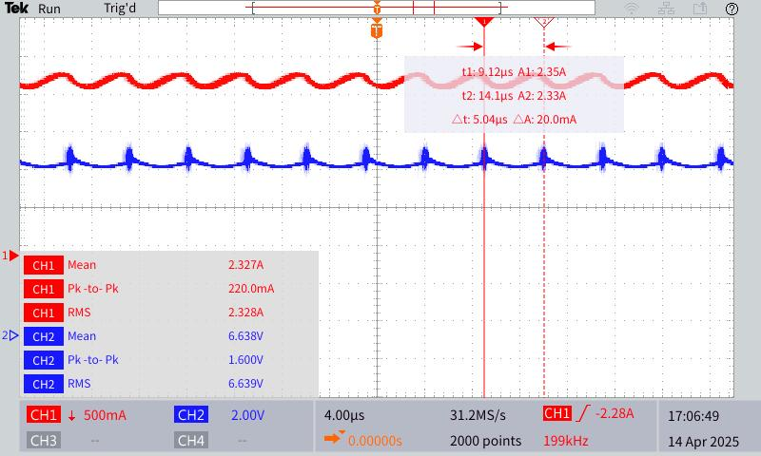
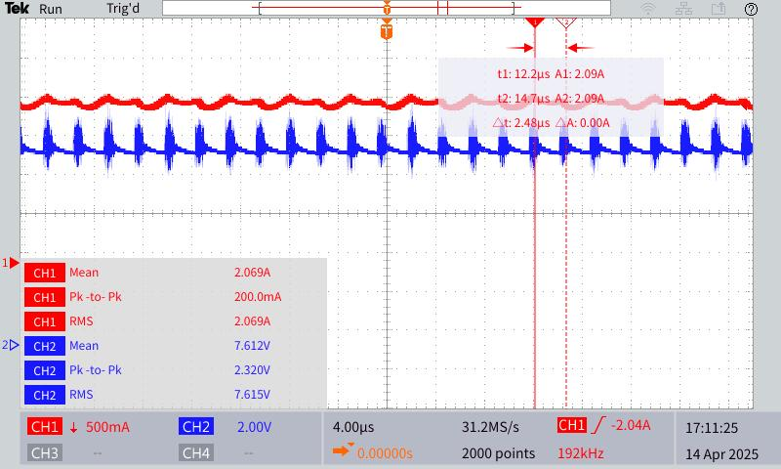

Slide 59
Open Loop Test

Slide 60
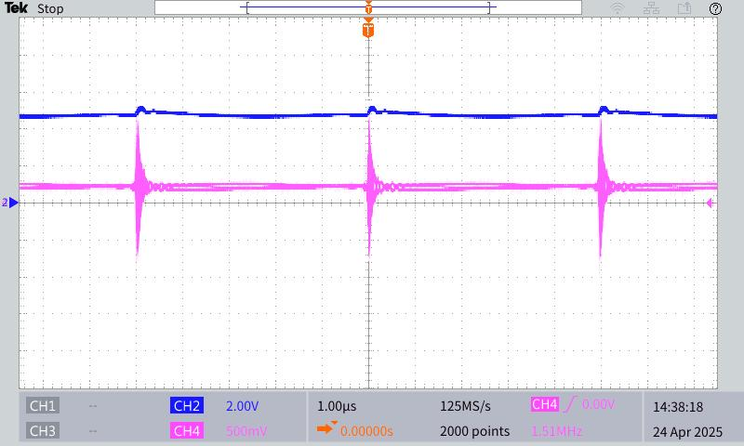
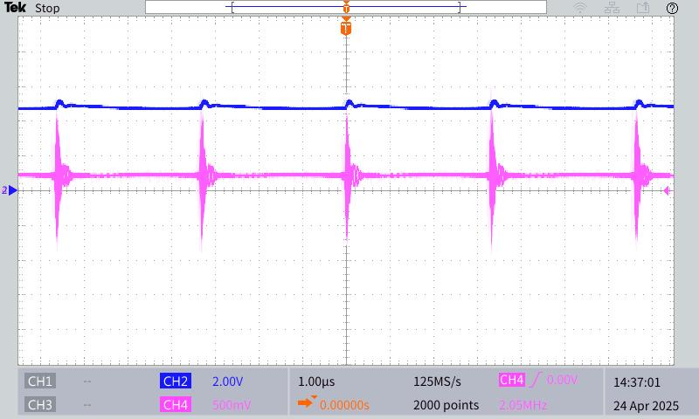
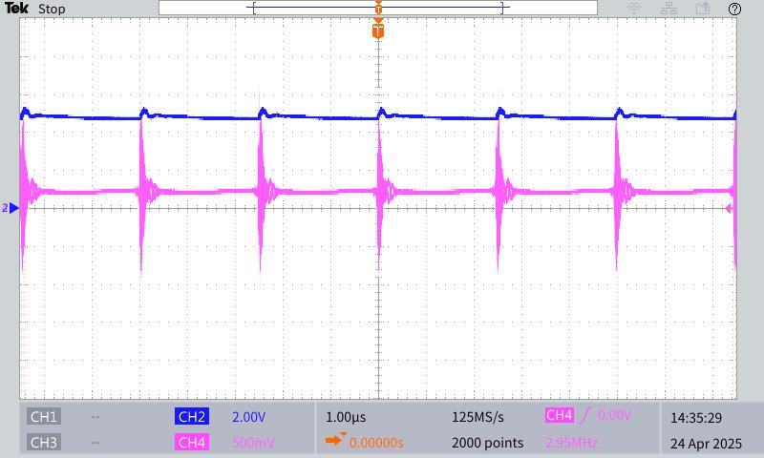














Vin =5V
$$V_{pv}(2V/div)$$
$$4.83V_{rms}$$
$$0.24V_{rms}$$
$$5μs$$
$$V_{sense}(0.5V/div)$$
$$V_{pv}(2V/div)$$
$$V_{pv}(2V/div)$$
$$4.86V_{rms}$$
$$4.87V_{rms}$$
$$0.25V_{rms}$$
$$0.26V_{rms}$$
$$3.3μs$$
$$V_{sense}(0.5V/div)$$
$$2.5μs$$
$$V_{sense}(0.5V/div)$$

Slide 61
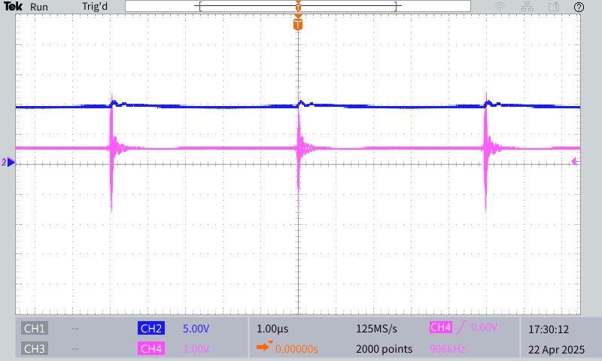
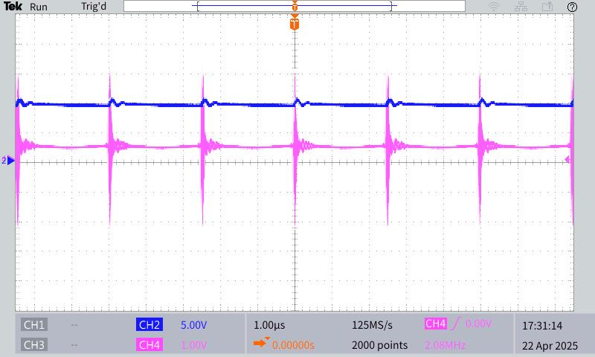
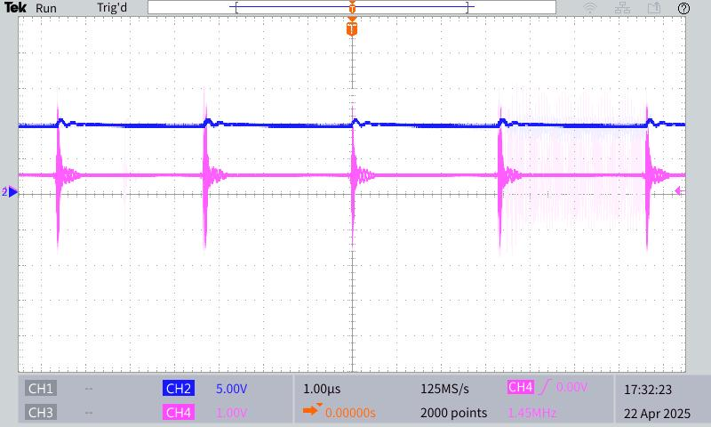















Vin =10V
$$V_{pv}(5V/div)$$
$$9.58V_{rms}$$
$$0.47V_{rms}$$
$$5μs$$
$$V_{sense}(1.0V/div)$$
$$V_{pv}(5V/div)$$
$$V_{pv}(5V/div)$$
$$9.69V_{rms}$$
$$9.65V_{rms}$$
$$0.51V_{rms}$$
$$0.49V_{rms}$$
$$2.5μs$$
$$3.3μs$$
$$V_{sense}(1.0V/div)$$
$$V_{sense}(1.0V/div)$$

Slide 62
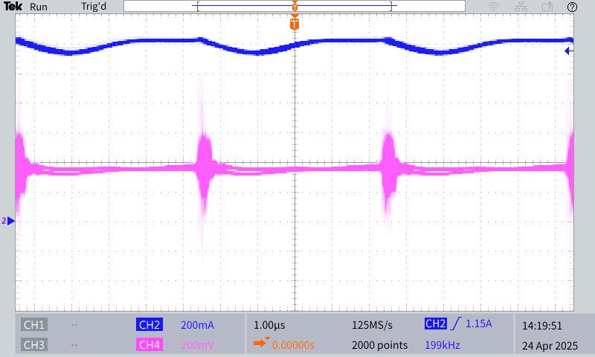
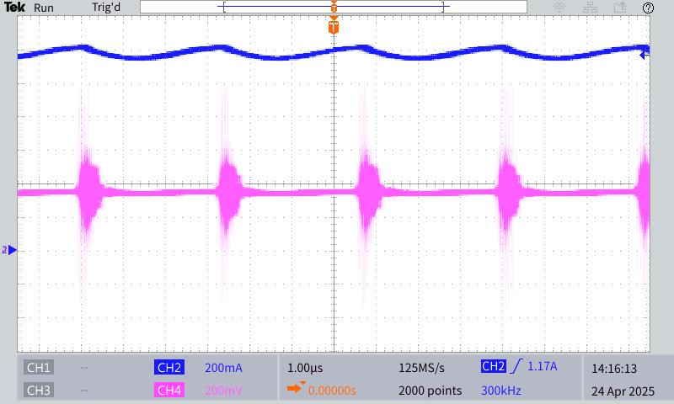
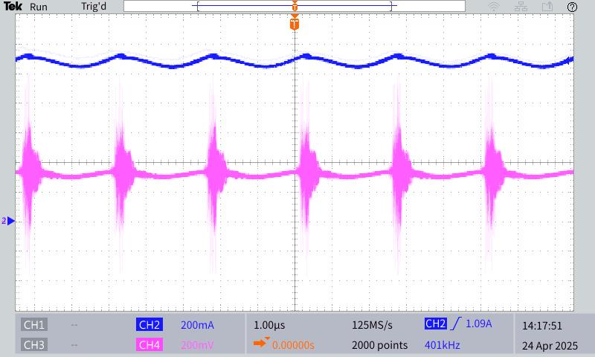













Iin =5V
$$1.20I_{rms}$$
$$I_{pv}(0.2A/div)$$
$$0.36V_{rms}$$
$$5μs$$
$$V_{sense}(0.2V/div)$$
$$1.19I_{rms}$$
$$I_{pv}(0.2A/div)$$
$$I_{pv}(0.2A/div)$$
$$1.09I_{rms}$$
$$0.36V_{rms}$$
$$0.33V_{rms}$$
$$3.3μs$$
$$2.5μs$$
$$V_{sense}(0.2V/div)$$
$$V_{sense}(0.2V/div)$$

Slide 63
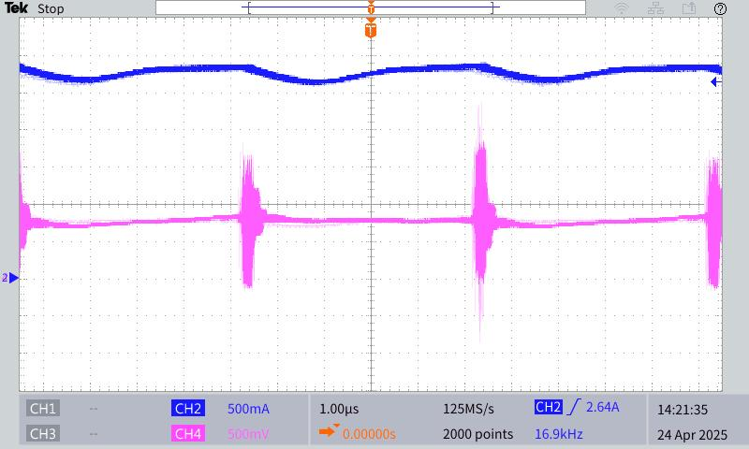
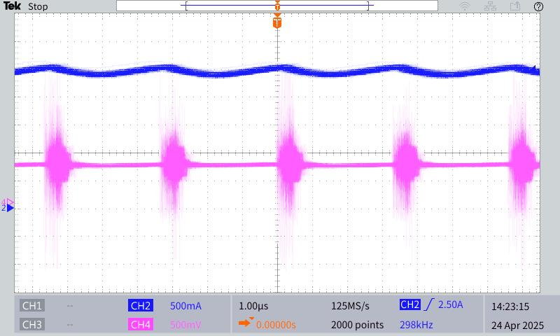















Iin =10V
$$2.80I_{rms}$$
$$I_{pv}(0.5A/div)$$
$$0.80V_{rms}$$
$$5μs$$
$$V_{sense}(0.5V/div)$$
$$2.45I_{rms}$$
$$I_{pv}(0.5A/div)$$
$$I_{pv}(0.5A/div)$$
$$2.25I_{rms}$$
$$0.70V_{rms}$$
$$0.65V_{rms}$$
$$3.3μs$$
$$V_{sense}(0.5V/div)$$
$$2.5μs$$
$$V_{sense}(0.5V/div)$$

Slide 64







15 Degree
Label again the phase shift to make it better
$$V_{GS1},V_{GS4}$$
$$φ=15°,Δt=420ns$$
$$V_{GS2},V_{GS3}$$
$$V_{GSa2}$$
$$V_{GSa1}$$

Slide 65


30 Degree
$$V_{GS1},V_{GS4}$$
$$φ=30°,Δt=840ns$$
$$V_{GS2},V_{GS3}$$
$$V_{GSa2}$$
$$V_{GSa1}$$

Slide 66


45 Degree
$$V_{GS1},V_{GS4}$$
$$φ=45°,Δt=1.26μs$$
$$V_{GS2},V_{GS3}$$
$$V_{GSa2}$$
$$V_{GSa1}$$

Slide 67


60 Degree
$$V_{GS1},V_{GS4}$$
$$φ=60°,Δt=1.68μs$$
$$V_{GS2},V_{GS3}$$
$$V_{GSa2}$$
$$V_{GSa1}$$

Slide 68


75 Degree
$$V_{GS1},V_{GS4}$$
$$φ=75°,Δt=2.12μs$$
$$V_{GS2},V_{GS3}$$
$$V_{GSa2}$$
$$V_{GSa1}$$

Slide 69


90 Degree
$$V_{GS1},V_{GS4}$$
$$φ=90°,Δt=2.52μs$$
$$V_{GS2},V_{GS3}$$
$$V_{GSa2}$$
$$V_{GSa1}$$

Slide 70



$$t_{dead}=100ns$$
$$t_{dead}=100ns$$

Slide 71




$$ZVS$$
$$ZVS$$

Slide 72



Circulating Current
Current Truncation

Slide 73
Full PFM Result with 5 results
Region 1, 2, 3

Slide 74




































T=50 degree (Done)
Irradiance=150, 200, 850
More label and put voltage value inside
Predicted LMPPs
$$9…$$
$$P_{GMPP}$$
$$(7.52, 49.95)$$
$$2$$
$$I_{nn1} \\ search$$
$$(18.58, 34.09)$$
$$(28.88, 36.75)$$
$$1$$
$$6, 7, 8$$
$$6$$
$$7$$
$$8$$
$$I_{nn3} \\ search$$
$$2$$
$$3$$
$$4$$
$$5$$
$$9$$
$$10$$
$$11$$
$$12$$
$$13$$
$$14$$
$$15$$
$$16$$
$$17$$
$$18$$
$$19$$
$$20$$
$$3, 4, 5$$
$$I_{nn2} \\ search$$
$$V_{OC} \\ measure$$
$$1$$
SS-PSM-3
mean(out.Ppv.Data(end-1000:end))

Slide 75































T=50 degree(Done)
Irradiance=250, 700, 1000
SS-PSM-7
Predicted LMPPs
$8$…
$$P_{GMPP}$$
$$(18.64, 105.80)$$
$$1$$
$$7$$
$$6$$
$$5$$
$$8$$
$$3, 4$$
$$(30.75, 65.27)$$
$$9$$
$$10$$
$$11$$
$$12$$
$$25$$
$$13$$
$$14$$
$$22$$
$$24$$
$$15$$
$$21$$
$$23$$
$$16$$
$$17$$
$$19$$
$$20$$
$$18$$
$$I_{nn2} \\ search$$
$$4$$
$$(7.74, 59.94)$$
$$3$$
$$2$$
$$5, 6, 7$$
$$2$$
$$I_{nn3} \\ search$$
$$I_{nn1} \\ search$$
$$V_{OC} \\ measure$$
$$1$$

Slide 76




























T=50 degree(Done)
Irradiance=250, 350, 850
SS-PSM-7
Predicted LMPPs
$$9$$
$$P_{GMPP}$$
$$(18.99, 54.31)$$
$$(29.59, 60.94)$$
$$2$$
$$(7.72, 50.91)$$
$$6, 7, 8$$
$$1$$
$$19$$
$$20$$
$$I_{nn1} \\ search$$
$$I_{nn3} \\ search$$
$$18$$
$$21$$
$$17$$
$$22$$
$$16$$
$$23$$
$$15$$
$$25$$
$$14$$
$$24$$
$$13$$
$$12$$
$$11$$
$$10$$
$$9$$
$$8$$
$$7$$
$$6$$
$$5$$
$$4$$
$$3, 4, 5$$
$$3$$
$$2$$
$$I_{nn2} \\ search$$
$$V_{OC} \\ measure$$
$$1$$

Slide 77



















T=25 degree(Done)
Irradiance=200, 300, 400
SS-PSM-12
Predicted LMPPs
$$(31.66, 52.28)$$
$$10$$
$$(20.02, 50.18)$$
$$P_{GMPP}$$
$$1$$
$$10$$
$$11$$
$$12$$
$$13$$
$$14$$
$$15$$
$$16$$
$$17$$
$$18$$
$$19$$
$$20$$
$$6$$
$$7$$
$$8$$
$$9$$
$$6, 7, 8, 9$$
$$4$$
$$5$$
$$I_{nn3} \\ search$$
$$2$$
$$3$$
$$(8.29, 29.41)$$
$$3, 4, 5$$
$$I_{nn2} \\ search$$
$$2$$
$$I_{nn1} \\ search$$
$$V_{OC} \\ measure$$
$$1$$

Slide 78

















T=50 degree
Irradiance=200, 300, 400
SS-PSM-12
Predicted LMPPs
$$9$$
$$P_{GMPP}$$
$$1$$
$$9$$
$$10$$
$$11$$
$$12$$
$$13$$
$$14$$
$$15$$
$$16$$
$$17$$
$$18$$
$$19$$
$$20$$
$$(18.11, 44.27)$$
$$(28.65, 46.07)$$
$$6$$
$$7$$
$$8$$
$$4$$
$$5$$
$$6, 7, 8$$
$$2$$
$$3$$
$$I_{nn3} \\ search$$
$$(7.50, 25.95)$$
$$3, 4, 5$$
$$I_{nn2} \\ search$$
$$2$$
$$I_{nn1} \\ search$$
$$V_{OC} \\ measure$$
$$1$$

Slide 79












T=65 degree
Irradiance=200, 300, 400
SS-PSM-12
Predicted LMPPs
$$7$$
$$P_{GMPP}$$
$$1$$
$$8$$
$$9$$
$$10$$
$$11$$
$$12$$
$$13$$
$$14$$
$$15$$
$$16$$
$$17$$
$$18$$
$$19$$
$$20$$
$$(16.96, 40.77)$$
$$(26.83, 42.33)$$
$$6$$
$$7$$
$$6$$
$$4$$
$$5$$
$$I_{nn3} \\ search$$
$$3$$
$$2$$
$$3, 4, 5$$
$$(7.02, 23.75)$$
$$I_{nn2} \\ search$$
$$2$$
$$I_{nn1} \\ search$$
$$V_{OC} \\ measure$$
$$1$$

Slide 80
Full SS-PSM Result with 5 results
Region 1, 2, 3

Slide 81













T=50 degree (Done)
Irradiance=150, 200, 850
More label and put voltage value inside
Predicted LMPPs
$$10…$$
$$P_{GMPP}$$
$$(7.52, 49.68)$$
$$2$$
$$I_{nn1} \\ search$$
$$(28.78, 37.72)$$
$$(18.34, 34.77)$$
$$1$$
$$9$$
$$9$$
$$I_{nn3} \\ search$$
$$2$$
$$3$$
$$4$$
$$5$$
$$6$$
$$7$$
$$8$$
$$10$$
$$11$$
$$12$$
$$13$$
$$14$$
$$15$$
$$16$$
$$17$$
$$18$$
$$19$$
$$20$$
$$3,…,8$$
$$I_{nn2} \\ search$$
$$V_{OC} \\ measure$$
$$1$$
SS-PSM-3

Slide 82
















T=50 degree(Done)
Irradiance=250, 700, 1000
SS-PSM-7
Predicted LMPPs
$6$…
$$P_{GMPP}$$
$$(18.73, 100.50)$$
$$1$$
$$5$$
$$3$$
$$4$$
$$6$$
$$7$$
$$8$$
$$9$$
$$10$$
$$11$$
$$12$$
$$13$$
$$14$$
$$15$$
$$16$$
$$17$$
$$18$$
$$19$$
$$20$$
$$3, 4$$
$$2$$
$$(7.82, 60.09)$$
$$I_{nn2} \\ search$$
$$(30.85, 56.99)$$
$$5$$
$$2$$
$$I_{nn3} \\ search$$
$$I_{nn1} \\ search$$
$$V_{OC} \\ measure$$
$$1$$

Slide 83







T=50 degree(Done)
Irradiance=250, 350, 850
SS-PSM-7
Predicted LMPPs
$$7$$
$$P_{GMPP}$$
$$(18.93, 54.01)$$
$$(29.51, 60.23)$$
$$7$$
$$8$$
$$9$$
$$10$$
$$11$$
$$13$$
$$14$$
$$15$$
$$17$$
$$18$$
$$19$$
$$20$$
$$2$$
$$(7.70, 50.50)$$
$$6$$
$$1$$
$$6$$
$$12$$
$$16$$
$$I_{nn1} \\ search$$
$$I_{nn3} \\ search$$
$$2$$
$$3$$
$$4$$
$$5$$
$$3, 4, 5$$
$$I_{nn2} \\ search$$
$$V_{OC} \\ measure$$
$$1$$

Slide 84












T=25 degree
Irradiance=200, 300, 400
SS-PSM-12
Predicted LMPPs
$$(31.17, 51.09)$$
$$(19.71, 49.12)$$
$$8$$
$$8$$
$$9$$
$$10$$
$$11$$
$$12$$
$$13$$
$$14$$
$$15$$
$$16$$
$$17$$
$$18$$
$$19$$
$$20$$
$$P_{GMPP}$$
$$1$$
$$7$$
$$7$$
$$3$$
$$4$$
$$5$$
$$6$$
$$I_{nn3} \\ search$$
$$2$$
$$(8.16, 28.88)$$
$$3, 4, 5, 6$$
$$I_{nn2} \\ search$$
$$2$$
$$I_{nn1} \\ search$$
$$V_{OC} \\ measure$$
$$1$$

Slide 85







T=50 degree
Irradiance=200, 300, 400
SS-PSM-12
Predicted LMPPs
$$8$$
$$P_{GMPP}$$
$$1$$
$$7$$
$$8$$
$$9$$
$$10$$
$$11$$
$$12$$
$$13$$
$$14$$
$$15$$
$$16$$
$$17$$
$$18$$
$$19$$
$$20$$
$$(18.06, 44.02)$$
$$(28.55, 45.72)$$
$$3$$
$$4$$
$$5$$
$$6$$
$$7$$
$$2$$
$$I_{nn3} \\ search$$
$$(7.45, 25.92)$$
$$3, 4, 5, 6$$
$$I_{nn2} \\ search$$
$$2$$
$$I_{nn1} \\ search$$
$$V_{OC} \\ measure$$
$$1$$

Slide 86








T=65 degree
Irradiance=200, 300, 400
SS-PSM-12
Predicted LMPPs
$$8$$
$$7$$
$$8$$
$$9$$
$$10$$
$$11$$
$$12$$
$$13$$
$$14$$
$$15$$
$$16$$
$$17$$
$$18$$
$$19$$
$$20$$
$$P_{GMPP}$$
$$(26.75, 41.32)$$
$$1$$
$$(16.91, 40.47)$$
$$3$$
$$4$$
$$5$$
$$6$$
$$7$$
$$2$$
$$I_{nn3} \\ search$$
$$3, 4, 5, 6$$
$$(7.00, 23.89)$$
$$I_{nn2} \\ search$$
$$2$$
$$I_{nn1} \\ search$$
$$V_{OC} \\ measure$$
$$1$$

Slide 87
Full PFM Result with 5 results
Region 1, 2, 3 and comparison with different temperature at region 3

Slide 88
GMPP
GMPP
LMPP
LMPP

Slide 89

























New 22/4
T=50 degree
Irradiance=150, 200, 850
PlsLastR1T50
Constant temperature
at 50 degree
Peak 1
$$2$$
$$2$$
$$I_{nn1}$$
$$5,…$$
Predicted LMPPs
$$5,…$$
$$(7.57, 45.57)$$
$$4$$
$$(28.89, 36.39)$$
$$(28.89, 36.31)$$
$$1$$
$$I_{nn2}$$
$$3$$
$$4$$
$$3$$
$$4$$
$$I_{nn3}$$
$$3$$
$$5…$$
$$2$$
$$1$$
$$1$$
Voc=31.64V
Init param=52.32 34.18 8.77 219.70
6.94, 6.56 45.52 0 0
Outputs: 45.5749, 36.9867, 36.3137, 7.5705, 18.5374, 28.8878
45.57, 7.57 finit=70000.00
$$3$$
$$4$$
$$5,…$$
$$2$$
$$1$$

Slide 90




















New 22/4
T=50 degree
Irradiance=250, 350, 850
PlsLastR3T50
Constant temperature
at 50 degree
Peak 3
Predicted LMPPs
$$4$$
$$5,…$$
$$I_{nn1}$$
$$(18.79, 54.32)$$
$$(29.48, 60.15)$$
$$2$$
$$2$$
$$3$$
$$1$$
$$4$$
$$(7.71, 41.07)$$
$$5…$$
$$I_{nn2}$$
$$3$$
$$4$$
$$2$$
$$3$$
$$I_{nn3}$$
$$5,…$$
$$1$$
$$1$$
Voc=32.31V
Init param=47.43 34.85 8.74 225.10
24.73, 2.19 54.23 0 0
Outputs: 41.0724, 54.3231, 60.1458, 7.7105, 18.7857, 29.4777
60.15, 29.48 finit=208733.77
$$3$$
$$5,…$$
$$4$$
$$2$$
$$1$$

Slide 91













Peak 3 (NewR3)(Checked)
T=50 degree
Irradiance=200, 300, 400
Constant temperature
at 50 degree
Peak 3
$$I_{nn1}$$
$$2$$
Predicted LMPPs
$$(28.65, 45.28)$$
$$5,…$$
$$3$$
$$4$$
$$I_{nn2}$$
$$(18.09, 43.96)$$
$$(7.48, 26.26)$$
$$3$$
$$4$$
$$I_{nn3}$$
$$5,…$$
$$2$$
$$1$$
$$4$$
$$5…$$
$$3$$
$$1$$
$$1$$
$$2$$
Voc=31.67V
Init param=52.10 34.21 8.77 219.94
22.43, 1.77 39.59 0 0
Outputs: 26.2564, 43.9567, 45.2832, 7.4750, 18.0875, 28.6469
45.28, 28.65 finit=223914.51
temperature, Voc, Isc, Pmax);
$$5,…$$
$$3$$
$$4$$
$$2$$
$$1$$

Slide 92












Peak 3 (2)(Checked)
T=65 degree
Irradiance=200, 300, 400
Change temperature
at 65 degree
Peak 3
$$1$$
$$4$$
$$5…$$
$$3$$
$$2$$
Predicted LMPPs
$$4$$
$$5,…$$
$$I_{nn1}$$
$$(16.60, 39.00)$$
$$2$$
$$3$$
$$(26.8, 41.00)$$
$$3$$
$$I_{nn2}$$
$$4$$
$$I_{nn3}$$
$$5,…$$
$$2$$
$$1$$
$$1$$
Predicted Outputs: -2.8, 39, 41, 0.2, 16.6, 26.8
41, 26.8 finit=168365.36Hz
$$5,…$$
$$3$$
$$4$$
$$2$$
$$1$$

Slide 93











Peak 1 (NewR1) (Checked)
T=25 degree
Irradiance=50, 100, 400
Testing peak 1 at temperature 25
at 25 degree
Peak 1
$$(7.90, 27.55)$$
Predicted LMPPs
$$2$$
$$5,…$$
$$5,…$$
$$(19.36, 23.33)$$
$$I_{nn1}$$
$$2$$
$$(30.24, 16.69)$$
$$1$$
$$4$$
$$4$$
$$3$$
$$I_{nn2}$$
$$3$$
$$4$$
$$3$$
$$5…$$
$$I_{nn3}$$
$$2$$
$$1$$
$$1$$
$$5$$
$$3$$
$$6,…$$
$$4$$
$$2$$
$$1$$
Voc=33.96
Init param: 35.37 36.50 8.68 238.40
temperature, Voc, Isc, Pmax);
Predicted Outputs: 27.5483, 23.3295, 16.6887, 7.9014, 19.3609, 30.2351
27.55, 7.90 finit=484,013.64

Slide 94









Peak 2 (Region2 New) (Checked)
T=70 degree
Irradiance=200, 400, 400
Testing peak 2 at temperature 70
$$2$$
$$3$$
Predicted LMPPs
$$5,…$$
$$I_{nn1}$$
$$I_{nn2}$$
$$5,…$$
$$3$$
$$(16.23, 46.23)$$
$$4$$
$$(26.61, 39.04)$$
$$4$$
$$2$$
$$1$$
$$I_{nn3}$$
$$4$$
$$3$$
$$1$$
$$1$$
$$2$$
$$5…$$
temperature, Voc, Isc, Pmax);
Voc=28.95
Init param=71.97 31.49 8.88 198.01
11.44, 3.46 39.64 0 0
Outputs: -0.8109, 46.2299, 39.0412, 0.0584, 16.2260, 26.6112
46.23, 16.23 finit=332509.07
$$5$$
$$6,…$$
$$3$$
$$4$$
$$2$$
$$1$$

