Slide 1

Define a Data Science Process
Presented by:
Donald aba

Slide 2
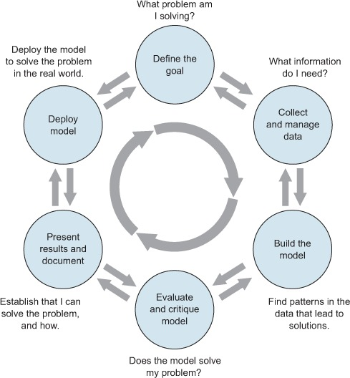
Zumel and Mount, Practical Data Science with R

Slide 3
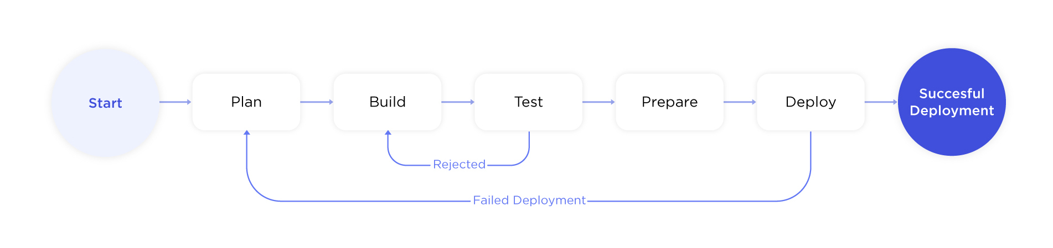
Define the goal
Stakeholders want to do the project to avoid losing business and improve decision making.
They need a much better way to understand how much credit to allow someone to use or, at the very least, if someone should be approved or not.
Their current solution is inadequate because it’s not based on a structure analysis that can target customers who are not allowed for credit.
We need customers database with every useful information for this project.
The result of our project will be deployed as follow:
70%
30%
50%
20%
30%

Slide 4
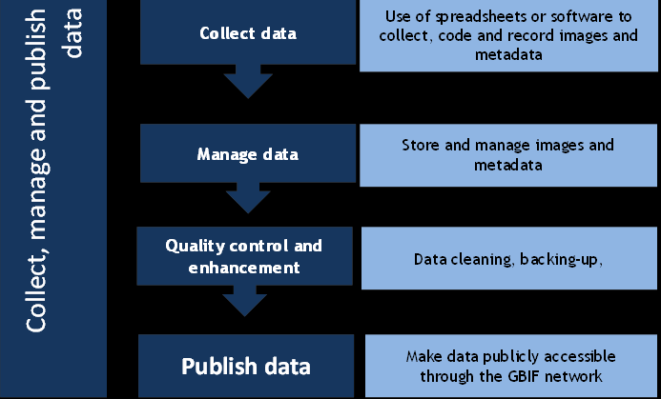
Collect and manage data
We will query a database to obtain the CreditOne data.
The given dataset is not enough to solve the problem, it need some improvement. We are going to apply some technics for cleaning and prepping the data in order to analyze it.
The data quality is not good enough to work on, so we are going to improve its readability for our visual.

Slide 5
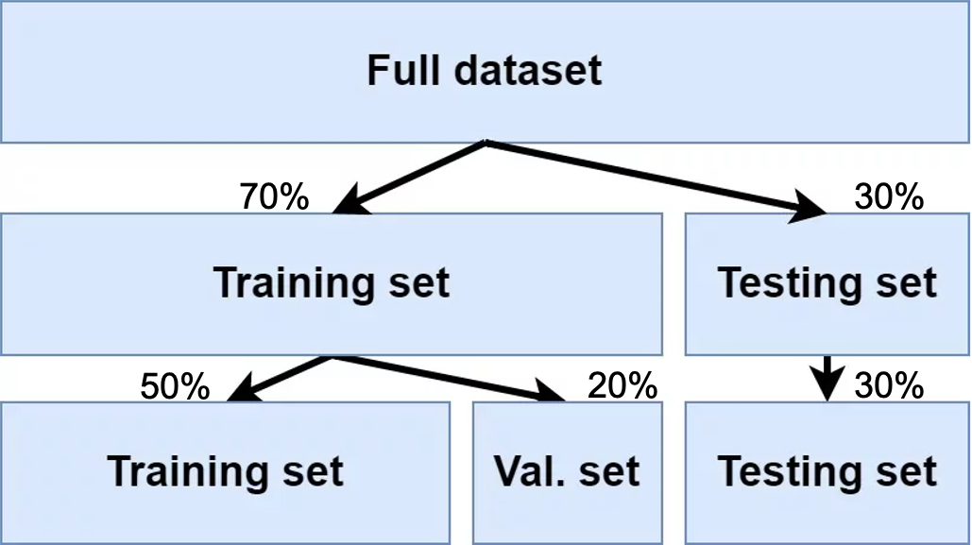
Build the model
We are going to use the machine learning techniques to build our model.
Depending on the data type (qualitative or quantitative) of the target variable, we are either going to be building a classification (if variable is qualitative) or regression (if variable is quantitative) model. We are going to split the data into training and test set as shown below.

Slide 6
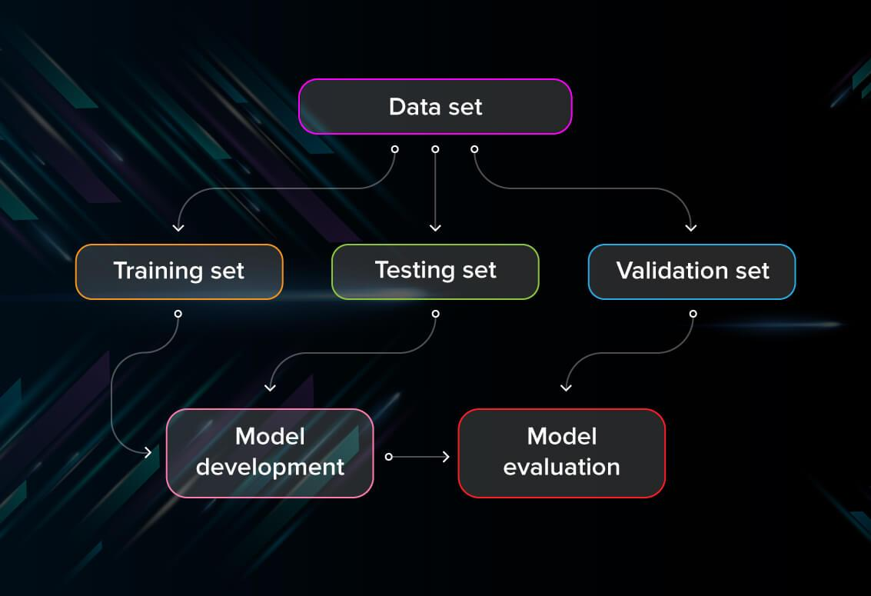
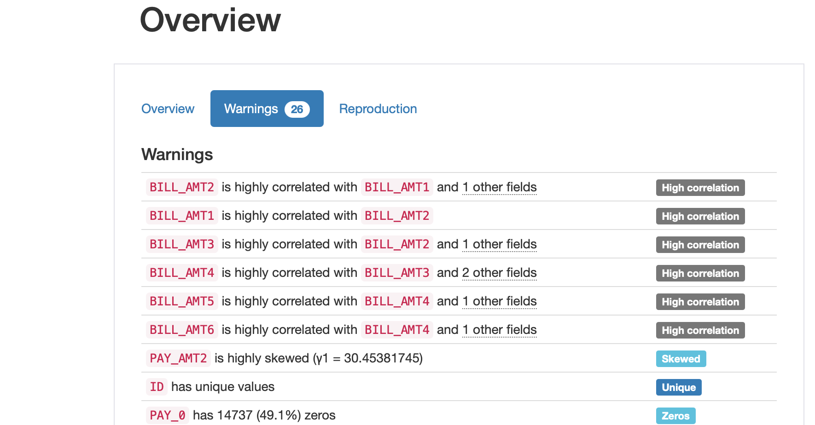
Evaluate and critique the model
The model is not accurate enough to meet the stakeholders’ needs, we still got some imperfections.
It does not perform better than "the obvious guess" and any techniques being used currently. We got some high correlations and some values in the data equal zero.
The model’s result does not make sense in the context of the real-world problem domain as shown below.

Slide 7
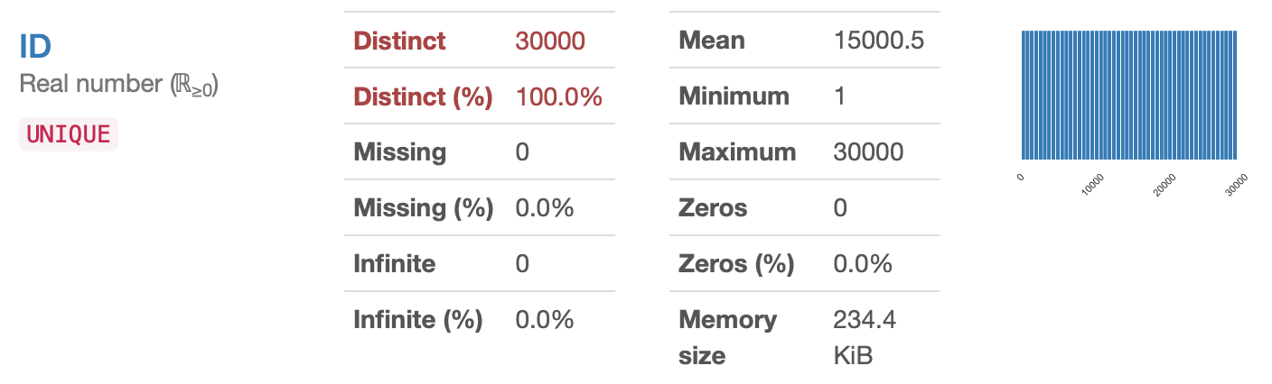
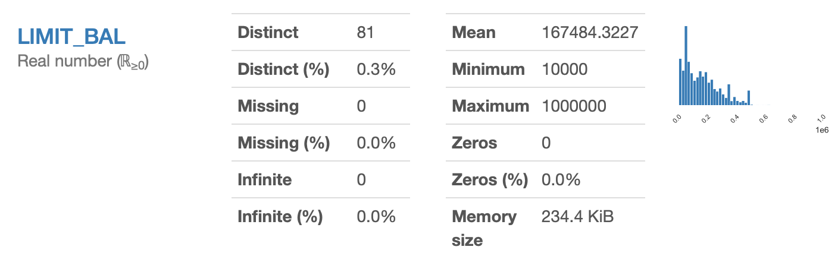
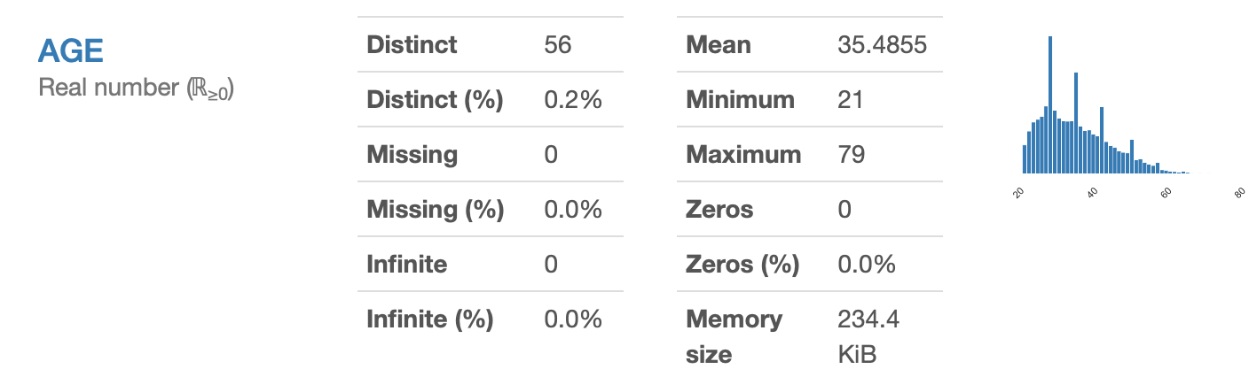
Insights
We are going to pay a particular attention to the features “ID”, “LIMIT_BAL” and “AGE”. k

