Slide 1
Real Time Carbon Storage Monitoring Pipeline
Applying Cloud-Native Streaming to CCS Operations
By Anasieze Ikenna - Cloud & AI Solutions Engineer

Slide 2
Background & Motivation
CCS operations require continuous monitoring
Injection rate, pressure and temperature are safety-critical
Batch reporting introduces delays
Goal: Real-time CCS monitoring & analysis using cloud-native systems

Slide 3
CCS Parameters in Scope
Dynamic parameters monitored
Injection well identifier
CO₂ injection pressure
CO₂ injection temperature
CO₂ injection rate
Timestamp
Reason
Directly affect injectivity and containment
First indicators of abnormal behaviour
Core parameters in real CCS operations

Slide 4
From Field to Cloud
Sensors measure field parameters (Temperature, Pressure, Injection Rate)
Edge gateway collects and formats data (JSON)
Data transmitted securely to the cloud
Cloud processes and stores data
Assumption: Edge Gateway layer simulated in this project

Slide 5
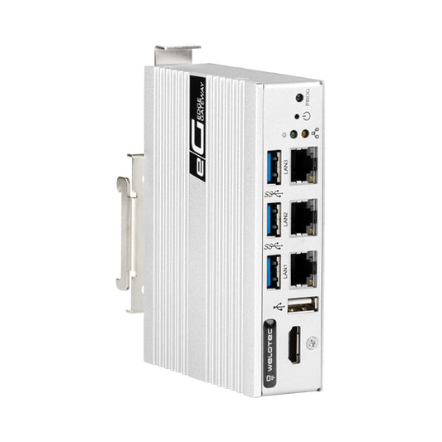
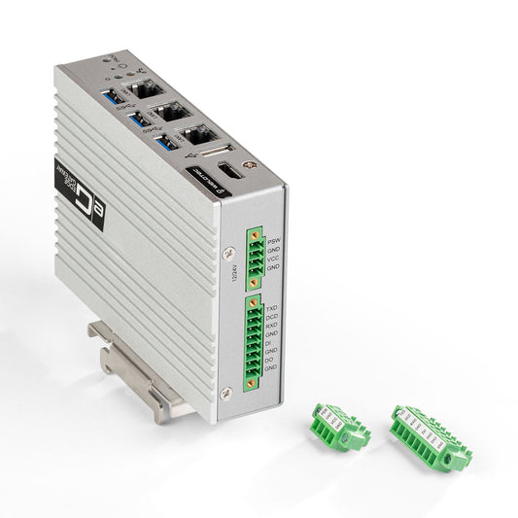
EDGE COMPUTING
Edge Gateways:
  Process data close to the source (sensors, devices, machines), reducing latency
  They keep things running even if the network is slow or down

Slide 6
EXAMPLE CCS Data Record
{
"storage_site": "Hibernia_CCS",
"injection_well": "INJ_03",
"co₂_injection_pressure_psi": 2950,
"co₂_injection_temperature_f": 121.4,
"co₂_injection_rate_tpd": 1800,
"timestamp": "2026-01-08T15:20:00Z"
}

Slide 7
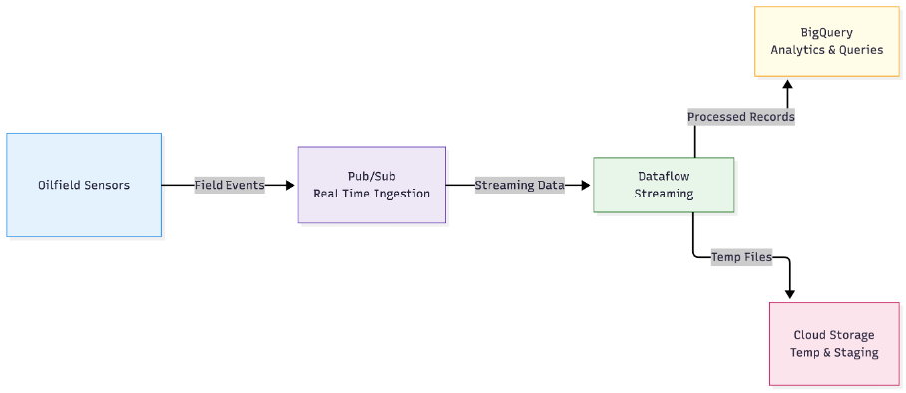
Cloud Architecture
Pub/Sub for event ingestion
Dataflow for real-time processing
BigQuery for analytics and monitoring
Benefits:
Serverless
Scalable
Real-time visibility

Slide 8
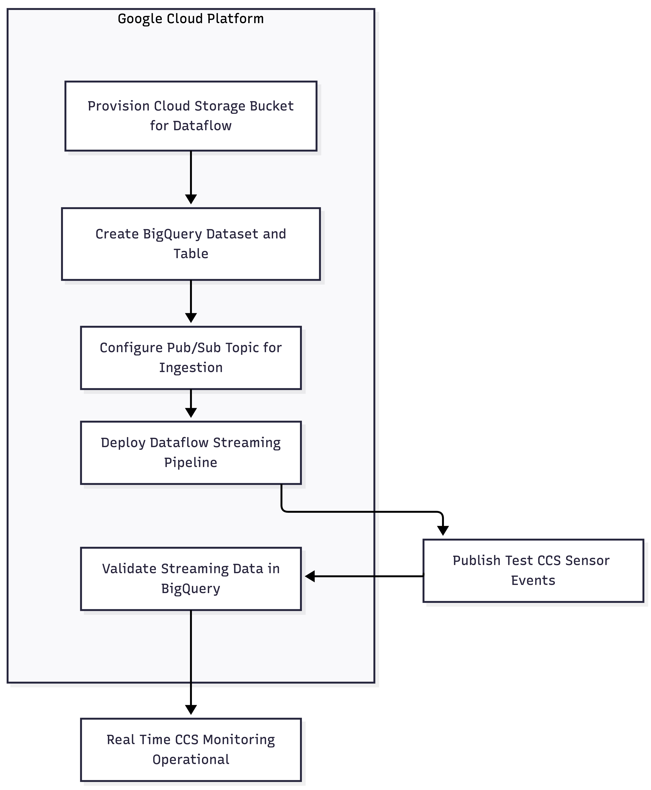
METHODOLOGY

Slide 9
Monitoring Output
What operators can see
Injection pressure per well
Injection rate
Temperature trends over time
Early detection of abnormal behaviour

Slide 10
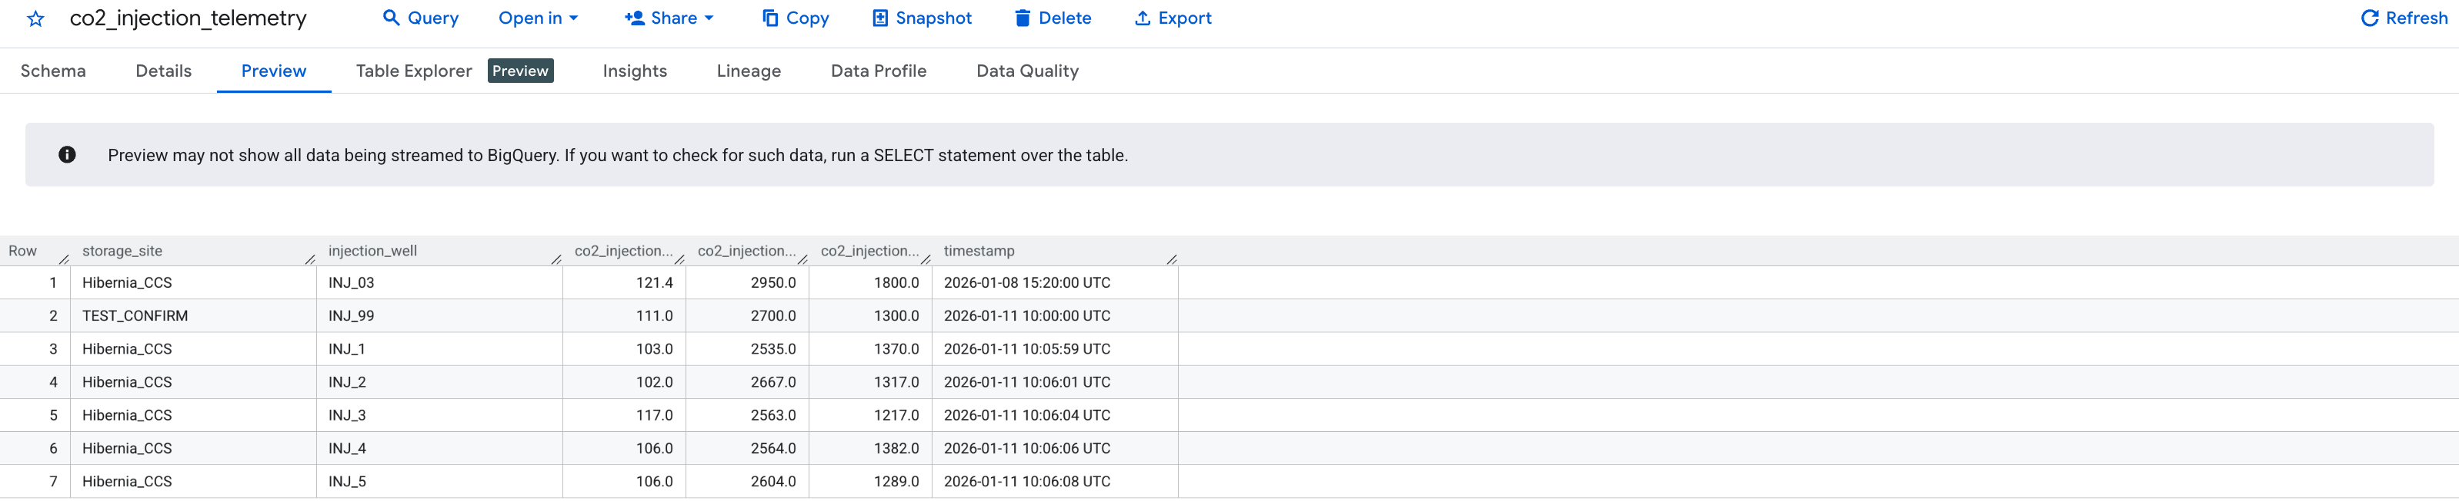
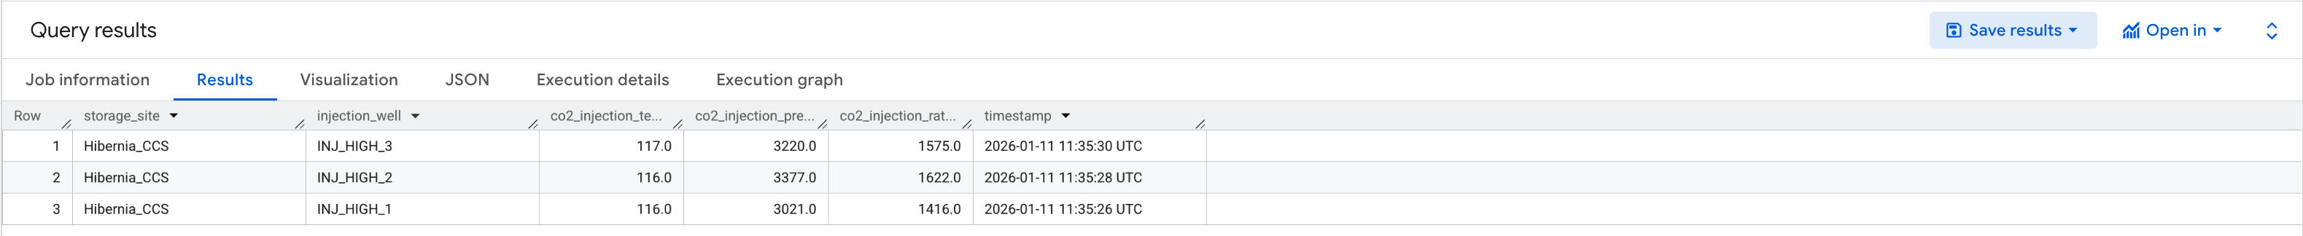
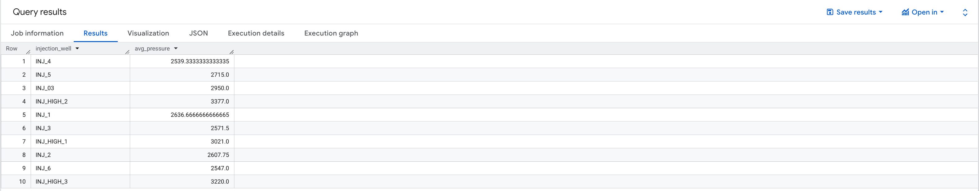
QUERY Output
Wells that exceeded 3000 PSI
```
SELECT *
FROM ` PROJECT.DATASET.TABLE `
WHERE co2_injection_pressure_psi > 3000
ORDER BY timestamp DESC;
```
Average pressure per well
```
SELECT injection_well,
AVG(co2_injection_pressure_psi) AS avg_pressure
FROM ` PROJECT.DATASET.TABLE `
GROUP BY injection_well;
```

Slide 11
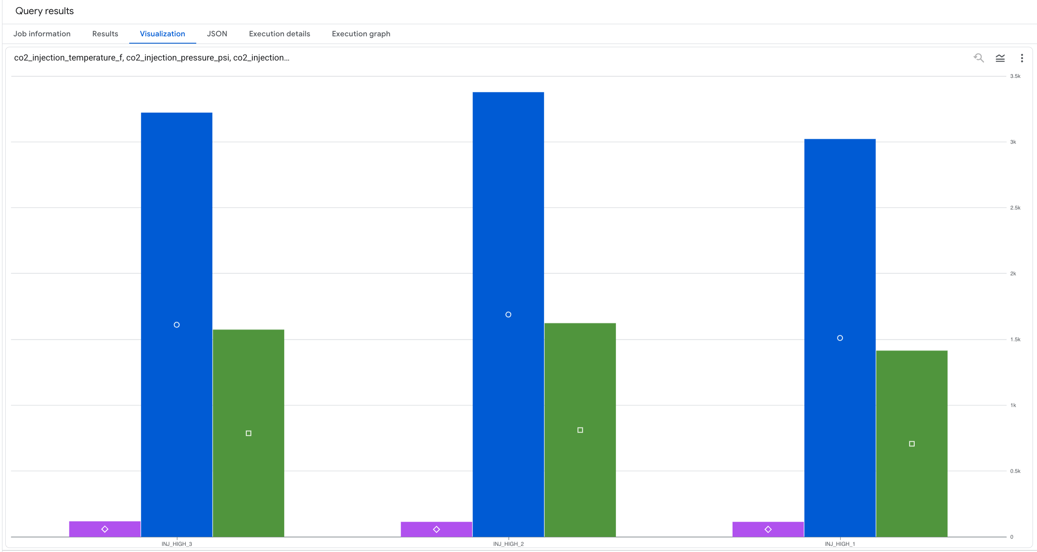
visualization
Wells that exceeded 3000 PSI

Slide 12
Scope & Future Work
In Scope:
Real-time CCS monitoring and Analysis layer
Future Extensions:
Alerts
Regulatory dashboards

Slide 13


